Slide 1
Popular Education and Facilitation Skills

Slide 2
Objectives
At the end of the session, participants will be able to:
Explain the difference between conventional and popular education
Identify and apply popular education principles and methods
Notes:
Read the slide.

Slide 3
Conventional vs. Popular Education
Conventional Education | Popular Education
Education as domestication by the dominant group | Education for liberation and transformation
Fit learners into what the system wants them to be | Facilitator creates conditions for shared learning and leadership
Teacher as “expert” | Participants create knowledge together
Uses hierarchical leadership to maintain power imbalance | Everyone critically examines themselves and the world around them
Notes:
Paolo Freire was a Brazilian educator who is known as one of the first people to write about popular education. He described conventional education as education for domestication by the dominant group. Another way to think of the purpose of conventional education is to fit the learners into what the system wants them to be. Conventional education centers the teacher as “expert” and uses hierarchical leadership to maintain a power imbalance.
By contrast, Freire distinguished popular education as education for liberation and transformation. Popular education uses a facilitator to create the conditions for shared learning and leadership. Participants create knowledge together and critically examine themselves and the world around them.

Slide 4
Image Theater
“Image Theater is a method used within the Theater of the Oppressed, which uses theater as a tool for transformation. It was created by Brazilian Augusto Boal, a colleague of Paulo Freire. Image Theater uses the participants’ bodies as “clay” used to “sculpt” statues – still images representing their experiences, feelings, ideas, oppressions, and/or dreams.”
- Marc Weinblatt, Mandala Center for Change, http://www.mandalaforchange.com/site/
Notes:
Explain that to help us reflect on these two styles, we will use a method called Image Theater.
Ask for a volunteer to read the slide.

Slide 5
Image Theater
Let’s practice!
Notes:
Divide participants into groups of five or six.
Give each group 10 minutes to create two images: one that represents conventional education and one that represents popular education.
Have each small group share their images with the larger group.

Slide 6
Image Theater
Reflection on activity comparing conventional and popular education
Notes:
Thank everyone for their participation.
Ask, “What did you notice about the images related to conventional education? Popular education? Which style do you think will work better with your clients and community members?”
Write reflections on flipchart.

Slide 7
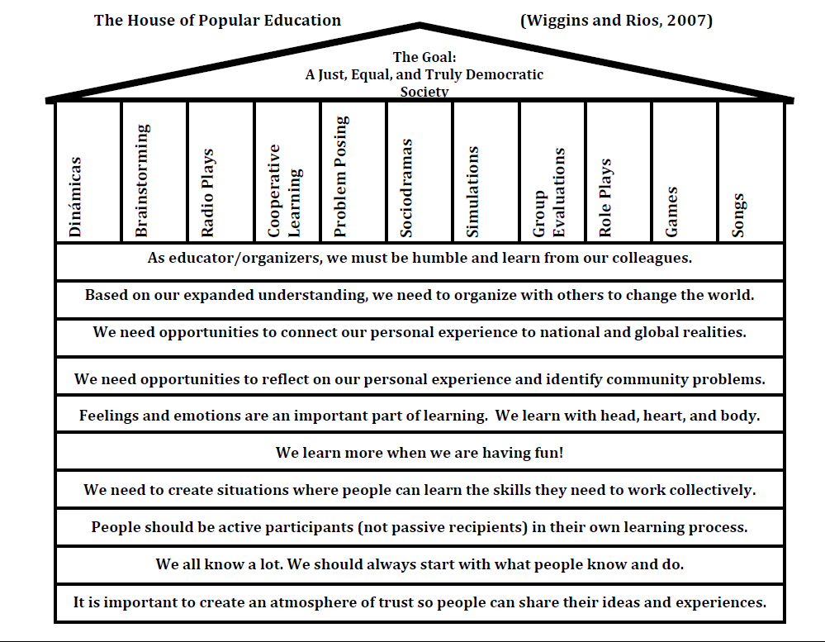
Notes:
Explain that we often use a house as a metaphor for popular education. To review some of the principles and methods of popular education, we will now build the house together.
Ask for volunteers to read the principles (foundation stones, written horizontally). Ask volunteers to read the methods and share examples of each.
Reference the Popular Education manual for descriptions of the methods and dinamicas, and the Popular Education fact sheet for more information about the principles.

