Slide 1
Empowering Leadership
Notes:
Welcome participants to the session on empowering leadership.

Slide 2
Objectives
At the end of this unit, participants will be able to:
Name three levels at which power operates
Describe four different models of leadership
Identify and apply qualities and skills of an empowering leader
Notes:
Review objectives.

Slide 3
Overview
Presentation & Brainstorm: Orientation to Power
Participatory Diagram: Four Models of Leadership
Small Groups: Empowering Leadership Skills & Qualities
Individual Writing: My Leadership Commitment
Notes:
Review the slide.
Explain: In order to begin our conversation about empowering leadership, we first have to start with a discussion about power.
Ask, “What comes to mind when you hear the word ‘power’?"

Slide 4
Power: Definition
The ability to act or produce an effect.
- Merriam Webster
Notes:
Review the definition.
Power is often tied into privilege based on one’s identity or position of authority. For example, someone could be in a position of authority as a supervisor, but may or may not hold privilege in the institution or broader society based on their racial or gender identity or immigration status.

Slide 5
Where Power Operates
Systemic / social / cultural
Values, beliefs, and norms
Interplay of policies, practices and programs from institutions
Institutional
Laws, policies, procedures, and practices
Individual / interpersonal
Attitudes and behaviors
Notes:
Review diagram of types of power, and lead discussion about examples of these types of power (see lesson plan).

Slide 6
Models of Leadership
Group Activity
Notes:
Explain that there are many different kinds of leadership. Now we will explore four different models of leadership.

Slide 7
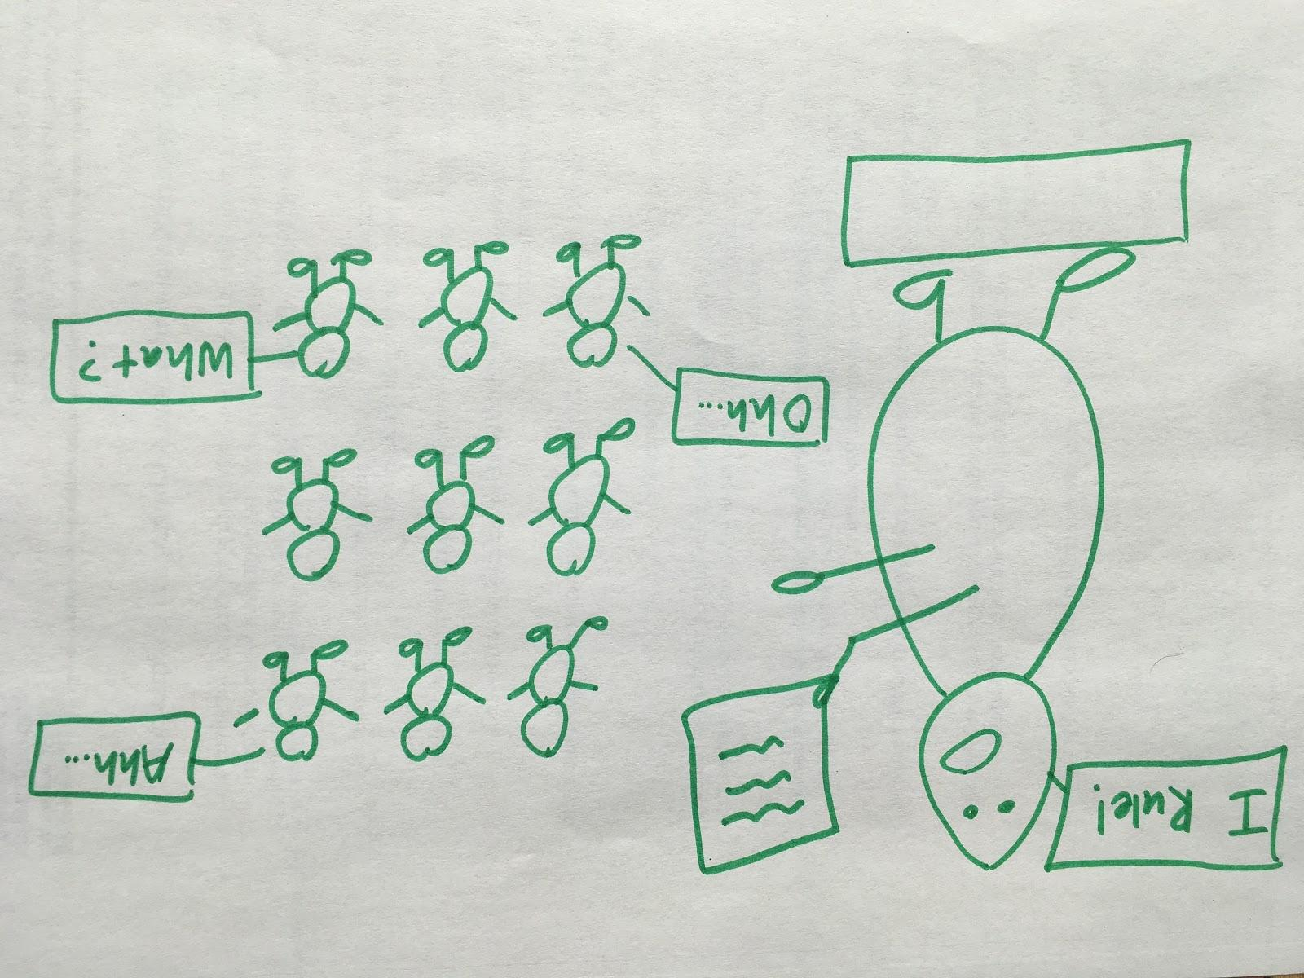
Four Leadership Models
Notes:
Ask, “What does this model tell or suggest to you? What kind of a leader is this? What might we call this leader? When would it be appropriate to use this leadership model? What are the advantages or disadvantages of this model?”
Explain that we could call this style “authoritarian” or “autocratic.”
Clarify the meaning of each type of leadership by referencing the handout on the four leadership styles.

Slide 8
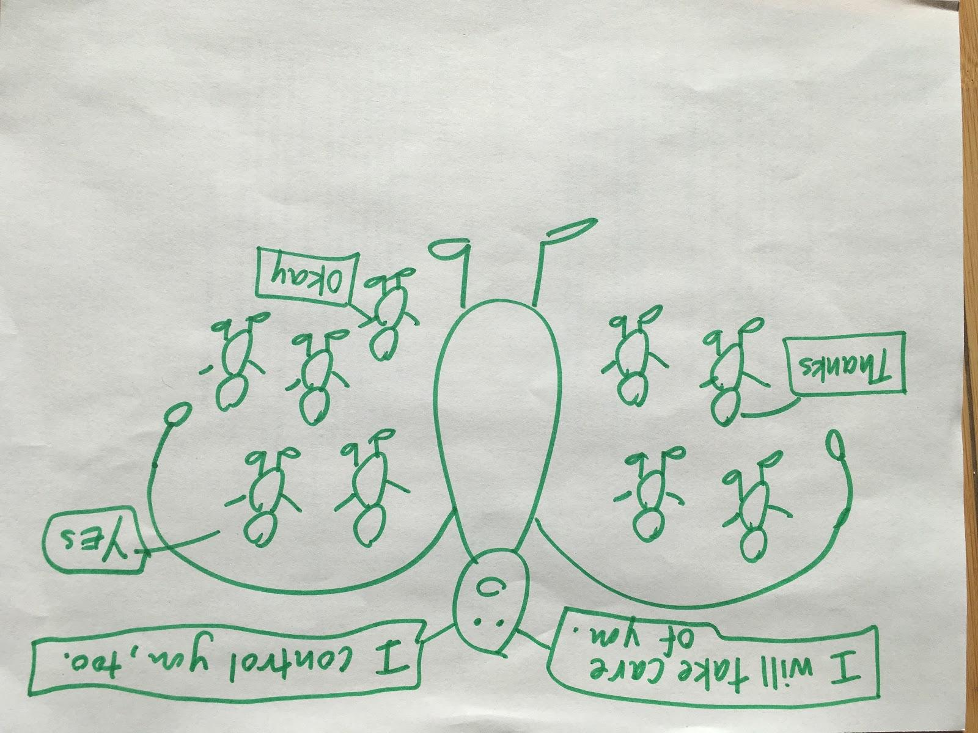
Four Leadership Models
Notes:
Ask, “What does this model tell or suggest to you? What kind of a leader is this? What might we call this leader? When would it be appropriate to use this leadership model? What are the advantages or disadvantages of this model?”
Explain that we could call this style “paternalistic” or “maternalistic.”
Clarify the meaning of each type of leadership by referencing the handout on the four leadership styles.

Slide 9
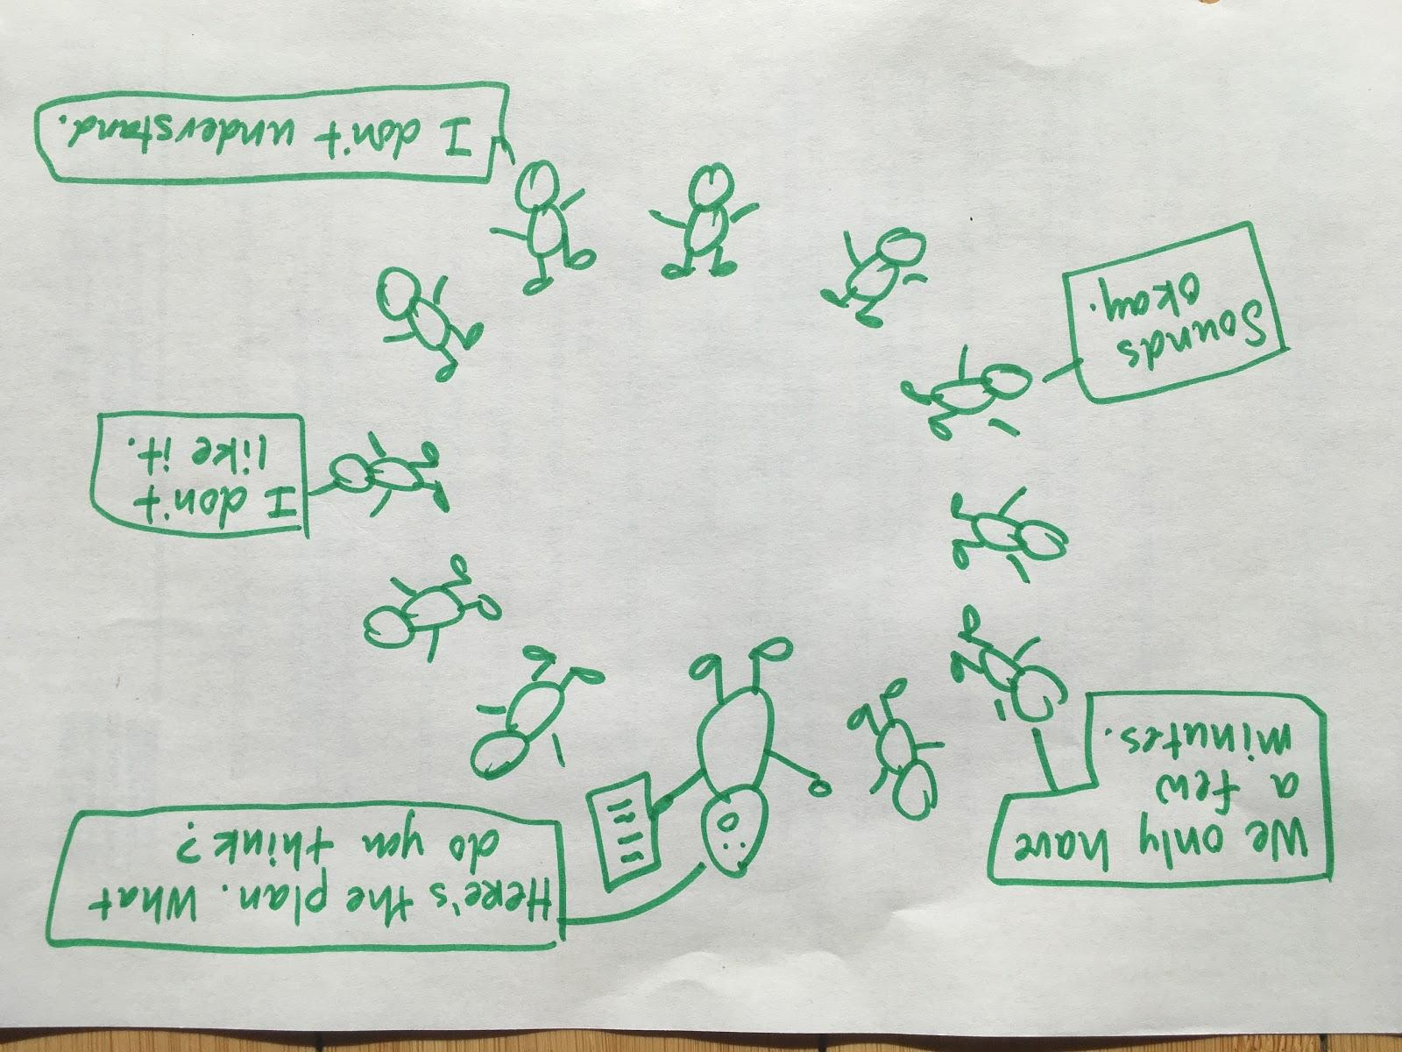
Four Leadership Models
Notes:
Ask, “What does this model tell or suggest to you? What kind of a leader is this? What might we call this leader? When would it be appropriate to use this leadership model? What are the advantages or disadvantages of this model?”
Explain that we could call this style “participatory.”
Clarify the meaning of each type of leadership by referencing the handout on the four leadership styles.

Slide 10
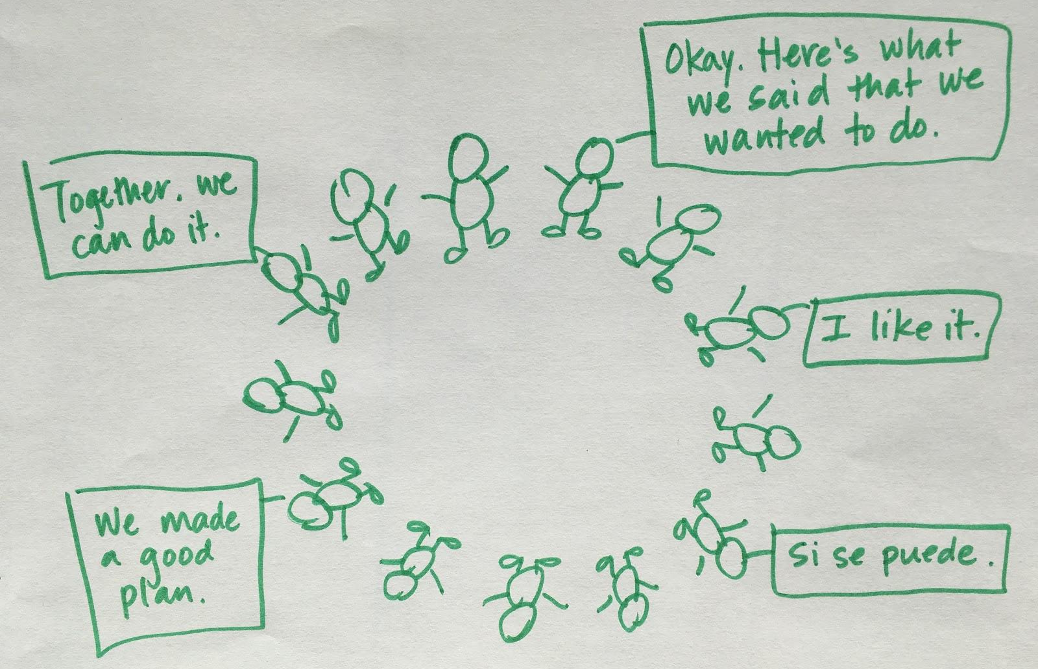
Four Leadership Models
Notes:
Ask, “What does this model tell or suggest to you? What kind of a leader is this? What might we call this leader? When would it be appropriate to use this leadership model? What are the advantages or disadvantages of this model?”
Explain that we could call this style “empowering.”
Clarify the meaning of each type of leadership by referencing the handout on the four leadership styles.
Reflection: Ask, “Which style or styles of leadership will be most effective in your role as a CHW in your own community?”
Reference the Expressions of Power handout. Share that the “power with,” “power to,” and “power within” models can be helpful ways for us to understanding an empowering approach to leadership.

Slide 11
Empowerment: A Definition & Reflection
“Empowerment is the process through which people gain greater control over the decisions and actions affecting their health.” - World Health Organization, 1986
“Power without love is reckless and abusive, and love without power is sentimental and anemic. Power at its best is love implementing the demands of justice, and justice at its best is power correcting everything that stands against love.” - Dr. Martin Luther King, Jr.
Notes:
As we mentioned in the last activity, taking an empowering approach to how we lead and work with others is a best practice for CHWs. We wanted to offer some additional information about what empowerment is and some of the related skills and qualities.
Read definition and Dr. King quote.
Ask, “What do you notice about these definitions/quotes? How do they connect with your work?”

Slide 12
Activity: Empowerment Scenarios
Read your scenarios in your groups.
Discuss what an empowering approach to each scenario would look like.
Use the empowering skills and qualities handout as a reference guide. Please add your own thoughts about additional skills and qualities of an empowering leader.
Be prepared to briefly share back an example of an empowering approach from your discussion.
Notes:
Distribute the Characteristics of Empowering Leadership handout and case scenarios and break participants into small groups.
Explain that participants will now have a chance to work in small groups to practice thinking through what an empowering approach to different scenarios would look like. Read through the scenarios in your group and talk through what an empowering leadership approach to the scenario could be. You can use the skills and qualities handout as a reference guide. We encourage you to add your own thoughts/ideas to the skills and qualities handout.
Allow for 20 minutes for work in small groups. Reconvene the large group for report backs.

