Slide 1
HIV 101

Slide 2
Objectives
HIV 101
At the end of this unit participants will be able to:
Give clients baseline information about HIV and AIDS
Clear up misconceptions regarding how HIV is transmitted
Provide a brief overview of HIV and AIDS facts
Help clients understand basic concepts about how HIV infection affects the body
Notes:
Review the objectives.
Acknowledge that for some participants, this will be a review of what they already know, however, for others this is new
information.

Slide 3
GROUP ACTIVITY
Notes:
Worksheets and discussion
Ask participants to complete the worksheets in their groups. Say, “Using your group’s collective knowledge of HIV and AIDS, you will have 10 minutes to complete all 3 worksheets. Groups will write in their answers or best guess to each question.” Explain the following details:
Worksheets should be completed in order:
Worksheet #1: HIV 101 – Understanding HIV and AIDS
Worksheet #2: Modes of HIV transmission
Worksheet #3: What stage am I?
The worksheets include fill in the blank, true/false, and multiple-choice questions.
Each group should select 2 people: one recorder to write answers, and one reporter to give answers when the facilitator calls on the group.
Each group will receive one point per each correct answer; no half points will be given, it’s all or none.
If a group gives an incorrect answer, the next group will have the opportunity to answer the question.
If no group gives the correct answer, the facilitator will give the correct answer.
Encourage participants to ask questions if they need assistance.
Call on the groups to answer questions as follows:
Group A, please answer question 1 on worksheet #1, HIV 101—Understanding HIV & AIDS.
What do the letters HIV and AIDS stand for?
What is HIV?
What is AIDS?
Now we’ve defined the acronyms HIV and AIDS.
Group A (you have 1 point)
Group B, next question.
Continue with each group until all worksheet questions have been answered.
Bring attention to the last handout, Stages of HIV Infection, to be used as a resource. Point out that if people who acquire HIV remain untreated and do not engaged in medical care and/or take anti-retroviral HIV medications, most succumb to AIDS.

Slide 4
HIV and AIDS
HIV 101
What is HIV? HIV is the virus that causes AIDS.
H – Human
I – Immunodeficiency
V – Virus
Notes:
What is HIV?
The virus that causes AIDS
What do the letters H-I-V stand for?
H-Human (one can only acquire HIV from humans, person-to-person, blood-to-blood, sexual contact and/or fluids).
I-Immunodeficiency (affects the immune system, making it too weak to fight off disease and infection).
V-Virus—it’s survival depends on cells in the host.

Slide 5
HIV and AIDS: What is AIDS
HIV 101
What is AIDS?
AIDS is a result of HIV infection.
A – Acquired
I – Immune
D – Deficiency
S – Syndrome
Notes:
What is AIDS?
AIDS is a result of HIV infection.
What do the letters A-I-D-S stand for?
A-Acquired (must get it from someone)
I-Immune (collection of cells and substances that act like soldiers against germs)
D-Deficiency (weakens immune system causing opportunistic infections)
S-Syndrome (collection of symptoms or illnesses)

Slide 6
HIV and AIDS: How does it spread?
HIV 101
How do people contract HIV?
By having vaginal, anal, or oral sex with someone who has HIV
By sharing needles or syringes with someone who has HIV
During pregnancy, birth, or breast feeding from a mother with HIV to her baby
Body fluids of a person living with HIV may include:
Semen
Blood
Vaginal fluid
Breast milk
Any other body fluids containing blood
Notes:
Review the slide.
Additional notes:
Injection drugs used either legally or illegally
Safety precautions should be used for tattoos and body piercings

Slide 7
HIV and AIDS: How to prevent infection
HIV 101
How can people prevent contracting HIV?
People can choose not to have sex or use drugs.
People can choose ways to be affectionate that do not transmit HIV or other STDs/STIs.
If people have sex, using a latex condom (barrier) the right way every time greatly reduces the risk of contracting HIV and other STDs/STIs.
Notes:
Review the slide.
Additional notes:
Protected sex using a latex condom greatly lowers risk
PrEP and HIV medication – PrEP means Pre-Exposure Prophylaxis, and it’s the use of anti-HIV medications to keep HIV negative people from becoming infected. PrEP is approved by the FDA and has been shown to be safe and effective in preventing HIV infection
Recent research indicates that people living with HIV who have an Undetectable viral load are Untransmittable (otherwise known as U=U).
These safety precautions will be discussed in more detail in later units.
If time allows, lead discussion about HIV and AIDS myths. Give two myths and ask participants to say why it is a myth.
People in the community say that a person with HIV is also living with AIDS. Why is this a myth?
Answer: This is a myth because people often call everything AIDS; but there is a difference. HIV is a virus; AIDS is a syndrome. Also, a person’s CD4 count that is below 200 and/or has an opportunistic infection may be diagnosed by their doctor with AIDS. A person with CD4 above 200 is said to have HIV.
You can get HIV from a blood transfusion. Why is this a myth?
Answer: The risk of becoming infected with HIV from a blood transfusion in the United States is extremely low. Since donor interviews for HIV risks began in 1983 and HIV-antibody testing began in 1985, the risk of HIV-contaminated blood entering the blood supply has dropped dramatically. In 1992, antibody testing was expanded to include HIV-2 (in addition to HIV-1).

Slide 8
People Cannot Get HIV Through:
HIV 101
Everyday social activity or through casual contact
Handshakes
Coughs or sneezes
Sweat or tears
Food
Drinking fountains
Straws, spoons, or cups
Mosquito bites & other bug bites (ticks, lice, etc.)
Sharing:
Toilets
Telephones
Office equipment
Clothing
Cooking or eating utensils
Hugging, touching
Attending church, school, or going to any public place with a person with HIV
Working with someone who is HIV positive
Notes:
Review the slide.
The bottom line is, people do not get HIV from casual contact.

Slide 9
Stages of HIV/AIDS
HIV 101
Person contracts HIV
Acute Infection – occurs 2 to 4 weeks after initial transmission.
Person may have flu-like symptoms:
Fever Headache
Tiredness Enlarged lymph glands
Chronic HIV Infection – also called asymptomatic HIV infection or clinical latency. Chronic signs and symptoms are not present. Person may look healthy and feel well. People with chronic HIV infection may not have any HIV-related symptoms, but they can still transmit HIV to others (i.e. unless the person living with HIV has been undetectable for at least 6 months).
AIDS - The virus weakens and eventually destroys the immune system. When a person with HIV develops AIDS, his or her body has lost most of its ability to fight off certain bacteria, viruses, fungi, parasites, and other germs.
Notes:
Review the slide.

Slide 10
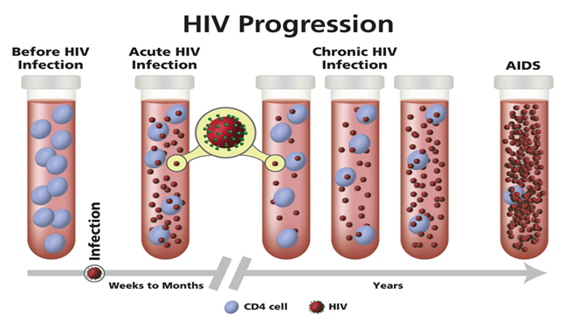
Stages of HIV/AIDS
HIV 101
Notes:
Review the slide. Participants can also follow along on the handout.
To conclude the session, ask participants to recall any new words or terms they have learned so far. Write them on the flip chart.
If time allows, ask participants the following:
Who can explain what an unsuppressed viral load is to a client?
Who can explain what it means to be undetectable?
To close, thank the participants for their participation and for doing a good job.

