Slide 1
Ryan White HIV/AIDS Program (RWHAP) + Evolving Health Care Landscape = Results
USCA - September 15, 2016
Notes:
Goal of Session:
Affordable Care Act (ACA) Medicaid expansion and access to qualified health plans has opened up new health care coverage options for many Ryan White HIV/AIDS Program (RWHAP) clients. Listen to findings from two HRSA studies on the ACA’s impact and join an interactive discussion to explore how the ACA has affected health care coverage and service provision.

Slide 2
Speakers
Antigone Dempsey, MEd
Division Director, Division of Policy and Data
HRSA HIV/AIDS Bureau
Michael Costa, MPH
Principal Associate
Abt Associates

Slide 3
What We Will Cover Today
11:15-12:00 pm Overview: RWHAP & Health Care Landscape
12:00-12:15 pm RWHAP Studies
12:15-1:15 pm Panel Q/A
1:15-1:30 pm Closing Comments

Slide 4
Overview: RWHAP and the Health Care Landscape

Slide 5
RWHAP Moving Forward
Public health approach to provide a comprehensive system of care
Ensure low-income people living with HIV (PLWH) receive optimal care and treatment
Notes:
Remember why this program exists. It is to provide high-quality HIV care and treatment services to low-income PLWH.
RWHAP has an important role to play in the public health response to HIV. Our clients achieve higher rates of viral suppression than PLWH receiving services elsewhere.
When a person is virally suppressed, they are far less likely to transmit HIV to others.

Slide 6
RWHAP and the Evolving Health Care Landscape
The RWHAP is the payor of last resort for services not covered or not fully covered by other forms of health care coverage
The evolving health care landscape changed health care coverage options for many RWHAP clients
Notes:
Continued role of RWHAP in filling gaps in care

Slide 7
HIV/AIDS Bureau Priorities and the Evolving Health Care Landscape
NHAS 2020/PEPFAR 3.0 - Maximize HRSA HAB expertise and resources to operationalize NHAS 2020 and PEPFAR 3.0
Leadership - Enhance and lead national and international HIV care and treatment through evidence-informed innovations, policy development, health workforce development, and program implementation
Partnerships - Enhance and develop strategic domestic and international partnerships internally and externally
Integration - Integrate HIV prevention, care, and treatment in an evolving healthcare environment
Data Utilization - Use data from program reporting systems, surveillance, modeling, and other programs, as well as results from evaluation and special projects efforts to target, prioritize, and improve policies, programs, and service delivery
Operations - Strengthen HAB administrative and programmatic processes through Bureau-wide knowledge management, innovation, and collaboration
Notes:
NHAS 2020/PEPFAR 3.0: Maximize HRSA HAB expertise and resources to operationalize NHAS 2020 and PEPFAR 3.0. This includes utilizing our RWHAP and PEPFAR legislations, resources, staff and recipient expertise, national leadership, and partnerships to achieve the goals of NHAS 2020 and PEPAR 3.0.
Examples of focus areas/activities:
• RWHAP Part A HIV Continuum of Care Learning Collaborative Initiative
• Continuous engagement of HAB staff expertise for the development and implementation of NHAS and PEPFAR activities
Leadership: Enhance and lead national and international HIV care and treatment through evidence-informed innovations, policy development, health workforce development, and program implementation.
Examples of focus areas/activities:
• Presenting at the USCA and other high profile meetings to disseminate HRSA policies, HIV care and treatment information and best practices
• Series of ACA policies adopted by HRSA to provided grant recipients with added flexibility in implementing ACA.
• Convening the Ryan White HIV/AIDS Program Consultation on Clinical Quality Measurement of Retention in HIV Medical Care
• Staff engagement with opportunities for leadership through workgroups, special projects, Cooperative Agreement and/or contract lead, etc. as well as HRSA leadership training
• Focusing on leadership development by and for people living with HIV
• Development of the National HIV Curriculum with the AETC National Resource and Coordination Center
• Dissemination of best practices through the SPNS Dissemination of Evidence Informed Interventions to Improve Health Outcomes along the HIV Care Continuum Initiative (DEII)
• Developing an HIV health care workforce strategy
Partnerships: Enhance and develop strategic domestic and international partnerships internally and externally. This includes promoting better collaboration across Divisions, Bureaus/Offices, and HHS OpDivs and other federal agencies in design and implementation of data utilization, programmatic initiatives, communications, and policy development to support service integration and to utilize HRSA, HAB, and partner resources most effectively.
Examples of focus areas/activities:
• Strategic partnerships development work focusing on CDC,SAMSHA, CMS, and HOPWA
• Internal HRSA strategic partnership work with BPHC on service delivery; BHW for workforce development; MCHB for adolescent health and maternal and child health
• Overall Hepatitis C focus and SMAIF Hepatitis C initiative working with BPHC, CDC, and OHAIDP
Integration: Integrate HIV prevention, care, and treatment in an evolving healthcare environment. This includes maximizing opportunities afforded by the healthcare system for preventing infections, increasing access to quality HIV care, and reducing HIV-related health disparities.
Examples of focus areas/activities:
• Quality Management Programs and Quality Measures in the RWHAP and Medicaid
• SPNS Health Information Technology
• Integrated HIV Prevention and Care Plans, including the Statewide Coordinated Statement of Need
• Leveraging opportunities offered by health delivery system reform
Data Utilization: Use data from program reporting systems, surveillance, modeling, and other programs, as well as results from evaluation and special projects efforts to target, prioritize, and improve policies, programs, and service delivery.
Examples of focus areas/activities:
• Continue to document outcomes of the RWHAP and delineate health disparities
• Provide technical assistance to grantees and staff to enhance their capacity
• Focus programmatic, cooperative agreements, and special study investment on specific population focus based on data, e.g. youth, black men who have sex with men, transgender individuals to improve health outcomes
• SPNS Health Information Technology investments
Operations: Strengthen HAB administrative and programmatic processes through Bureau-wide knowledge management, innovation, and collaboration. This includes supporting excellence in HIV care and treatment service delivery and programs by ensuring efficient business and scientific administration, implementing effective communication and policies, and enhancing the skills of current staff.
Examples of focus areas/activities:
• Streamline and improve the site visit, non-site visit, and conference planning processes for travel
• Enhancing communication mechanisms for external and internal stakeholder with an emphasis on staff communications
• Improving SharePoint functionality for workflow processes and information management
• Improving EHB functionality for workflow, dashboard utilization, and reports

Slide 8
Integrating with the Health Care Delivery System - Highlights
Engaging in Marketplace Insurance Plans Train RWHAP providers of core medical services to contract with qualified health plans
Facilitate client enrollment into health plans as appropriate
Establishing AIDS Service Organization (ASO) Service Models
Train non-medical ASOs to develop business plans to provide services for vulnerable populations
Improve health outcomes across the care continuum
Ryan White HIV/AIDS Program Outcomes within the Context of the Affordable Care Act
Assess effect of services offered post ACA implementation
Develop TA tools to assist recipients navigate insurance marketplace
Notes:
Engaging in Marketplace Insurance Plans
Cooperative agreement; Cicatelli; 7/1/2014 – 6/30/2017
ACE Project
Cooperative Agreement; John Snow Inc (JSI); ends 8/31/2016
Establishing ASO Service Models
Cooperative Agreement; Fenway; 7/1/2014 -6/30/2017
National Center for Innovation in HIV Care

Slide 9
Impact of Health Care System Changes on RWHAP Clients
Data
Demographics
Studies
Notes:
Policies enacted to facilitate implementation
RSR data analysis internally and what it tells us about impact of ACA

Slide 10
Ryan White HIV/AIDS Program Clients (non-ADAP), by Health Care Coverage, 2014—United States and 3 Territories
Notes:
Ryan White has historically covered many insured individuals. Thus, we asked ourselves: why do we still need RWHAP when you have Medicaid coverage?
This is how health coverage of RWHAP clients is today.

Slide 11
Select Demographics of RWHAP Clients, 2014
In 2014, 54% of HIV-positive RWHAP clients were served in Medicaid expansion states, 46% in non-Medicaid expansion states
 | Medicaid Expansion States (n=257,029) | Non-Medicaid Expansion States (n=245,361)
Black/African American | 42% | 53%
Hispanic/Latino | 25% | 19%
White | 29% | 25%
<100% Federal Poverty Level | 61% | 67%
Notes:
To start off, it’s important to look at the variable coverage of RWHAP clients, by demographic and income characteristics.

Slide 12
Health Care Coverage Among HIV-Positive RWHAP Clients, 2012–2014
Notes:
Let’s look at how health coverage has changed with implementation of ACA.

Slide 13
Health Care Coverage, by Medicaid Expansion Status, 2012–2014
Notes:
And let’s dig deeper and look at changes in coverage across Medicaid expansion v. non-expansion states.

Slide 14
RWHAP ACA Studies
Special Study-Emerging Issues Related to ACA Implementation. The Future of Ryan White Services: A Snapshot of Outpatient Ambulatory Medical Care
(2015)
RWHAP Outcomes within the Context of the Affordable Care Act
(2015-2017)
Notes:
We also wanted to look at the clinical impact of ACA on Ryan White clients and thus embarked on several studies.
One was completed in late 2015. The second is now underway.

Slide 15
Acknowledgments
Robert Mills, PhD.
Antigone Dempsey, MEd.
HAB Advisory Group
All of the participating RWHAP site staff

Slide 16
Study Purpose
To assess:
the current status of Ryan White services during the early and later stages of ACA implementation;
how well the RWHAP is positioned to improve clinical outcomes, including viral suppression, retention to care, and linkage to care services; and,
the efforts of RWHAP providers to adapt to the implementation of the ACA
Collect information on service provision, quality of care, barriers, gaps, and challenges related to ACA implementation in 2014.

Slide 17
Abt Associates
Review of Study Methodology
Results

Slide 18
Mixed Methods Design
Qualitative Analyses:
2 sets of Interviews with 30 RWHAP sites: June – July 2014 and February – March 2015.
Grant application narratives.
State Insurance Department info re: Qualified Health Plans (QHP) Benchmark and Medicaid Alternative Benefit Plans.
Quantitative Analyses:
2013 and 2014 RSR client-level data (preliminary).
~44,000 cases/yr.
Interview data (events – counts/duration)

Slide 19
Site Sample Criteria
Criteria | Site Selection
Medicaid expansion | 10 expansion states/ 5 non-expansion states
Prevalence | 1/3 of sites are high, mid or low prevalence (4=ECHPP “12 Cities”)
Population density | Metropolitan, micropolitan, and rural
# and types of RWHAP services | 1 – 21 services 23 serve > 50% OAMC clients / 7 serve < 50% OAMC clients
Numbers of clients served | 116 – 4,286
Part funding | 92% have Parts A and/or B funding 33% have Parts C and/or D funding 26% have a funding from both of the above categories

Slide 20
Overall Conclusions
RWHAP funding continues to be critical to ensure the care necessary to fill gaps in essential services for clients.
There is a divergence of experience between expansion and non-expansion states that will likely continue.
RWHAP sites are successfully adapting to ACA, but challenges remain.
Some RWHAP clients experienced fragmentation of care due to RWHAP sites’ lack of contracts with new insurers.
Sites added additional insurance enrollment/billing staff.
Fewer clients received OAMC services in expansion states after ACA implementation.
However, we cannot statistically distinguish this reduction from an overall downward trend in all states.

Slide 21
Q/A for the Panel

Slide 22
Question 1
How have RWHAP clinics adapted to the changing health care environment?

Slide 23
Leveraging of New Health Care Landscape
Cost Savings. Some sites that successfully established billing agreements with MCOs and private insurers reported increased revenues.
Increased revenues allowed sites to increase staff, and/or offer additional services by reprogramming funds.
Increased Access to Specialty Providers and Services. Sites in 3 expansion states and 1 site in a non-expansion states (TX) noted that clients who gained insurance through MCOs/QHPs experienced increased access to both providers and services.
Continued Availability of RWHAP Funding. All sites noted that sustained RWHAP funding is essential to maintaining the level and quality of care needed by RWHAP clients.

Slide 24
Staffing Changes
The majority of sites reported increasing staff to assist with client enrollment and new insurer requirements:
Case Managers
Benefits Counselors
Resource Specialists
Certified Application Counselors
Billing Specialists
Staff were also hired to assist with:
Early Intervention Services (EIS)
Patient navigation services
Mental health services

Slide 25
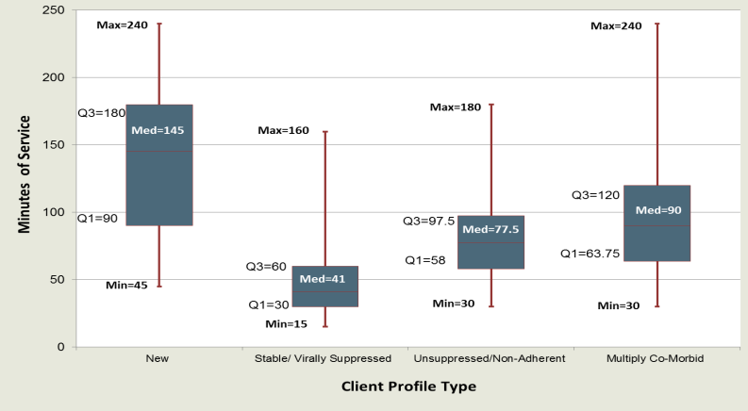
Service Visit Length
Clinic visits vary in length: 15 minutes to four hours.
Median times: 41 minutes to 145 minutes.
Interview Data

Slide 26
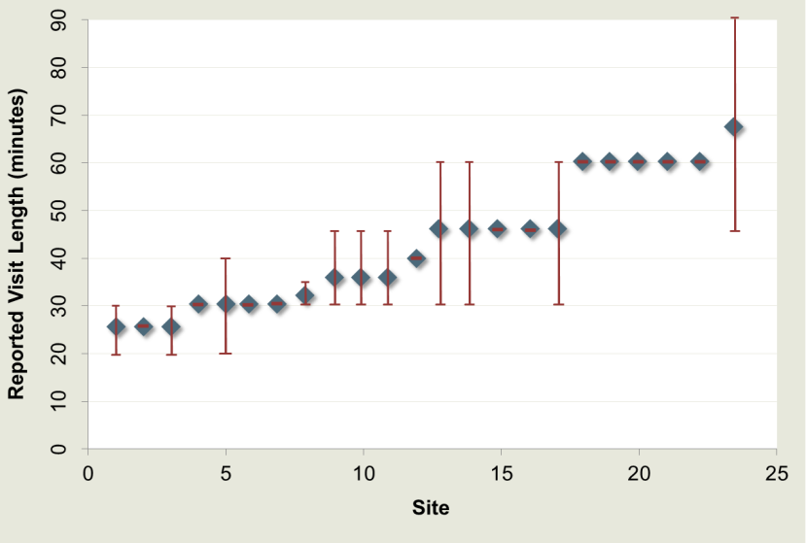
OAMC Visit Length
OAMC times: 20-30 minutes / 45-90 minutes
Average length: 47 minutes
Interview Data

Slide 27
Question 2
What has been the overall effect of people having Medicaid coverage or health insurance? Did the HIV outcomes of patients get better because of expanded health care coverage?

Slide 28
Viral Suppression, 2012–2014 Ryan White HIV/AIDS Program
 | Viral Suppression*
2012 | 75.0%
2013 | 78.6%
2014 | 81.4%
*Defined as the most recent HIV RNA level <200 copies/mL in the calendar year, calculated among clients who received RWHAP-funded HIV medical care and whose visit dates and viral load values were available

Slide 29
Viral Suppression: 2013 to 2014
Viral Suppression increased by 7% in expansion state sites
No statistically significant change in non-expansion sites.
 | 2013 | 2014 | %Change¹
Expansion | 67% | 71% | 7%**
Non-Expansion | 62% | 64% | 4%
¹No statistically significant difference in 2013-2014
change between expansion & non-expansion sites.
**p<0.01
Preliminary RSR Data
Notes:
.

Slide 30
Question 3
Do certain patients who vary significantly experience different outcomes? Why?

Slide 31
Service Utilization and Viral Suppression
Service Utilization
Outpatient ambulatory medical care, case management, substance abuse treatment, mental health
Very little change in the percent of clients receiving selected services and the volume of services received
Viral Suppression
Increased 3 percentage points each year in both expansion and non-expansion states
However, higher rates of viral suppression in Medicaid expansion states than non-Medicaid expansion states (not adjusted for confounders)

Slide 32
Outcomes Differ by State Medicaid Expansion Status
Nationally, the evolving health care landscape has had a modest impact on the health care coverage and clinical outcomes of RWHAP
Patterns of health care coverage differ drastically between clients in Medicaid expansion states and non-Medicaid expansion states, and within demographic subgroups
Viral suppression among RWHAP clients continues to improve beyond National HIV/AIDS Strategy 2020 indicators
Sociodemographic and structural differences between jurisdictions in Medicaid expansion states and non-Medicaid expansion states may account for the varied outcomes among these two client groups

Slide 33
Health Care Coverage in Non-Medicaid Expansion States
In non-Medicaid expansion states:
4.2 point decrease in the percentage of RWHAP clients covered by Medicaid/other public
Little/no change in the percentage of uninsured clients or in the percentage of privately insured clients
Hispanic/Latino clients had the largest decrease in Medicaid/other public coverage and largest increase in uninsured

Slide 34
Health Care Coverage in Medicaid Expansion States
In Medicaid expansion states:
3.9 point increase in the percentage of RWHAP clients covered by Medicaid/other public sources
6.1 point decrease in the percentage of uninsured clients
2.9 point decrease in the percentage of privately insured clients
Clients 19–34 years of age had the largest increase in Medicaid/other public coverage and largest decrease in uninsured
Hispanic/Latino clients had little/no change in Medicaid/other public coverage or uninsured

Slide 35
Not All RWHAP Clients Benefit from Medicaid Expansion
Given the high rates of poverty among PLWH, Medicaid expansion is the major source of increased access to health care services in states with expanded coverage.
In 2014, only occurred in 26 states and the District of Columbia
54% of RWHAP clients served in Medicaid expansion states
In non-expansion states, 67% of RWHAP clients had incomes at or below 100% federal poverty level.
May remain uninsured because they do not qualify for premium tax credits and/or cost-sharing reductions
No safety net outside the RWHAP

Slide 36
Question 4
How can case management and other support services be supported in the current health care environment?

Slide 37
Continued Need for the RWHAP
The majority of the people living with HIV (PLWH) served by the RWHAP have some form of health coverage
83% of RWHAP clients in Medicaid expansion states
64% of clients in non-Medicaid expansion states
RWHAP clients continue to access RWHAP services like case management that are not typically covered or not fully covered by insurers or Medicaid
Many health plans have significant deductibles or cost-sharing requirements which may be prohibitive for many lower income people seeking care
Evidence in support of a continuing need for RWHAP-funded services for those with health care coverage

Slide 38
RWHAP Services Received by Newly Insured Clients
Insured services do not always fulfill the range of services or intensity needed.
Service | Expansion 18 Sites # (%) | Non-Expansion 12 Sites # (%) | Total 30 Sites
Medical Case Mgt | 11 (61) | 4 (33) | 15 (50)
Oral Health | 8 (44) | 6 (50) | 14 (47)
Mental Health | 7 (39) | 6 (50) | 13 (43)
Case Management | 5 (28) | 6 (50) | 11 (37)
Nutritional Assistance | 2 (11) | 3 (25) | 6 (20)
Transportation | 4 (22) | 2 (17) | 6 (20)
Substance Abuse Svc | Reported by less than 20% of either group
Alternative Care
Treatment Adherence
Lab Work
Social Services

Slide 39
Question 5
What can I do with the information shared in this session?

Slide 40
RWHAP Supports a Comprehensive System of Care
Health care coverage is important, but not sufficient to ensure PLWH achieve the positive health outcomes that are necessary to reduce the burden of HIV in the United States
While the evolving health care landscape provides expanded access to a discrete set of essential health benefits, RWHAP supports a community-based, comprehensive system of care
The public health focus of the RWHAP addresses the socioeconomic and behavioral health issues faced by the diverse population of PLWH

Slide 41
Resources
HRSA/HAB Website
Policies
Program Information
http://hab.hrsa.gov
TARGET Center
Health Care Reform Topic Page
TA Providers Focused on Health Care Reform
https://careacttarget.org/category/topics/health-care-reform

Slide 42
Thank you!
Antigone Dempsey, MEd
Division Director, Division of Policy and Data
HRSA HIV/AIDS Bureau
adempsey@hrsa.gov
Michael Costa, MPH
Principal Associate, Abt Associates
Michael_Costa@abtassoc.com

