Slide 1
HRSA Talk: HIV From the Inside
Notes:
Care and prevention coordination is more important than ever as agencies seek to engage people in the HIV care continuum, stem new infections, and improve planning to allocate funds to varied HIV services. Join federal and other staff as they cover a series of hot topics (planning, PrEP, data use, HIV testing, stigma). Also, share your insights about capacity building assistance (CBA) collaborative work.

Slide 2
What I Will Cover Today Early Years Supporting PLWHA Changes in HIV Care Moving Forward

Slide 3
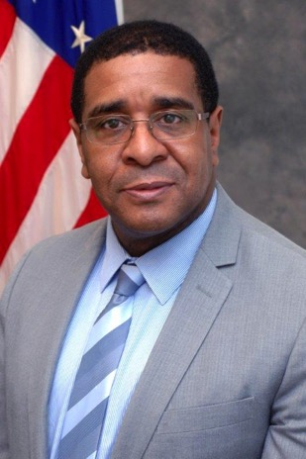
Hally

Slide 4
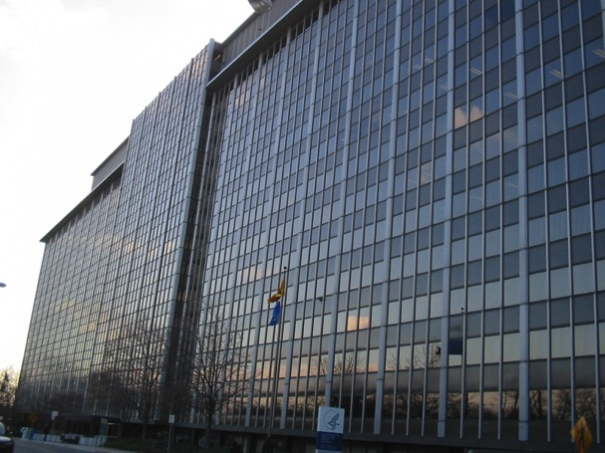
Where I Work: 5600

Slide 5
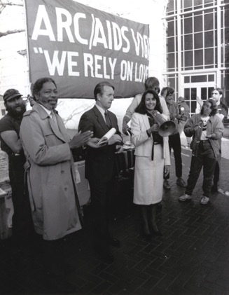
How Long Have You Worked on HIV Issues?
Tell Me About Your Work on HIV

Slide 6
Early Years

Slide 7
Ryan White CARE Act Began
When the Ryan White CARE Act became law in 1990, more than 150,000 AIDS cases had been reported in the U.S., and 100,000 of those people had died.

Slide 8
Early Years Supporting PLWHA

Slide 10
Help with Housing

Slide 11
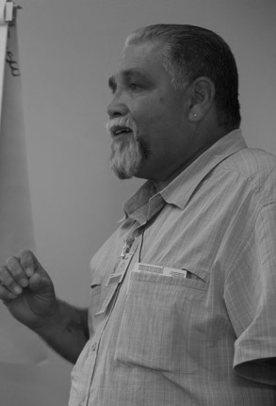
Coming to Work for NMAC

Slide 12
Stigma

Slide 13
Early Years Supporting PLWHA Changes in HIV Care

Slide 14
Funding
Overall
ADAP
1991
$100 Million
$100 Million
FY15
$2.32 Billion
$900 Million

Slide 15
Who We Serve

Slide 16
Retaining People in Care

Slide 17
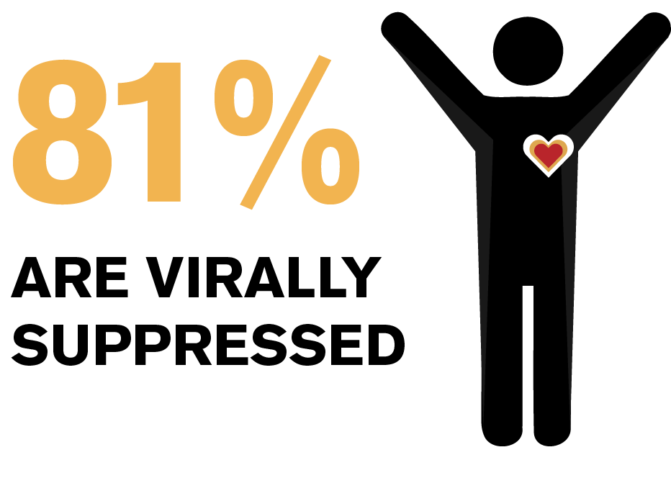
People Staying Healthy

Slide 18
Life Expectancy
20 Years Old and HIV Positive
1996-97
39 Years
2011
73 Years
Notes:
Life expectancy in HIV-positive people in the US still lags 13 years behind HIV-negative people. AIDSMap. February 2016

Slide 19
Why are People Not in Care?
What are the top reasons people do not enter care after receiving HIV diagnosis?

Slide 20
Early Years Supporting PLWHA Changes in HIV Care Moving Forward Getting People in Care Early

Slide 21
Early Intervention Services (EIS)
Allowable activities to increase awareness of HIV status and facilitate access to the HIV care system using HIV testing, referral services, health literacy/education and linkage to care as a bridge to medical care, medication access and treatment adherence

Slide 22
Early Intervention Services (EIS)
Counseling/Testing
Referral Services
Health Literacy/Health Education (Counseling)
Access and Linkage to Care

Slide 23
Early Years Supporting PLWHA Changes in HIV Care Moving Forward Housing

Slide 24
Ryan White HIV/AIDS Program Why Housing Support?
Over 16% of RWHAP clients have temporary or unstable housing situations
Populations identified as high priority in National HIV/AIDS Strategy (NHAS) experience highest rates of unstable housing (youth, injection drug users, men having sex with men (MSM) injecting drugs, transgender persons)
Unstably housed clients had lowest level of medical retention in all sub-analysis
Clients with unstable housing also have among the lowest rates of viral load suppression of any sub-group
Ryan White HIV/AIDS Program Annual Client-Level Data Report and Ryan White HIV/AIDS Program Services Report (RSR)

Slide 25
Ryan White HIV/AIDS Program Clients (non-ADAP), by Housing Status, 2014—United States and 3 Territories
Notes:
In 2014, of the 481,745 RWHAP clients with reported housing status, 11.8% had temporary housing and 4.7% had unstable housing.

Slide 26
HIV, Homelessness, & Suppression
2014 Ryan White Services Report Data:
Suppression by Housing Status
Viral suppression: had at least one OAMC visit, at least one viral load count, and last viral load test <200
Notes:
Similarly for this subset of the RWHAP client population that receives Outpatient/Ambulatory Medical care, viral suppression declines slightly as housing stability declines.

Slide 27
Why Housing? National HIV/AIDS Strategy
Housing Measure
Federal Action Plan
Indicator 7
Reduce percentage of persons in HIV medical care who are homeless to < 5 percent from a baseline 7.4 percent
Progress
The rate of homelessness increased to 8.3% in 2012
Addressing HIV Care and Housing Coordination through Data Integration to Improve Health Outcomes along the HIV Care Continuum (HRSA)
Improving the ability of HUD-funded "Continuums of Care" to identify homeless persons living with HIV and link them to housing assistance, medical care, and other services (HUD)
Addressing the intersection of HIV and IPV, identify models of improved service integration among HIV housing providers and providers of services for persons experiencing sexual assault, domestic violence, dating violence, and stalking (HUD)

Slide 28
Early Years Supporting PLWHA Changes in HIV Care Moving Forward Southern States

Slide 29
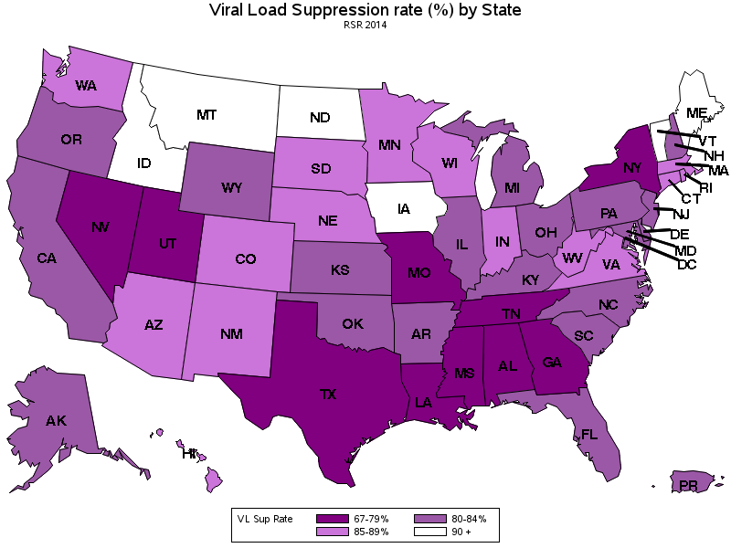
Viral Suppression among Clients Served by the Ryan White HIV/AIDS Program (non-ADAP), by State, 2014
Notes:
Looking at geography, we know some areas of the country have higher rates positive health outcomes than others.
This generally reflects more on political will, issues of stigma, and public health infrastructure than on the efforts on the part of states or other RWHAP recipients in those states. These disparities demonstrate the ‘playing field’ is not level across the country. There are opportunities for all of us to do better.

Slide 30
Early Years Supporting PLWHA Changes in HIV Care Moving Forward Black MSM

Slide 31
Black Gay/Bisexual Men and HIV/AIDS

Slide 32
Viral Suppression among MSM Served by the Ryan White HIV/AIDS Program (non-ADAP), 2014—United States and 3 Territories
Note: N represents the total number of clients in the specific subpopulation.. Viral suppression: ≥ 1 outpatient ambulatory medical care visit during the calendar year and ≥1 viral load reported, with the last viral load result <200 copies/mL.

Slide 33
Viral Suppression among Young, Black/African American MSM (YBMSM) Aged 13–24 Years Served by the Ryan White HIV/AIDS Program (non-ADAP), 2014—United States and 3 Territories
≥5 percentage points lower than YBMSM overall
Note: N represents the total number of clients in the specific subpopulation.
Viral suppression: ≥ 1 outpatient ambulatory medical care visit during the calendar year and ≥1 viral load reported, with the last viral load result <200 copies/mL.

Slide 34
Black MSM Initiatives
New Initiatives in 2016
Building Care/Prevention Capacity: HIV Care Continuum in Southern Metro Areas
Improving Access to Care Using Community Health Workers Increase Access to Health Care Coverage &Improve Health Literacy
Leadership Training for People of Color Living with HIV
Notes:
New Initiatives That Include Black MSM Focus
Building Care/Prevention Capacity: HIV Care Continuum in Southern Metro Areas
Improving Access to Care Using Community Health Workers to Improve Linkage and Retention in HIV Care
Increase Access to Health Care Coverage and Improve Health Literacy
Leadership Training for People of Color Living with HIV
Jurisdictional Approach to Curing Hepatitis C among HIV/HCV Co-infected People of Color

Slide 35
Legacy & Evolution of the Ryan White HIV/AIDS Program

Slide 36
Contact Information
Harold Phillips
HRSA HIV/AIDS Bureau
hphillips@hrsa.gov
http://hab.hrsa.gov

