Slide 1

end+disparities ECHO Collaborative
Pre-Work Webinar: Disparities Calculator, Writing Aim Statements, and Data Expectations
May 24, 2018: 12pm-1pm ET

Slide 2
Disparities affect us all.
Health equity benefits everyone.

Slide 3

Agenda
Welcome (5min)
Disparities Calculator Overview (10min)
Writing Aim Statements (15min)
Data Expectations (15min)
Glasscubes (5min)
Q&A Session (10min)

Slide 4
Disparities Calculator

Slide 5
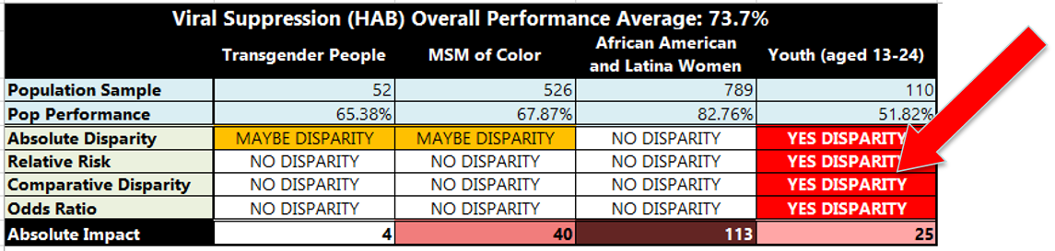
Disparities Calculator
The Disparity Calculator is a MS Excel spreadsheet to automatically calculate HIV performance data and highlight the presence and severity of disparities

Slide 6

Tabs in the Workbook
Instructions
  Descriptions of each tab and instructions for how to enter data
Stats Basics
  Refresher on statistics and terminology used in the calculator
Data Entry
  The SINGLE place to enter data in the calculator
Summaries
  Dashboard of final calculation results for quick sharing
Analyses
  Background statistical values that inform the summary
  dashboard for sharing with leaders and decision makers

Slide 7
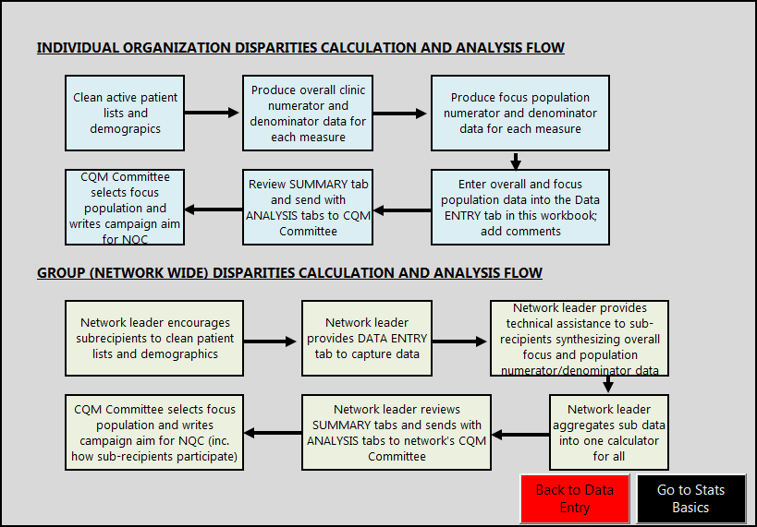
Instructions Screenshot

Slide 8
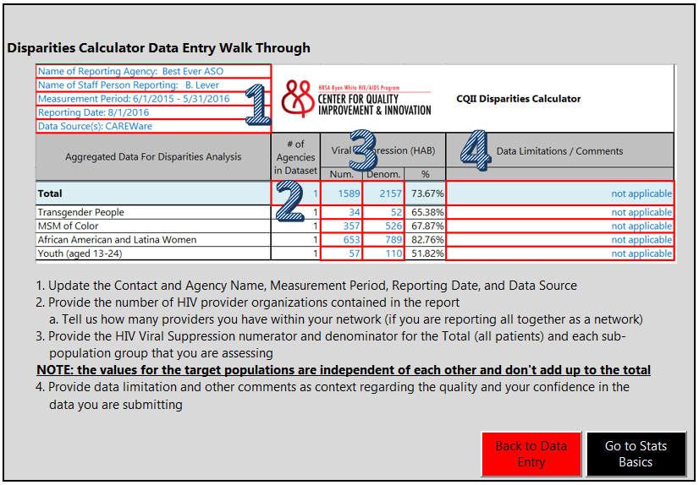
Data Entry Screenshot

Slide 9
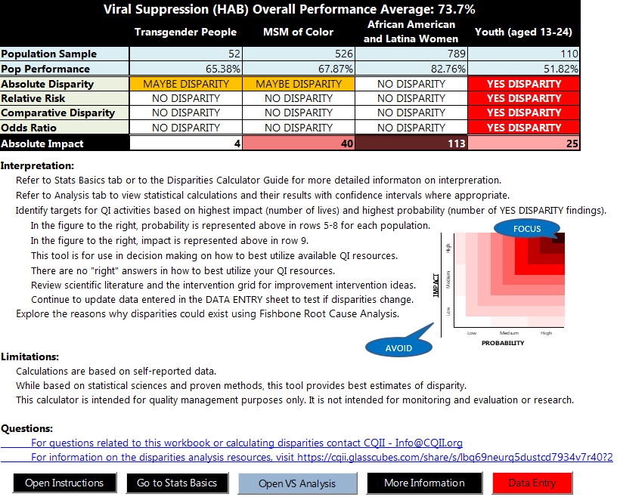
Summary Screenshot

Slide 10
Intersecting Probability and Impact
We have limited time and resources
Which subpopulation has the greatest disparities?
Which subpopulation has the greatest number of lives that can be improved?
Often the most probable and highest impact
subpopulations are not going to be the same
Focus your energy where you have
the highest impact and probability for success
FOCUS
AVOID

Slide 11
Next Steps – Disparities Calculator
Familiarize with Disparity Calculator and access corresponding Guide Use Disparity Calculator to identify agency-specific subpopulation Write an agency-specific aim statement to charter your commitment to reduce disparities for your selected subpopulation Continue to track progress over time using this Calculator to ensure that disparities are closing
Notes:
11

Slide 12


Learn More |
Disparity Calculator
Disparity Calculator Guide
Disparity Calculator FAQ
CAREWare Tips
https://cqii.glasscubes.com/share/s/iduf4sgdk0rrfn7j9h13gdq407

Slide 13
Aim Statements

Slide 14

What is an Aim Statement?
Serves as a local blueprint
Clarifies and focuses the team’s direction and scope of work
Creates a standard document for communication what the improvement work is, what I intends to accomplish ,when it is likely to be completed, and who is responsible for its completion

Slide 15
Anatomy of an Aim Statement
An aim statement typically includes
Problem Statement
  Use concrete terms—terms that clearly describe the problem to be addressed
  Include quantifiable numbers that indicate the current level of performance
Improvement Goal
  Effective teams work with clearly defined SMART goals (specific, measurable, assignable, realistic, time-related)
  Set the goals and then continue making changes until the level is reached at which the effort expended is too great for the gain

Slide 16
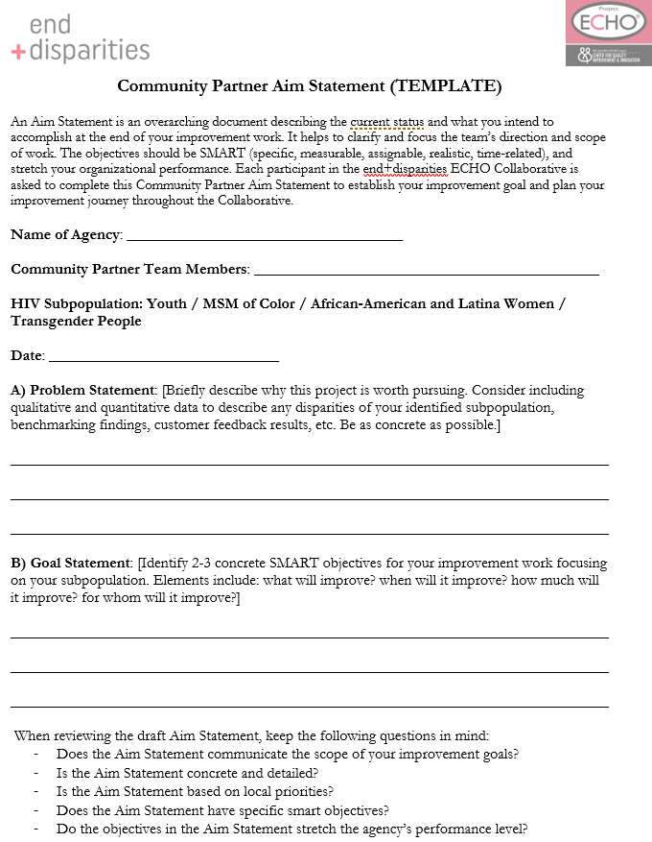
Community Partner Aim Statement
The Aim Statement describes the current status and what your agency intends to accomplish at the end of the Collaborative; each participant is asked to complete one
A template and completed sample are provided:
  Problem Statement: Briefly describe why your agency improvement efforts are worth pursuing, include qualitative and quantitative data, benchmarking findings, etc. Be as concrete as possible.
  Goal Statement: Identify 2-3 concrete SMART objectives for your improvement work. What? When? How much will it improve? For whom will it improve?
Notes:
16

Slide 17

Community Partner Aim Statement
Tips for an agency level aim statement
  Take into consideration agency data and regional improvement goals
  Allow for flexibility
  Make sure that your goals are realistic for your current system. For those agencies surpassing national benchmarks, a higher local goal may be set
  Be relevant to HIV care and services provided by your agency
  Focus on the subpopulation of choice of your agency for this Collaborative

Slide 18
Community Partner Aim Statement – Examples
[Community Partner] Team will improve its HIV care for our patients living with HIV. We will focus on improving viral suppression within our identified disparity subpopulation. This will be evidenced by:
  By Dec 2019, the identified disparity subpopulation will have the same average viral suppression rate as the entire HIV caseload; no measurable disparities will be detected for this subpopulation
  At least 95% of patients in the identified disparity subpopulation who are out of care in the past 6 months will have an outreach contact by May 2019
  At least 85% of all patients living with HIV served by the agency will be virally suppressed by Dec 2019 compared to the baseline of 74% in Sept 2018
  At least 80% of all patients served by the agency who are ART adherent but remain not virally suppressed will be genotype or phenotype tested for drug resistance by Dec 2019

Slide 19
Community Partner Aim Statement – Examples
[Community Partner] Team will improve its HIV care for our patients living with HIV. We will focus initially on antiretroviral therapy for the identified disparity subpopulation to ultimately improve the agency viral suppression rate from currently 65% to 77% by Oct 2019:
  At least 95% of eligible disparity subpopulation patients have an active ART prescription by Jan 2019
  Follow-up with 100% of disparity subpopulation patients who have not filled ART prescriptions by Apr 2019
  At least 85% of disparity subpopulation patients are provided with consistent messaging on the importance of ART adherence
  At least 90% of opioid-dependent disparity subpopulation patients receiving methadone maintenance treatment receive Directly Administered Anti-Retroviral Therapy (DAART) simultaneously

Slide 20
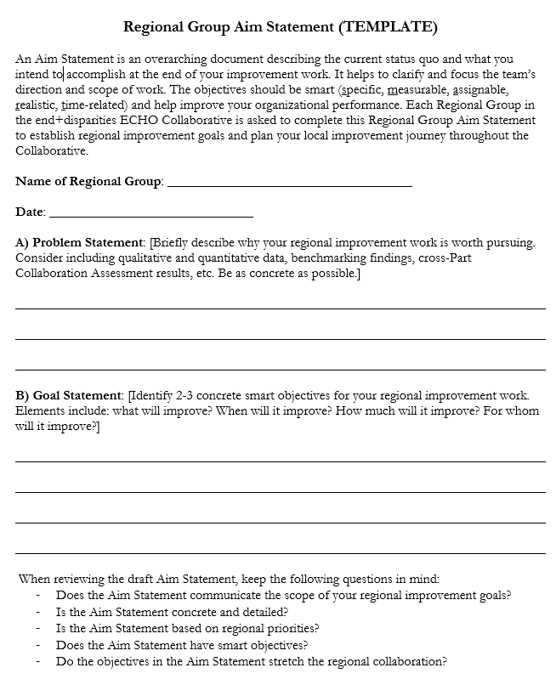
Regional Group Aim Statement
Each Regional Group describes in their Aim Statement what each Regional Group intends to accomplish with a focus on cross-Part alignment, regional coordination of QI activities, and harmonization of improvement efforts
The development process involves Community Partners and is driven by the Response Team
Regional Group Aim Statement is finalized after LS1 and submitted to Regional Group Coach for review and input
Key components should include:
  Problem Statement: A brief description of why the regional improvement work is necessary
  Goal Statement: A set of 2 to 3 concrete SMART objectives that address what is being targeted and who this improvement effects
Notes:
20

Slide 21
Regional Group Aim Statement – Examples
[Regional Group] Team will improve the collaboration across all Ryan White HIV/AIDS Program-funded recipients across the region. We will focus on establishing a consistent and routine communication flow to share and exchange among all participating agencies:
  By Nov 2018, a detailed written communication plan is in place to share local disparity improvement efforts by local agencies At least 85% of disparity subpopulation patients are provided with consistent messaging on the importance of ART adherence
  90% of regional agencies share their improvement updates with the Regional Group and are distributed back to all agencies by May 2019
  At least 50% of all regional agencies reach their individually identified improvement goals by Dec 2019
  By Dec 2019, the average regional viral suppression rate across all agencies increase from the current 73% to 80%

Slide 22
Regional Group Aim Statement – Examples
[Regional Group] Team will improve the regional viral suppression rate within our community by 10% point across all agencies from the onset of the Collaborative.
  By Oct 2018, 100% of regional agencies have identified a disparity subpopulation and improvement plans are in place
  100% of agencies report their viral suppression data on time and written feedback is provided to low performers by the Regional Response Team
  90% of agencies with technical assistance needs receive a site visit by Regional Response Team members

Slide 23
Next Steps – Aim Statement
Familiarize yourself with the reporting templates and samples for the Community Partner and Regional Group Aim Statement Draft Community Partner Aim Statement after selecting the subpopulation Draft the Regional Group Aim Statement with other local participants Share on Glasscubes for review by Regional Group Coach
Notes:
23

Slide 24
Learn More |
Collaborative Toolkit
Community Partner Aim Statement Template and Sample
Regional Group Aim Statement Template and Sample
NQC Cross-Part Guide
HIVQUAL Workbook
Office Hours
https://cqii.glasscubes.com/share/s/iduf4sgdk0rrfn7j9h13gdq407

Slide 25
Reporting Expectations

Slide 26
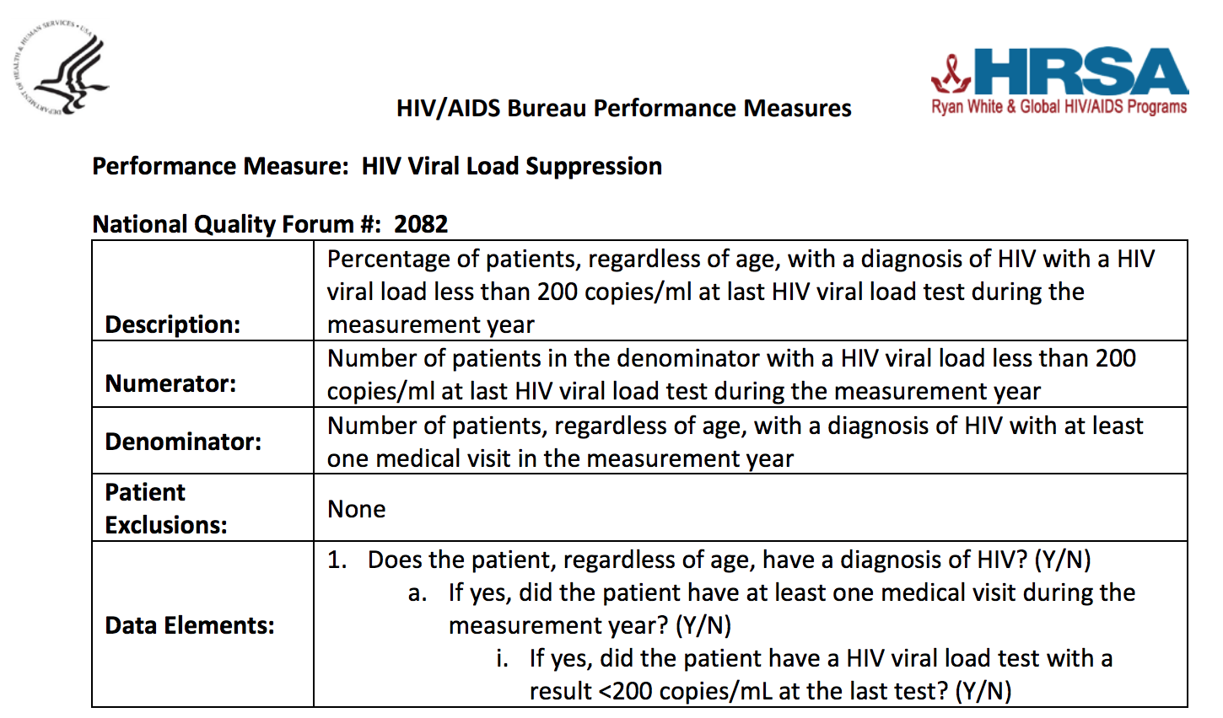
Performance Measurement Overview
Submission of viral suppression data every other month for entire HIV caseload and for identified subpopulation
Adoption of HAB Viral Suppression Measure definition (National Quality Forum #: 2082)
The submission is done using our online database
To ensure consistencies across a region, each Regional Group develops a written Regional Performance Data Management Plan

Slide 27
Performance Measurement Steps
Share Benchmark Reports
Agency Cleans Data
Agency Submits Data
Regional Group Reviews Data
Create Benchmark Reports
Agency Collects Data
Agency Review Reports

Slide 28
Performance Measurement Details
Every other month, each Community Partner is asked to report viral suppression data for
all HIV patients receiving HIV outpatient ambulatory health services (entire HIV caseload)
  Each Regional Group will need to decide on the criteria for defining people living with HIV receiving HIV outpatient ambulatory health services (for instance, RWHAP eligible scope versus all clients)
all HIV patients identified in the participant-selected disparity group (identified HIV subpopulation)
The following data points are required to be submitted using the online data reporting database at each data submission deadline:
Numerator and denominator for entire HIV caseload
Numerator and denominator for identified HIV subpopulation

Slide 29
Unduplication of Local Data Submissions
Community Partners unduplicate their patient data when reporting their data
All local submissions by Community Partners need to be unduplicated; individual patient data are not unduplicated across agencies
The Regional Performance Data Management Plan by the Response Team outlines the unduplication process of facilities (who report data to whom)

Slide 30
Viral Suppression Data Reporting Timeline
The submission deadlines are on the third Friday of each reporting month for submitting the viral suppression data using a rolling 12-month measurement period:

Slide 31
Online Reporting Database
Features of the end+disparities Database:
  Easy to use online application; previously utilized by in+care Campaign
  Immediately trends entered performance data over time
  Allows to group all Community Partners in a Regional Group to produce a single regional performance score
  Benchmarking function compares all submissions by Collaborative participants, top 10% and top 25% performers across all submissions, and stratification by Part, state, or facility type
Each agency sets up one account to avoid double entry and reporting
The Response Team Data Liaison and the assigned Regional Group Coach have access to look at individual local performance data and across a region

Slide 32
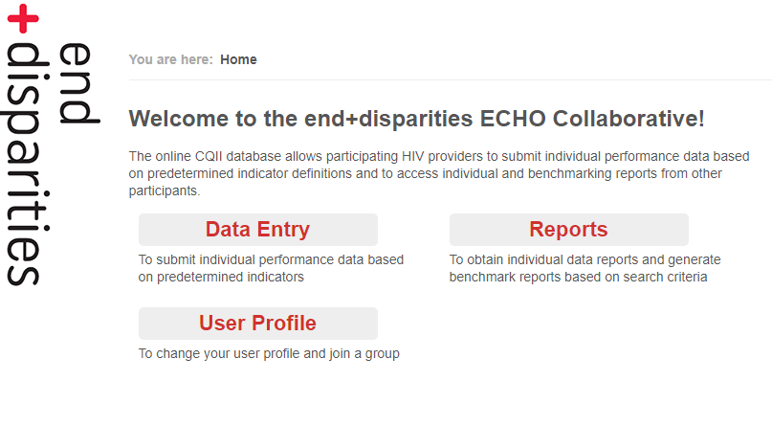
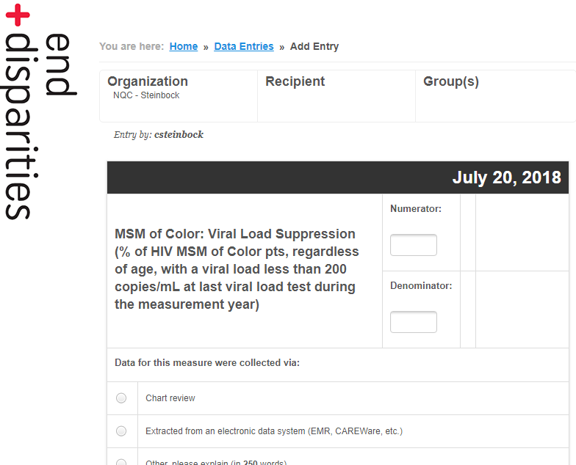
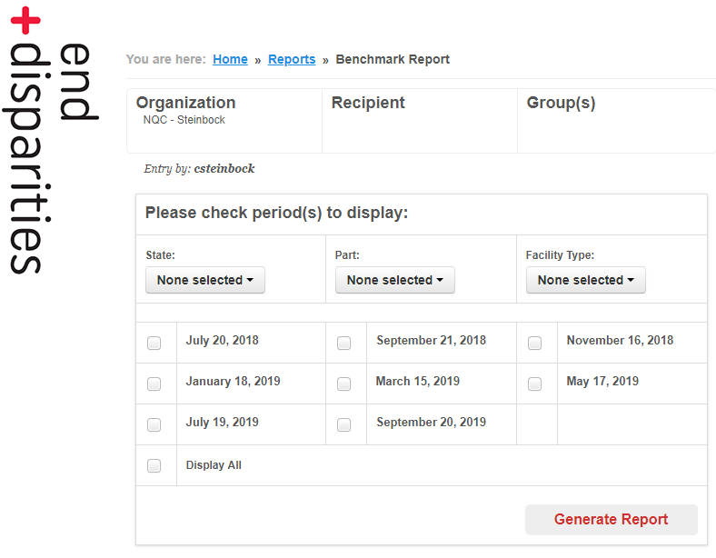
Online Database: Screenshots

Slide 33
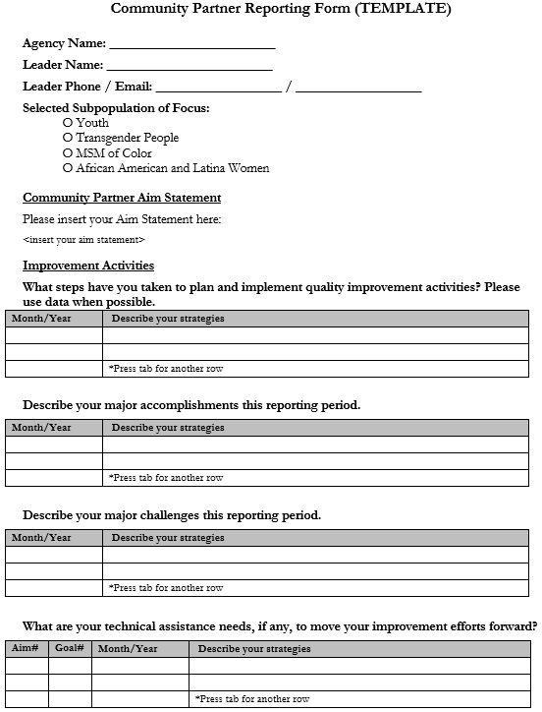
QI Interventions
All participants are asked to report their improvement interventions on a quarterly basis, starting Sep 2018
A reporting template is provided to chronicle the individual improvement journeys; only activities/findings related to that reporting period are reported
Submitters are encouraged to share the information within their organizations and or educating the community

Slide 34
QI Intervention Reporting Timeline
Individual Community Partners and Regional Groups report their improvement efforts to reduce HIV-related disparities on a quarterly basis
The completed reporting form is submitted by participants to the designated Glasscubes folder to ensure that their Regional Response Team members, assigned Regional Group Coach, and Regional Group participants have appropriate access, and to promote peer sharing and networking

Slide 35
Next Steps – Viral Suppression Reporting
Familiarize with performance measurement expectations Develop a Regional Performance Data Management Plan Set up an account in the online end+disparities Database Mark the reporting deadlines in your calendar Report your data and generate benchmarking reports
Notes:
35

Slide 36
Next Steps – QI Intervention Reporting
Familiarize yourself with reporting templates; review the samples Mark the reporting deadlines in your calendar Rather than waiting till the deadline, complete the form along the way Consider to routinely share with internal and external shareholders
Notes:
36

Slide 37
Learn More |
Performance Measurement Guide
Collaborative Toolkit
Community Partner QI Intervention Reporting Template/Sample
Response Team Reporting Template/Sample
Office Hours
https://cqii.glasscubes.com/share/s/iduf4sgdk0rrfn7j9h13gdq407

Slide 38
Glasscubes

Slide 39
Glasscubes
A password-protected online platform open to all Collaborative participants for document sharing
Features include:
  share QI resources
  maintain a library of documents
  report aim statements
  report QI Interventions
Each Regional Group can manage their own Glasscubes workspace and post documents relevant to their local work
https://cqii.glasscubes.com/share/s/lbq69neurq5dustcd7934v7r40
Notes:
39

Slide 40
2nd Pre-Work Webinar:
Getting Ready for Learning Session 1 - What You Need to Know about the Agenda and Travel Logistics
https://echo.zoom.us/j/765538195
Tue, June 5 at 12pm ET (9am PT)

Slide 41

Learn More:
212-417-4730 (phone)
212-417-4684 (fax)
CollaborativeSupport@CQII.org
This project is supported by the Health Resources and Services Administration (HRSA) of the U.S. Department of Health and Human Services (HHS) under grant number U28HA30791 and the HRSA Ryan White HIV/AIDS Program Center for HIV Quality Improvement & Innovation for $1.5 M. This information or content and conclusions are those of the author and should not be construed as the official position or policy of, nor should any endorsements be inferred by HRSA, HHS or the U.S. Government.

