Slide 1

Improving Continuum of Care Outcomes in the American Indian/Alaska Native Population
Indian Health Service
Office of Clinical and Preventive Services
Division of Behavioral Health
Health Resources and Services Administration
HIV/AIDS Bureau
Division of State HIV/AIDS Programs
For the:
2016 National Ryan White Conference on HIV Care and Treatment
August 24, 2016

Slide 2
Disclosures
Terry Friend, Candace Webb, and Jeremy Hyvarinan have no financial interests to disclose.
This continuing education activity is managed and accredited by Professional Education Services Group in cooperation with HSRA and LRG. PESG, HSRA, LRG and all accrediting organizations do not support or endorse any product or service mentioned in this activity.
PESG, HRSA, and LRG staff have no financial interests to disclose.

Slide 3
Presenters
Theresa Friend, IHS
Candace Webb, HRSA
Jeremy Hyvarinen, Phoenix Part A, Maricopa County, AZ

Slide 4
Learning Objectives
At the end of this session, participants will be able to:
Define HIV/AIDS epidemiology and trends among American Indian/Alaska Native (AI/AN) Populations.
Identify and prioritize barriers and opportunities to linkage to care for AI/AN patients.
Describe strategies to improve HIV Care Continuum outcomes and high-quality customer service for AI/AN patients.

Slide 5
Obtaining CME/CE Credit
If you would like to receive continuing education credit for this activity, please visit:
http://ryanwhite.cds.pesgce.com

Slide 6
Three Questions Answered in the Next 90 Minutes
What is the HIV/AIDS epidemiology and trends in HIV Care Continuum outcomes among AI/AN populations?
What are some of the main barriers and opportunities for linkage to care for AI/AN people living with HIV?
What are some strategies to improve HIV Care Continuum outcomes and customer service for AI/AN people living with HIV?

Slide 7
HIV/AIDS Bureau Vision and Mission
Vision
Optimal HIV/AIDS care and treatment for all.
Mission
Provide leadership and resources to assure access to and retention in high quality, integrated care, and treatment services for vulnerable people living with HIV/AIDS and their families.

Slide 8
HIV/AIDS Bureau Priorities
NHAS 2020/PEPFAR 3.0 - Maximize HRSA HAB expertise and resources to operationalize NHAS 2020 and PEPFAR 3.0
Leadership - Enhance and lead national and international HIV care and treatment through evidence-informed innovations, policy development, health workforce development, and program implementation
Partnerships - Enhance and develop strategic domestic and international partnerships internally and externally
Integration - Integrate HIV prevention, care, and treatment in an evolving healthcare environment
Data Utilization - Use data from program reporting systems, surveillance, modeling, and other programs, as well as results from evaluation and special projects efforts to target, prioritize, and improve policies, programs, and service delivery
Operations - Strengthen HAB administrative and programmatic processes through Bureau-wide knowledge management, innovation, and collaboration

Slide 9
The Ryan White HIV/AIDS Program (RWHAP) and American Indians and Alaska Natives

Slide 10
Fast Facts
HIV infection affects American Indians and Alaska Natives (AI/AN) in ways that are not always apparent because of their small population size
Compared with other races and ethnicities, AI/AN have poorer survival rates after an HIV diagnosis
AI/AN face special HIV prevention and care challenges, including poverty and health inequities

Slide 11

Prevention and Care Challenges
Health Inequities
Poverty and Other Socioeconomic Issues
Cultural Diversity
Surveillance/Data limitations
Lack of awareness of HIV status
Mistrust of government and its health care facilities
Trauma and Stigma
Location and Migration

Slide 12
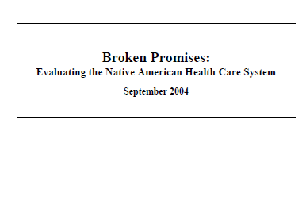
Health Inequities Among AI/AN
U.S. Commission on Civil Rights’ groundbreaking research report
Compared with other racial and ethnic groups, AI/AN people are…
“770 percent more likely to die from alcoholism,
650 percent more likely to die from tuberculosis,
420 percent more likely to die from diabetes,
280 percent more likely to die from accidents, and
52 percent more likely to die from pneumonia or influenza.”

Slide 13
The Numbers
American Indians and Alaska Natives in the Ryan White HIV/AIDS Program
Source: Health Resources and Services Administration. Ryan White HIV/AIDS Program Annual Client-Level Data Report 2014.

Slide 14
Ryan White HIV/AIDS Program (non-ADAP) Clients, by Race/Ethnicity, 2014—United States and 3 Territories
N=507,562
American Indian/Alaskan Native
Asian
Black/African American
Hispanic/Latino*
Native Hawaiian/Pacific Islander
White
Multiple races
*Hispanic/Latinos can be of any race.

Slide 15
Ryan White HIV/AIDS Program (non-ADAP) Clients, by Gender and Race/Ethnicity, 2014—United States and 3 Territories
American Indian/Alaskan Native
Asian
Black/African American
Hispanic/Latino*
Native Hawaiian/Pacific Islander
White
Multiple races
* Hispanics/Latinos can be of any race.

Slide 16
Clients Served by the Ryan White HIV/AIDS Program (non-ADAP) Living ≤100% of the Federal Poverty Level, by Race/Ethnicity, 2014—United States and 3 Territories
*Hispanics/Latinos can be of any race.
FPL: Federal Poverty Level
Note: N represents the total number of clients in the specific subpopulation.
N=5,471
N=105,484
N=126,620
N=8,728
N=220,704
N=2,225
N=789

Slide 17
Clients Served by the Ryan White HIV/AIDS Program (non-ADAP) with Any Health Care Coverage, by Race/Ethnicity, 2014—United States and 3 Territories
N=5,575
N=108,766
N=130,373
N=8,820
N=225,933
N=2,259
N=786
*Hispanics/Latinos can be of any race.

Slide 18
Retention in Care among Clients Served by the Ryan White HIV/AIDS Program (non-ADAP), by Race/Ethnicity, 2014—United States and 3 Territories
N=272,193
* Hispanics/Latinos can be of any race.
Note: N represents the total number of clients in the specific subpopulation.
Retention in care: ≥1 outpatient ambulatory medical care (OAMC) visit during January through September 1, 2014 with ≥1 OAMC visit at least 90 days after the first visit.

Slide 19
Viral Suppression among Clients Served by the Ryan White HIV/AIDS Program (non-ADAP), by Race/Ethnicity, 2014—United States and 3 Territories
* Hispanics/Latinos can be of any race.
Note: N represents the total number of clients in the specific subpopulation.
Viral suppression: ≥ 1 outpatient ambulatory medical care visit during the calendar year and ≥1 viral load reported, with the last viral load result <200 copies/mL.

Slide 20
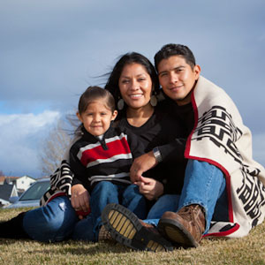
Strategies for Care
Understanding Culture
Improving Patient-Provider Communication
Providing Support Services as a Lifeline
Healing Practices

Slide 21
The RWHAP and American Indians and Alaska Natives
RWHAP Legislation
HRSA HIV/AIDS Bureau Policy Notice 07-01
Special Projects of National Significance
AIDS Education and Training Center National Multicultural Center
RWHAP Grant Recipient Spotlight: ARIZONA

Slide 22
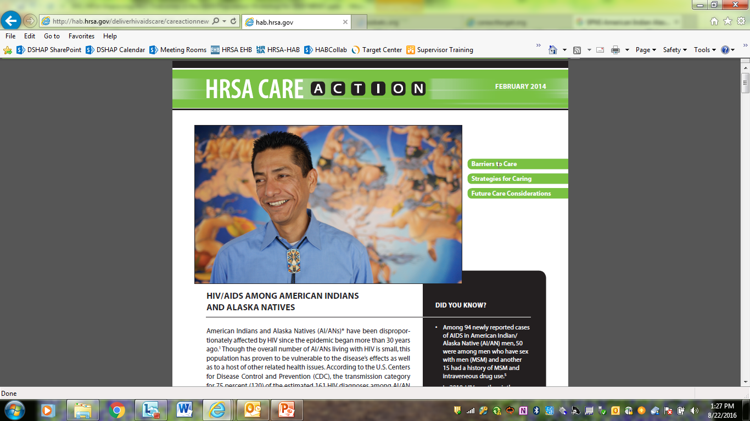
The RWHAP Legislation, the Indian Health Service, and AI/AN
Improving access and the quality of care for AI/AN PLWH remains important to the overall objective of the RWHAP
The Ryan White HIV/AIDS Treatment Modernization Act of 2006 (RWMA of 2006) established opportunity for more seamless access to HIV care and treatment for AI/AN PLWH

Slide 23
The RWHAP Legislation, the Indian Health Service, and AI/AN
RWMA of 2006 provisions affecting the Indian Health Service and AI/AN:
  Indian Health Service (IHS) Health Facilities or those operated by the IHS became eligible to apply as direct recipients for Part C and Part D grants under the RWHAP
    In addition to previously authorized Urban Indian Health Programs and 638 Tribal Facilities under HAB Policy Notice 00-01
  Planning Council representation under Part A should include members from Federally recognized Indian tribes as represented in the population

Slide 24
The RWHAP Legislation, the Indian Health Service, and AI/AN cont’d.
RWMA of 2006 provisions affecting the Indian Health Service and AI/AN:
  Programs administered by or providing services of the IHS are exempt from the “Payor of Last Resort” mandate for Parts A, B, and C of the RWHAP
    This amendment exempts IHS/Tribal/Urban facilities from reimbursement, regardless of referral
  Language was added that specifically names “Native Americans” as person(s) to be trained under the AIDS Education and Training Centers (AETCs) Program

Slide 25
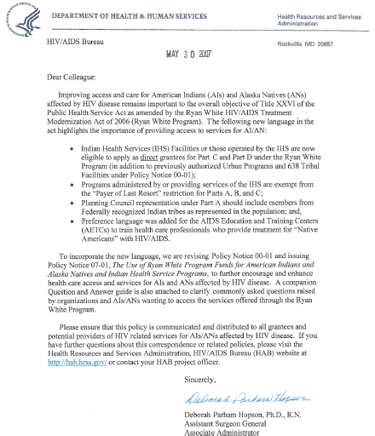
HAB Policy Notice 07-01
HAB Policy Notice 07-01, The Use of Ryan White Program Funds for American Indians and Alaska natives and Indian Health Service Programs
  Revised Policy Notice 00-01 to incorporate new AI/AN-specific provisions in the RWMA of 2006
  Issued May 25, 2007
  Companion Question & Answer Guide

Slide 26

Special Projects of National Significance (SPNS) American Indian/Alaska Native Initiative, 2003-2007
5-year initiative designed to integrate substance abuse and mental health services with HIV primary health care for AI/AN communities
  Focus:
    AI/AN PLWH or at-risk AI/AN
    Co-morbidities: substance abuse (including alcohol), sexually transmitted infections and/or mental illness
  Mechanism:
    Six demonstration projects
    National American Indian/Alaska Native HIV/AIDS Technical Assistance Center (University of Oklahoma)

Slide 27

AIDS Education and Training Center
National Multicultural Center – BE SAFE Model
Barriers
Ethics
Sensitivity of the Provider
Assessment
Facts
Encounters
Cultural Competency Model for use in
clinical practice
Supports training of health care providers
to become more comfortable in treating
and improving health outcomes of
AI/AN/NH PLWH

Slide 28
Lessons from the Field:
ARIZONA
RWHAP and Indian Health Service Collaborations
Jeremy Hyvarinen, Phoenix EMA
Maricopa County

Slide 29
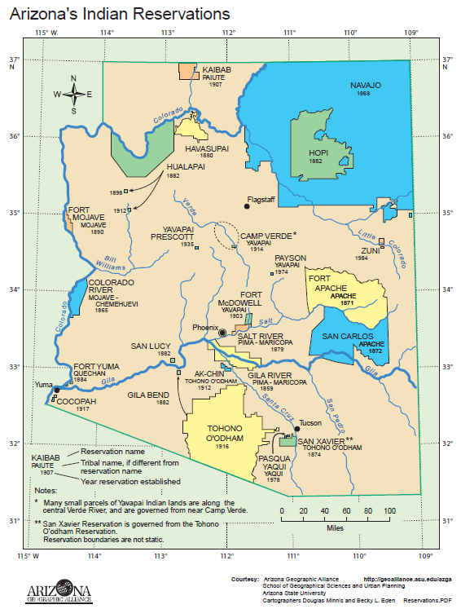
Arizona’s Indian Reservations

Slide 30
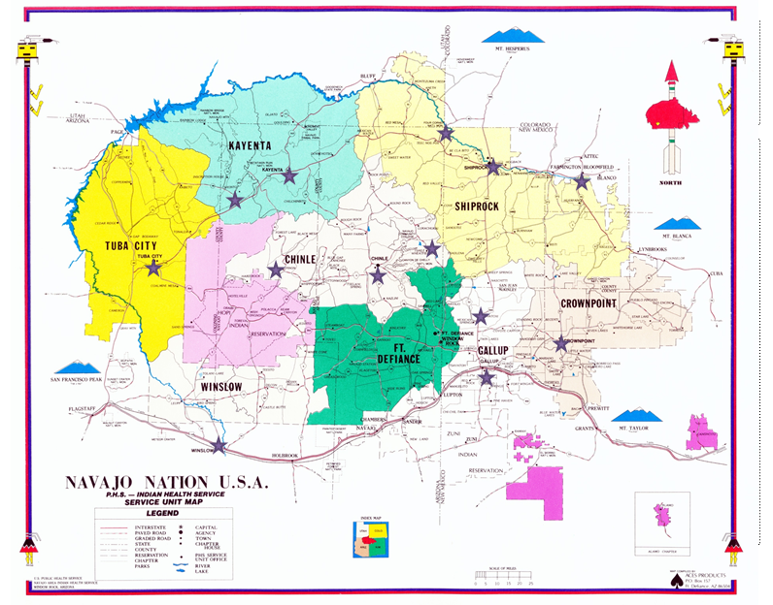
Navajo Map

Slide 31
Incorporating Indian Health Services
Phoenix Indian Medical Center is a “HIV Center of Excellence for American Indians/Alaska Natives”
RWPA contracts for Medical Case Management services and limited primary medical care at IHS facilities.
  Includes Pharmacist that conducts treatment adherence activities

Slide 32
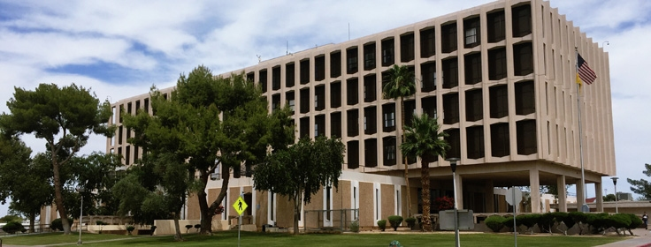
PIMC involvement in RWPA Clinical Quality Management Group
Source: https://www.ihs.gov/Phoenix/healthcarefacilities/phoenix/

Slide 33
Continuum of care
 | Arizona: Source ADHS 2014 |  | Phoenix EMA: RWPA* |  | RWPA Funded Clinic*
 | # | % | # | % | # | %
HIV-Diagnosed | 607 | 100% | 114 | 100% | 103 | 100%
Linked to HIV care Prevalence | 492 | 81% | 80 | 70% | 89 | 86%
Retained in HIV Care | 364 | 60% | 75 | 66% | 86 | 83%
On ARV Therapy | 377 | 62% | 74 | 65% | 84 | 82%
Adherent / Suppressed | 367 | 60% | 70 | 61% | 82 | 80%
*2015 Data

Slide 35
Successes
Some of strongest outcomes in the state
Culturally competent care
Established a one-stop shop model with:
  Clinician
  Medical Case Manager
  Pharmacist
  Mental Health
Included Native Health in the Integrated Planning process
Tele-health

Slide 36
Opportunities
Staff turnover at PIMC
Maximizing billing
  Mental Health
  Primary Medical Care
Stigma
Transportation
Annual Site Visits at a federal facility
Including the Native American Community Groups in Integrated Planning

Slide 37
Indian Health Service
Overview

Slide 38
Indian Health Service – Mission
The Indian Health Service mission, in partnership with American Indian and Alaska Native people, is to raise their physical, mental, social, and spiritual health to the highest level.

Slide 39
Indian Health Service – Priorities
Assessing Care
Improving How We Deliver Services
Strengthening Management
Bringing Health Care Quality Expertise to IHS
Engaging Local Resources

Slide 40
Indian Health Care System
IHS Direct Health Care Services
Tribally-operated Health Care Services
  Titles I and V of the Indian Self-Determination and Education Assistance Act provide Tribes the option to assume control and management of programs.
  Today, over half of the IHS appropriation is administered by Tribes, primarily through self-determination contracts or self-governance compacts.
Urban Indian health care services and resource centers

Slide 41
Indian Health Service – Profile
Serves members of 567 federally-recognized Tribes
2.2 million American Indians and Alaska Natives
12 Area Offices: Alaska, Albuquerque, Bemidji, Billings, California, Great Plains, Nashville, Navajo, Oklahoma City, Phoenix, Portland, Tucson
170 IHS and tribally-managed service units
34 urban programs

Slide 42
Indian Health Service – Facilities
 | Hospitals | Health Centers | Alaska Village Clinics | Health Stations
IHS | 28 | 62 | n/a | 25
Tribal | 18 | 282 | 150 | 80

Slide 43
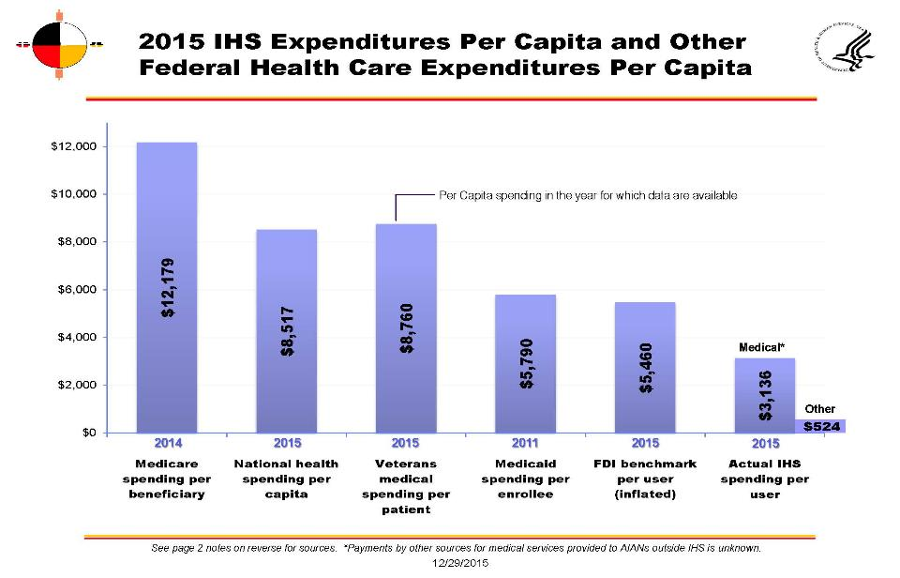

Slide 44
Challenges
The Indian health system faces a number of challenges, including:
  Populations growth and increased demand for services
  Rising cost/medical inflation
  Difficulties recruiting and retaining medical providers
  Increased rates of chronic diseases

Slide 45
Challenges
  Challenges in providing rural health care
  Aging facilities and outdated equipment
  Lack of sufficient resources to meet demand for services
  Balancing the needs of patients service in HIS tribal and urban Indian health programs

Slide 46
Health Disparities
Increased chronic disease mortality
  Alcohol related – 520% greater
  Chronic liver disease and cirrhosis – 368% greater
  Diabetes related – 177% greater
Increased injury mortality
  Moto vehicle crashes – 207% greater
  Unintentional injuries – 141% greater
  Homicide – 86% greater
  Suicide – 60% greater
  Firearm injury – 16% greater

Slide 47
Health Disparities - STI
  High rates of STI
  Second highest rates of Gonorrhea/Chlamydia (GC/CT) are in Native American populations

Slide 50
Poverty & Income
  Poverty –
    28.3% on Reservations
    22% among all American Indians
    15.5% US average
  Income -
    $37,227 AI/AN households in 2014
    $53,657 for the nation as a whole.
    Sources: 2014 American Community Survey
    http://factfinder.census.gov/bkmk/table/1.0/en/ACS/14_1YR/S0201//popgroup~006
    http://factfinder.census.gov/bkmk/table/1.0/en/ACS/14_1YR/S0201//popgroup~006>
    http://factfinder.census.gov/bkmk/table/1.0/en/ACS/14_1YR/S0201>

Slide 51
  Housing
HUD Secretary, Julian Castro toured ND’s Turtle Mountain reservation and SD’s Pine Ridge reservation in 2014.
Castro called those visits "probably the most poignant visits I've had as HUD secretary because of the severe need that exists.“
Housing
  Overcrowding
  Homelessness
  Substandard
National American Indian Housing Council 8/10/16

Slide 52
Violence
Native women experience violence more than any other race or ethnicity in the US
Estimated: 46% of NA/AN women have experienced IPV (AKA DV)
Includes:
  Physical violence
  Sexual violence (1:3 lifetime risk, 2.5 times higher than all others)
  Threats of physical or sexual violence
  Psychological/emotional violence
  Stalking
        National Intimate Partner Violence and Sexual Violence Survey 2010

Slide 53
Environment
Substance Use/Abuse
↑ HIV RISK
Violence
Health Disparities/STI

Slide 54
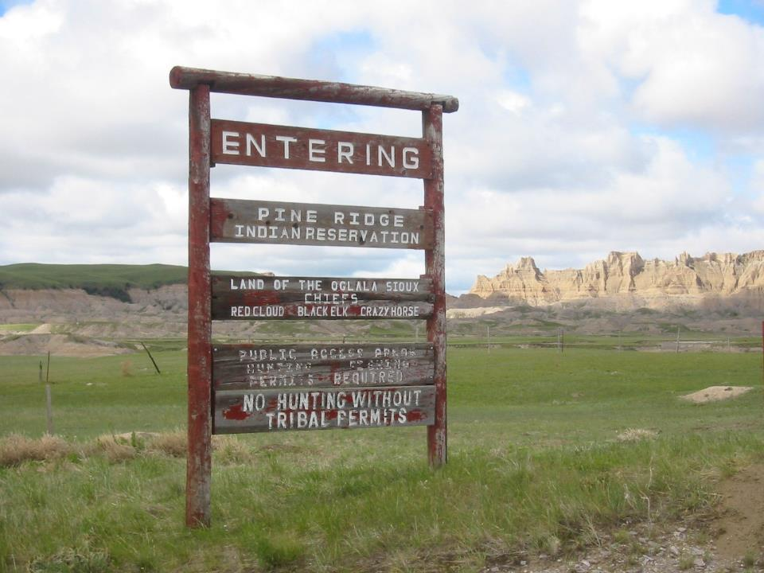

Slide 55
New York Times “Poverty Poster Child”
“Pine Ridge is a poster child of American poverty and of the failures of the reservation system for American Indians in the West. The latest Census Bureau data show that Shannon County here had the lowest per capita income in the entire United States in 2010.”
                OP ED2012- Nicholas Kristof

Slide 56
Barriers
Access
  Primary Health Care
  Distances
  Lack of resources
Stigma
  Loss of confidentiality
  Homelessness
  Isolation
Fear
  Disease process

Slide 57
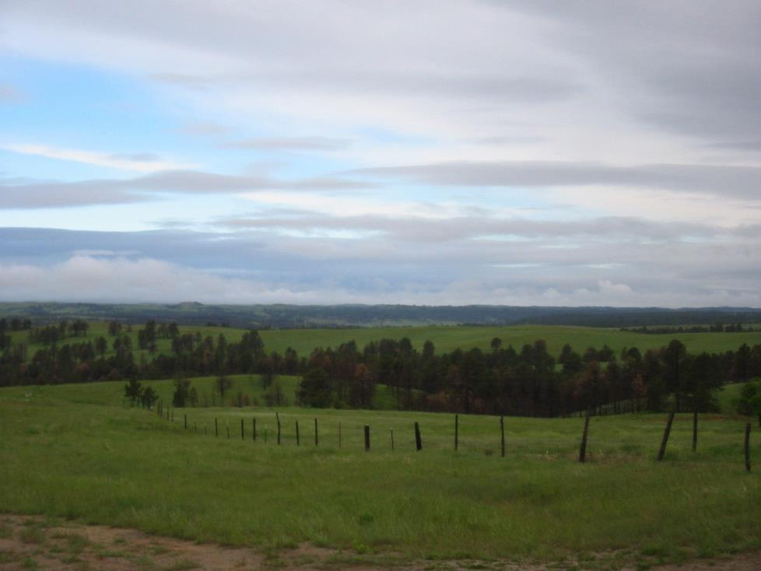

Slide 58
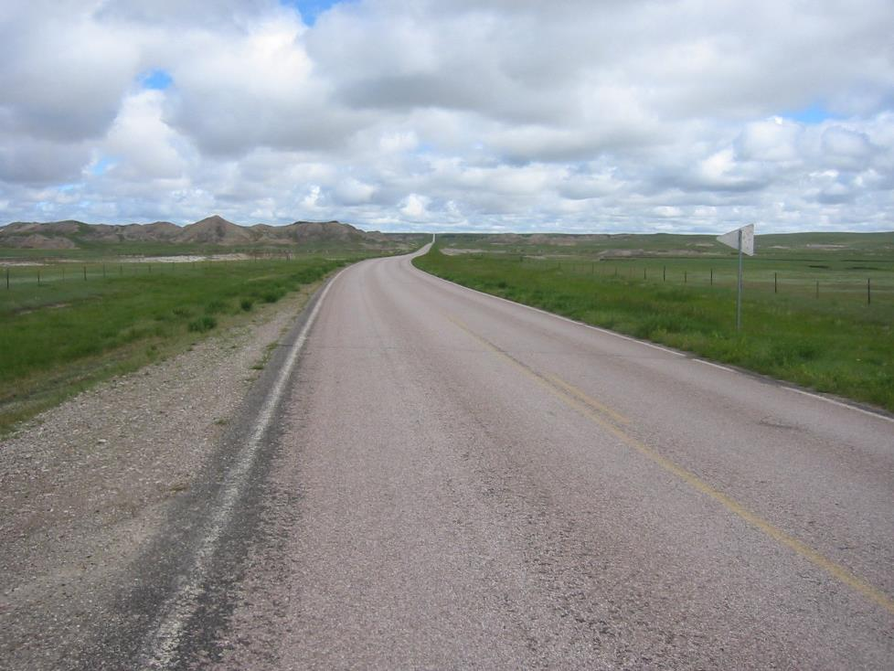

Slide 59
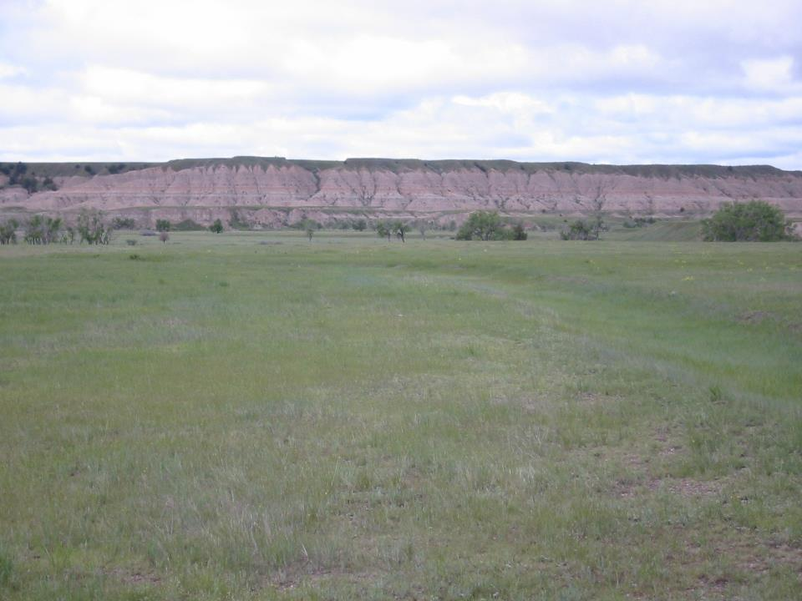

Slide 60
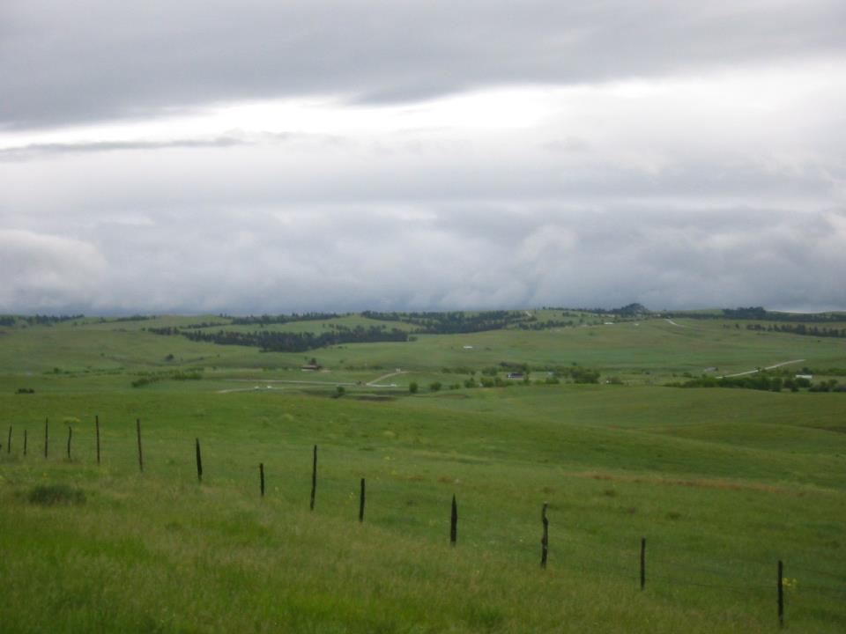

Slide 61
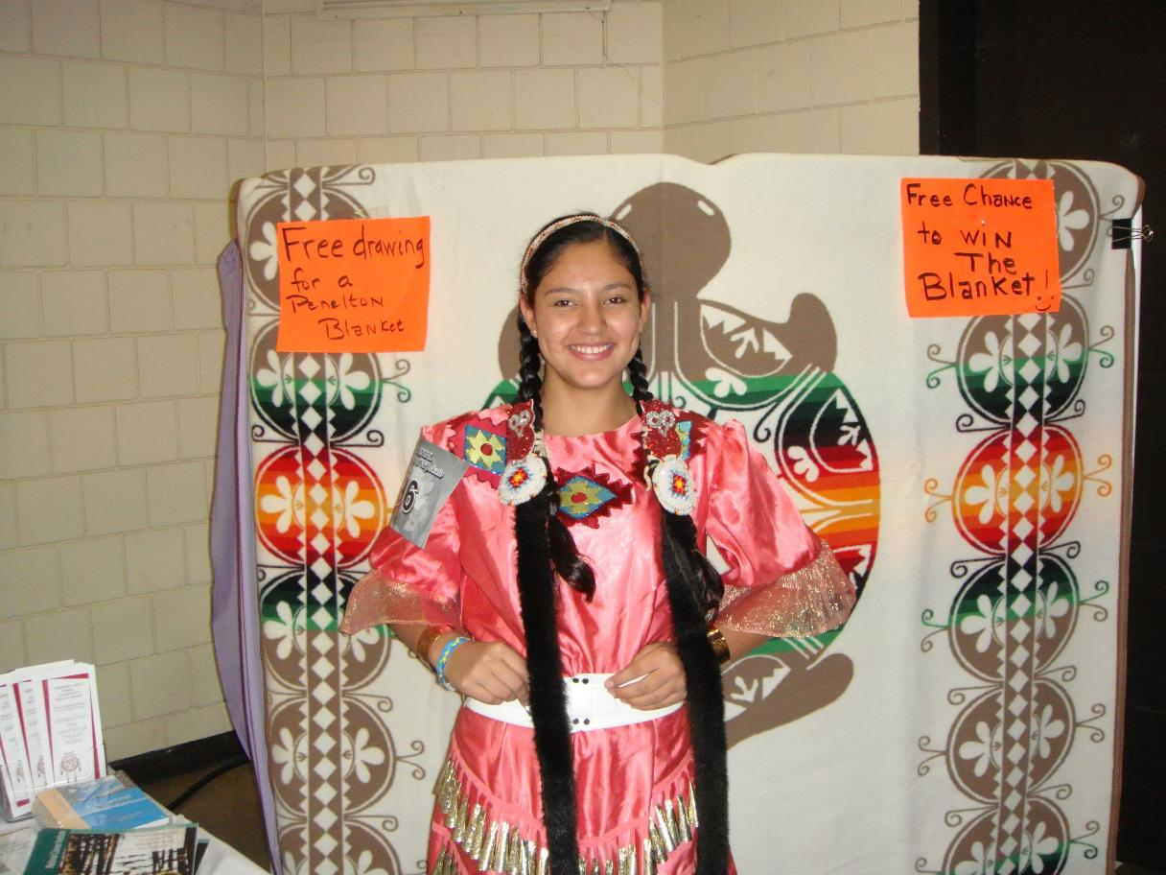

Slide 62
Learn More/
Resources and References
Centers for Disease Control and Prevention. Diagnoses of HIV infection in the United States and dependent areas, 2014. HIV Surveillance Report 2015;26. Available at: http://www.cdc.gov/hiv/pdf/library/reports/surveillance/cdc-hiv-surveillance-report-us.pdf
Centers for Disease Control and Prevention. HIV/AIDS Fact Sheet: American Indians and Alaska Natives. April 2016. Available at: http://www.cdc.gov/hiv/group/racialethnic/aian/
Health Resources and Services Administration. Ryan White HIV/AIDS Program Annual Client-Level Data Report 2014. Available at: http://hab.hrsa.gov/data/servicesdelivered/2014rwhapdatareport.pdf.

Slide 63
Learn More/
Resources and References
Health Resources and Services Administration. HIV/AIDS Among American Indians and Alaska Natives. HRSA CAREAction. February 2014. Available at: http://hab.hrsa.gov/deliverhivaidscare/careactionnewsletter.pdf.
U.S. Commission on Civil Rights. Broken promises: Evaluating the Native American Health Care System. September 2004. Available at: http://www.usccr.gov/pubs/nahealth/nabroken.pdf.
Health Resources and Services Administration. HIV/AIDS Bureau Policy Notice 07-01, The Use of Ryan White Program Funds for American Indians and Alaska Natives and Indian Health Service Programs. May 25, 2007. Available at: http://hab.hrsa.gov/manageyourgrant/files/indiansalaskanspn0701.pdf.

Slide 64
Learn More/
Resources and References
Health Resources and Services Administration. What’s Going on @ SPNS. AI/AN Initiative Highlights Challenges of Unique Service Settings. May 2005. Available at: http://hab.hrsa.gov/abouthab/files/cyberspns_aian.pdf.
AIDS Education and Training Center National Coordinating Resource Center. BE SAFE: A Cultural Competency Model for American Indians, Alaska Natives, and Native Hawaiians Toward the Prevention and Treatment of HIV/AIDS. January 2006. Available at: http://aidsetc.org/resource/be-safe-cultural-competency-model-american-indians-alaska-natives-and-native-hawaiians.
Indian Health Service. National HIV/AIDS Program. Available at: https://www.ihs.gov/hivaids/programgoals/.

Slide 65
Learn More/
Resources and References
Indian Health Service. Ryan White Program and IHS. Available at: https://www.ihs.gov/hivaids/ryanwhiteprogram/.
Indian Health Service. Ryan White CARE Act Provisions in the Reauthorization. Available at: https://www.ihs.gov/hivaids/ryanwhiteprogram/rwcaprovisions/.
Indian Health Service. HIV/AIDS Training Kit and Guide. Available at: https://www.ihs.gov/hivaids/ryanwhiteprogram/rwcaprovisions/.

Slide 66
Learn More/
Resources and References
Health Resources and Services Administration and Indian Health Service. The Clinician’s Guide: Working with Native Americans Living with HIV. Available at: https://www.ihs.gov/hivaids/includes/themes/newihstheme/display_objects/documents/Cliniciansguide.pdf.
Indian Health Service. HIV/AIDS Online Training. Available at: https://www.ihs.gov/hivaids/training/.
Indian Health Service. HIV/AIDS Media Campaigns. Available at: https://www.ihs.gov/hivaids/mediacampaigns/.

Slide 67
Three Questions That Were Answered Today
What is the HIV/AIDS epidemiology and trends in HIV Care Continuum outcomes among AI/AN populations?
What are some of the main barriers and opportunities for linkage to care for AI/AN people living with HIV?
What are some strategies to improve HIV Care Continuum outcomes and customer service for AI/AN people living with HIV?

Slide 68

Questions & Answers
IHS National HIV/AIDS Program:
Theresa “Terry” Friend, CNM, MSN
Forensic Consultant – Sexual and Domestic Violence
Division of Behavioral Health
Office of Clinical and Preventive Services
Email: Theresa.Friend@ihs.gov
Phone: 301-443-1870
HRSA HIV/AIDS Bureau:
Candace Webb, MPH
Branch Chief
Western Services Branch
Division of State HIV/AIDS Programs
Email: cwebb@hrsa.gov
Phone: (301) 443-9089

