Slide 1

Advanced Quality Management:
How to Best Track and Measure Your QI Project Using Intermediate Measures
Clemens Steinbock, MBA - Director, Center for Quality Improvement & Innovation (CQII)
Adam Thompson, BA - Regional Partner Director, South Jersey AETC
Lori Delorenzo, RN, MSN - Executive Director, Organizational Ideas

Slide 2
Introductions

Slide 3
Learning Objectives
Understand the different uses of outcome, process, and intermediate measures
Understand the application of intermediate measures to track PDSA Cycles and learn which of your tested interventions have the most impact
Learn from case studies how to monitor progress of quality improvement projects

Slide 4
Agenda
Introductions (5 min) - Clemens
Setting the Stage (10 min) - Clemens
Overview of Performance Measures (10 min) - Adam
Measures in the Context of PDSA Cycles (10 min) - Lori
Case Study 1 (10 min) – Adam/Lori
Case Study 2 (10 min) – Adam/Lori
Frequently Asked Questions (10 min) – Panel Discussion
CQII Resources (5 min) – Clemens
CQII at Ryan White Conference (5 min)– Clemens

Slide 5
Setting the Stage
Notes:
Clemens

Slide 6


CQII Overview
Center for Quality Improvement & Innovation (CQII)
Funded by the HRSA HIV/AIDS Bureau [#U28HA37644]
Timeframe: July 1, 2020 to June 30, 2024 (4 years)
New York State Department of Health AIDS Institute
Center for Program Development, Implementation, Research and Evaluation (CPDIRE)
  “Together, we continue to improve the lives of people with HIV across the United States. CQII provides state-of-the-art technical assistance and training to Ryan White-funded recipients and subrecipients that measurably strengthen local clinical quality management programs and improve patient care, health outcomes, and patient satisfaction.”
Notes:
Clemens

Slide 7
Technical Assistance Levels
Communities of Learning
National QI collaboratives with engagement of RWHAP recipients
Annual Quality Award Program to highlight QI leaders
Provision of Technical Assistance
Provision of on/off-site technical assistance
Access to nationally recognized QI content and consumer experts
Tracking all ongoing TA engagements and activities
Communities of Learning
QI Trainings
Face-to-face training sessions to build capacity among providers and consumers
National TA Calls to showcase recipients and QI content
Online tutorials for providers and consumers to learn about QI
Consultation/Coaching
Dissemination of QI Resources
Online presence of CQII on the TargetHIV website
Presence at national conferences, including the 2020 National Ryan White Conference
National announcements to highlight upcoming events and QI resources
Training/Educational Fora
Intensity
Information Dissemination
CQII.org | 212-417-4730

Slide 8
Setting the Stage for Workshop
Documenting local improvement efforts, not just outcome data
Importance of understanding which of the multi-layered interventions have a measurable impact on the QI project outcome
Target audience is already familiar with basic QI concepts how to measure individual tests of change during PDSA Cycles
Learn through application - case studies and discussions

Slide 9

We Teach as if Learning Were Like Filling up an Empty Pot….
Setting the Stage for Workshop

Slide 10

…When Actually, It Is a Very Complex and Active Filtering Process
Setting the Stage for Workshop

Slide 11
Overview of Performance Measures
Notes:
Kevin

Slide 12
Types of Healthcare Quality Measures
Structure
  Structural measures give consumers a sense of a health care provider’s capacity, systems, and processes to provide high-quality care
Process
  Process measures indicate what a provider does to maintain or improve health, either for healthy people or for those diagnosed with a health care condition
Outcome
  Outcome measures reflect the impact of the health care service or intervention on the health status of patients
Types of Health Care Quality Measures. Content last reviewed July 2015. Agency for Healthcare Research and Quality, Rockville, MD.
https://www.ahrq.gov/talkingquality/measures/types.html

Slide 13
Examples of Healthcare Quality Measures
Structure
  The representativeness of staffing; percentage of Black or African-American providers
Process
  The percentage of people receiving preventive services (such as cervical cancer or behavioral health screenings)
Outcome
  The percentage of patients who are virally suppressed

Slide 14
Sub-Process
A Sub-Process is a way to describe a series of logical steps within a parent process
A Sub-Process for Screening for Syphilis would be the steps required to screen:
  Training of Staff
  Procurement of Screening Materials
  Patient Education
  Referral and/or Treatment Options
  Regulatory Requirements

Slide 15
Quality Improvement
Process measures are the practices that represent a provider’s efforts to systematize its improvement efforts.
While most quality improvement projects focus on improvement in a process or outcome measure, often the changed ideas are related to sub-processes
The steps of a sub-process are the important steps to ensure the implementation of the process.
PDSA Cycles are tests of changes in sub-processes.

Slide 16

Ask Yourself
Ask yourself:
When you are planning a PDSA cycle, how often do you identify a measure for the cycle?
When you are implementing a PDSA cycle, how often do you measure and document the effect?
Notes:
When you are planning a PDSA cycle, how often do you identify a measure for the discrete cycle?
Always
Sometimes
Never
2. When you are implementing a PDSA cycle, how often do you measure and document the effect of the discrete cycle?
Always
Sometimes
Never
Ask them to consider what stops them from measuring the results.

Slide 17
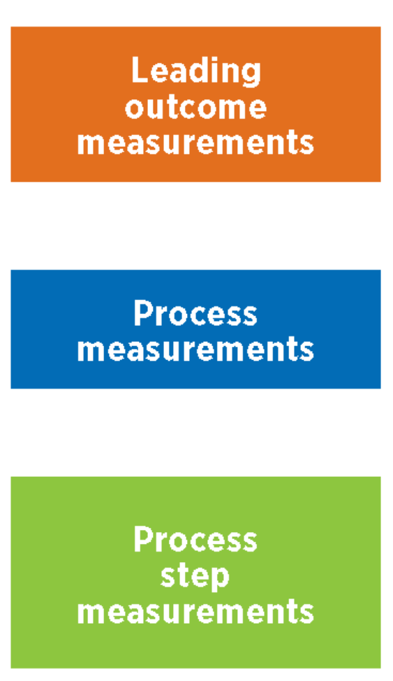
Measuring Tests of Change
We base our standard performance measures on our outcomes (viral suppression)
  Annualized, sequential cross-sections
When testing changes, we are adjusting our process, so we measure that as well
  Simple process measurement (MVs, % screened)
Step measurements measure the PDSA cycle activities
Sub-process
PDSA Cycles
Notes:
When you put these elements together, you create a measurement tree (which is shown on the next slide)

Slide 18
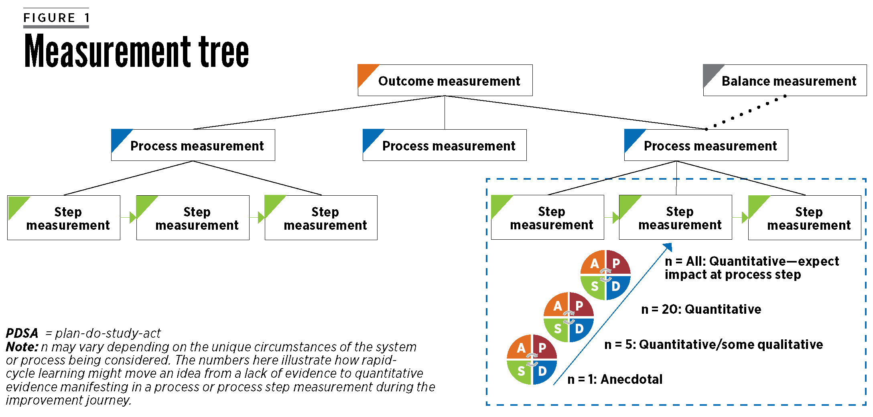
Measurement Tree
Notes:
The measurement tree visually depicts the relationship between measures, with the ultimate outcome represented at the top of the hierarchy. All of the activities implemented are intended to positively impact the outcome, which would be represented in the outcome measure itself.
Let’s look at an example.

Slide 19

NJ B-HIP Measurement Tree Example
Balance – staff and patient experience evaluation
Step
Measures
Process
Measures
Outcome
Measure
Percentage of Patients with BH Disorders Virally Suppressed
% Screened for Depression using Valid Tool
% Screened for SUD using Valid Tool
% Screened Positive with Follow-up Plan
% Pts w BH Disorders Retained in Care
CHANGE IDEAS
Notes:
This is an example of a measurement tree for another project that being implemented in NJ that focuses on Behavioral Health integration into HIV primary care.
For this initiative, the leading outcome focuses on VLS. The process measures focus on different elements that the initiative is measuring, such as % screened for depression & SUD using a standardized tool, follow-up on positive results, retention in care and ARV therapy.
Across the state, all of the sites are using the same outcome and process measures. Where they differ are the change ideas that are being tested, which are represented as step measures. The specific change ideas implemented at the sites are developed through QI-related activities, such as root cause analysis, driver diagrams, affinity exercises, etc.
For Project ECHO, there is one primary outcome measure that has been identified. Sites can self-identify process measures to follow and step measures align with the change ideas being implemented.

Slide 20
Measures in the context of PDSA cycles
Notes:
Kevin

Slide 21
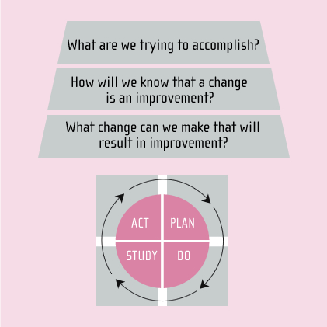
Model for Improvement
The Model for Improvement guides change by asking 3 questions:
  An aim is set by asking “What are we trying to accomplish”
  Measures are established by asking “How will we know that a change is an improvement”
  Action can be readied by identifying “What change can we make that will result in improvement”
Process Measures
Source: NQC Quality Academy PDSA Cycle
Notes:
Before going any further, it’s important to take a step back and remind ourselves of the key elements of the the Model for Improvement.
The Model for Improvement guides change by asking 3 questions:
An aim is set by asking “What are we trying to accomplish”
Measures are established by asking “How will we know that a change is an improvement”
Action can be readied by identifying “What change can we make that will result in improvement”
The “measure” identified as part of the 2nd question are typically process measures, such as patient show rates, % screened, MVs kept, etc.
The PDSA cycle is used test whether a change makes a positive change (improvement).

Slide 22
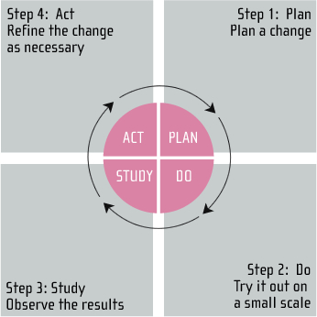
The PDSA Cycle for Learning and Improvement
The PDSA Cycle has 4 parts: PLAN-DO-STUDY-ACT.
PLAN: let’s first plan your change
DO: Try it out on a small scale
STUDY: Analyze the results from your test
ACT: What should we change, based on what our experiment showed, for the next test?
Source: NQC Quality Academy PDSA Cycle
Notes:
The PDSA Cycle has 4 parts: PLAN-DO-STUDY-ACT.
PLAN: let’s first plan your change
DO: Try it out on a small scale
STUDY: Analyze the results from your test
ACT: What should we change, based on what our experiment showed, for the next test?
The Key Point is that this is a cycle. One series of steps leads to the next. The cycles build on each other.

Slide 23
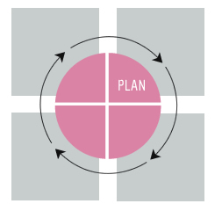
Plan
Clarify your Objective
Make a prediction
  Formulate theory
  Objective + specificity
What is to be done
  Who
  What
  Where
  When
  How
Source: NQC Quality Academy PDSA Cycle
Notes:
As you plan your PDSA cycle, you identify the 4 Ws:
Who will be responsible for specific elements of the PDSA cycle? Who is going to carry out the activities?
What will be done? What are the actual steps that will be carried out?
Where will it take place?
When will it occur?
The “how” helps to identify how will you measure the outcome. This is where step measurement comes into play. It is how you determine whether the steps taken have led to an improvement.

Slide 24

Do
Carry out the plan
Document your observations
  Expected
  Unexpected
Begin analysis
Source: NQC Quality Academy PDSA Cycle
Notes:
You test out your idea in the “Do” phase. Carry out the test, as you planned, document your observations, both expected and unexpected, and begin analysis of the data.
It is during the ”Do” phase where you are collecting data for step measurement.

Slide 25

Study
The “Study” phase is when you look at the test, complete the analysis of data, compare it to your theory and predictions, and summarize what you have learned.
You are studying the results of the steps that were implemented and the step measurement data that were collected.
Source: NQC Quality Academy PDSA Cycle
Notes:
The third step is ‘Study’
The “Study” phase is when you look at the test, complete the analysis of data, compare it to your theory and predictions, and summarize what you have learned.
You are studying the results of the steps that were implemented and the step measurement data that were collected.

Slide 26
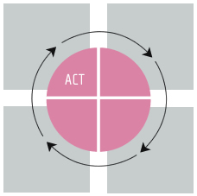
Act
Adjustments
  Changes to previous test?
  What adjustments?
  Expand last cycle?
New cycles
  What are you planning?
  What are you going to test?
Step Measurement
Source: NQC Quality Academy PDSA Cycle
Notes:
That’s exactly what we do in the “Act” phase. We are re-acting based on the results of our test cycles.
In this step you have two different choices: either you can modify a previous test cycle to optimize its impact or you decide to start a new category of test cycles based on your acquired knowledge.
- What changes are to be made to the previous test cycle? What adjustments are you considering? How can we expand the last cycle?
- What next cycles are you planning? Based on the information you gained, what are the new cycles that you want to test?
Regardless of which path you take, you need to once again decide how you will determine if the step implemented is an improvement; and we circle back to the issue of step measurement.

Slide 27
Case Study 1
Notes:
Lori

Slide 28

Application of Step Measurement - Clinic
An HIV clinic has 300 women enrolled. Pap screening has historically been a challenge with no improvement noted in the last 4 years.
Within the last 12 months, 3 women were diagnosed with stage IV cervical cancer.
Most women are referred out for screening as there are a limited number of providers who are trained to perform pap screening.

Slide 29
Clinical Case Example: Pap Screening
Primary Area of Focus Selected
Cervical Cancer Screening
Data Drill Down
54% of women received pap screen; rates drop to 42% among BAAL
Screening rates have remained low for last 4 years with no improvement
Understand the Problem: Review current process for pap screening to identify root cause
Limited number of providers trained to perform pap screening
Exam rooms not set up to perform pap screens
85% of women are referred for screening; only 25% of those referred receive screen
Lack of understanding among clients re importance of screening
Change Idea: Offer pap screening on-site
Contract with OB/GYN to provide pap screens on-site
No process in place to readily identify those in need of pap screen
3 women were diagnosed with stage IV cervical cancer in last 12 mos.
Create mobile “pap” cart
Train providers to perform pap screening
Create custom report in EHR & review during weekly huddle
Notes:
Note: This is an example of how an agency could reach a decision on which change idea they want to implement.
A wide range of areas of potential focus were identified by working through the root cause analysis. This agency elected to focus on pap screening
To better understand the current state of cervical cancer screening, a further analysis of data was conducted. This led to further exploration of the specific processes that are in place for how pap screening is being implemented. They learned the following:
There is a limited number of providers trained to perform pap screening
Some providers don’t feel it’s their responsibility to perform pap screens or don’t want the responsibility of following should an abnormal result be detected
Exam rooms are not set up to perform pap screens
There is a lack of understanding among clients about the importance of screening
Determination of which clients should be screening varies
There is not a process in place to readily identify those in need of pap screens
Based on an understanding of the root cause, a range of change ideas were identified, some of which included:
Establish a contract with the OB/GYN located on floor above clinic to provide pap screens on-site
Create a mobile “pap” cart
Train providers to perform pap screening so they can begin performing pap screens
Create custom report in EHR to identify those women in need of a pap smear and review the list during the weekly huddle to identify those women who have appts. That week
Create pt education materials to focus on importance of cervical cancer screening

Slide 30

Goal
Increase cervical cancer screening among all women from 54% to 75%.

Slide 31
Measurement Tree
Step
Measures
Process
Measures
Outcome
Measure
Percentage of Patients with Cervical Cancer
% Screened
% Screened with Abnormal Follow-up
% Patient with Medical Visit in each 6 Month Period
CHANGE IDEAS
Notes:
If we put this into a measurement tree it would look like the diagram depicted.
Cervical cancer screening dramatically reduces the risk of developing cervical cancer. The outcome measure focuses on the percentage of women diagnosed with cervical cancer with goal of having this measure be as low as possible.
In this instance, 3 process measures are shown:
Percentage of women screened for cervical cancer
Percentage of women screened who have an abnormal result and have documented follow-up. This can include repeat pap screen, colposcopy or excisional treatment (LEEP or conization)
Percentage of women retained in care as evidenced by a medical visit in each 6 mo. period. This one is of interest because a woman is more likely to receive the screening if she is retained in care.
If change ideas were targeted to any of these process measures, step measures would be identified.
In this instance, the change ideas are targeted at increasing the cervical cancer screening rates, which ultimately impacts the outcome measure.

Slide 32

PDSA cycles is the formal testing of change ideas
Offer pap screens on-site
Contract with OB/GYN provider to provide on-site screening
Train providers: 1) importance of screening 2) how to perform pap screen
Create mobile pap cart
Generate weekly report of women due for pap screen
Notes:
Each of the change ideas represent a series of steps that can be taken. And each of these steps will result in multiple PDSA cycles as it will take several cycles to test out the ideal process.
In this diagram, 4 different change ideas are identified. For each of these change ideas, step measures are used to track progress and determine if the change is an improvement.

Slide 33
Step measures document whether the change idea is an improvement
Offer pap screens on-site
Contract with OB/GYN provider to provide on-site screening
Train providers: 1) importance of screening 2) how to perform pap screen
Create & utilize mobile pap cart
Generate weekly report of women due for pap screen
No. of functional pap carts available
No. of times pap cart was used
No. of times cart was not appropriately stocked
Notes:
Step measures are used to document whether a change is an improvement.
If we take the mobile pap cart as an example, several steps go into the creation and utilization of the cart
Cart must be obtained
Cart must be stocked with appropriate materials and supplies
Staff must be assigned to restock cart to ensure available supplies are in sufficient number and not expired
Cart must be easily located by providers
Cart must be placed in room prior to provider
Potential step measures for the utilization of a mobile pap cart could be:
No. of pap carts that were ultimately secured
No. of times pap cart was used
No. of times cart was not appropriately stocked
All of these provide helpful information to determine if the utilization of the pap cart was positively impacting the process measure (increase cervical cancer screening rates)
For each change idea, 1 or more step measures should be identified. The step measures for the other change ideas are represented on the measurement tree shown in the next slide.

Slide 34
Measurement Tree
Step
Measures
Process
Measures
Outcome
Measure
Percentage of Patients with Cervical Cancer
% Screened
% Screened with Abnormal Follow-up
% Patient with Medical Visit in each 6 Month Period
Offer Pap Screen Onsite
Number of Screens Performed
Number of Providers Trained
Number of Times Pap Cart was Used
Number of Reports Generated
Notes:
We return to the measurement tree. The change idea is to offer pap screening on-site. As part of this process, 4 steps were identified:
Contract with OB/GYN provider to provide services on-site
Train clinic providers in how to perform a pap screen
Create and utilize a mobile pap cart
Modify the EHR to generate a standardized report that will be reviewed during the weekly huddle
The step measures align with the respective change ideas, all of which are targeted at increasing the cervical cancer screening rates and ultimately reducing the number of clients diagnosed with cervical cancer.

Slide 35
Case Study 2
Notes:
Lori

Slide 36
Application of Step Measurement - CBO
A Community-Based Organization (CBO) is aiming to improve the integration of behavioral health support into their service model.
The CBO currently does not know what clients have been screened, diagnosed, referred, or in treatment for behavioral health disorders.
The CBO decides to integrate behavioral health screening for clients; because depression is prevalent in Persons with HIV, they decide to begin there.

Slide 37
CBO Case Example: Depression Screening
Primary Area of Focus Selected
Depression Screening for Clients using evidence-based tool
Data Drill Down
60% of clients are not seen in RWHAP
No information about whether HIV provider screens for depression
Understand the Problem: Review current barriers to adopting PHQ-9 Screening
No information about HIV Provider depression screening practices
No empanelment to systematically track client depression status
0% of clients had BH Status Documented
No Staff trained to deliver PHQ-9
Change Idea: Screen Clients with PHQ-9 Depression Screening Tool
Empanel Non-Medical Case Managers to Client Provider Sites
No process for communicating with HIV Provider or BH Provider
100% of clients in single provider sample were diagnosed with depression
Train Staff in PHQ-9 Screening
Identify HIV Provider depression screening practices
Formalize Communication with Providers

Slide 38
Goal
Screen all clients using the PHQ-9 Depression Screening Tool.

Slide 39
Measurement Tree
Step
Measures
Process
Measures
Outcome
Measure
Percentage of Patients with BH Disorders Virally Suppressed
% of Clients Screened for Depression
% of Positive Screens with Follow-up
% of Clients Diagnosed with BH in Treatment
CHANGE IDEAS

Slide 40
PDSA cycles is the formal testing of change ideas
Screen Clients using PHQ-9 Tool
Empanel Non-Medical Case Managers to Client Provider Sites
Identify HIV Provider Depression Screening Practices
Train Staff to Screen using the PHQ-9 Tool
Formalize Communication with Providers

Slide 41
Step measures document whether the change idea is an improvement
Empanel Non-Medical Case Managers to Client Provider Sites
Identify HIV Provider Depression Screening Practices
Train Staff to Screen using the PHQ-9 Tool
Formalize Communication with Providers
PHQ-9 Screening Training
Percentage of Staff Trained in PHQ-9
Number of Staff Observations
Screen Clients using PHQ-9 Tool

Slide 42
Measurement Tree
Step
Measures
Process
Measures
Outcome
Measure
Percentage of Patients with BH Disorders Virally Suppressed
% Screened for Depression
% of Clients Screened for Food Insecurity
% of Clients Screened for Housing Stability
Screen with PHQ-9 Tool
Percentage of Staff Trained
PHQ-9 Screening Training
Number of Staff Observations
Positivity Rate

Slide 43
Frequently Asked Questions
Notes:
Clemens to facilitate

Slide 44
Frequently Asked Questions
When our QI efforts result in measurable outcome improvements, why does it really matter to know what PDSA Cycles had the most impact?

Slide 45
Frequently Asked Questions
When committing more time to measurement, don’t we take time away from improvement efforts?

Slide 46
Frequently Asked Questions
Our EMR is getting better in reporting our viral suppression data for my QI project, aren’t we going back to paper?

Slide 47
Frequently Asked Questions
How can we effectively integrate documentation of step measures in our local process of improvement?

Slide 48
Frequently Asked Questions
Where can I learn more about these type of measures?

Slide 49
Key CQII Resources
Notes:
Clemens

Slide 50


Quality Academy
Online, asynchronous training course on quality improvement for different QI competencies and audiences (providers and consumers)
Close to 40 interactive tutorials (15-20 mins each) are available at no cost, offering more than 800 training minutes; all presentation slides and notes are available for download
Created in 2007 and expanded in 2009 (English
and Spanish); over 35,000 tutorials have been taken so far
Developed a new Consumers in Quality section of the Quality Academy with consumer tutorials
CQII.org

Slide 51


On-Site Technical Assistance
On-site/off-site short-term technical assistance (TA) is provided to RWHAP recipients and subrecipients
Technical Assistance is designed to help the implementation of effective quality improvement efforts
TA Request Form is available online for completion for review and approval by HIV/AIDS Bureau
Technical Assistance is provided by CQII and/or the HIV/AIDS Bureau
CQII.org

Slide 52


Technical Assistance Calls
Monthly 60-minute national webinars are guided by quality experts and RWHAP recipients to share emerging practices and opportunities for peer learning
Zoom platform encourages interactions with presenters using chat room and polling functionalities
Slide presentations, handouts, webinar recordings are available for later download at CQII website
CQII.org

Slide 53


Learning Lab
Upcoming QI resource by CQII: an online virtual QI training course program
Comprised of three independent courses (QI 101, Advanced QI, and PLWH in QI) each offered every four months
Each Lab consist of six 90min virtual sessions every two weeks and a 6-month post-graduation sharing session
Curriculum includes homework assignments
All participants are supported by the course faculty
CQII.org

Slide 54

Available QI Guides

Slide 55

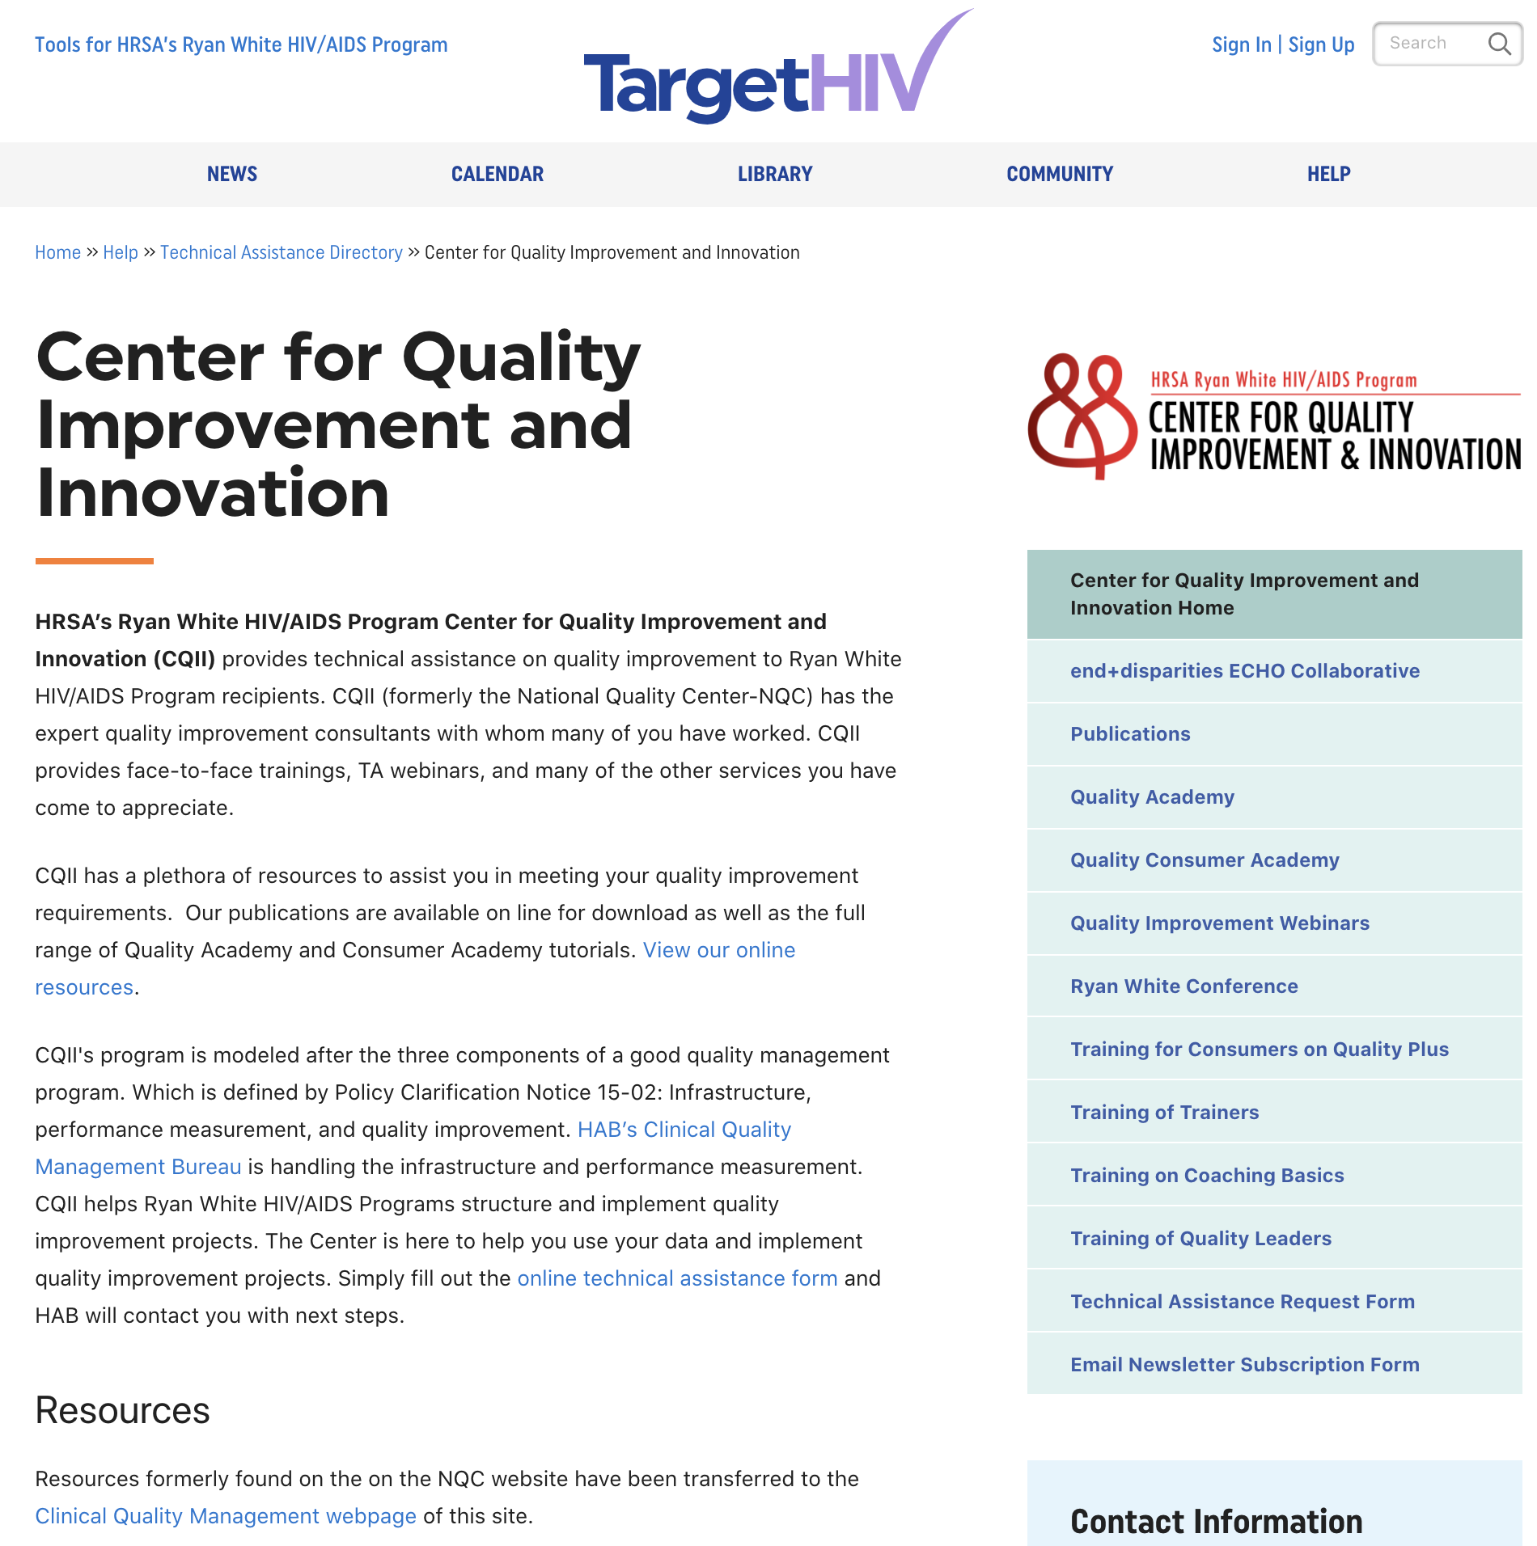
CQII Website
Detailed description of and access to CQII services, including Quality Academy
CQII resources are available, including didactic presentations, past recordings
Guides and tools to learn more about quality improvement
Resources of end+disparities ECHO Collaborative
Access to TA Request Form
Access point to CQII trainings
CQII.org

Slide 56
CQII at the RW Conference

Slide 57
Other CQII Workshops
QI 101 Institute: Clinical Quality Management
  Thursday, August 13 at 4:30 p.m.-5:30 p.m.
Advanced Quality Management: How to Best Track and Measure Your QI Project Using Intermediate Measures
  [TBD]
Advanced Quality Management: Learn about QI Tools You Might Not Have Not Ever Used Before
  [TBD]
Addressing Disparities Using Quality Improvement to Make Measurable Differences: Experiences from the end+disparities ECHO Collaborative
  Friday, August 14 at 11:00 a.m.-12:30 p.m.
Engaging People with HIV in Quality Improvement: Best Practices to Meaningfully Engage and Involve Consumers
  [TBD]
TargetHIV Panel: Resources and Technical Assistance by the CQII
  Friday, August 14 at 12:45 p.m.-2:15 p.m.
CQII.org | 212-417-4730

Slide 58
Contact Information

Slide 59

Contact Information
Contact Information
Clemens M. Steinböck, MBA
Director, CQII
New York State Department of Health
AIDS Institute
90 Church Street, 13th floor
New York, NY 10007-2919
212.417.4730
Clemens.Steinbock@health.ny.gov
Kevin Garrett, MSW
CQII
New York State Department of Health AIDS Institute
90 Church Street, 13th floor
New York, NY 10007-2919
212.417.4730
Kevin.garrett@health.ny.gov
Lori Delorenzo, RN, MSN
Executive Director
Organizational Ideas
VA
(540) 951-0576
loridelorenzo@comcast.net

