Slide 1
Imposition of Charges: Not Just an Imposition, It’s the Law! October 2, 2018
Heather Hauck, Deputy Associate Administrator
Gail Williams Glasser, Sr. Project Officer
Connie Jorstad, Public Health Analyst
Kelley Weld, Public Health Analyst
HIV/AIDS Bureau (HAB)
Health Resources and Services Administration (HRSA)

Slide 2
Learning Objectives
By the end of this session, participants will be able to:
Summarize statutory and programmatic requirements related to imposition of charges.
Review the distinctions between schedule of charges, nominal fee, flat rate, and sliding fee scale.
Apply statutory and programmatic requirements to common recipient organizational scenarios.
Identify resources to assist HRSA HAB recipients and subrecipients with implementation of this statutory requirement.

Slide 3
What is it, and Why is it Important?
“Imposition of Charges” is a term used to describe all activities, policies, and procedures related to assessing RWHAP patient charges as outlined in legislation
It’s the law!
Public Health Service Act Sections 2605(e), 2617(c), and 2664(e)(1)(B)(ii)
Based on individual (not family income)
Prohibits charges imposed on RWHAP patients with incomes below FPL
Requires charges imposed on RWHAP patients with incomes above FPL
Established annual caps on charges
No RWHAP patient shall be denied service due to an individual’s inability to pay
HRSA RWHAP statute does not require that patients that fail to pay be turned over to debt collection agencies

Slide 4
Applicability and Implementation
Legislative language pertaining to services and applicability:
Part A: services with assistance provided under the grant
Part B: services with assistance provided under the grant
Part C: early intervention services under the grant
Imposition of Charges applies to those services for which a distinct fee is typically billed within the local health care market
This is practical, implementable, and in alignment with other Federal programs
Applies to all HRSA RWHAP Parts A, B, and C; it does not apply to Part D, or ADAP

Slide 5
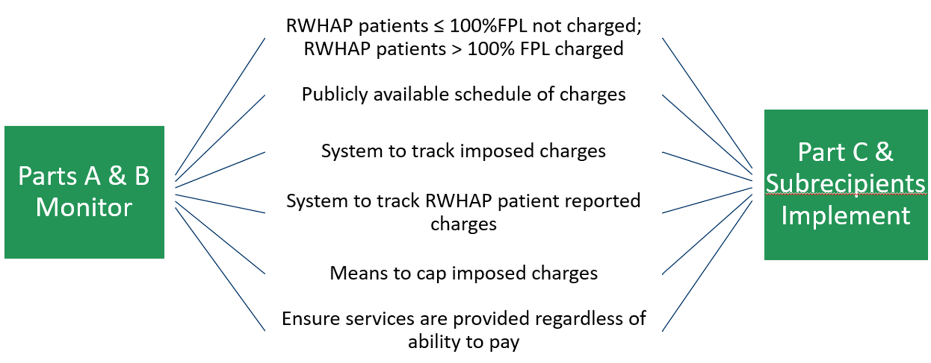
Role of HRSA RWHAP Parts in Imposition of Charges

Slide 6
Can My Organization Get a Waiver?
Recipients operating as free clinics (e.g. healthcare for the homeless clinics) have the option to waive the imposition of charges on HRSA RWHAP patients.
Only a handful of recipients are operating as free clinics. Therefore, most recipients should be charging RWHAP patients over 100% FPL for services rendered, even if it is only $1.

Slide 7
AGENDA for Today’s Session
Terminology
Federal Poverty Level
Statutory Requirement
Schedule of Charges
Cap on Charges
Imposition of Charges
Winding Down
Looking Forward
Resources
Q&A

Slide 8
Terminology
Understanding Imposition of Charges Lingo

Slide 9
Important Definitions (1)
Fee Schedule: complete listing of billable services and their associated fees based on locally prevailing rates or charges. A fee schedule is not a schedule of charges. A fee schedule is not required by the RWHAP legislation, but having one in place is considered a best practice, and is a requirement for BPHC grant recipients.
Schedule of charges: fees imposed on the patient for services based on the patient’s annual gross income. A schedule of charges may take the form of a flat rate or a varying rate (e.g. sliding fee scale).
Nominal Charge: fee greater than zero.

Slide 10
Important Definitions (2)
Cap on charges: limitation on aggregate charges imposed during the calendar year based on RWHAP patient’s annual gross income. All fees are waived once the limit on annual aggregate charges is reached for that calendar year.
Waiver: recipients operating as free clinics (e.g. healthcare for the homeless clinics) have the option to waive the imposition of charges on RWHAP patients.
Only a handful of recipients are operating as free clinics. Therefore, most recipients should be charging RWHAP patients over 100% FPL for services rendered, even if it is only $1.

Slide 11
Important Definitions (3)
Federal Poverty Level (FPL): an economic measure used to determine eligibility for certain programs.
Annual Gross Income
Gross Income: total amount of income earned from all sources during the calendar year before taxes.
Adjusted Gross Income: gross income less deductions.
Modified Adjusted Gross Income (MAGI): adjusted Gross Income plus certain deductions. REMINDER!
Throughout this presentation “annual gross income” refers to income earned during the calendar year.

Slide 12
Federal Poverty Level (FPL)
Fundamental to implementing imposition of charges

Slide 13
Federal Poverty Level (FPL) Guidelines
Federal Poverty Level (FPL) Guidelines are a measure of poverty based on income
Varies according to family size and their geographical location
Commonly used to determine eligibility for certain programs and benefits
HRSA RWHAP legislation refers to the FPL guidelines to define
Who should not have a charge imposed
Who should have a charge imposed
The cap on charges imposed on an individual during a calendar year
Issued by HHS: https://aspe.hhs.gov/poverty-guidelines
Providers are expected to update their systems each year to reflect the new guidelines

Slide 14
2018 FPL and Imposition of Charges
PERSONS IN FAMILY/HOUSEHOLD | POVERTY GUIDELINE
1 | $12,140
2 | $16,460
3 | $20,780
4 | $25,100
5 | $29,420
6 | $33,740
7 | $38,060
8 | $42,380
FPL is based on household size
Imposition of charges is based on individual income as it relates to FPL
Poverty level for an individual is $12,140
HRSA RWHAP eligibility can be based on individual income or household income
For the 48 States and District of Columbia

Slide 15
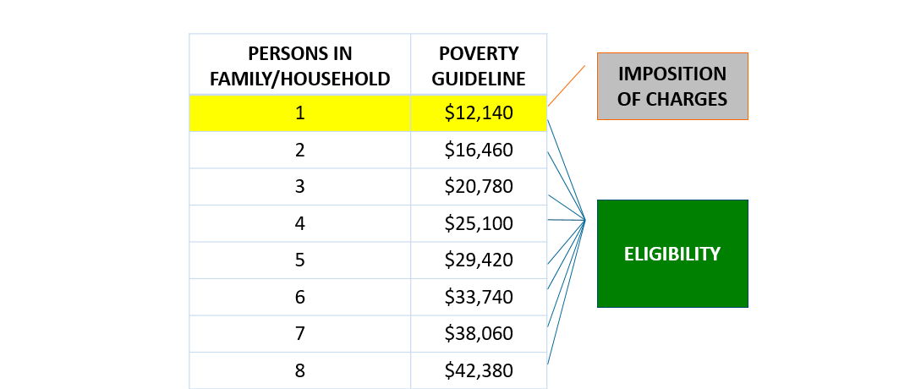
2018 FPL: Eligibility vs. Imposition of Charges

Slide 16
Converting Percentage of FPL to Income
Who should NOT have a charge imposed
Individuals with an income ≤ 100% of the official poverty line…
Individuals with income ≤ $12,140
Who SHOULD have a charge imposed
Individuals with income > 100% of the official poverty line…
Individuals with income > $12,140
What the annual cap on charges for an individual should be
Individuals with an income of 101-200% of the official poverty line…
Individuals with an income of 201-300% of the official poverty line…
Individuals with an income >300% …
Individuals with an income of $12,141 - $24,280
Individuals with an income of $24,281 - $36,420
Individuals with an income >$36,420

Slide 17
Percentage Multiples of 2018 FPL
PERSONS IN FAMILY/HOUSEHOLD | 100% | 150% | 200% | 250% | 300%
1 | $12,140 | $18,210 | $24,280 | $30,350 | $36,420
2 | $16,460 | $24,690 | $32,920 | $41,150 | $49,380
3 | $20,780 | $31,170 | $41,560 | $51,950 | $62,340
4 | $25,100 | $37,650 | $50,200 | $62,750 | $75,300
5 | $29,420 | $44,130 | $58,840 | $73,550 | $88,260
6 | $33,740 | $50,610 | $67,480 | $84,350 | $101,220
7 | $38,060 | $57,090 | $76,120 | $95,150 | $114,180
8 | $42,380 | $63,570 | $84,760 | $105,950 | $127,140
For the 48 States and District of Columbia

Slide 18
FPL & Imposition of Charges – Summary
To determine whether or not a patient is eligible for HRSA RWHAP services
To determine how much to charge a RWHAP patient
To determine the maximum amount a RWHAP patient can be charged based on how the recipient defines “low income”

Slide 19
Statutory Requirement
The Components of Imposition of Charges

Slide 20
Imposition of Charges
Schedule of Charges
Cap on Charges
Imposition of Charges

Slide 21
Schedule of Charges
Schedule of Charges
Cap on Charges
Imposition of Charges

Slide 22
Schedule of Charges – Statutory Language
in the case of individuals with an income less than or equal to 100 percent of the official poverty line, the provider will not impose charges on any such individual for the provision of services under the grant;
Part A: See § 2605(e)(1) of the PHS Act
Part B: See § 2617(c)(1) of the PHS Act
Part C: See § 2664(e)(1) of the PHS Act

Slide 23
Schedule of Charges – Statutory Language (2)
in the case of individuals with an income greater than 100 percent of the official poverty line, the provider— (i) will impose a charge on each such individual for the provision of such services; and (ii) will impose the charge according to a schedule of charges that is made available to the public
Part A: See § 2605(e)(1) of the PHS Act
Part B: See § 2617(c)(1) of the PHS Act
Part C: See § 2664(e)(1) of the PHS Act

Slide 24
Nominal Charge – Statutory Language
ASSESSMENT OF CHARGE.—With respect to compliance with the assurance made under paragraph (1), a grantee or entity receiving assistance under this subpart may, in the case of individuals subject to a charge for purposes of such paragraph—assess the amount of the charge in the discretion of the grantee, including imposing only a nominal charge for the provision of services, subject to the provisions of such paragraph regarding public schedules and regarding limitations on the maximum amount of charges
Part A: See § 2605(e)(2) of the PHS Act
Part B: See § 2617(c)(2) of the PHS Act
Part C: See § 2664(e)(3) of the PHS Act

Slide 25
Schedule of Charges – Layman’s Terms
Schedule of charges: Fees imposed on the patient for services based on the patient’s annual gross income.
Prohibits fees imposed on individuals with income ≤ 100% FPL
Required fees be imposed on Individuals with income > 100% FPL
Nominal Charge: fee greater than zero.

Slide 26
Schedule of Charges – Requirements
May not assess a charge on RWHAP patients with incomes at or below 100% FPL
Must assess a charge on RWHAP patients with incomes above 100% FPL
The schedule of charges must be publicly available
Placement on the schedule of charges is based on individual annual gross income

Slide 27
Schedule of Charges – Other Considerations
Applies to uninsured RWHAP patients
Clinics should decide whether to apply imposition of charges to insured patients
If imposition of charges is applied to insured patients, it should be uniformly applied rather than on a case-by-case basis
Clinics should also consider how to avoid requiring two payments for the same visit/service for insured patients (one for the insurance copay and one for the imposition of charges fee)
Since schedule of charges is based on individual annual gross income, each RWHAP patient’s income must be documented, even if household income is used to determine HRSA RWHAP eligibility
A RWHAP patient’s placement on the schedule of charges will change if there is a change in an individual’s annual gross income or the FPL Guidelines
Examples of ways recipients/subrecipients may establish a schedule of charges for patients with incomes over 100% FPL:
Flat Rate – a single fee, regardless of service type
Varying Rate - fee or percentage discount based on income (sliding fee scale)

Slide 28
Schedule of Charges: 3 Examples
Clinic A: Flat Rate Nominal fee
Clinic B: Varying Rate Nominal fee
Clinic C: Varying Rate Sliding fee scale
FPL Category | Clinic A | Clinic B | Clinic C
<=100% FPL | $0 | $0 | 0%
101-200% FPL | $5 | $5 | 10%
201-300% FPL | $5 | $10 | 20%
>300% FPL | $5 | $25 | 100%

Slide 29
Schedule of Charges – Actors & Roles
HRSA RWHAP Recipients
HRSA RWHAP Patients
Develop a schedule of charges
Make schedule of charges publicly-available
Use patient income for placement on schedule of charges
Inform patient of placement on schedule of charges
Impose charges on RWHAP patients based on their schedule of charges
Provide HRSA RWHAP recipients with income information/documentation as requested

Slide 30
Cap on Charges
Schedule of Charges
Imposition of Charges
Cap on Charges

Slide 31
Cap on Charges – Statutory Language
in the case of individuals with an income greater than 100 percent of the official poverty line and not exceeding 200 percent of such poverty line, the provider will not, for any calendar year, impose charges in an amount exceeding 5 percent of the annual gross income of the individual involved;
in the case of individuals with an income greater than 200 percent of the official poverty line and not exceeding 300 percent of such poverty line, the provider will not, for any calendar year, impose charges in an amount exceeding 7 percent of the annual gross income of the individual involved; and
in the case of individuals with an income greater than 300 percent of the official poverty line, the provider will not, for any calendar year, impose charges in an amount exceeding 10 percent of the annual gross income of the individual involved.
Part A: See § 2605(e)(1) of the PHS Act
Part B: See § 2617(c)(1) of the PHS Act
Part C: See § 2664(e)(2) of the PHS Act

Slide 32
Cap on Charges – Layman’s Terms
Cap on Charges: limitation on aggregate charges imposed during the calendar year based on RWHAP patient’s annual gross income.
Cap on charges is based on income as a percentage of FPL:
101-200% FPL – 5% cap
201-300% FPL – 7% cap
>300% FPL – 10% cap

Slide 33
Calculating Cap on Charges
Example: Patient with annual income of $18,000
HRSA RWHAP FPL Categories | HRSA RWHAP Cap on Charges (Percent of Income)
≤100% FPL | 0%
101-200% FPL | 5%
201-300% FPL | 7%
>300% FPL | 10%
2018 Income Equivalent
≤ $12,140
$12,141 - $24,280
$24,281 - $36,420
> $36,420
$18,000
x .05
$900

Slide 34
Aggregate Applicable Charges – Statutory Language
…the annual aggregate of charges imposed for such services [during the calendar year] without regard to whether they are characterized as enrollment fees, premiums, deductibles, cost sharing, copayments, coinsurance, or other charges
Part A: See § 2605(e)(3) of the PHS Act
Part B: See § 2617(c)(3) of the PHS Act
Part C: See § 2664(e)(4) of the PHS Act

Slide 35
Cap on Charges – Layman’s Terms (2)
The aggregate of charges imposed for such services [during the calendar year] without regard to whether they are characterized as enrollment fees, premiums, deductibles, cost sharing, copayments, coinsurance, or other charges
Any charge for services provided with “assistance under the grant” for which a distinct fee is typically billed in the local health care market imposed by:
‘You’ the RWHAP provider
Other RWHAP providers
Any charge for HIV-related care to the extent the charge is in the context of (or as a result of) a HRSA RWHAP service

Slide 36
Aggregate Applicable Charges
RWHAP Charges
Other RWHAP Charges
Patient Out-of-Pocket
Cap on Charges

Slide 37
Cap on Charges – Requirements
Calculate each RWHAP patient’s annual cap based on their individual annual gross income
Inform the patient of their cap and their responsibility to track all charges
Aggregate/add up or track all applicable charges
Stop imposing charges on RWHAP patient when cap is met

Slide 38
Cap on Charges – Other Considerations
The calculated cap on charges will change if there is a change in an individual’s annual gross income or the FPL Guidelines
Since cap on charges is based on individual annual gross income, each RWHAP patient’s income must be documented, even if household income is used to determine HRSA RWHAP eligibility
Cap on charges applies to all HRSA RWHAP patients, regardless of income or healthcare coverage
Based on charges imposed on the RWHAP patient, not the actual fee for service
Applies when services are rendered – not upfront
Based on the calendar year

Slide 39
Tracking Aggregate Applicable Charges
Responsibility is on the RWHAP patient to track and report charges incurred
Providers need to:
Inform RWHAP patients of their responsibility to track and submit other RWHAP provider charges or out-of-pocket payments
Review documentation of HIV related charges or payments provided by the RWHAP patient to determine if they are allowable
Track the charges ‘you’ impose on RWHAP patients AND have a process in place, outside of your existing financial management system, that tracks other allowable HIV-related charges as submitted by the patient
Have a process in place that will alert the provider that the RWHAP patient has reached the cap and should not be further charged for the remainder of the calendar year

Slide 40
Cap on Charges – Actors & Roles
HRSA RWHAP Recipients
HRSA RWHAP Patients
Calculate cap based on patient’s individual income
Inform RWHAP patients of their cap and their responsibility to track and submit other HRSA RWHAP imposed charges and other related out-of-pocket payments
Have process must be in place to ensure that the annual cap for each RWHAP patient is not exceeded
Track other HRSA RWHAP imposed charges and other related out-of-pocket payments submitted by clients
Aggregate all charges
Waive any additional charges for the remainder of the calendar year once the cap is met
Collect or track other HRSA RWHAP imposed charges and other approved out-of-pocket payments
Submit other HRSA RWHAP imposed charges and other related out-of-pocket payments to HRSA RWHAP providers

Slide 41
Imposition of Charges (2)
Schedule of Charges
Cap on Charges
Imposition of Charges

Slide 42
Imposition of Charges Policy
Schedule of charges that:
does not impose a charge to RWHAP patients with income at or below 100% FPL
imposes a charge to all RWHAP patients with income over 100% FPL
limits aggregate charges during the calendar year for all RWHAP patients (cap on charges)
Process to capture documentation of RWHAP patient’s annual gross income needed to determine placement on the schedule of charges and annual cap on charges
Process to assess, document, and track the charges the agency imposed on RWHAP patients and charges received from RWHAP patients through an accounting system
Process to alert the billing system that a RWHAP patient’s cap has been reached and should not be further charged for the remainder of the calendar year

Slide 43
Imposition of Charges Policy, Cont.
Providers should make materials available to RWHAP patients, explaining their role in the imposition of charges
Imposition of charges policy may be part of a larger organizational policy
Providers should ensure staff are aware of and consistently following the established policies and procedures
Recipients/subrecipients should include these requirements in their provider agreements (i.e. Memorandums of Understanding, contracts, etc.)

Slide 44
Excerpt of RWHAP Recipient Policy

Slide 45
Excerpt of RWHAP Recipient Policy (2)
must
Any service or set of services for which a distinct fee is typically billed for separately within the local health care market.

Slide 46
Multi-funded Clinics
 | HRSA RWHAP Imposition of Charges | BPHC Sliding Fee Discount Program
Applicability | Any service or set of services for which a distinct fee is typically billed for within the local health care market | All required and additional health services for the HRSA BPHC approved health center’s scope of project for which a distinct fee is typically billed for within the local health care market
Denial of service | No RWHAP patient shall be denied service due to an individual’s inability to pay | No patient shall be denied service due to an individual’s inability to pay
Fee Schedule | Recommended | Required
Basis by which to charge patients | Schedule of Charges (flat or varying rate) | Sliding Fee Scale (varying rate)
Patients eligible for reduced fees/discounts | All HRSA RWHAP-eligible patients may receive a reduced fee. | Only patients at or below 200% FPL may be eligible for discounts.
Assessment of charges | All patients above 100% FPL must be charged, and patients at or below 100% FPL MUST NOT be charged. | All patients above 100% FPL must be charged, and patients at or below 100% FPL MAY be charged.
Cap on charges | Annual limit based on RWHAP patient’s income level | No limit

Slide 47
Multi-funded Clinics (cont.)
Main difference between HRSA RWHAP and HRSA BPHC legislation: imposing charges and the payor of last resort vs. discount program
Multi-funded clinics may should assess whether both a schedule of charges AND a separate BPHC sliding fee scale (SFS) is necessary
If the existing SFS is in compliance with HRSA RWHAP legislation then recipient/subrecipient may utilize the existing SFS
If the existing SFS is not in compliance with HRSA RWHAP requirements, the recipient/subrecipient will need to adopt a schedule of charges specific to the HRSA RWHAP program for HRSA RWHAP-eligible patients
Multi-funded clinic will be in compliance with both requirements as long as the clinic’s sliding fee scale does not charge for those at or below 100% and does not offer a discount for those above 200%

Slide 48
Strategies - RWHAP Patient Engagement
Provide RWHAP patients with information and/or tools to help them do their part
Identify routine opportunities to ask RWHAP patients about income and other imposed charges
In some instances, a change in a RWHAP patient’s income can change their placement on the schedule of charges
A change in RWHAP patient’s income can change their cap on charges
Ask RWHAP patient for other HRSA RWHAP charges that have been imposed

Slide 49
Strategies – Engaging across HRSA RWHAP
Coordination
Any HRSA RWHAP recipients/subrecipients can coordinate with other recipients/subrecipients
Identify ways to ‘share’ information or documentation
Establish a process across multiple recipients/subrecipients to share information
Data sharing
All HRSA RWHAP recipients/subrecipients may consider data sharing
Can occur between recipients and among subrecipients
HRSA HAB encourages recipients to pursue data sharing agreements
Reduces burden on all stakeholders, including RWHAP patients

Slide 50
Winding Down
Next steps, Resources, & Questions

Slide 51
Looking Forward
Ongoing technical assistance
Working across HRSA HAB to identify topics for future training
Working with HRSA BPHC on technical assistance for multi-funded recipients
Implementation strategies
Enhancing CAREWare to help manage the ‘data’ aspect of imposition of charges
Encouraging recipients and subrecipients to share your strategies on TARGETHIV

Slide 52
Resource List
Your HRSA HAB Project Officer!
BPHC’s requirements: https://bphc.hrsa.gov/programrequirements/compliancemanual/chapter-9.html#titletop
Federal Poverty Level: https://aspe.hhs.gov/poverty-guidelines
Percentage of FPL Table: http://www.needymeds.org/poverty-guidelines-percents
FPL Calculator: https://www.needymeds.org/FPL_Calculator
CMS Fee Schedule: https://www.cms.gov/Medicare/Medicare-Fee-for-Service-Payment/FeeScheduleGenInfo/index.html
TARGET Center: https://targethiv.org/
HRSA HAB Website: https://hab.hrsa.gov
Statutory References:
RWHAP: Sections 2605(e), 2617(c), and 2664(e) of the PHS Act
BPHC: Section 330(k)(3)(G) of the PHS Act; 42 CFR 51c.303(f), 42 CFR 51c.303(g), 42 CFR 51c.303(u), 42 CFR 56.303(f), 42 CFR 56.303(g), and 42 CFR 56.303(u)

Slide 53
Impositions of Charges Workgroup
Kristina Barney, DMHAP
Jewel Bazilio-Bellegarde, OTCD
Gail Glasser, DCHAP
Connie Jorstad, DPD
Alice Litwinowicz, DSHAP
Edwin Patout, OPS
Elizabeth Saindon, OGC
Amy Schachner, OAA
Lisa Thombley, OGC
Kelley Weld, DPD

Slide 54
Questions
Schedule of Charges
Cap on Charges
Imposition of Charges

Slide 55
Contact Information
Connie Jorstad and Kelley Weld
Division of Policy and Data
HIV/AIDS Bureau (HAB)
Health Resources and Services Administration (HRSA)
Emails: cjorstad@hrsa.gov and kweld1@hrsa.gov
Web: hab.hrsa.gov

Slide 56
Connect with HRSA
To learn more about our agency, visit
www.HRSA.gov
Sign up for the HRSA eNews
FOLLOW US:

