Slide 1
Partnerships for Care (P4C): Health Departments and
Health Centers Collaborating to Improve HIV Health Outcomes
Agatha Eke, PhD
Behavioral Scientist, Prevention Research Branch
Centers for Disease Control and Prevention
Division of HIV/AIDS Prevention

Slide 2
Project Framework
Multi-site demonstration project
  CDC/DHAP: 4 State HDs (FL, MA, MD, NY)
  HRSA/BPHC: 22 FQHCs (4-6 per state) Non-Ryan White Part C funded
Overarching Goal
  Enhance collaboration between HDs and FQHCs to improve HIV outcomes along continuum of care, especially among racial/ethnic minority persons
Strategies
  Integrate HIV services into primary care
  Interventional surveillance (“D2C”)

Slide 3


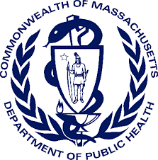























Notes:
Specifically

Slide 4


Data-to-Care
HIV-Positive Persons in the P4C Services Area and Health Center Patients Lost to Follow-Up
Notes:
D2C activities under the project focused on a Collaborative Model……….

Slide 5

Data to Care (D2C)
A public health strategy using surveillance and other data to identify people with HIV that may be in need of HIV medical care and services and facilitating linkage to those services. Examples include:
  Persons not in care
  Persons in care but with sustained high viral load
  Mothers and infants in need of perinatal HIV services coordination
Uses surveillance data to determine care status
  CD4 or viral load test result as proxy for care visit and dates
Data are used and shared for public health follow up
  Continuum of Care = aggregate data for monitoring
  D2C = individual data for public health action

Slide 6
Health Departments FQHCs
HIV Surveillance
System
Electronic Health
Records
Improved HIV Outcomes
Notes:
Whereby health department surveillance data and electronic health record data from health centers were used to identify persons living with HIV who were not in HIV medical care and link them to care.

Slide 7



D2C Not-in-Care Groups
Health Department-Initiated
Not-In-Care
(HIV Surveillance System)
FQHC-Initiated
Not-In-Care
(Electronic Health Records)
Persons in the P4C Service Area
Former HC Patients Lost to Follow-Up
Never Linked
Previously Linked
1
2
3
Notes:
In terms of the types of not-in-care cases that P4C tried to address, there were 3 distinct groups.
They included health department initiated not-in-care persons identified through surveillance who lived in P4C service areas and who were either never linked to care or previously linked but not current to care.
And also FQHC-initiated not-in-care patients based upon review of EHR data.
Routinely planned case conferencing sessions, usually monthly, provided health departments and health center clinicians with a dedicated time to group and compare NIC lists and known case dispositions.

Slide 8
P4c Data-to-Care
Have activities effectively identified people not in care and connected them to care?
What are some strengths of the P4C collaborative D2C model?
Can the process be improved?
Notes:
For today’s discussion, I thought there would be a lot of utility, particularly as the division is embarking on the implementation of 1802, to provide a little context for 3 important questions from the implementation of D2C during P4C.
First, did P4C activities effectively identify people not-in-care and connect them to care?
Second, what are some strengths of this collaborative model?
And third, can the process be improved?

Slide 9
Data-to-Care
Have activities effectively identified people not in care and connected them to care?
Notes:
In terms of question 1.

Slide 10
D2C Overall Outcomes
8,527
Of those,
are confirmed NICs
4,971
2,801
(58%)
(56%)
presumed NIC assigned for investigations
presumed NIC with a known care status
1,225 (44%) of confirmed NICs were re-engaged in care
Re-engaged
Not Re-engaged
Notes:
Across the P4C catchment areas, overall, 2,801 HIV-positive persons were confirmed to be out-of- care. And health department field staff, working in tandem with health center clinical staff when appropriate, were able to get 44% of not-in-care persons back into care.

Slide 11
53% of persons currently ‘not-in-care’ had previously never been linked to care
Previously Linked
Never
Linked
Notes:
It is important to emphasize that approximately half of persons confirmed to be not-in-care had never been linked to care.

Slide 12
Health Center Initiated: Lost to Follow-Up Patients
1,472
(100%)
HC lost to follow-up patients were assigned for investigation
1,408
(96%)
of those had a completed care status investigation
192
(14%)
individuals were confirmed
lost to follow-up
115 (60%) of those were re-engaged in care
Re-engaged
Not Re-engaged
Notes:
Taking a more careful look specifically at electronic health record data as the starting point for D2C, the 22 health centers identified 1,472 HIV+ patients who appeared to be out-of-care through review of electronic health record systems. 192 persons (14%) were confirmed to be truly out-of-care following review with surveillance data, and 60% of these individuals were re-engaged back into care.
Relative to surveillance-initiated D2C outcomes, these outcomes represent relatively modest numbers. Though, I think there are important considerations for our state partners in terms of how medical record data is used to help refine surveillance-based D2C processes.

Slide 13
Data-to-Care
What are some strengths of the P4C collaborative D2C model?
Notes:
Focusing on question 2…..what are some of the strengths of this collaborative model?

Slide 14
P4C Maryland Data Matching Results
FQHC Electronic Health Records & State Surveillance Registry
73,070 total medical patient records reviewed in match.*
972 total HIV+ persons identified (1.3% seropositivity)
Notes:
Maryland negotiated data sharing agreements with their 4 health centers that included a mechanism to receive clinical data from all patients, not just patients with HIV. They received data for approximately 73,000 unique health center patients.
Through a match with state surveillance data, 972 persons were identified as being HIV-positive.
The bar on the left shows that 750 (or 77%) of positive persons matched in both EHR and surveillance records. Meaning, the health centers knew the serostatus of these individuals and so did the health department. (Note: 77% determined to be in care somewhere else)
The bar on the right shows the 218 (or 22%) of HIV-positive persons who were in surveillance, but NOT known to be HIV-positive to the FQHCs. Meaning, the health centers were providing primary care to 218 people who for one reason or another were either not provided HIV testing, or the client declined screening. The health department determined that 25% of these individuals had never been linked to care or were currently out-of-HIV-care.
Maryland’s work with FQHCs suggests that the bi-directional exchange of data has benefits both for jurisdictional D2C outcomes, and also for providing health centers with important data on potential shortcomings of how they had been implementing HIV screening and the value of routinizing opt-out testing.
Left bar (77% determined to be in care somewhere else)

Slide 15
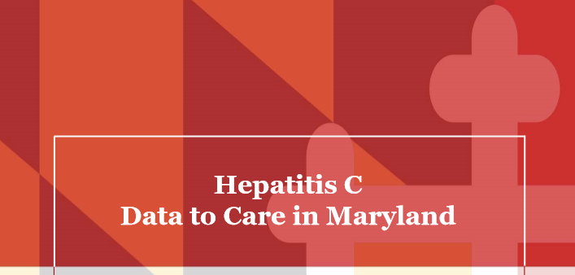
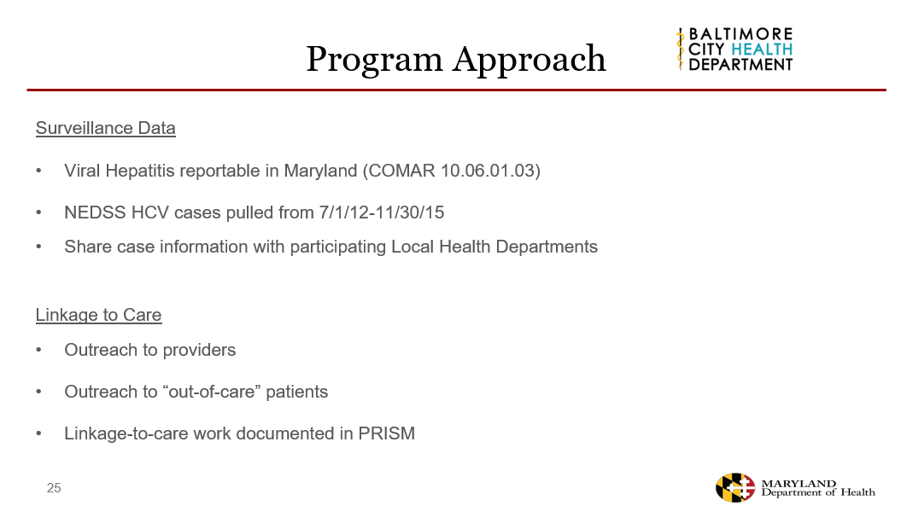
Notes:
Maryland’s experiences working with providers on P4C has also helped to shape their ability to use D2C as a strategy to reduce Hepatitis C morbidity, and this work has already demonstrated impact.

Slide 16

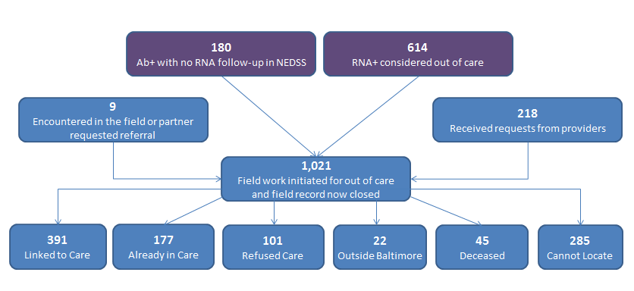
Informing HCV D2C Program
*Three individuals were encountered during outreach and requested a referral to HCV care. Two partners of the original client requested linkage to HCV testing. Both tested positive for active HCV infection and were linked to care.
Notes:
In a relatively short period of time, Maryland was able to identify 1,021 persons who appeared to be out-of-care and treatment, and has linked 391 individuals to care and HCV therapy.

Slide 17
P4C Data-to-Care
Can the process be improved?
Notes:
And in terms of question 3. Can the collaborative D2C processes as implemented in P4C be improved?

Slide 18
D2c challenges & opportunities
Establishing bi-directional data sharing agreements between DPH & providers can be complex and lengthy process
State statutes
Not-in-Care definitions, generating NIC lists, linkage outcomes
Electronic Health Records
Managing other external data sources for case investigations
Staffing (shift in skills)
Manual bi-directional data exchange & communication processes can be resource intensive and delay public health follow-up
Feedback to providers is an additional but important step
Notes:
I think these potential improvements can be defined by some important challenges and opportunities that we encountered, and they are listed here on this slide - including:
1. Complexities establishing data sharing agreements with clinical providers.
2. These complexities were often a result of how to operationalize public health state statues.
3. Making decisions on jurisdictional definitions for not-in-care and how to operationalize the most impactful D2C strategies.
4. Managing data from electronic health records and other external data sources.
5. Managing staffing and what skill sets were needed to have an impactful D2C program.
6. Balancing the manual bi-directional exchange of data with the need for rapid public health action.
7. And ensuring that providers understood that the time and resources they put into collaborating on D2C was value-added required some additional efforts.
So, I wanted to spend the remainder of my short time providing a little bit more detail on 4 of these challenges.

Slide 19
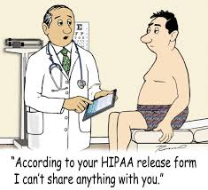
D2C challenges & opportunities
Establishing bi-directional data sharing agreements between DPH & providers can be complex and lengthy process
State statutes
Notes:
Many of the delays we encountered were related to how exactly to operationalize, what in some cases, were broadly defined state statues around data sharing.

Slide 20
NY State Public Health law
2010 - NYS Public Health Law broadened allowed use HIV surveillance data to locate out of care individuals and link them back to care. However, this information could not be shared with medical providers.
2015 - legislation passed expanding the permissible use of HIV surveillance data to allow NYSDOH to share patient specific HIV information with medical providers for the purposes of improving linkage to care (LTC)
Formal guidance needed to be developed to operationalize what information could and could not be shared with individual providers
  e.g., confirmed newly diagnosed status could not be shared
  In the interim, data sharing protocols accommodated data sharing between HIV surveillance and the six partner FQHCs
Notes:
In New York, as an example, where the ink was still drying on revised 2015 public health laws that broadened the ability of the health department to share HIV information with providers, there was no formal operational guidance yet in place. The health department was working on it, but questions around whether there were limits around what information could and could not be shared with providers was still being discussed across legal counsel, surveillance, and prevention units.
Ultimately they found a way to move forward, but not without some interesting suspenseful drama.

Slide 21
Challenges in Florida
  Delays in development and implementation timelines
Legal Issues
  MOAs between health department and health centers
  Client consent forms
Data Sharing
  Health centers and their EHR capabilities/costs associated with modifications
  Format of shared data from multiple EHRs
  Development time and processes
  Consistent out-of-care definitions (linkage/retention)
Notes:
Florida found other legal challenges related to D2C. The department’s legal eagles felt that to be in compliance with state public health laws for the bidirectional exchange of data, it was permissible for the FQHCs to share data with the health department, but for the health department to share data with FQHCs, the health centers would need to add a statement to their general patient consenting process that clearly outlined that some health information might be shared with the dept. of health for public health related purposes.
This also created its share of concerns with fears that no one would sign the consent forms, but in the end it proved a non-issue.

Slide 22
D2c challenges & opportunities
Establishing bi-directional data sharing agreements between DPH & providers can be complex and lengthy process
State statutes
Not-in-Care definitions, generating NIC lists, linkage outcomes
Notes:
In terms of challenges in how best to define not-in-care, how to most efficiently generate NIC lists, and how to most impactfully increase linkages back to care.

Slide 23
Not-In-Care Definitions
 | Surveillance initiated definitions | Time Frame for Not-In-Care Status
FL | Never or previously linked | ≥ 12 months without labs
MA | Previously linked | ≥ 6 months without medical visit (after 12 months in care)
MA | Never linked | ≥ 3 months post-diagnosis without medical visit
MD | Never or previously linked | ≥ 13 months without labs (never linked diagnosed for 2-3 years currently prioritized)
NY | Previously linked – NYC | ≥ 9 months without labs
NY | Previously linked − ROS | 13-24 months without labs
NY | Never linked− NYC & ROS | ≥ 3 months post-diagnosis without labs
 | Health Center Initiated definitions | Time Frame for Not-In-Care Status
NY | Never linked - NYC & ROS | ≥ 3 months post-diagnosis without medical visit
NY | Previously linked - NYC & ROS | ≥ 9 months without medical visit
Notes:
Health departments were afforded leeway with how they approached not-in-care definitions, and final decisions were based upon local epi and public health resources. As you can see here, we had a few different definitions, with a range of 3 to 24 months without evidence of care.

Slide 24
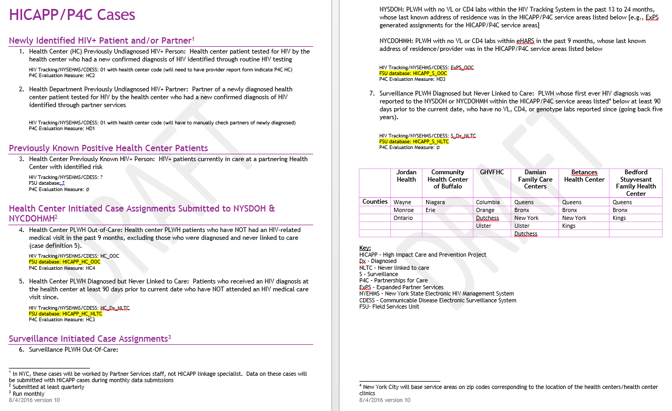
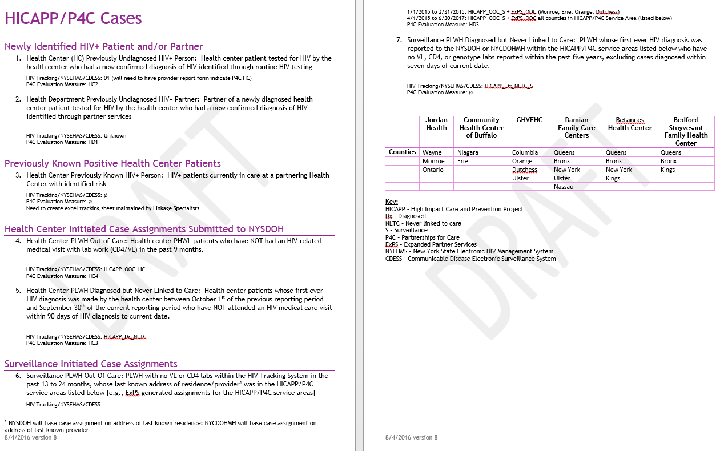
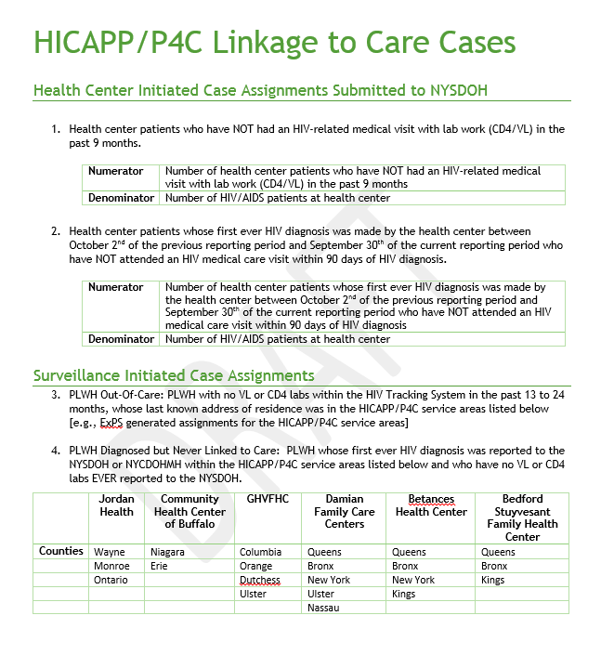
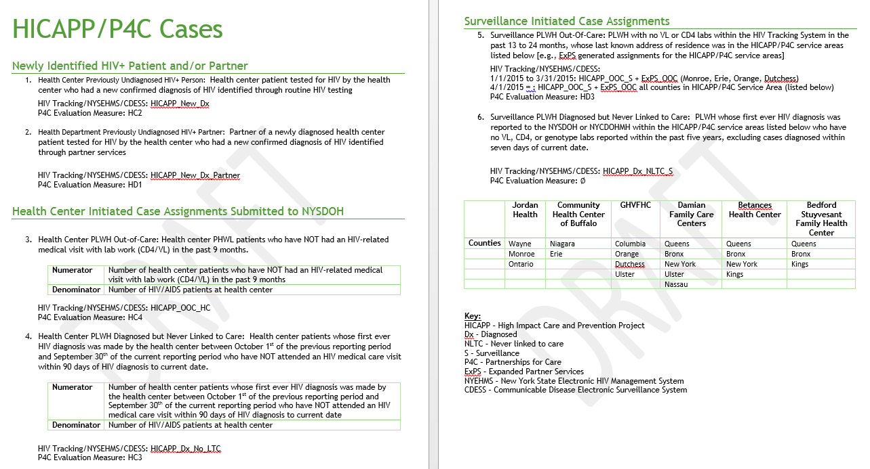
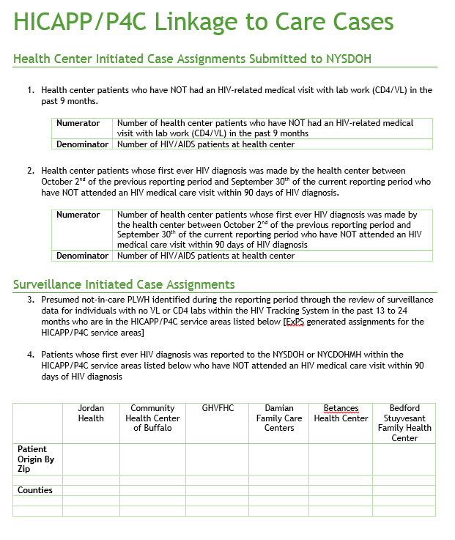
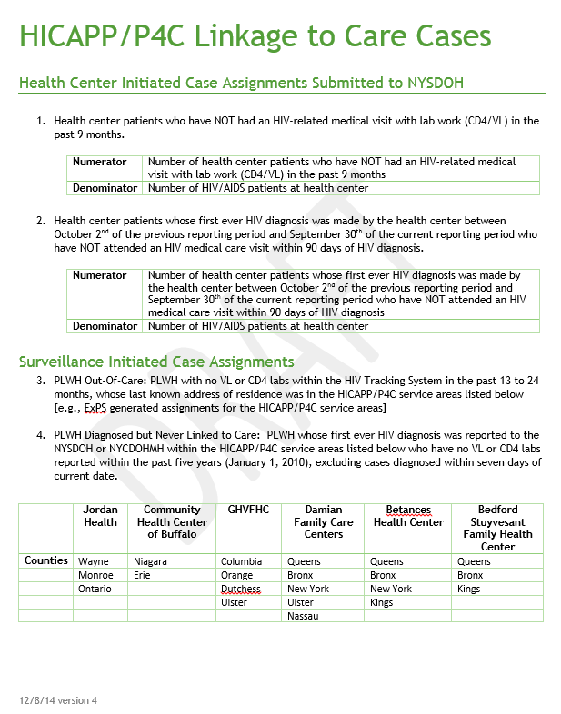
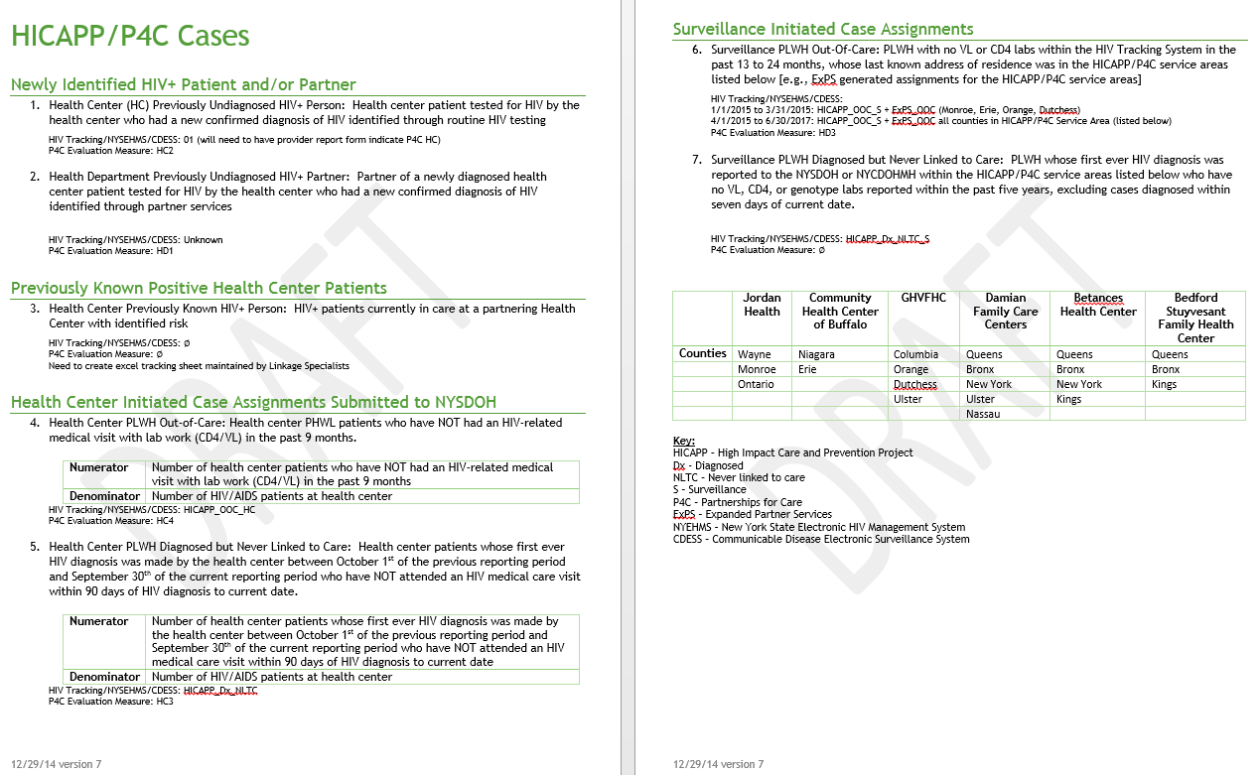
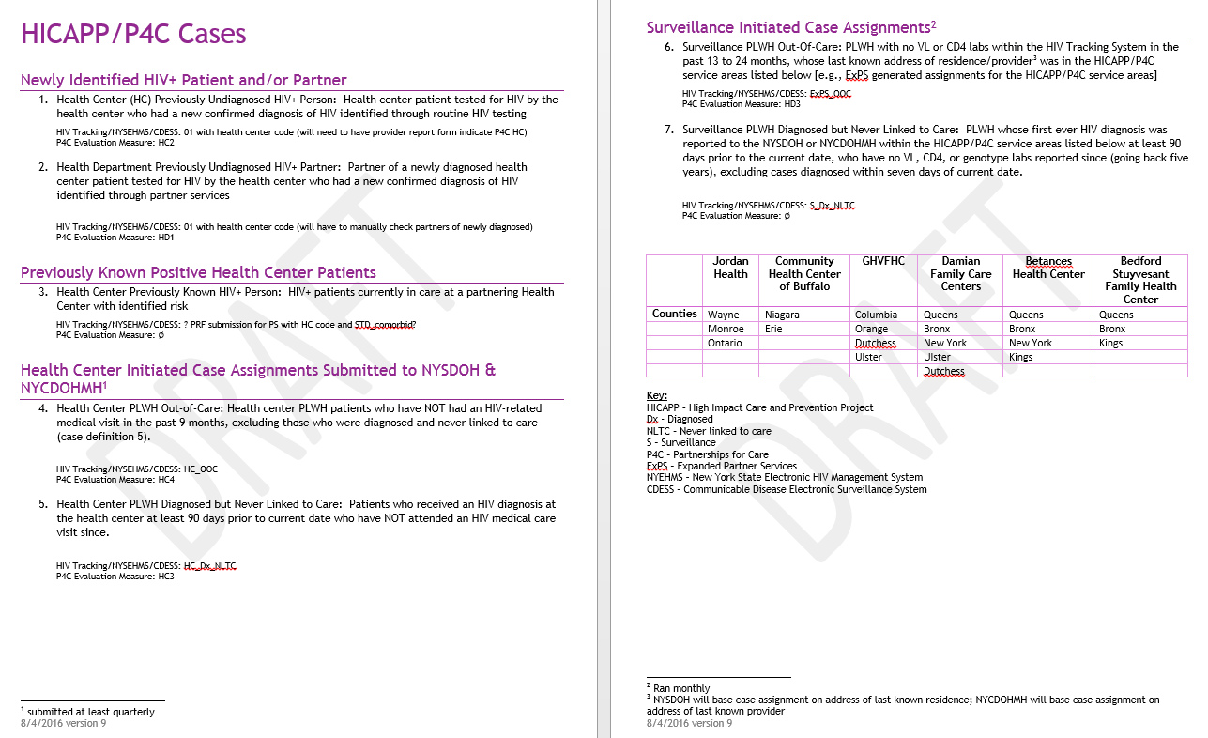
NY Defining “Not-in-Care”
Four definitions developed with input from our health centers
Notes:
In many cases, deciding on final NIC definitions, as in the case of NY shown here, was an iterative process that included important input from participating providers.

Slide 25
D2c challenges & opportunities
Establishing bi-directional data sharing agreements between DPH & providers can be complex and lengthy process
State statutes
Not-in-Care definitions, generating NIC lists, linkage outcomes
Electronic Health Records
Managing other external data sources for case investigations
Staffing (shift in skills)
Notes:
Data to Care during P4C also represented the important marrying of technical data mining skills with shoe leather contact tracing skills, and P4C health departments found themselves rethinking training and expertise, and how best to staff their programs.

Slide 26
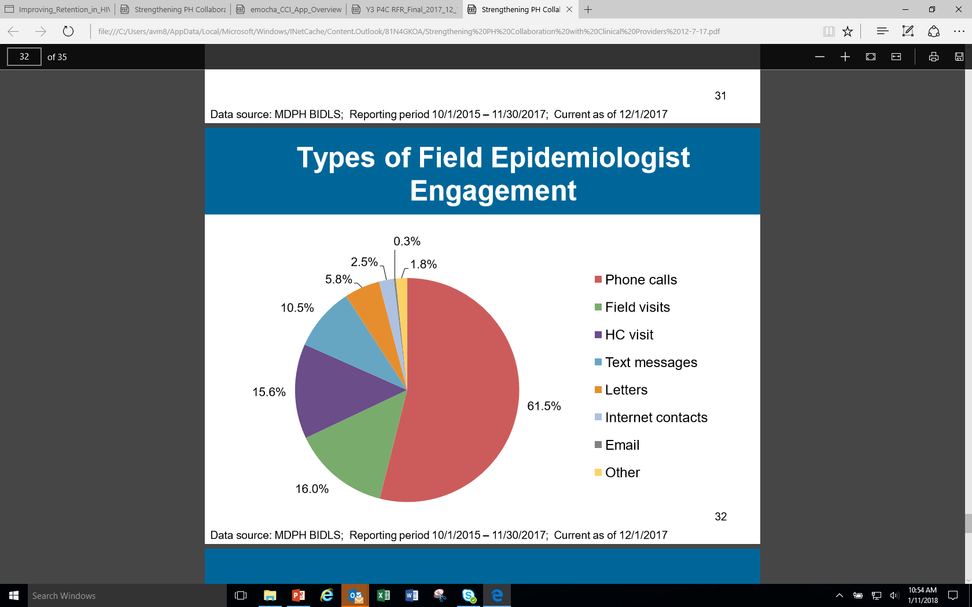
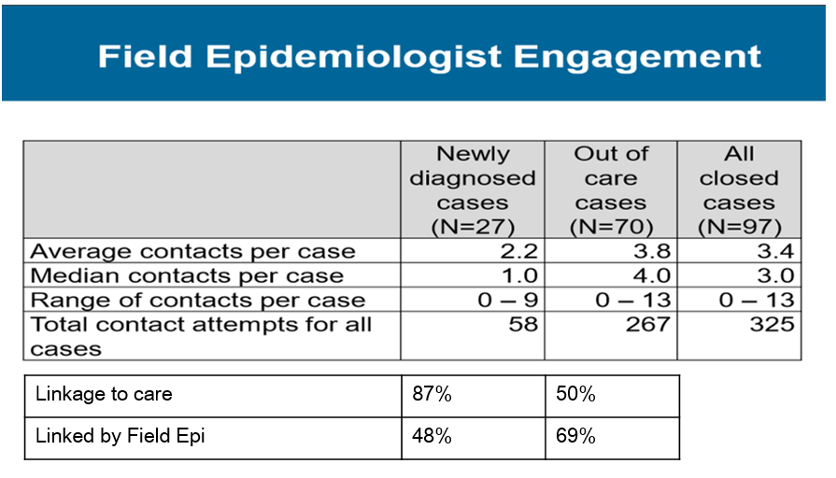
D2C STAFFING
Traditional DIS/linkage coordinators
Hiring epidemiologists as field staff
  Data and technology background
  Support provider education and coordination
Emphasis on monitoring client engagement efforts for impact
Notes:
In Massachusetts, as an example, hiring epidemiologists who had both a data background and field expertise represented a shift to supporting increased coordination between public health and clinical care. It’s also important to point out, and the graph and table on the right help to illustrate this, that there was also an enhanced emphasis on evaluating the types of outreach activities staff engaged in and their relative impactfulness to help continuously improve programmatic efficiencies.

Slide 27
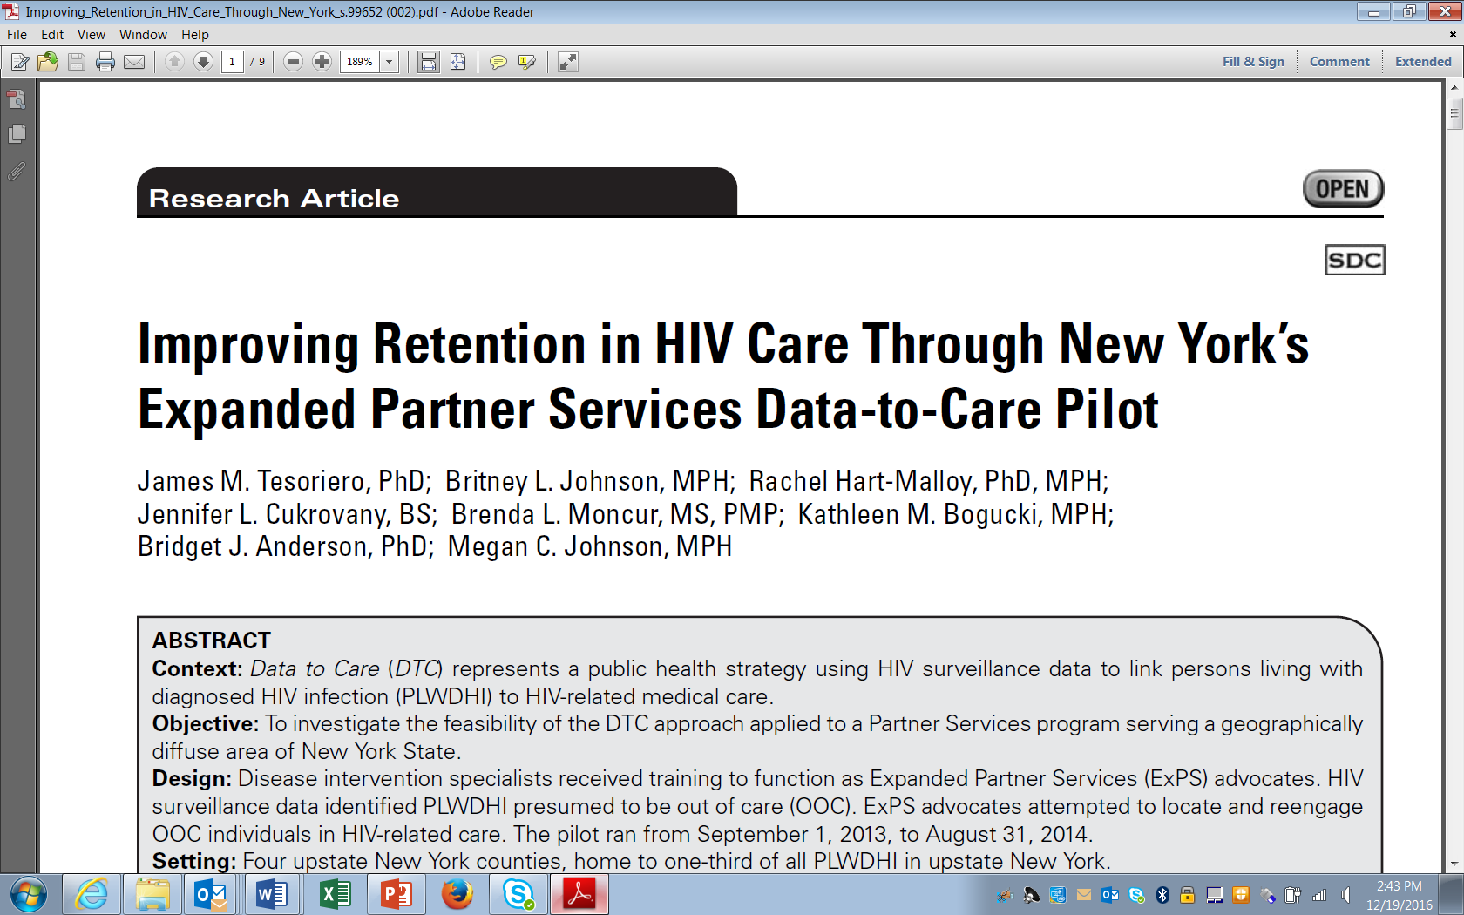
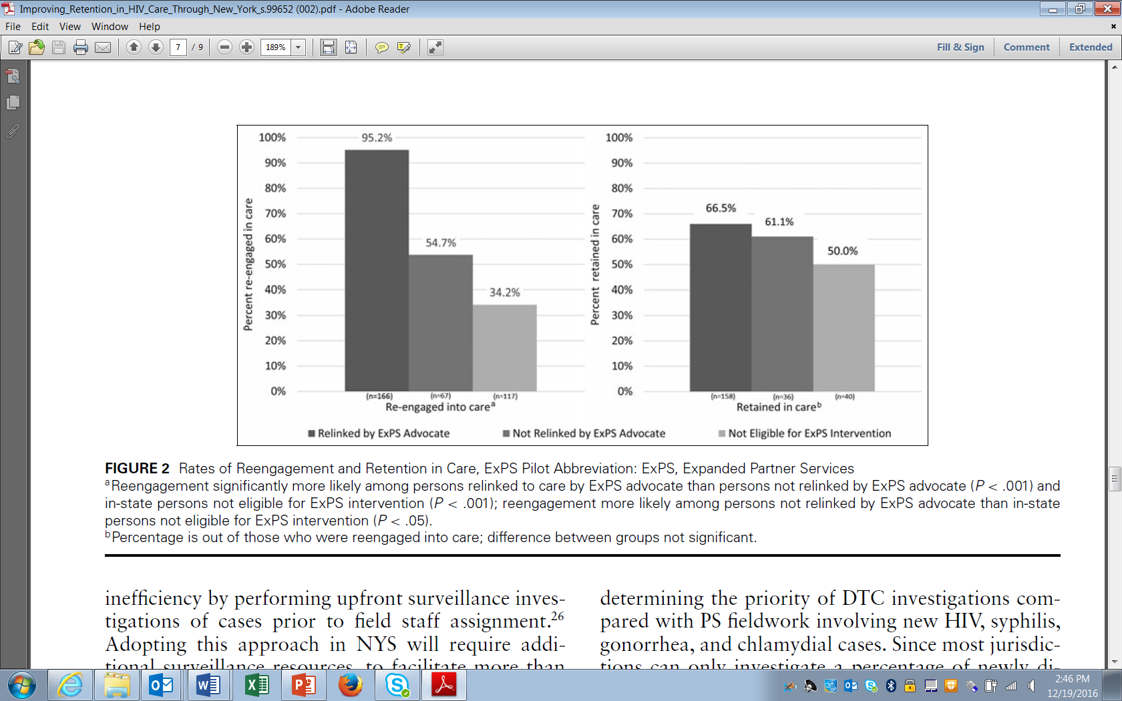
J Public Health Manag Pract 2017 May/Jun; 23(3):255-263
Objective: Investigate feasibility of D2C approach applied to Partner Services program
Results: Individuals relinked by ExPS DIS were more likely to reengage in care
Conclusions: D2C can be effective when conducted outside a large MSA and/or closed health care systems. It can also be effectively incorporated into existing PS programs.
Notes:
Also related to D2C staffing and training considerations, a paper published in the Journal of Public Health Management and Practice by New York colleagues found that individuals relinked to care by specially trained field staff were more likely to re-engage back into care than other types of re-linkage approaches.

Slide 28
D2C challenges & opportunities
Establishing bi-directional data sharing agreements between DPH & providers can be complex and lengthy process
State statutes
Not-in-Care definitions, generating NIC lists, linkage outcomes
Electronic Health Records
Managing other external data sources for case investigations
Staffing (shift in skills)
Manual bi-directional data exchange processes can be resource intensive and delay public health follow-up
Notes:
The manual exchange of data between health departments and health care providers often requires considerable time and can lead to significant delays in public health follow-up.

Slide 29
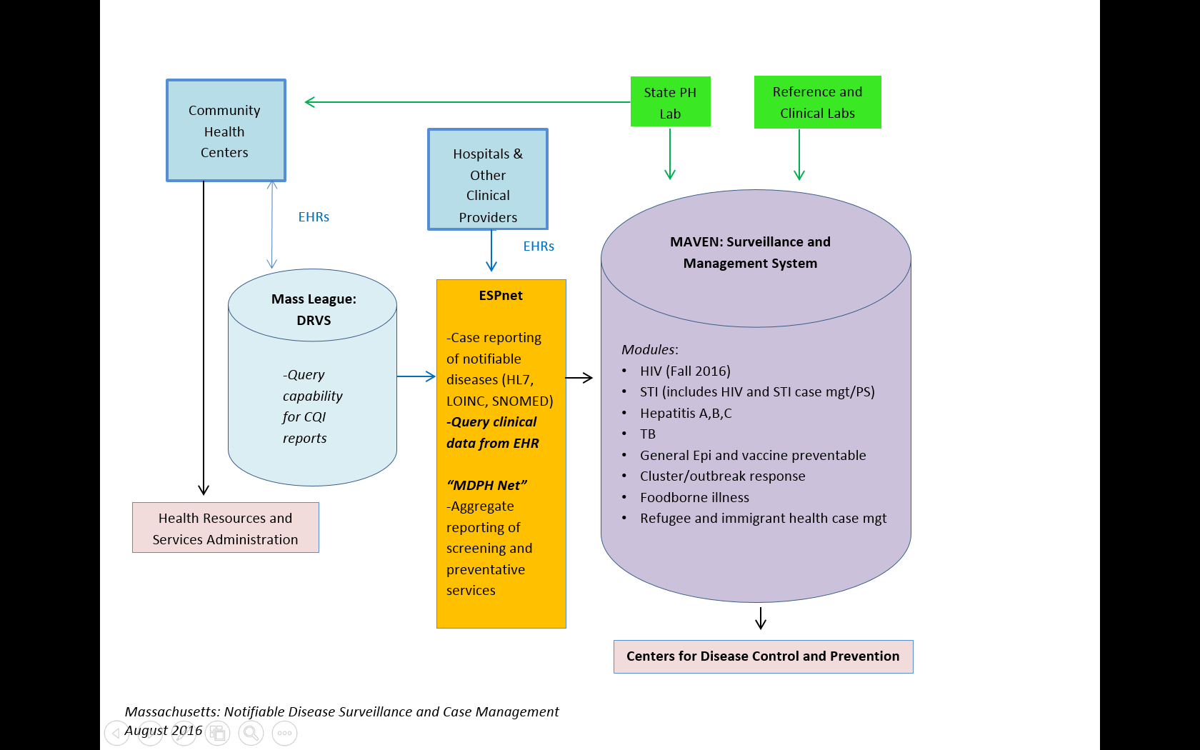
Automated Notifiable Disease Surveillance & Case Management
August 2017
Notes:
Through P4C, several health departments focused efforts on how to better automate these processes. This slide illustrates how Massachusetts has been building out their fully automated notifiable disease management system that aims to automate reporting from FQHCs. This piece of the system is outlined in red and shown in the top left corner of the graphic. Medical record data from participating providers feeds automatically on a nightly basis into the Maven component of the state’s surveillance system and medical visit data is used to augment viral load and CD4 lab data.

Slide 30

“Next Frontier” of D2C
Benefits of Investment
- More complete data
- Faster field follow-up
- Improved QA&QI
Notes:
The automation of data integration may represent an important next step in D2C.
Although the up-front costs can be significant, the benefits of the investments may be paid back in spades through more complete data to improve the process of identifying persons who are truly out-of-care, accelerating the amount of time it takes from NIC identification to actual field follow-up, and improving the ability of health departments to deliver high-quality prevention services.

Slide 32


