Slide 1
HRSA HAB Building Futures: Supporting Youth Living with HIV – Lessons Learned and Successes in Practice December 12, 2018
CDR Holly Berilla
Public Health Analyst
HIV/AIDS Bureau (HAB)
Health Resources and Services Administration (HRSA)

Slide 2
Health Resources and Services Administration (HRSA) Overview
Supports more than 90 programs that provide health care to people who are geographically isolated, economically or medically vulnerable through grants and cooperative agreements to more than 3,000 awardees, including community and faith-based organizations, colleges and universities, hospitals, state, local, and tribal governments, and private entities
Every year, HRSA programs serve tens of millions of people, including people living with HIV/AIDS, pregnant women, mothers and their families, and those otherwise unable to access quality health care

Slide 3
HRSA HIV/AIDS Bureau (HRSA HAB)
Vision
Optimal HIV/AIDS care and treatment for all.
Mission
Provide leadership and resources to assure access to and retention in high quality, integrated care, and treatment services for vulnerable people living with HIV/AIDS and their families.

Slide 4
Ryan White HIV/AIDS Program (RWHAP)
Provides comprehensive system of HIV primary medical care, medications, and essential support services for low-income people living with HIV
More than half of people living with diagnosed HIV in the United States – more than 550,000 people – receive care through the Ryan White HIV/AIDS Program (RWHAP)
Funds grants to states, cities/counties, and local community based organizations
Recipients determine service delivery and funding priorities based on local needs and planning process
Payer of last resort statutory provision: RWHAP funds may not be used for services if another state or federal payer is available
84.9% of clients served by the RWHAP were virally suppressed in 2016, exceeding the national average of 60%
Source: HRSA. Ryan White HIV/AIDS Program Annual Client-Level Data Report 2016; CDC. HIV Surveillance Supplemental Report 2016;21(No. 4)

Slide 5
HRSA HAB Building Futures: Supporting Youth Living with HIV Objectives
After this presentation, participants will be able to:
Identify purpose and scope of project;
Describe three characteristics of youth-serving HRSA HAB RWHAP providers that have high viral suppression and retention in care rates;
Identify three promising practices that youth-serving RWHAP providers may institute to improve health outcomes in youth served; and
Discuss technical assistance (TA) resources available for RWHAP youth-serving programs.

Slide 6
HRSA HAB Building Futures: Supporting Youth Living with HIV

Slide 7
HRSA HAB Building Futures: Supporting Youth Living with HIV Primary Organization, Partners, and HRSA HAB Team
Primary Organization Funded for Project:
DS Federal, Inc.
Consultants from CAI, Mission Analytics, and Positive Outcomes, Inc., & Deborah J. Isenberg
Independent youth consultants: D’Ontace D’Angelo Keyes, Jontraye Davis, Kahlib Barton, DaShawn Usher, & Antoine Crosby
Subject Matter Experts: Jeffrey Birnbaum & Adam Thompson
HRSA HAB Team Members:
Antigone Dempsey; CAPT Tracy Matthews; CDR Holly Berilla, COR; R. Chris Redwood, SME; & Jhetari Carney, SME

Slide 8
HRSA HAB Building Futures: Supporting Youth Living with HIV Today’s Presenters
CDR Holly Berilla, HRSA HAB
Elizabeth Coombs, Mission Analytics
AJ Jones, Mission Analytics
HRSA HAB RWHAP-funded providers:
Heath A. Nicholas, LMSW, Director of Case Management Services, AIDS Action Coalition dba Thrive Alabama
Jennifer McMillen Smith, LISW-S, MetroHealth

Slide 9
HRSA HAB Building Futures: Supporting Youth Living with HIV Understanding the Need
551,567 clients receive services from RWHAP-funded providers in 2016:
Approximately 4% of RWHAP clients living with HIV are youth (aged 13-24 years)
Retention in care (76.6%) was lower than the national RWHAP average (81.7%)
Viral suppression (71.1%) was much lower than the average (84.9%)
Source: Health Resources and Services Administration. Ryan White HIV/AIDS Program Annual Client-Level Data Report 2016. http://hab.hrsa.gov/data/data-reports. Published November 2017.

Slide 10
HRSA HAB Building Futures: Supporting Youth Living with HIV Project Purpose
The overarching goal of the project was to:
Assess the current state of youth living with HIV (YLWH) aged 13-24 receiving RWHAP funded care and
Develop and provide TA for youth-serving RWHAP providers to overcome barriers to care, fill gaps in care, and optimize health outcomes for this special population.

Slide 11
HRSA HAB Building Futures: Supporting Youth Living with HIV Project Timeline
Project period: three years
September 2015 – September 2016 (Base Year)
HRSA HAB RSR data review and initial evaluation report
September 2016 – September 2017 (Option Year 1)
Conducted 20 site visits to HRSA HAB RWHAP-funded provider sites
Preliminary report of findings
September 2017 – September 2018 (Option Year 2)
Developed, tested, and published the TA toolkit and delivered four TA webinars to youth-serving RWHAP-funded providers
Final report of findings

Slide 13
HRSA HAB Building Futures: Supporting Youth Living with HIV Applying Lessons to the Field
Elizabeth Coombs, Project Consultant, Mission Analytics
Jennifer McMillen Smith, LISW-S, MetroHealth
Heath A. Nicholas, LMSW, Director of Case Management Services, AIDS Action Coalition dba Thrive Alabama

Slide 14
Toolkit Themes and Topics
Clinical Service Models
Informing Program Development
Gathering structured feedback from youth
Infrastructure Development
Staff recruitment and retention
Wraparound Services
Youth support groups
Youth-centered services
Interdisciplinary care teams
Identifying and addressing support service needs
Re-engaging youth lost to care
Data-driven programming for youth
Improving communication with youth
LGBTQ-friendly policies, environment, and culture

Slide 15
Something for Everyone
Each topic represents a range of strategies and considerations
Some topics have a clinical focus, while others are more relevant to case managers or program leadership
The Toolkit presents concrete examples of implementation

Slide 16
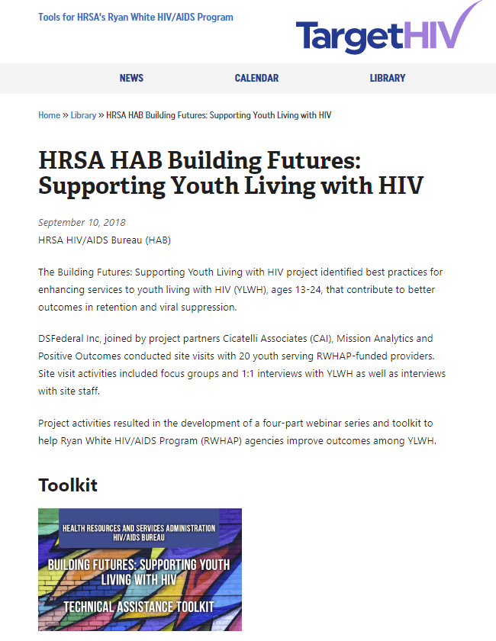
Learn More
TargetHIV: https://targethiv.org/library/hrsa-hab-building-futures-supporting-youth-living-hiv
Toolkit
Webinar slides and recording

Slide 17
Lessons from the Field
MetroHealth
Youth-centered services and youth support groups
Improving communication with youth
Thrive Alabama
Re-engaging youth lost to care
Gathering structured feedback from youth

Slide 18
The MetroHealth System
Located in Cleveland, OH
County “safety-net” hospital
Infectious disease clinic provides HIV care for about 1,600 people living with HIV
About 140 patients are 13-24 years old
Prior to Building Futures, already offered:
Patient-centered Medical Home-style HIV care
Day-time support group for <30
Facebook Secret Group
Positive Peers mobile app

Slide 19
Evening clinic + support group
Toolkit topic of Youth-Centered Services as inspiration to offer enhanced services for youth and young adults living with HIV
Taco Tuesday support group runs from 5:00 – 7:00 p.m., the same time as the youth-exclusive evening clinic hours
Features:
Flexibility for patients to come in and out of the group to see doctor
Co-facilitation
Ability to accommodate small children
Low-key vibe

Slide 20
Other Toolkit take-aways
From Improving Communication with Youth topic: Began work on a strategy for collecting non-traditional contact information, such as Instagram name, as alternative way to outreach patients.
Toolkit served as an “official” reason to approach hospital’s Arts in Medicine office to request artwork reflective of clinic population, using the LGBTQ-Friendly Policies, Environment, and Culture topic.
From Re-engaging Youth Lost to Care topic:
Shortened window for outreach of <25 from 6 months to 4 months
Began weekly calls of <25 no shows

Slide 21
AIDS Action Coalition dba Thrive Alabama
Survey Purpose
Find out why the younger clients want to remain in care and what services would help to keep them in care.
Results from the survey provided some useful information for the second topic.

Slide 22
We have signs in every exam room to ensure that all clients are aware of the majority of the services provided at Thrive.

Slide 23
Step One
Gathered structured feedback by completing a survey with our actively engaged youth at Thrive.
Used the results of the survey and brainstormed additional ideas about youth engagement.

Slide 24
Step Two
Develop a youth-friendly intake packet.
Create a psychosocial assessment that is youth-focused.
Designate a social worker strictly for our youth.

Slide 26
Youth Social Worker
Completes all intakes on youth.
Follows up on any missed appointments.
Checks in monthly.
Meets briefly after each appointment.

Slide 27
Small Group Activity
Select a topic you are most interested in exploring:
LGBTQ-friendly policies, environment, and culture
Improving communication with youth
Youth support groups
Re-engaging youth lost to care
Your choice: group vote on another topic
Work with other attendees also interested in that topic to develop an Action Plan.
Take your Action Plan home to implement within your agency.

Slide 28
LGBTQ-Friendly Policies, Environment, and Culture
Youth who are LGBTQ face psychosocial and structural challenges including:
Mental health issues
Trauma
Homelessness
Substance use
Stigma and discrimination
Challenges make coping and living with HIV diagnosis more complex

Slide 29
How Do You Know If Your Agency is LGBTQ-Friendly?
Organizational Culture
Culturally Competent Care and Treatment Services
Environment
Disclosure and Inclusivity
Training
Data Management Systems
LGBTQ-Focused Activities and Services

Slide 30
Improving Communication with Youth
Phone calls do not work well for youth.
Difficulty navigating Health Insurance Portability and Accountability Act (HIPAA) regulations for using text messaging or social media.
Not sure how social media can help.
Lack of relevant best practices to properly manage a social media account.

Slide 31
Communication Strategies
Text messaging
HIPAA-compliant text messaging using a regular cellphone
Secure text messaging
Using social media platforms
Social media messaging
Pushing content on social media
Social media groups

Slide 32
Youth Support Group Goals
Help YLWH achieve viral suppression and stay in care
Build social networks
Increase the knowledge and skills of participants
Decrease social isolation

Slide 33
Steps to Establish a Youth Support Group
Refine logistics
Select a location
Identify a time
Determine number of meetings or end date
Decide what, if any, additional services will be provided
Establish a recruitment and sustainability plan
Identify the right facilitator

Slide 34
Reengaging Youth Lost to Care
YLWH often lead more transient lifestyles than older clients
Challenging to determine when YLWH are out of care versus at another provider, moved, incarcerated, etc.
What works for identifying and re-engaging adult clients might not work for youth

Slide 35
Steps to Reengagement
Identifying out-of-care clients
Cross-check YLWH identified in measures with other sources.
Consider establishing a relationship with Data to Care or other local programs (e.g., local health departments).
Intensive outreach and linkage
Who is responsible (e.g., peers)?
Meet youth where they are / understand what happened.
Retention in care
Strategy for first appointment.
Enhanced support services.
Celebrate victors, no matter how small!

Slide 36
Another Topic of Interest?
Youth-centered services
Interdisciplinary care teams
Staff recruitment and retention
Gathering structured feedback from youth
Data-driven programming for youth
Identifying and addressing support service needs

Slide 37
Small Group Activity – Break-out
Find your group
Develop the Action Plan
Take it home for implementation!

Slide 38
Questions and Answers

Slide 39
Contact Information
CDR Holly Berilla
Public Health Analyst
HIV/AIDS Bureau (HAB)
Health Resources and Services Administration (HRSA)
Email: HBerilla@hrsa.gov
Phone: 301-443-6695
Web: hab.hrsa.gov

Slide 40
Connect with HRSA
To learn more about our agency, visit
www.HRSA.gov
Sign up for the HRSA eNews
FOLLOW US:

