Slide 1
Enhancing Engagement and Retention in Quality HIV Care for Transgender Women of Color
Jessica Xavier, MPH

Slide 2
Disclosures
Presenter(s) have no financial interest to disclose.
This continuing education activity is managed and accredited by AffinityCE/Professional Education Services Group in cooperation with HRSA and LRG. PESG, HRSA, LRG and all accrediting organization do not support or endorse any product or service mentioned in this activity.
PESG, HRSA, and LRG staff as well as planners and reviewers have no relevant financial or nonfinancial interest to disclose.
Commercial Support was not received for this activity.

Slide 3
Learning Objectives
At the conclusion of this activity, the participant will be able to:
Learners will be able to list innovative approaches that community based organizations (CBOs) and healthcare organizations can use to link and/or retain transgender women of color into HIV care and complementary clinical services.
Learners will be able to describe key engagement in care outcomes from the local and multi-site evaluations.
Learners will acquire an understanding of challenges and successes in implementing innovative programming to improve engagement in care among transgender women of color living with HIV.

Slide 4
Background
In the US, transgender (‘trans’) women are disproportionately impacted by HIV
Newly identified HIV-positive tests are as high or higher than MSM (CDC)
Less likely to be on ART than other populations
Greatest impact is among Trans Women of Color due to racial/ethnic HIV disparities within trans communities

Slide 5
Background
Trans women of color also experience barriers to HIV care including:
Limited access to and avoidance of healthcare due to transphobic stigma and past negative experiences with providers
Prioritizing gender transition-related health care over HIV care
Concerns regarding adverse interactions between ART and hormone therapy

Slide 6
The Initiative
In 2012, the Health Resources and Services Administration (HRSA) under the Ryan White HIV/AIDS Program, Part F, Special Programs of National Significance (SPNS) Program funded a five year demonstration project initiative -
Enhancing Engagement and Retention in Quality HIV Care for Transgender Women of Color

Slide 7
The Initiative
Demonstration Site Recipients included a combination of HIV clinics and community service providers:
Chicago (2)
Los Angeles (2)
New York (2)
San Francisco Bay area (3)
One Evaluation and Technical Assistance Center at University of California, San Francisco Center for AIDS Prevention Studies, teaming with the Center of Excellence for Transgender Health

Slide 8
The Interventions
Demonstration Projects—
Clinical Sites:
Community Healthcare Network (NYC, NY)
Howard Brown Health (Chicago, IL)
San Francisco Department of Health (San Francisco, CA)
SUNY Downstate (NYC, NY)
Tri-City Health Center (SF Bay Area, CA)
Community Sites:
Bienestar Human Services (Los Angeles, CA)
Chicago House (Chicago, IL)
Friends Research Institute (Los Angeles, CA)
Public Health Institute (Oakland CA)

Slide 9
Theory-based Interventions
Social Cognitive Theory
Social Learning Theory
Trans-theoretical Model of Behavior Change
Theories of Gender and Power
Critical Race Theory
Syndemic Theories
Other guiding philosophies:
Behavioral Economics
Motivational Enhancement
Patient-Centered Medical Homes
Strength-Based Service Provision

Slide 10
Intervention Background
SPNS-funded interventions are not designed to be “stand alone” projects
Instead, they “float” on top of an organizations existing programs and structure
Combination of direct service, internal referrals, and external referrals
Activities designed to address one or more stages of the HIV care continuum

Slide 11
Intervention Activities
Most common (direct service or by referral):
Community outreach
Navigation services
Trans-affirming health care (non-HIV)
Trans-competent HIV medical care
HIV testing
Case management/Social work
Small groups
Other individual sessions
Trans competency trainings
Drop-in centers

Slide 12
Intervention Activities
Less frequent (direct service or by referral):
Social network engagement
Community advisory boards
Motivational interviewing
On-site medical education
Contingency management
Social network recruitment

Slide 13
Key Elements in Interventions
Culturally competent services:
Linkages and referrals
Advocacy
Provision of HIV care and hormones
Social and emotional support
Health education
Access and referrals to address unmet immediate needs
Supportive messages that contribute to health literacy and personal and community development

Slide 14
Key Elements in Intervention
Increased social support:
Caring relationships and interactions between staff and transgender women of color
Among intervention participants
Between transgender women in the interventions (taking on roles of advocates and educators) and positive peers in their communities not receiving HIV care.

Slide 15
Engaging Transgender Women of Color Living with HIV into Healthcare
Cathy J. Reback, Ph.D.,^{1,2}
Kimberly A. Kisler, M.P.H., Ph.D.,¹
Jesse B. Fletcher, Ph.D.¹
¹Friends Research Institute, Inc.
²UCLA Center for HIV Identification, Prevention, and Treatment Services
Presented at the National Ryan White Conference, Washington DC, December 2018.

Slide 16
The Alexis Project was named after Alexis Rivera who died at the age of 34 from complications related to HIV. Alexis was a Latina trans woman, a community activist, a peer advocate, and a gatekeeper. Yet, even as a knowledgeable role model to so many, Alexis’ own health suffered as a result of ART non-adherence and the use of gender-enhancing substances that compromised her immune system.
Alexis Rivera
October 28, 1977 – March 28, 2012

Slide 17
Background
Trans women, particularly trans women of color, experience multiple psychosocial and structural disparities including:
Increased rates of homelessness, substance use disorders, sex work, victimization and violence, mental health disorders, reduced access to health care, incarceration, unsafe or medically unmonitored gender-confirming procedures, and increased stigma, discrimination and transphobia.
The synergistic and intersectionality nature of these health disparities place trans women at increased risk for HIV, and, for trans women living with HIV, greatly impact advancement along the HIV Care Continuum.

Slide 18
Community Participatory Study Design
During the development of the grant application, two focus groups (N=19) were held with trans women community members. Focus group participants were asked to identify which components of a hypothetical intervention were necessary to make it responsive to the needs of trans women of color living with HIV.
Responses included:
“give us transportation,” “make sure we make it to our appointments,” “give us incentives ‘cause we need stuff,” “stimulate people to take care of themselves,” “support us,” “I want money and a ride.”
Content analysis of focus groups:
Peer Health Navigation to respond to transportation, make appointments, increase self-efficacy to take care of self, provide support
Contingency Management to respond to “give us incentives “cause we need stuff”

Slide 19
Peer Health Navigation
The PHN sessions include (1) identify the barriers to HIV care, (2) identify and link participants into other auxiliary needed services, and (3) increase participants’ self-efficacy in working with HIV care providers. Peer Health Navigators do not provide counseling or psychotherapy; rather, they work with participants to successfully navigate complicated health care and social service systems.
Contingency Management
Behavioral economics is the application of contingencies to motivate individuals toward health-promoting behavior change. The escalating reinforcement schedule (a primary tenet of CM) serves to motivate behavior change. The CM intervention provides vouchers redeemable for goods or services (or purchasing the goods or services online for the participant) that promote a healthy/health-promoting lifestyle.

Slide 20
Study Design, N = 139
Social Network Recruitment
(Respondent Driven Sampling)
HIV status
Unknown
Known HIV+
HIV Testing & Counseling
Retest in
3 months
HIV-
HIV+
Health Outcomes
Existing HIV Prevention Service
Peer Health Navigation
+
Contingency Management
N=139
↑ Linkage & Retention in HIV Care
+
↑ HIV Milestones (viral suppression)
Follow-up @ 6-, 12-, 18-, 24-, 30-, 36-months
post- enrollment

Slide 21
Methods
Enrollment from February 2014 through August 2016
Recruitment:
Community-wide social network recruitment and engagement methodology (i.e., Respondent Driven Sampling)
Venue- and street-based outreach
Dissemination of project flyers
In-reach at other programs conducted at the project site
In-services conducted at local agencies
Collaborating HIV medical care clinics
Assessment time points and incentives:
Eligibility screening = $10
Baseline = $25
6- and 12-month follow-up = $50
18-, 24-, 30-, and 36-month follow-up = $100
Computer Assisted Self Interview (CASI) assessments administered via REDCap

Slide 22
Eligibility
Identified as a trans woman
Assigned the male sex on her original birth certificate
Between the ages of 18 and 65 years
Reported her racial/ethnic identity as other than Caucasian/White
HIV positive and currently not in HIV care or had not seen a HIV medical provider in the previous six months or not prescribed ART medication or prescribed ART medication but not always adherent.

Slide 23
Combined Peer Health Navigation +
Contingency Management Intervention
Peer Health Navigation
$100
Undet. VL or <200
$50
Undet. VL or <200
$50
Undet. VL or <200
$50
Voucher Points
$80
VL
2 log ↓
$40
$60
VL & CD4
$20
VL
1 log ↓
$30
HIV Care Visit
$50
HIV Care Visit
$50
HIV Care Visit
$50
$40
Pick Up Meds
$20
HIV Care Visit
$40
HIV Care Visit
$30
$20
HIV Care Visit
$20
Timeframe
0-2 mos
3-5 mos
6-7 mos
8-9 mos
11-13 mos
17-19 mos
Visit
1
2
3
4
5
6
Evaluations
Baseline
6-month
follow-up
12-month
follow-up
18-month
follow-up

Slide 24
Study Progress and Retention
Inquiries
382
Eligible = 146
Ineligible = 19
Reason for Exclusion
(not mutually exclusive)
Not transgender = 1
Not transgender woman of color = 1
HIV negative = 7
Actively in care/Medically adherent = 6
Enrolled at other site = 4
Screened
165
Consented
140
Percentage inquiries/enrollment: 36.4%
Enrolled
139
Withdrawn
No longer transgender = 2
6-Month Follow-up
n = 102/135; 75.6%
12-Month Follow-up
n = 107/133; 80.5%
18-Month Follow-up
n = 102/113; 90.3%
24-Month Follow-up
n = 80/91; 87.9%
30-Month Follow-up
n = 53/62; 85.5%
36-Month Follow-up
n = 34/40; 85.0%

Slide 25
Baseline Demographics (N = 139)
Variable |  | n (%)
Race/Ethnicity
 | Hispanic/Latina | 53 (38.1%)
 | African American/Black | 54 (38.9%)
 | American Indian/Alaska Native | 10 (7.2%)
 | Asian/Pacific Islander | 3 (2.2%)
 | Multi/Other | 19 (13.7%)
Age
 | Range | 19 – 59 years
 | Mean | 36.2 yrs (9.7)

Slide 26
Sociodemographics
Variable |  | n (%)
Sexual Identity
 | Heterosexual | 65 (46.8%)
 | Gay/bisexual | 40 (28.8%)
 | Lesbian | 4 (2.9%)
 | Other/refused | 30 (21.6%)
Educational Attainment
 | ≤ High School/GED | 53 (38.1%)
 | High School Diploma/GED | 45 (32.4%)
 | Some College | 36 (25.9%)
 | Bachelor’s Degree or Higher | 3 (2.1%)
Housing Status
 | Homeless/Transitional Housing | 59 (42.5%)
 | Housed | 55 (39.5%)
 | Other/DK/Refused | 25 (18.0%)

Slide 27
Stage of HIV Care Continuum
11 were unaware of their HIV positive status; 7.9% new positivity rate
Most need ART / medication non-adherent
32 (23.0%) had never been in care
Engagement in Care Continuum at Enrollment (not mutually exclusive)
Unaware of HIV Status | Know HIV Status | Never in HIV Care | Dropped out of HIV Care | Need ART | On ART but non-adherent
11 | 128 | 33 | 36 | 57 | 71
118/139 (84.9%) linked to care
Range of time from baseline assessment to linkage to care:
Range 0 – 467 days
Median = 20 days
Mean = 67 (SD = 103) days

Slide 28
Peer Health Navigation Outcomes
Range of Peer Health Navigation sessions: 1-31 sessions; Mean 6.6 (SD = 6.5); 919 total PHN sessions
88.4% of the participants attended 2 or more PHN sessions
Only 16 (11.6%) participants did not have a PHN session past their baseline session

Slide 29
Contingency Management Outcomes
Contingency Management Behavioral Targets
Target | 1st HIV Care Visit | Received ART Medication | Returned for VL/CD4 | 2nd HIV Care Visit | 3rd HIV Care Visit | 4th HIV Care Visit | 5th HIV Care Visit | 6th HIV Care Visitª
Achieved | 118 (84.9%) | 98 (70.5%) | 96 (69.1%) | 79 (56.8%) | 59 (42.5%) | 40 (28.8%) | 29 (20.9%) | 16 (11.5%) | 525 Achieved
Reward | $20 pts | $20 pts | $20 pts | $30 pts | $40 pts | $50 pts | $50 pts | $50 pts | $280 Pts Possible
Total | $2,360 pts | $1,960 pts | $1,920 pts | $2,370 pts | $2,360 pts | $2,000 pts | $1,450 pts | $800 pts | $15,220 Pts Earned
Contingency Management Biomedical Targets
Target | Reduce VL ≤ 1 Log | Reduce VL ≤ 2 Logs | Undetectable VL (1) | Undetectable VL (2) | Undetectable VL (3)
Achieved | 52 (37.4%) | 37 (26.6%) | 19 (13.7%) | 12 (8.6%) | 3 (2.2%) | 123 Achieved
Reward | $30 pts | $40 pts | $50 pts | $50 pts | $50 pts | $220 Pts Possible
Total | $1,560 pts | $1,480 pts | $950 pts | $600 pts | $150 pts | $4,740 Pts Earned
Contingency Management Totals:
648 Targets Achieved Mean = 4.7 targets (SD = 3.7) Total = $19,960 Pts Earned
ª12 participants were not eligible to reach their 6th HIV care visit, due to the late date of their enrollment

Slide 30
Viral Load Outcome
83% who enrolled detectable and achieved the minimum 1 log viral load reduction advanced to full viral suppression
60/135 (44.4%) have achieved/maintained viral load suppression

Slide 31
Conclusions
7.9% new positivity rate
85% were linked to HIV care
Almost all (88.4%) attended at least 2 PHN sessions
Almost all (88.9%) earned a CM reward
Increased attendance to PHN sessions was associated with significant achievement of both behavioral (coef. range 0.12-0.38) and biomedical (coef. = 0.10) HIV milestones (all p ≤ 0.01)

Slide 32
Future Directions: Next Steps
A randomized controlled trial is needed to unpack the mechanism of behavioral change of Peer Health Navigation versus Contingency Management

Slide 33
Thank you! reback@friendsresearch.org
This project was supported by the Health Resources and Services Administration (HRSA) of the U.S. Department of Health and Human Services (HHS) under grant number H97HA24968 in the last annual award amount of $285,757 awarded to Friends Research Institute. No percentage of this project was financed with non-governmental sources. This information or content and conclusions are those of the authors and should not be construed as the official position or policy of, nor should any endorsements be inferred by HRSA, HHS or the U.S. Government.

Slide 34
Engaging transgender women of color living with HIV into healthcare: findings from a SPNS initiative
Dr. Luis F. Molano, Vice President of ID and LGBTQ Programs
Jessica Contreras, BA, H.I.P.P Program Manager
Community Healthcare Network, New York, NY
National Ryan White Conference, Washington DC,
December 2018

Slide 35
Background – T.W.E.E.T Care Project
The program operated out of our Jamaica Health Center, located in Jamaica, Queens.
The T.W.E.E.T Care Project provided the following services to individuals 18 years of age and older:
Identify newly diagnosed transgender women of color and link them to care.
Identify HIV-positive transgender women of color who are currently out of care and link them to care.
Enroll identified clients into the TL-Teach Back Intervention
Identify and utilize Peer Leaders,

Slide 36
Background – Theoretical Models
T.W.E.E.T. is rooted in the following theoretical frameworks:
Social Cognitive Theory: Involves observation, imitation, reward, interaction, and sharing in learning and adopting new behaviors modeled by peers.
Trans-Theoretical Model: Five stages of change regarding adopting healthy behaviors— not ready to change (pre-contemplation), getting ready to change (contemplation), ready to change (preparation), changing (action), and prevention (maintenance).
The intervention component of TL – Teach Back comprised peer-led educational group sessions on sexual health or HIV prevention topics related to engagement in care twice a week. Specifically, each week group sessions covered an educational topic followed by group discussion in one of the following areas: 1) HIV/AIDS and sexually transmitted infections (STIs), 2) Sexual Health, 3) Gender Transitioning, 4) Wellness, and 5) Mental Health. Group sessions lasted up to 120 minutes.

Slide 37
Implementation Activities
Job descriptions were developed based on the program requirements, positions included; Program Manager, Patient Services and Retention Specialist (1-2 people), Peer Educator, Court Navigator (if applicable). Each staff person contributed to the uniqueness of the program and patients.
Trans leaders are women enrolled in the program and community advocates.
Focus groups occurred to identify the needs of the targeted population. We wanted to design a program for Trans women based on their recommendations, what services were most important, and structure a welcoming safe environment.
We identified and collaborated strong community partners. Local night clubs, CBO’s, pharmacies, courts, police departments and legal organizations who provided pro bono work.

Slide 38
Transgender Leader Teach Back Intervention
Transgender leaders has the following responsibilities:
Choose a topic from the teach back intervention curriculum and facilitate at least one (and up to three) group sessions;
Meet with a staff member for three individual coaching sessions while preparing the group session;
Participate in outreach activities following recruitment guidelines.
Refer potential client to the project;
Encouraged referred clients to make and keep medical appointments.

Slide 39
Intervention Activities
Recruitment and Retention
Staff conducted weekly nontraditional outreach events such as visiting night clubs near known high-sex trafficking areas. Staff walked the streets handing out safer sex packages that include program materials, condoms, and lubricant.
Staff planned special events such as celebration of Trans PRIDE, Trans Day of Remembrance, Miss Trans Latina, and holidays). Those individuals who attended weekly workshops on a consistent basis were chosen to assist in planning and running the event alongside CHN staff.
Participants received a incentive of $25 for facilitating a group and a $25 gift card at graduation. Graduation celebrations were hosted a local establishments. Community involvement was key.

Slide 40
Intervention Activities cont.
Develop online outreach modalities: Staff members diffused health education and promotion on internet-based social networks (such as Facebook, Twitter, and Instagram). Facebook is a great tool to use to maintain contact with participants.
Followed up with home visits for patients who were difficult to engage due to substance use challenges
Supportive services through CHN included assistance with name change or gender marker; referrals for gender confirmation surgeries (linked with knowledgeable and skilled providers); referral to trans-sensitive shelters or housing specialists; referral or peer support for legal problems, which included accompanying clients to court or to see a lawyer.

Slide 41
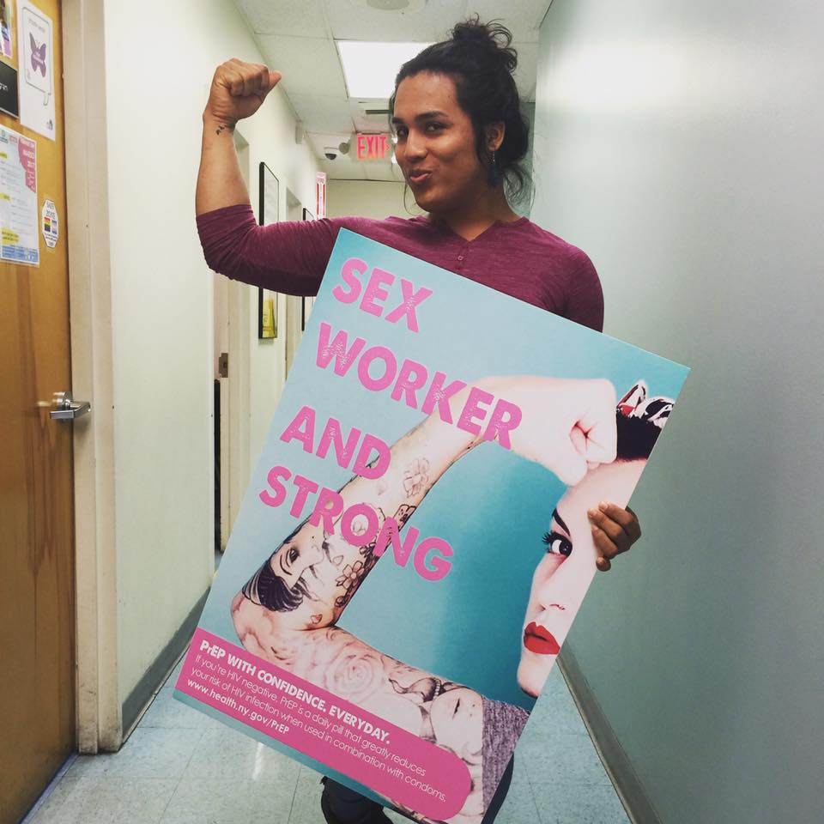
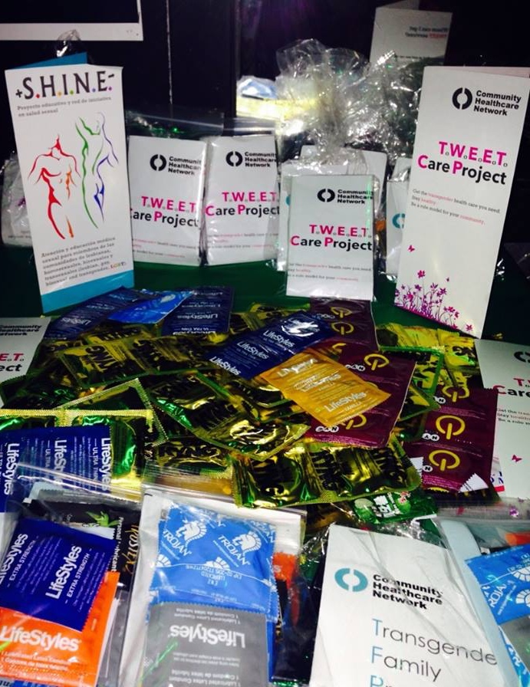
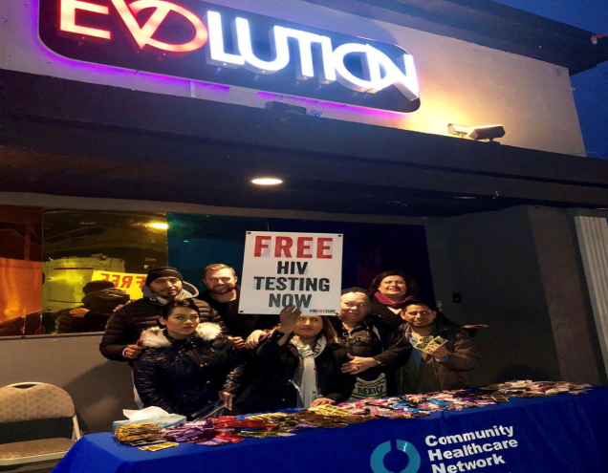
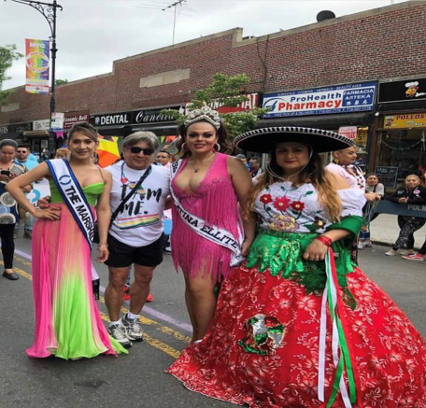
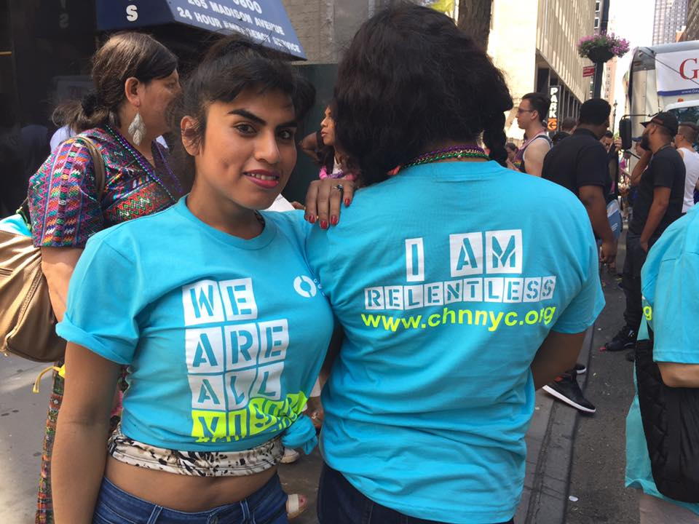
Empower your community
Promotional material available during recruitment activities in night clubs.

Slide 42
Clinical Outcomes
From December 2013 to August 2016, 163 TW were enrolled in the TL – Teach Back intervention.
Over the course of the 5-year intervention and seven 6-month interview waves, only 28 (17%) of the participants were lost to follow-up, yielding an 83% retention rate in HIV clinical care at the final visit.
Approximately 39% of participants became Peer Leaders through the TL – Teach Back intervention. Ages 18 to 61.
93% self-identified as Hispanic or Latina
Approximately 25% of participants had a new (past year) HIV diagnosis.
After completing the intervention, 83% of participants went from no care to being retained in care; of these participants, 79% were virally suppressed.

Slide 43
Best practices
Findings from this intervention demonstrate that becoming a Peer Leader in this trans-specific and trans-inclusive intervention was associated with improved health outcomes including suppressed viral load and an increase in CD4 count.
A recommendation for the replication of this program is that community dialogue is essential to the success of the program.
The Peer Leader model exemplified leadership from the community, created a safe space for TW, and increased access to needed care and services, which led to improved health outcomes.
Part of our commitment to the execution of the project was community empowerment, so participants were able to become their own advocates and were able to disseminate and replicate the information to the rest of their peers in the community.
Identify medical providers with extensive knowledge of trans care, comfort level to assess sexual behavior in professional manner, differentiating between medical necessity & personal curiosity.

Slide 44
Next steps
Since program ended we were able to retain 70% of patients enrolled in the program.
Weekly group sessions continue.
Funding is provided by the Human Trafficking Intervention Court city grant.
Community Healthcare Network received an High Impact Prevention AIDS Institute grant, all staff members were able to transfer and remain employed.
During the five years, staff focused and ensured patients have:
Medical Insurance
Stable Housing
Resources
T.W.E.E.T Care Project Intervention was selected as a national implementation by Fenway Community Health Center, Inc. in collaboration with AIDS United, is the Evidence-Informed Interventions Coordinating Center for Technical Assistance (E2i CCTA) under a four-year HRSA/HAB cooperative agreement (August 2017 - July 2021). Three sites have been awarded funding .

Slide 45
This project was supported by the Health Resources and Services Administration (HRSA) of the U.S. Department of Health and Human Services (HHS) under grant number H97HA24967 SPNS Linkages and Access to Care Initiative, awarded at $300,000 per year over 5 years, with no non-governmental funds used to finance the project systems. This information or content and conclusions are those of the author and should not be construed as the official position or policy of, nor should any endorsements be inferred by HRSA, HHS or the U.S. Government.
Thank you!
Dr. Luis F. Molano, Vice President of ID and LGBTQ Programs, fmolano@chnnyc.org
Jessica Contreras, BA, H.I.P.P Program Manager, jecontreras@chnnyc.org

Slide 46
Engaging transgender women of color living with HIV into healthcare
Brendan O’Connell, MSW
BIENESTAR Human Services

Slide 47
BIENESTAR
A grassroots, non-profit community service organization established in 1989
Created due to a lack of and non-existent HIV/AIDS services for the Latino community
6 service site in Los Angeles
Current services provided:
HIV/STI screening ● mental health treatment ● out-patient substance abuse treatment ● linkage to care ● support groups ● HOPWA case management ● food bank ● syringe exchange ● HIV prevention programming and research

Slide 48
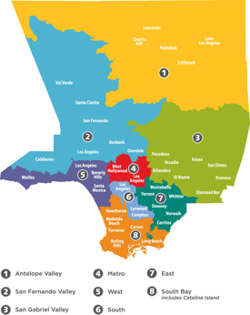
HIV in Los Angeles
Los Angeles County:
over 4,000 square miles
88 cities & 26 health districts
population: 10.2 million
7,000 transgender women
As of 2016 Los Angeles County estimates:
60,946 PLWH
8,654 unaware of infection
43% of PLWH are Latino
54% Viral Suppression for Transgender persons
60.1% Viral Suppression for Latino’s in LAC

Slide 49
TransActívate Overview
TransActívate: A comprehensive and innovative program to improve the timely entry, engagement and retention in quality HIV care for Latina transgender women in Los Angeles County
Based on two theoretical foundations:
Transtheoretical model
Strength-based perspective
Key components:
Social Network Testing (SNT)
Social Network Engagement (SNE):
Mobile Testing
Motivational interviewing
Peer Navigation
Linkage to Care

Slide 50
TransActívate Overview
TransActívate Eligibility
Latina Transgender
Newly diagnosed with HIV​
18+ years of age
Lives In Los Angeles County
Aware of their HIV diagnosis but have refused care
or dropped out of care
In care but could benefit from more support
Goals and Objectives
Enrollment - 150 enrollees
Timely Linkage to Care - 85% linkage rate
HIV screening - 1160 Transgender tests

Slide 51
TransActívate Overview
Medical Provider
BIENESTAR partnered with 7 Federally Qualified Health Centers (FQHC)
Staffing
Linkage Coordinator/Peer Navigator
HIV testing counselor
Program Manager
Community Trust
Physical locations to provide the initiative across LA
Wraparound services
Evaluation

Slide 52
Implementation
Program enrollment timeline: January 1, 2014- August 30, 2016
Program Enrollment : 150 enrollees​
​Timely Linkage to Medical Care ​: 96% linkage rate
HIV tests : 1,075 test with a (1.6 positivity rate)

Slide 53
Findings- Demographics
Variables | Total (%); Mean [SD]
Age | 44 [8.36]
Foreign born | 140 (93.3%)
Education (High school or less) | 132 (88.0%)
Income level (in the past 12 months)
Less than $2,999 ($249/month) | 77 (51.3%)
$3,000 - $11,490 ($250 - $957/month) | 33 (22.0%)
$11,491 ($958 /month) and above | 11 (7.3%)
Don’t know or decline t answer | 29 (19.3%)
Undocumented | 36 (24.0%)
Sex work (in the past 6 months) | 45 (30.0%)

Slide 54
Findings- Enrollment

Slide 55
Outcomes: Viral suppression
 | Baseline (n=62) | 6 months (n=82) | 12 months (n=62)
VL: Mean [SD] | 26,308 [169,443] | 15,780 [78,260] | 1,132 [7,362]

Slide 56
Viral Load Outcomes: Paired Comparisons
VL Baseline to 6 months (N=53)
 | Baseline | 6 month | Difference | McNemar Test p-value
VL <50 | 40 (75.5%) | 39 (73.6%) | 1 (1.9%) | N.S.
VL <200 | 45 (84.9%) | 43 (81.1%) | 2 (3.8%) | N.S.
VL Baseline to 12 months (N=41)
 | Baseline | 12 month | Difference | McNemar Test p-value
VL <50 | 30 (73.2%) | 32 (78.0%) | 2 (4.9%) | N.S.
VL <200 | 35 (85.4%) | 38 (92.7%) | 3 (7.3%) | N.S.

Slide 57
Outcomes: CD4 counts
 | Baseline (n=62) | 6 months (n=84) | 12 months (n=62)
CD4: Mean [SD] | 632.23 [336.94 ] | 572.33 [332.71 ] | 550.24 [329.48 ]

Slide 58
CD4 Outcomes: Paired Comparisons
CD4 Baseline to 6 months (N=54)
 | Baseline | 6 month | Difference | McNemar Test p-value
CD4 <50 | 1 (1.9%) | 1 (1.9%) | 0 (0.0%) | N.S.
CD4 <200 | 5 (9.3%) | 6 (11.1%) | 1 (1.9%) | N.S.
CD4 Baseline to 12 months (N=41)
 | Baseline | 12 month | Difference | McNemar Test p-value
CD4 <50 | 1 (2.4%) | 1 (2.4%) | 0 (0.0%) | N.S.
CD4 <200 | 6 (14.6%) | 5 (12.2%) | 1 (2.4%) | N.S.

Slide 59
Barriers to engagement
Self-reported barriers at intake:
27% some type of housing instability
31% drug use (not including marijuana)
30% sex trade
94% born outside the USA
9% incarceration
50% violence from primary partners
Provider related barriers:
Lack of medical providers at the start of the program
Clinical partners unable to share data of those fallen out of care
Three clients passed away

Slide 60
Adaptation to barriers
Expanding support services:
Creating MOU’s with new clinical partners
Developing agreements with other agencies
such as legal services
Expanding support programming for recruitment
HIV-positive support groups
Starting Trans Health Conference
National Transgender Testing Day
Modifying Social Network Strategies

Slide 61
Lessons Learned
Staff at the agency and medical providers must all be Trans competent
Community trust is vital for recruitment
Don’t be afraid to modify something if it isn’t working
Participants will have many needs
Find internal and external supports
Staff retention

Slide 62
Thank you!
This project was supported by the Health Resources and Services Administration (HRSA) of the U.S. Department of Health and Human Services (HHS) under grant number H97HA24964 SPNS Transgender Women of Color Initiative, awarded at $1,485,860 per year over 5 years, with no non-governmental funds used to finance the project systems. This information or content and conclusions are those of the author and should not be construed as the official position or policy of, nor should any endorsements be inferred by HRSA, HHS or the U.S. Government.​

Slide 63
Outcomes of the Trans Women of Color Initiative: Linkage, Treatment, Retention and Viral Suppression
Greg Rebchook, PhD; Starley Shade, PhD; Deepalika Chakravarty, MS; JoAnne Keatley, MSW
University of California, San Francisco (UCSF)

Slide 64
Evaluation Approach
Objective: To conduct a cross-site evaluation to assess the relationship between intervention participation and improvement in engagement and retention in care for trans women of color living w/HIV
Qualitative interviews with intervention staff & participants
Surveys with trans women of color living with HIV
Review of medical chart data
Cost analysis

Slide 65
Evaluation Plan Overview
TETAC
Client Survey via REDCap
Clinical Data from EMR
Process Measures
URN
Var PS1
Var PS2
Var PS3
……
URN
Var CD1
Var CD2
Var CD3
……
URN
Var IE1
Var IE2
Var IE3
……
Local Evaluation
Sites will plan and implement
Qualitative Interviews
Cost Data
Site ID
Var C1
Var C2
Var C3
……

Slide 66
Methods
Eligibility Criteria
Transgender woman of color living with HIV
Assigned male sex at birth
Identifies as female or transgender
At least 16 years old
Fluent in English or Spanish
Recruitment strategies were designed by the demonstration sites and include
Community outreach
Networking, word of mouth
Publicity materials
Referrals from clinics and other service providers

Slide 67
Methods – Data Collection
Computerized, self-administered surveys administered using REDCap in the language of participant’s choosing (English or Spanish)
Surveys at baseline and every 6 months thereafter
Data are therefore participant self-reports

Slide 68
Methods – Data Analysis
On baseline data from the 861participants
Sample descriptive statistics (frequencies, measures of central tendency)
Multivariate logistic regressions (odds ratios and their 95% CI are reported)
All reported results are statistically significant (p<0.05)

Slide 69
Sample Characteristics
 | n | %
Ethnicity: Latina | 418 | 49%
Race: Black | 365 | 42%
Race: American Indian (non-Hispanic) | 9 | 1%
Race: API (non-Hispanic) | 14 | 2%
Additional race (non-Hispanic) | 11 | 1%
Multi-racial (non-Hispanic) | 29 | 3%
No response | 15 | 2%
< Grade 12/ GED | 638 | 74%
Employed in past 6m (PT or FT) | 204 | 24%
Annual Income <= $11,490 | 649 | 75%
 | Median | SD
Age (years) | 36 | 10.9

Slide 70
Sample Characteristics
Gender Identity (check all) | n | %
Transgender | 351 | 41%
Transfemale/Transwoman/Transgender Woman | 338 | 39%
Transsexual Woman | 116 | 13%
Female/ Woman | 87 | 10%
Additional | 6 | <1%

Slide 71
Sample Characteristics
Engagement in Care | n | %
Primary Care, ever | 662 | 77%
ART prescription, ever | 332 | 39%
Primary Care, 6 & 12 months | 193 | 22%
VL, tested in last 12 month & undetectable at last test | 314 | 36%

Slide 72
A preliminary analysis of engagement in care at baseline

Slide 73
Predictors of “Ever been in primary care”
 | aOR | 95% CI | p
Age | 1.03 | 1.02– 1.05 | <.001
Latina ethnicity | 1.54 | 1.08 – 2.20 | <.05
Sex work (a main source of income) | 0.68 | 0.47 – 0.99 | <.05
Disclosed HIV status | 2.11 | 1.39 – 3.21 | <.001
Healthcare Empowerment | 1.3 | 1.16 – 1.57 | <.001
Currently on hormones | 1.57 | 1.07 – 2.32 | <.05
Incarcerated (6 months) | 0.55 | 0.33 – 0.90 | <.05
Non-significant bivariate predictors: substance use impacting care, CSA, depression, disclosing gender identity, social support, transience, lack of transportation, healthcare discrimination

Slide 74
Predictors of “Ever Prescribed ART”
 | aOR | 95% CI | p
Age | 1.03 | 1.01 – 1.04 | <.001
Disclosed HIV status | 1.65 | 1.15 – 2.37 | <.01
Healthcare empowerment | 1.18 | 1.03 – 1.35 | <.05
Exchanged sex, 6 months | 1.45 | 1.08 – 1.94 | <.05
Non-significant bivariate predictors: Latina ethnicity, substance use impacting care, CSA, sex work, depression, disclosing HIV status, social support, homelessness, transportation, healthcare discrimination

Slide 75
Predictors of Retention in Care (PC visits in last 6 and 12 months)
 | aOR | 95% CI | p
Age | 1.02 | 1.003 – 1.04 | <.05
Latina | 2.01 | 1.41 – 2.85 | <.001
Sex work (a main source of income) | 0.56 | 0.36 – 0.87 | <.05
Disclosed HIV status | 1.83 | 1.13 – 2.95 | <.05
Healthcare empowerment | 1.37 | 1.13 – 1.66 | <.01
Discrimination shelter | 0.53 | 0.34 – 0.84 | <.01
Currently on hormones | 1.84 | 1.28 – 2.63 | <.01
Non-significant bivariate predictors: Latina ethnicity, substance use impacting care, CSA, sex work, depression, disclosing HIV status, social support, homelessness, transportation, healthcare discrimination

Slide 76
Predictors of UVL at last test*
 | aOR | 95% CI | p
Age | 1.02 | 1.002 – 1.03 | <.05
Latina | 1.48 | 1.09 – 2.02 | <.05
Disclosed trans identity | 2.31 | 1.41 – 3.78 | <.01
Social support (from non-trans) | 0.85 | 0.75 – 0.97 | <.05
Homeless/unstable housing, 6 months | 0.47 | 0.36 – 0.67 | <.001
Lack of transportation | 0.55 | 0.37 – 0.81 | <.01
Healthcare empowerment | 1.43 | 1.21 – 1.69 | <.001
Currently on hormones | 1.64 | 1.19 – 2.5 | <.01
* and reported VL test in last 12 months
44% reported undetectable VL at last test
Non-significant bivariate predictors: Latina ethnicity, substance use impacting care, CSA, sex work, depression, disclosing gender identity, social support, homelessness, healthcare discrimination

Slide 77
Summary: Predictors of Linkage
At baseline:
Age, Latina ethnicity, HIV-status disclosure, healthcare empowerment, and current hormone use were positively associated with linkage to care
Sex work being a main source of income and being incarcerated in the past 6 months were negatively associated with linkage to HIV care

Slide 78
Summary: Predictors of Treatment (ever prescribed ART)
At baseline:
Age, HIV status disclosure, healthcare empowerment, and exchanging sex for necessities, were positively associated with ever having been treated for HIV

Slide 79
Summary: Predictors of Retention in Care
At baseline:
Age, Latina ethnicity, HIV status disclosure, healthcare empowerment, and currently being on hormones were positively associated with retention in care
Reporting sex work as a main source of income and being discriminated against in receiving shelter were negatively associated with retention in HIV care

Slide 80
Summary: Predictors of viral suppression at last test within the past year
At baseline:
Age, Latina ethnicity, disclosing trans identity, healthcare empowerment and currently being on hormones were positively associated with reporting an undetectable VL
Social support from non-trans friends, being homeless, and facing transportation barriers were negatively associated with an undetectable VL at last test

Slide 81
Evaluation Plan Overview
TETAC
Client Survey via REDCap
Clinical Data from EMR
Process Measures
URN
Var PS1
Var PS2
Var PS3
……
URN
Var CD1
Var CD2
Var CD3
……
URN
Var IE1
Var IE2
Var IE3
……
Local Evaluation
Sites will plan and implement
Qualitative Interviews
Cost Data
Site ID
Var C1
Var C2
Var C3
……

Slide 82
Medical Chart Data
Data captured from medical chart abstraction
Data available from eight (8) sites
Included participants enrolled through 08/31/2015 (N=562)
Outcomes assessed every six months based on time since enrollment
0, 6, 12, 18 and 24 months
Patients censored if they had not reach end of follow-up window

Slide 83
Outcomes
Linked
Any HIV primary care visit current or past
On Treatment
Rx of ART within six month period
Retained
At least one visit in each of the two prior six month periods, separated by >= 60 days
Virally suppressed
<200 at last test within period

Slide 84
Analyses
We employed models which allowed us to examine changes over time in engagement in HIV care, while controlling for the fact that women were seen multiple times throughout the interventions
Generalized estimating equations
Logit link and binomial distribution
Polynomial models

Slide 85
Linkage to Care (overall and range)

Slide 86
Current ART Treatment (overall and range across sites)

Slide 87
Retention in Care (overall and range across sites)

Slide 88
Viral Suppression (overall and range across sites)

Slide 89
Compared to Ryan White HIV/AIDS Program (RWHAP)

Slide 90
Compared to Ryan White HIV/AIDS Program (RWHAP)

Slide 91
Compared to US Population

Slide 92
Conclusions
Overall, TWOC demonstration site interventions reduced disparities in linkage, treatment, retention and viral suppression.
Interventions that were successful at improving retention and viral suppression, include:
Empowering environments and activities;
Transwomen in visible staff/mentoring roles;
Support for self-care of staff; and
Incentives to attend intervention activities and/or health services

Slide 93
Disclaimer
This project is supported by the Health Resources and Services Administration (HRSA) of the U.S. Department of Health and Human Services (HHS) under grant number U90HA24973 in the amount of $536,244 awarded to the University of California at San Francisco.
No percentage of this project was financed with non-governmental sources. This information or content and conclusions are those of the authors and should not be construed as the official position or policy of, nor should any endorsements be inferred by HRSA, HHS or the U.S. Government.

Slide 94
Thank you!
Bienestar Human Services: Robert Contreras, MBA (PI)
Chicago House: Judy Perloff, LCSW (PI)
Community Health Network: Freddy Molano, MD (PI)
Friends Research Institute: Cathy Reback, PhD (PI)
Howard Brown Health: Kelly Ducheny, PsyD (PI)
Public Health Institute: Tooru Nemoto, PhD (PI)
San Francisco Department of Health: Royce Lin, MD (PI)
SUNY Downstate: Jeffrey Birnbaum, MD (PI)
Tri City Health Center: Zettie Page, MD (PI)
HRSA SPNS Project Officers and the entire SPNS team
All the project participants & the SPNS Transgender Women of Color Study Group

Slide 95
Obtaining CME/CE Credit
If you would like to receive continuing education credit for this activity, please visit:
http://ryanwhite.cds.pesgce.com
Intervention Manuals:
https://targethiv.org/library/spns-transgender-women-color-initiative-manual

