Slide 2
PROJECT CoRECT: INITIAL EXPERIENCE WITH IMPLEMENTING DATA TO CARE IN CONNECTICUT
Merceditas Villanueva M.D.
Director HIV/AIDS Program
Yale University School of Medicine
December 13, 2018

Slide 3
OUTLINE
Epidemiology and HIV Care Continuum in CT
Project CoRECT Study Design and Implementation
Preliminary results
Conclusions

Slide 4


Epidemiology, HIV Care Continuum in Connecticut
Notes:
DITAS

Slide 5
CT HIV Epidemiology (2016)
Magnitude: 10,400 PLWH in Connecticut (291/100,000 people)
Incidence: 269 new cases of HIV infection (7.5 per 100,000 people)
  -Disproportionately higher in people of color

Slide 7
Project CoRECT:
Cooperative Re-Engagement Controlled Trial
Notes:
DITAS

Slide 8
Project CoRECT
CDC-sponsored 5 year grant (2014-2019)
Grantees are Health Departments
  Philadelphia
  MA
  CT

Slide 9
Goals
1. Establish a statewide data monitoring system to identify PLWH who are out-of-care (OOC)
2. Develop and deploy a Disease Intervention Specialist (DIS) intervention to LINK → RETAIN →Viral Suppression
3. Randomize 600 PLWH who are OOC to DIS vs standard of care (SOC)

Slide 10
PROJECT CoRECT PARTNERS in CT
CT DPH
Surveillance Team
YSM
Intervention Development
Study Design
Evaluation
Data Management
Participating Clinics
(N=23)
Ryan White (N=18)
Private Clinics (N=4)
VAMC (N=1)
Disease Intervention Services
Notes:
Unique to CT is an academic partner rationale=previous community partnerships; facility with research and data analysis

Slide 11
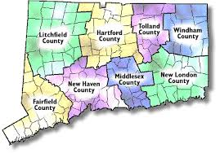
Background: CT Counties
Account for 85% of HIV cases in Connecticut

Slide 12
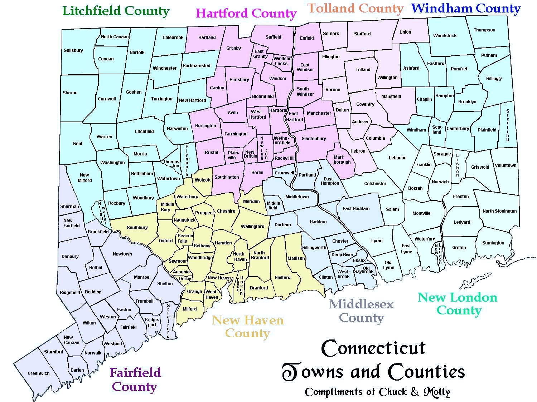
23 CLINIC SITES
LITCHFIELD
Community Health and Wellness Center Of Greater Torrington, Inc
HARTFORD
Burgdorf-Gengras-St. Francis
Community Health Center, Inc.
Community Health Services
Hospital of Central Connecticut
Kenneth Abriola, M.D.
Hartford Hospital / Brownstone
UCONN
FAIRFIELD
Danbury Hospital
Circle Care Center
Optimus CHC
Southwest Community Health Center
Stamford Hospital
Bridgeport Hospital Primary Care Clinic
Internal Medicine and ID Associates
Norwalk Community Health Center
NEW HAVEN
Cornell Scott Hill Health Center
Fair Haven Community Health Center
Haelen Center
Nathan Smith Clinic
Veterans Administration Medical Center
Staywell Health Center
Waterbury Hospital
Notes:
Unique to CT: multiplicity of sites various clinic structures; challenging

Slide 13
Study Design and Implementation
Notes:
DITAS

Slide 14
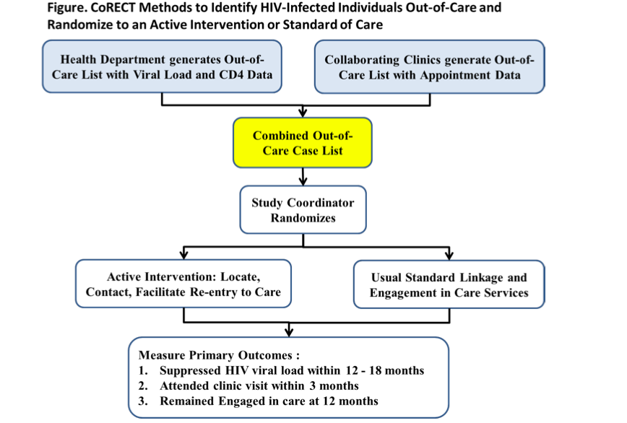
Original Algorithm for Data to Care
DIS
Disease Intervention Specialist

Slide 15
Defining Out-of-Care
12 months in Care followed by 6 months Out of Care
1 mo
lag
Case Conference
DIS and Participating Clinic
Exclude:
Visit scheduled in 9-month window
Recent visits during lag period
“Well” patients (scheduled annually and have sequential VL<20)
Notes:
These are “newly out of care”

Slide 16
Reality of Data to Care
**HD Preliminary Investigation
Deceased
Moved out of jurisdiction
Changed providers
Incarcerated
Other
⁰Health Dept and individual CLINIC Data Manager generate list for HD matching
¹Clinic Data Manager generates No Visit in 6 months list for HD matching with eHARS no VL in 6 months list and sorting into Boxes B, C, D in Excel; HD fills out participant eligibility dispo form for CDC
Notes:
JRM-should we include this? Isn’t this the algorithm at all sites?
Cmc – hard to read

Slide 17
Electronic Data Exchange Between DPH and Clinics
DPH:
  eHARS generates In Care and Out of Care Lists based on HIV VL reporting
Clinics:
  Generate In Care and Out of Care Lists based on:
    CAREWare (Ryan White Clinics)
    EMR appointment data
    Manual list appointment data
Electronic data exchange unique feature at CT site due to large number of clinics, need for decentralization

Slide 18
Disposition Process
Clinic Data managers reviewed OOC list for:
  Well Patient( 2 consecutive VL of <=20 at least 6 months apart)
  Recent Visit(last month)
  Upcoming Visit(in 3 months)
  Resident of extended care facility
  Incarcerated
  Moved out of jurisdiction
  Not our patient
  Deceased
  Provider discretion(mental illness, stigma concerns etc)
  Other, specify(comment section available)
  None of the above apply (randomizable)
Notes:
JRM-should we include this? Isn’t this the algorithm at all sites?

Slide 19
Complex Data Flow
CLINICS
DPH
YSM
Clinic visit records (CORE01 and Gap list)
eHARS Demographics, lab results
Potential OOC list
Disposition Assessment (Form #11)
Randomizable Subjects List
Randomization Performed (REDCap)
DIS
Receive assigned subject eHARS data
Intervention-Assigned Subjects list
SOC and Cost Analysis (REDCap)
Collect Clinic and Barriers to Care
Deidentify clinic & Barriers to Care
Data Repository (REDCap)
CDC
Notes:
Data Flow is complex
This is good – easier to read - cmc

Slide 20
Preliminary Results
Notes:
DITAS

Slide 21
Randomization Flow
Eligible for Case Conference
(Potentially OOC)
N=2961
Randomizable
N=655
Non-randomizable N=2306
DIS
N=333
SOC
N=322

Slide 22
Overall Dispositions
Disposition (N=2961) | Percent
Recent visit | 31.98%
Well patient | 16.97%
Upcoming visit | 13.49%
Randomizable | 21.06%
Other* | 16.50%
*Other=incarcerated, out of jurisdiction, deceased, resident ECF, provider discretion, other

Slide 23
Demographics by Randomization
Variable | TOTAL N=2961 | Not Randomized N=2306 | Randomized N=655 | P-Value (Randomized vs Non-Randomized)
Age |  | N (%) | N (%) | <.0001
Under 30 | 275 (9.29) | 166 (7.20) | 109 (16.64)
30-39 | 403 (13.61) | 287 (12.45) | 116 (17.71)
40-49 | 684 (23.10) | 502 (21.77) | 182 (27.79)
50-59 | 1,087 (36.71) | 907 (39.33) | 180 (27.48)
Over 60 | 512 (17.29) | 444 (19.25) | 68 (10.38)
Sex at Birth |  |  |  | 0.1894
Male | 1,913 (64.61) | 1504 (65.22) | 409 (62.44)
Female | 1,048 (35.39) | 802 (34.78) | 246 (37.56)
Demographics – by Randomization
Notes:
Mean Age: Randomizable = 44.94, Not Randomizable = 50.47, p<.0001. Medians: Randomizable = 46.02, Not Randomizable = 52.07

Slide 24
Demographics by Randomization
Variable | TOTAL N=2961 | Not Randomized N=2306 | Randomized N=655 | P-Value (Randomized vs Non-Randomized)
Race |  |  |  | 0.0012
Hispanic | 997 (33.67) | 755 (32.74) | 242 (36.95)
Black, Not Hispanic | 1,072 (36.20) | 808 (35.04) | 264 (40.31)
White, Not Hispanic | 815 (27.52) | 679 (29.44) | 136 (20.76)
Asian | 21 (0.71) | 19 (0.82) | 2 (0.31)
Mixed | 51 (1.72) | 40 (1.73) | 11 (1.68)
Other | 5 (0.17) | 5 (0.22) | 0 (0.00)

Slide 25
Odds Ratios for Age and Race – Randomizable vs. Non-Randomizable
Comparison | Reference Value | Odds Ratio | 95% Confidence Limit
Under 30 - Randomizable vs. Non-Randomizable | Over 30 | 1.3891 | 1.0904-1.7695
Black – Randomizable vs. Non-Randomizable | White | 1.6337 | 1.2845-2.0778
Hispanic, Randomizable vs. Non-Randomizable | White | 1.5158 | 1.1877-1.9347

Slide 26
Demographics by Randomization
Variable | TOTAL N=2961 | Not Randomized N=2306 | Randomized N=655 | P-Value (Randomized vs Non-Randomized)
Exposure Category |  |  |  | 0.0121
MSM Only | 802 (27.09) | 627 (27.19) | 175 (26.72)
IDU Only | 567 (19.15) | 455 (19.73) | 112 (17.10)
Hetero Only |  | 716 (31.05) | 190 (29.01)
Multi-Exposure | 417 (14.08) | 309 (13.40) | 108 (16.49)
Perinatal | 52 (1.76) | 31 (1.34) | 21 (3.21)
Other | 10 (0.34) | 9 (0.39) | 1 (0.15)
None Identified | 177 (5.98) | 134 (5.81) | 43 (6.56)
None Reported | 30 (1.01) | 25 (1.08) | 5 (0.76)

Slide 27
Last In Care CD4 and Viral Load by Randomization
CD4-Value | Randomized (%) | Not Randomizable (%) | P-value
<200 | 15.94 | 8.13 | <.0001
200-299 | 10.07 | 7.07
300-499 | 24.33 | 21.65
500 and over | 49.66 | 63.15
Viral Load
Detectable | 45.87 | 28.54 | <.0001
Undetectable | 54.13 | 71.46

Slide 28
Last In Care CD4 and Viral Load (Mean/Median) by Randomization
Lab | Randomizable | Not-Randomizable | P-value
Last in care VL – mean | 10,633.48 | 3,833.64 | 0.0011
Last in care VL – median | 20.00 | 20.00
Last in care CD4 – mean | 550.62 | 642.31 | <.0001
Last in care CD4 – median | 497.00 | 593.00

Slide 29
Characterizing PLWH Randomized to DIS OR SOC
COMPARED TO NON-RANDOMIZED GROUP, PLWH RANDOMIZED IN THIS STUDY WERE MORE LIKELY TO BE:
  Young (<30 years old)
  Black
  Hispanic
  Lower CD4
  Higher VL
This group of “newly out of care” were immunologically preserved (mean CD4=550.6 cells/ul)

Slide 30
Back to the DIS…
DIS
SOC

Slide 31
DIS Outcomes Data
(90 days post randomization)
DIS N=329
Returned to Care
Unable to Locate
Located but Refused
Miscategorized
Other (deceased, incarcerated, moved, ECF, upcoming visit, missing data)

Slide 32
Other

Slide 33
Demographics of Select DIS Outcomes
Variable | Total (%) N=225 | Returned to Care (%) n=101 | Located Refused (%) n=50 | Unable to Locate (%) n=74 | P-Value (Returned to Care vs Not Returned to Care)
Age |  |  |  |  | 0.1060
Under 30 | 34 (15.11) | 11 (10.89) | 14 (6.22) | 9 (12.16)
30-39 | 38 (16.89) | 15 (14.85) | 8 (16.00) | 15 (20.27)
40-49 | 73 (32.44) | 33 (32.67) | 15 (30.00) | 25 (33.78)
50-59 | 57 (25.53) | 33 (32.67) | 9 (18.00) | 15 (20.27)
Over 60 | 23 (10.22) | 9 (8.91) | 4 (8.00) | 10 (13.51)
Sex at Birth |  |  |  |  | 0.4563
Male | 138 (61.33) | 63 (62.38) | 27 (54.00) | 48 (64.86)
Female | 87 (38.67) | 38 (37.62) | 23 (46.00) | 26 (35.14)
Notes:
Mean Age: Mean age RTC = 45.96, Mean Age Located Refused = 40.68, Mean Age Unable to Locate = 45.78. p-value = <.0001 between RTC and other 2 groups combined and individually. Therefore, since the chi-square for the grouped ages was NOT significant, this indicates that between the groups ages are significantly different – those who were located but refused are significantly younger. However, there is no significant difference in the distribution of ages between the 3 groups.

Slide 34
DIS Outcomes
No statistically significant differences between returned to care and those unable to locate/located refused in:
  Age
  Race/ethnicity
  Transmission risk factors
  Last in care mean CD4/HIV viral load

Slide 35
DIS Outcomes: Barriers to Care
Barrier to Care | N=176 | %
Life Issues* | 175 | 99.94
Mental/Physical Barriers ** | 71 | 40.34
Didn’t want to go | 28 | 15.91
Financial Considerations | 26 | 14.77
Treated poorly at clinic in the past | 10 | 5.68
Can’t find clinic where speak my language | 2 | 1.14
Don’t trust doctors | 6 | 3.41
Unsure where to go | 2 | 1.14
Stigma | 5 | 2.84
Didn’t want provider to be mad | 2 | 1.14
Other | 83 | 47.16
*Couldn’t take time off from work or school; no transport or child care, forgot, didn’t like making appt in advance
**Depressed, didn’t care about health, too sick, didn’t feel sick
Notes:
Total N = 176. Mean Number of barriers to care for those who have at least 1 barrier = 2.33. Min = 1, Max = 8.

Slide 36
CONCLUSIONS-1
1. This is the first RCT using a Data to Care approach and DIS Intervention targeted at re-engagement in care for PLWH who are out of care (OOC)
2. A data sharing process to characterize PLWH who are newly OOC was successfully created using clinic-based visit data and DPH-based lab surveillance data
3. By using combined data, 21% of PLWH who are newly OOC are eligible for more intensive DPH case finding and linkage via DIS; persons in this group are more likely to be younger, AA/Hispanic, with last in care labs showing lower CD4/higher VL

Slide 37
CONCLUSIONS-2
4. This group of “newly out of care” had relatively well-preserved CD4 counts and nearly 50% had VL undetectable during their in-care period
5. DIS intervention shows 34% return to care, with no difference in PLWH who re-link vs. those who are unable to be located or refused intervention
6. The most common barriers to re-engagement in care included “life issues” and “mental/physical health issues”

Slide 38
LIMITATIONS
Study included only subset of PLWH who were newly OOC
Heterogeneity of clinic data systems affected accuracy of disposition process
Variability of DIS efficacy affected success of re-linkage to care

Slide 39








ACKNOWLEDGEMENTS
DPH TEAM
YALE TEAM
Heidi Jenkins
Suzanne Speers
Constance Carroll
Janet Miceli
Lisa Nichols
Rick Altice
CDC Team:
-Robyn Neblett Fanfair
-Paul Weidle
Clinics:
-Data Managers
-Medical directors
Justin Mitchell
Dustin Pawlow
Alida Martinez
Barbara Valdes
Arit Ogbuagu
Christina Rizk
Notes:
ADD ARIT and BARBARA and CONSTANCE – I lsent Lisa a couple of pictures to choose from

