Slide 2
Integration of Prevention and Care Service Delivery and Funding
Julie Hook, MA, MPH
Project Director, Integrated HIV/AIDS Planning Technical Assistance Center
JSI Research &Training Institute, Inc.

Slide 3
Integration of Prevention and Care Service Delivery and Funding
Julie Hook
December 13, 2018

Slide 4
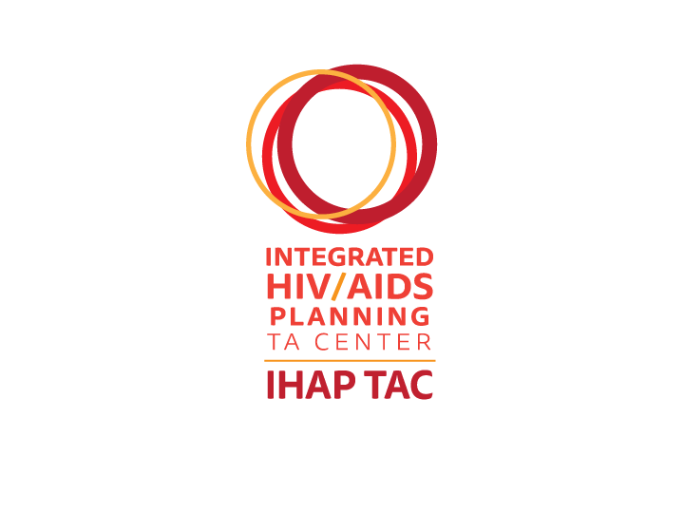
About the Integrated HIV Planning (IHAP) Technical Assistance Center (TAC)
3-year
project
Supports
Conducts
national & targeted
Ryan White HIV/AIDS Program Parts A & B recipients and their respective planning bodies with integrated planning including implementation of their Integrated HIV Prevention and Care Plans
began
July 1, 2016
training and technical assistance activities
This project is supported by the Health Resources and Services Administration (HRSA) of the U.S. Department of Health and Human Services (HHS) under grant number U69HA30144, Ryan White HIV/AIDS Program Integrated HIV Planning Implementation. This information or content and conclusions are those of the author and should not be construed as the official position or policy of, nor should any endorsements be inferred by HRSA, HHS or the U.S. Government.
Notes:
Julie: As a reminder, the IHAP TAC is a three year cooperative agreement to support jurisdictions and their planning bodies with implementation of the Integrated HIV Prevention and Care Plans, including both national and targeted TA activities.

Slide 5
Support available through the IHAP TAC
Integrating HIV prevention and care at all levels
Strategies for implementing Integrated Plan activities
Publicizing and disseminating progress of Integrated Plan activities to stakeholders
Identifying roles and responsibilities for Integrated Plan activity implementation
Monitoring and improving Integrated Plan activities
Collaborating across jurisdictions
Notes:
- Integrating HIV prevention and care at all levels
- Strategies for implementing Integrated Plan activities
- Publicizing and disseminating progress of Integrated Plan activities to stakeholders
- Identifying roles and responsibilities for Integrated Plan activity implementation
- Monitoring and improving Integrated Plan activities
- Collaborating across jurisdictions

Slide 6
Session Objectives
Describe the value of integrating HIV prevention and care service delivery within health departments
Describe the value of integrating funding of HIV prevention and care services within health departments
Identify at least one program activity supported by integrated HIV prevention and care service delivery
Identify at least two strategies to facilitate integrating HIV prevention and care service delivery

Slide 7
Acknowledgements
HealthHIV
Office of HIV/AIDS, Bureau of Infectious Disease and Laboratory Sciences, Massachusetts Department of Public Health
Division of Public Health Communicable Disease Branch, North Carolina Department of Health and Human Services
Washington State Department of Health
Notes:
Director, Office of HIV/AIDS, Bureau of Infectious Disease and Laboratory Sciences, Massachusetts Department of Public Health

Slide 8
Why Integrate Programs & Services?

Slide 9
National HIV/AIDS Strategy: 2020 Goals
Four primary goals
Reduce new HIV infections
Increase access to care and optimize health outcomes for people living with HIV (PLWH)
Reduce HIV-related health disparities and health inequities
Achieve a more coordinated national response to the HIV epidemic
Increase the coordination of HIV programs across the Federal government and between Federal agencies and State, territorial, Tribal, and local governments.
www.hiv.gov/federal-response/national-hiv-aids-strategy/nhas-update
Notes:
The fourth goal of the National AIDS/HIV Strategy is to achieve a more coordinated national response to the HIV epidemic.

Slide 10
CDC and HRSA’s Alignment of Goals and Expectations Facilitates Integration
Integrated HIV Prevention and Care Plan Guidance, including Statewide Coordinated Statement of Need (SCSN) released in 2015 for 2017-2021 Integrated HIV Prevention and Care Plans.
An underlying goal of integrated planning is to better leverage resources and improve efficiency and coordination of HIV prevention and care service delivery.
Reduce reporting burden and duplicated efforts
Streamline work of health department staff and HIV planning groups
Promote collaboration and coordination in the use of data
Notes:
With the release of the Integrated HIV Prevention and Care Plan Guidance, including the Statewide Coordinated Statement of Need (SCSN), CDC and HRSA sought to build upon existing efforts to reduce reporting burden, streamline the work of health department staff and HIV planning groups, and promote collaboration and coordination in the use of data. People living with HIV (PLWH) and those at increased risk for HIV infection have similar needs when accessing and using healthcare. The skills necessary to successfully recruit, link, engage, and retain individuals on PrEP and HIV treatment are very similar. By integrating HIV prevention and care services, health departments can better position themselves to achieve the goals to end the epidemic.
In 2015, the Centers for Disease Control and Prevention (CDC) and the Health Resources and Services Administration (HRSA) released joint guidance to support the submission of an Integrated HIV Prevention and Care Plan, including the Statewide Coordinated Statement of Need (SCSN).
Guide built upon efforts to:
Further reduce reporting burden and duplicated efforts
Streamline the work of health department staff and HIV planning groups
Promote collaboration and coordination in the use of data

Slide 11
What do we mean by “integration”?
Integrated Care: “a package of preventive and curative health interventions for a particular population group”
Integrated health services: range of services provided at one location
Integrated service delivery: “the management and delivery of health services so that clients receive a continuum of preventive and curative services, according to their needs over time and across different levels of the health system” (WHO)
Simply, an organizational arrangement focusing on more coordinated and integrated forms of care provision.

Slide 12
What do we mean by Integrated Funding?
Blended Funding
Braided* Funding
Stakeholders merge funding from individual sources into one funding stream, with each individual funding source losing its specific identity
Stakeholders coordinate funding from individual sources, with each individual funding source keeping its specific identity
*Adapted from the Association of Government Accountants, “Blended and Braided Funding: A Guide for Policy Makers and Practitioners,” December 2014.
Notes:
NASHP has a brief providing accounting definition of each that may be useful: https://nashp.org/wp-content/uploads/2016/02/Jean1.pdf
Blending funding involves co-mingling the funds into one “pot” where case managers can draw down service dollars, personnel expenses can be paid, or other program needs can be met.
In contrast, braided funding involves multiple funding streams used to pay for all of the services needed by a given population, with careful accounting of how every dollar from each funding stream is spent.

Slide 13
Rationale for Integration
Many prevention and care programs with health departments have functioned in silos
Duplicative efforts among staff
Reporting burdens
PLWH and those at risk for HIV infection have similar needs when accessing health care.
Skills needed to recruit, link, engage and retain individuals on PrEP and HIV treatment are similar
Notes:
Traditionally, prevention and care departments within health departments have functioned in silos, which contributes to reporting burdens and duplicative efforts among staff.
In recent years, many health departments have moved toward a more integrated structure of their HIV prevention and care departments as a way to better leverage resources and improve efficiency and coordination of HIV prevention and care service delivery.
People living with HIV (PLWH) and those at increased risk for HIV infection have similar needs when accessing and using healthcare. The skills necessary to successfully recruit, link, engage, and retain individuals on PrEP and HIV treatment are very similar.
By integrating HIV prevention and care services, health departments can better position themselves to achieve the goals to end the epidemic.

Slide 14
Why integrate programs/services?
Enhance capacity to address multiple health-related goals
Respond to syndemics with similar risks for acquisition
Decrease barriers to providing services
Maximize opportunities for people to receive the best care and treatment when they interact with providers
Eliminate duplicative services
Maximize federal and state resources
Notes:
As discussed by jurisdictions during an IHAP TAC webinar, doing so helped increase their capacity to address multiple health-related goals; decrease administrative barriers and eliminate duplicative services; and ultimately, maximize resources to improve outcomes along the HIV care continuum and support prevention services.
Allowed RNCPs to better control resources to respond to need

Slide 15
Why Integrate Funding?
Maximize the impact of limited public funding.
Provide opportunity to pull from multiple smaller sources to support and sustain new and innovative HIV prevention care and treatment programs.
Improve efficiencies and effectiveness in meeting goals/achieving health outcomes by coordinating and across programs and services.
Use of resources to respond better to need

Slide 16
Opportunities to Collaborate with Health Department
Community Planning
Data (data sharing, joint surveillance activities, and cross-matching cases)
Cross-training staff/providers
Collaborative funding
Staff sharing among programs
Notes:
Program Collaboration and Service Integration (PCSI): “a mechanism for organizing and blending interrelated health issues, activities, and prevention strategies to facilitate a comprehensive delivery of services” (CDC)

Slide 17
Opportunities to Integrate Service Delivery
Testing
Strengthening systems to deliver PrEP and HIV Treatment
Outreach/Education around PrEP and HIV Treatment
Partner Services
Substance use/ Harm reduction
PrEP (education, prescription)
Syringe services programs
HCV testing & treatment
Integrated surveillance/reporting
Health insurance enrollment
Supporting medication adherence
Notes:
PrEP (education, prescription)
Many HDs started with PrEP as part of partner services and then transitioning to offering PrEP in all HIV/STI prevention, syringe services programs & primary care programs
Outreach and Education around PrEP and HIV treatment
Support for enrollment into health care coverage options
Strengthening systems to deliver PrEP and HIV treatment
Supporting medication adherence

Slide 18
Integration should not be prescriptive
Determine what integration means for your jurisdiction
Integration can mean different things to different jurisdictions
Shared Leadership
Co location of prevention and care in same space can help facilitate collaboration and communication
Regular prevention and care staff meetings
Integrating HIV prevention and care service delivery
Integrating HIV/Hepatitis C (HCV)/sexually transmitted infection (STI) prevention and care service delivery
Should not be a prescriptive “one size fits all” approach
May not be feasible/practical to integrate prevention and care services
Notes:
Determine what integration means for your jurisdiction. Integration can mean different things to different jurisdictions and it should not be a prescriptive ‘one size fits all’ approach. It may not be feasible, or even practical for you to fully integrate prevention and care services. It is important to recognize that integration can take many different forms, from integrating care and prevention funding to integrating HIV/Hepatitis C (HCV)/sexually transmitted infection (STI) prevention and care service delivery.
Integration can not be prescriptive – what works for one jurisdiction will not necessary work for other jurisdictions.
Co-locate the HIV prevention and care departments. While it may not be possible to fully integrate HIV prevention and care departments, having the departments co-located in the same building and on the same floor can help facilitate collaboration and communication.

Slide 19
Challenges to prevention and care integration
Funding streams
Infrastructure
Expertise
Community
Culture
The division of labor works…
Teams are strong and functional…
If it isn’t broken, don’t fix it…
This is how we’ve always done it…
I like the people I work with now…

Slide 20
Integration takes time
Integration takes time and change is hard
Years, not months to integrate existing prevention and care structures
May require a cultural or paradigm shift
Importance to include all stakeholders involved in conversations from beginning
Agencies that may experience funding changes should be alerted to upcoming changes
Notes:
Understand that integration takes time and change is hard. It will likely take years - not months - to integrate existing prevention and care structures and the process should not be rushed. Successful integration will require a cultural or paradigm shift for those involved, so it is important to make sure all stakeholders, including community planning groups, providers, and health department staff, are a part of the conversation from the beginning. Similarly, any agencies that may experience funding changes should be alerted of the upcoming changes well in advance of funding decisions being made. to integrate existing systems? existing structures?
+stewart_landers@jsi.com does my addition make sense as it relates to prevention and care within health departments?

Slide 21
Get on the same page
Prevention and care may use different terminology
Create a common lexicon or a care and prevention crosswalk to help cross train care and prevention staff
Key service definitions
Data systems
Data points
Match care and prevention staff together
Notes:
Get on the same page. Prevention and care staff may use different terminology or definitions for the same words or concepts. Create a common lexicon or a care and prevention crosswalk of key service definitions, data systems, and data points to help cross train care and prevention staff.

Slide 22
Joint HIV prevention and care funding opportunities
Allow for joint HIV prevention and care funding opportunities.
Maximize the impact of limited public funding
Allow to pull from smaller sources to support and sustain new and innovative HIV prevention, care and treatment programs
Economies of scale could be achieved through leveraging funding streams to have the greatest net impact on services and programming.
Notes:
Allow for joint HIV prevention and care funding opportunities. Funding agencies to provide HIV care and prevention services will allow you to maximize the impact of limited public funding and allow you to pull from multiple smaller sources to support and sustain new and innovative HIV prevention, care, and treatment programs. In doing so, economies of scale could be achieved in leveraging funding streams to have the greatest net impact on services and programming.
Maximize the impact of limited public funding.
Provide opportunity to pull from multiple smaller sources to support and sustain new and innovative HIV prevention care and treatment programs.
Improve efficiencies and effectiveness in meeting goals/achieving health outcomes by coordinating and across programs and services.

Slide 23
Engage stakeholders early
Engage community-based and local health partners early in process.
To let them know about integrated funding and programming
Gather feedback from them on challenges and how could implement integrated services at their agencies.
Washington State Department of Health
White paper and concept paper to inform partners about proposed changes
Gather feedback prior to releasing a RFA for integrated care and prevention services
Community engagement
Technical assistance
Notes:
Engage community-based and local health partners early in the process let them know about integrated funding and programming and gather feedback on how they could implement integrated services at their agencies. For example, the Washington State Department of Health developed a white paper and concept paper to inform partners about proposed changes to their current portfolio of HIV Community Services. This allowed them to gather feedback prior to releasing a request for application (now closed) for community partners to submit applications to develop and implement an HIV Community Services System that integrated care and prevention services.
Preparing community is important but doesn’t mean that circumventing ALL barriers to integrating funding and programming will be easy!
Prevention, really just given the lesser amount of funding, had more work to do in aligning with care services. Many prevention staff were prepared and excited to take on new navigation-focused work but this wasn’t the case for everyone—increased data collection efforts, routine client follow up, more standardized approach to navigation services was a struggle for many to fully adopt (still work to be done).
Maintaining separate staffing for care and prevention for billing purposes is easier—a product of how our billing works in WA and the reporting requirements for different activities. But key to maximizing resources! Particularly for outreach and engagement activities (locating high risk PrEP clients and out of care PLWH can look very similar…)
Regular and consistent communication is KEY. Looking for opportunities to get integrated agencies to have their care and prevention teams interact is important (e.g.: integrating quarterly reports, building prevention activities in to quality management activities, integrated partner check ins, etc.).
Barriers to communication between care and prevention staff exist at the state level—our teams are physically separated (same building, different sides), different managers coordinating prevention and care staff, embrace of alternate workplace environment means many staff are not in the office regularly. How do you maintain regular and consistent communication between health department staff? And be aware that agencies receiving prevention and care funding will be experiencing many similar challenges!
We have integrated funding through integrated contracts (easy part?) but programmatic integration has been more challenging. But contracts and billing can make programmatic integration hard so they are very closely interlinked.
Maybe full programmatic integration feels out of reach (e.g.: single staff member being funded by care and prevention funds doing outreach and engagement activities for PLWH and PAHR) but look for opportunities for care staff to help prevention staff to learn about the ‘case management’ approach to client-level work (things like data collecting and input, client follow up, using a data tracking system, etc.). And vice versa—prevention staff can help PLWH peers learn more about outreach and engagement activities!
Don’t underestimate the value of peer to peer technical assistance—some of our prevention partners struggled to take up PrEP navigation work while others thrived. Those who thrived can help elevate those finding the work more challenging. We even had care staff cross-training prevention staff at another agency in using CAREWare!
Care drives the choice of data systems while prevention ‘makes it work’
Documentation—when am I billing EIS for care services? When am I billing prevention for prevention services? How are we documenting when staff are engaging in care services or prevention services?

Slide 24
Massachusetts Department of Public Health Example
Objectives
Improve service response
Leverage expertise
Maximize fiscal efficiency
Streamline contract management
Reduce burden on funded agencies
Respond along the care continuum
Reduce stigma
Uncouple programs from HIV positive status
Notes:
Understand that integration takes time and change is hard. It will likely take years - not months - to integrate existing prevention and care structures and the process should not be rushed. Successful integration will require a cultural or paradigm shift for those involved, so it is important to make sure all stakeholders, including community planning groups, providers, and health department staff, are a part of the conversation from the beginning. Similarly, any agencies that may experience funding changes should be alerted of the upcoming changes well in advance of funding decisions being made. to integrate existing systems? existing structures?
+stewart_landers@jsi.com does my addition make sense as it relates to prevention and care within health departments?

Slide 25
Overview of Massachusetts Integration Process
Started transition process in 2011 with integration of Prevention Planning Group (PPG) with Service Coordination Collaboratives (SCCs) to form the Massachusetts Integrated Prevention and Care Committee (MIPCC)
Internal orientation and cross-training of Office of HIV/AIDS staff (OHA)
Re-organization of OHA operational infrastructure and senior manager roles and responsibilities in 2014
Integrated procurement of HIV/HCV/STI/TB Prevention, Linkage and Retention in Care and Treatment Completion Services in 2017
Notes:
Prevention and Care Programs are housed in same division, the Bureau of Infectious Disease and Laboratory Services (BIDLS)
Recently completed second round of integrated funding of HIV services
Integrates HIV prevention and care services
Integrates HIV, Hepatitis B and C, STIs, LTBI

Slide 26
Massachusetts Integration Lessons Learned
Integration takes time
Identify champions
Engage community
Sequence implementation
Tailor to city/state/territory
Peer to peer exchanges
Anticipate challenges
Create a new vocabulary

Slide 27
Want to learn more!
Archived Webinars at targethiv.org/library/ihap-webinars:
Moving Integrated HIV Prevention and Care Planning into Action: Integrated Funding for HIV Services
Health Department Structural Changes to Advance Integration of Prevention and Care Services

Slide 28
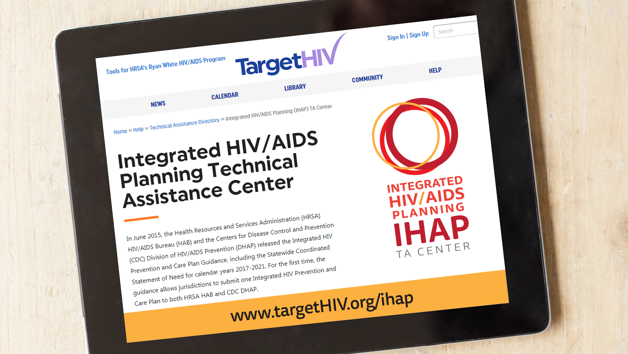

Slide 29
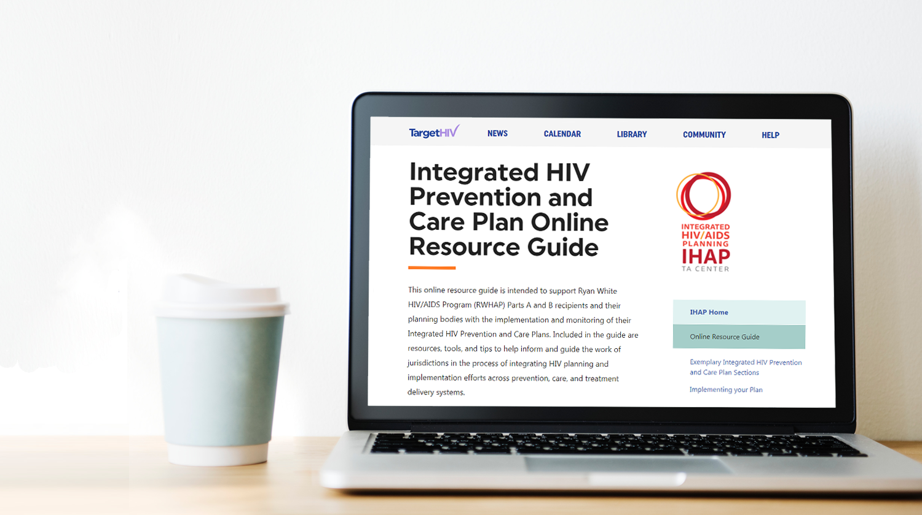
Integrated HIV Prevention and Care Plan Online Resource Guide
Resources, tools, and tips to support process of integrating HIV planning and implementation efforts across prevention, care, and treatment delivery systems.
Notes:
One of the things we developed and launched in Spring of this year is the Integrated HIV prevention and care plan online resource guide. This online resource guide is intended to support Ryan White HIV/AIDS Program Parts A and B recipients and their respective planning bodies with the implementation and monitoring of their Integrated HIV Prevention and Care Plans. Included in the online resource guide are Resources, tools, and tips to support process of integrating HIV planning and implementation efforts across prevention, care, and treatment delivery systems.

Slide 30
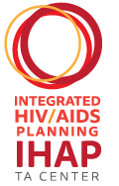
Questions?
Contact us at ihaptac@jsi.com!
Obtain more information, join our mailing list, request TA or to share your experiences or resources.
This project is supported by the Health Resources and Services Administration (HRSA) of the U.S. Department of Health and Human Services (HHS) under grant number U69HA30144, Ryan White HIV/AIDS Program Integrated HIV Planning Implementation. This information or content and conclusions are those of the author and should not be construed as the official position or policy of, nor should any endorsements be inferred by HRSA, HHS or the U.S. Government.

