Slide 1
Utilizing HIV Peer Navigators as Members of Care Management Teams to Achieve Viral Load Suppression
Sharen Duke
Marcy Thompson
Executive Director/CEO
Alliance for Positive Change
Chief Strategy Officer
Alliance for Positive Change

Slide 2
Disclosures
Sharen Duke and Marcy Thompson have no financial interest to disclose.
This continuing education activity is managed and accredited by AffinityCE/Professional Education Services Group in cooperation with HRSA and LRG. PESG, HRSA, LRG and all accrediting organization do not support or endorse any product or service mentioned in this activity.
PESG, HRSA, and LRG staff as well as planners and reviewers have no relevant financial or nonfinancial interest to disclose.
Commercial Support was not received for this activity.

Slide 3
Learning Objectives
Explore medical-community partnerships between community-based organizations and medical facilities that can result in increased patient engagement in HIV care and treatment.
Design effective strategies to integrate peer navigators into medical care management teams.
Understand how to effectively utilize HIV peer navigators in order to increase linkage to medical care and decrease missed appointment rates

Slide 4
Obtaining CME/CE Credit
If you would like to receive continuing education credit for this activity, please visit:
http://ryanwhite.cds.pesgce.com

Slide 5
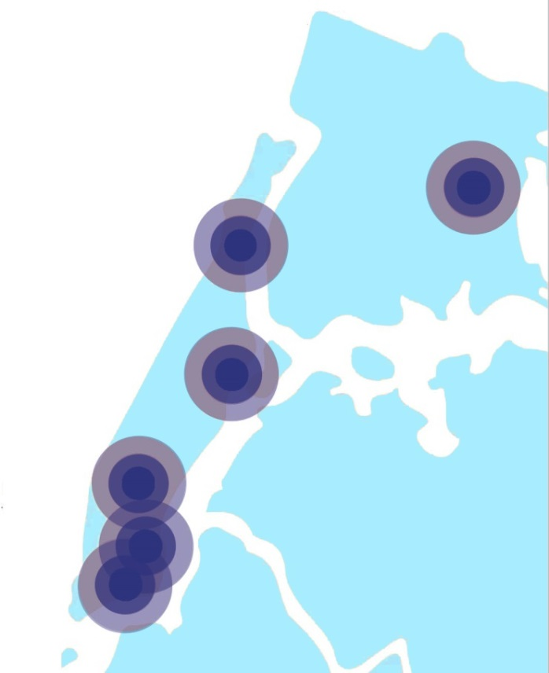
Positive Change in Action
The Alliance helps New Yorkers affected by HIV and other chronic illnesses make lasting positive changes towards health, housing, recovery, and self-sufficiency.
Each year, we help New Yorkers:
Get tested for HIV
Overcome addiction
Access medical care
Escape homelessness
Rejoin the world of work
Replace isolation with community
And lead healthier and more self-sufficient lives.
Alliance’s individualized, full-service approach gives each person the unique mix of support he or she needs to feel better, live better, and do better.

Slide 6
Alliance Service Population at a Glance
Most clients have multiple chronic illnesses.
Assist in obtaining the needed care and support:
Housing: unsafe, unstable, threats of eviction, rent arrears, needed repairs
Mental Health Diagnosis: Depression, Anxiety Disorder, Bipolar Disorder
Food Insecurity
Entitlements: undocumented, Medicaid reactivation; spend-downs
Mental Health Conditions (62%)
HIV/AIDS (55%)
Diabetes
(20%)
Alliance Service Population
Chemical Dependency History
(52%)
Asthma
(23%)
Cardiovascular (38%)
Hepatitis
(26%)

Slide 7
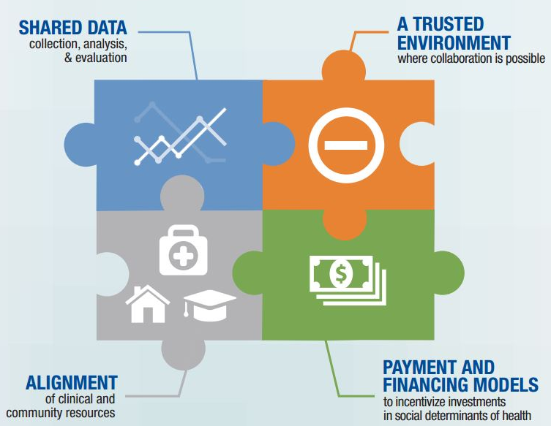
Models of Medical-Community Collaboration
Co-locate Community Care Managers in Medical Facilities
HIV Treatment Adherence
Access to Anti-Retroviral Treatment
Monetary Incentives for VLS
HIV Testing/Newly Diagnosed
Expedited confirmatory testing
Expedited medical appointment
Joint grant-seeking

Slide 8
Co-Location of Care Managers in Medical Clinics
GOAL
Co-locate Community Care Manager into medical clinic to address social determinants of health and retain patients in care by providing medical and behavioral health navigation, treatment adherence support, transportation assistance, and linkage to other community based support care.

Slide 9
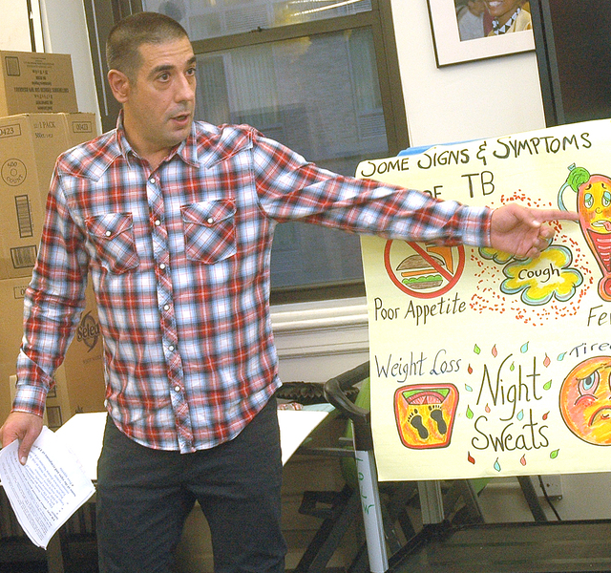
Care Management Services
Appointment reminders
Accompaniment to services
Follow-up on missed appointments
Entitlements advocacy
Housing placement assistance
Navigation to specialty care
Case conferences
Joint assessments and service plans
Photo: David Nager/ASCNYC

Slide 10
Alliance Co-Location Facilities
Dr. Zarkadas
Private
2018
Mt. Sinai Downtown Campus
2012
Ryan Health Center
November 2018
Mt. Sinai Uptown Campus
2010
Alliance Offices:
Herald Square
Washington Heights
East Harlem
Lower East Side
NY Presbyterian
Columbia Campus
2010
Mt. Sinai Beth Israel Peter Krueger Clinic
2007
NYP-Cornell
Downtown
2017
NYP-Chelsea
Downtown
2018

Slide 11
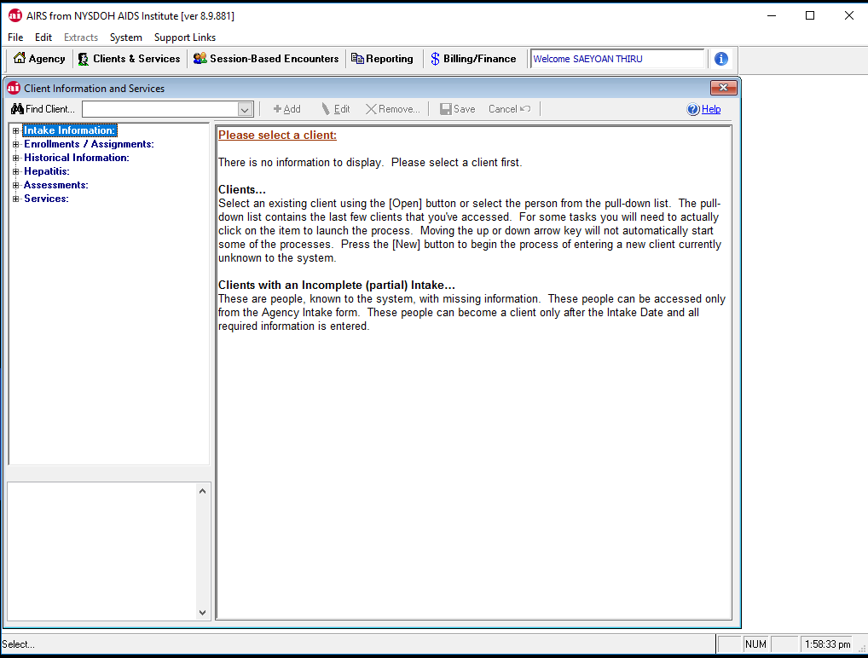
Co-Location Works!
Co-location of CBO care management within the medical setting provides:
Real time data exchange
On-site case conferencing between care managers and medical providers
Fast track access to medical appointments
Resources to address social determinants of health
Intensive field-based outreach to clients lost to care
Photo: David Nager/ASCNYC

Slide 12
Benefits of Peer Navigation
Each Alliance Health Home Care Manager has a dedicated Peer Navigator to provide the "feet on the ground" for the patients. Together, the HH Care Manager and Peer Navigator help patients work through any barriers that might prevent her/him from seeing their doctor or other medical care professional.
Photo: David Nager/ASCNYC

Slide 13
Role of Peer Navigators
Shared Lived Experience:
Culturally
Linguistically
Socially
Economically
Reduce Barriers to Care
Foster Trust
Promote Long-term Engagement
Guide Patients Toward Health and Stability
“Warm hand-off” to care coordination
Photo: David Nager/Alliance

Slide 14
Support & Training for Peer Navigators
Bi-Weekly Supervision with Staff Mentor: Focus on skills development by creating individualized personal and professional development plans tailored to each Peer’s interests, priorities, and needs.
Weekly Mandatory Support Group: Provide skill enhancements, encouragement, and guidance to help the Peer Interns “stay on track” with their own recovery and personal aspirations.
Continued Training / Education: Quarterly training on variety of topics
Photo: David Nager/Alliance

Slide 15
Benefits of Employing a Peer Workforce
FOR PEERS
Enhanced skills
Self-esteem
Peer placement
Marketability (employment)
Support network
FOR ORGANIZATIONS
Credentialed training
Credibility within community
Increased service resources (for outreach enrollment, and navigation)
Low-cost strategy
Role models

Slide 16
Role of Peer Navigators
Peer Navigators are integral members of Alliance’s Care Management Program. Peers conduct:
Outreach for Patient Activation/Linkage to Care
Patient Navigation, Appointment reminders, Accompaniment to services
Coaching / Health Education
Motivational Interviewing & Goal Setting
Self-Management & Adherence Support
Case Conferencing/Communication with care team
Photo: David Nager/Alliance

Slide 17
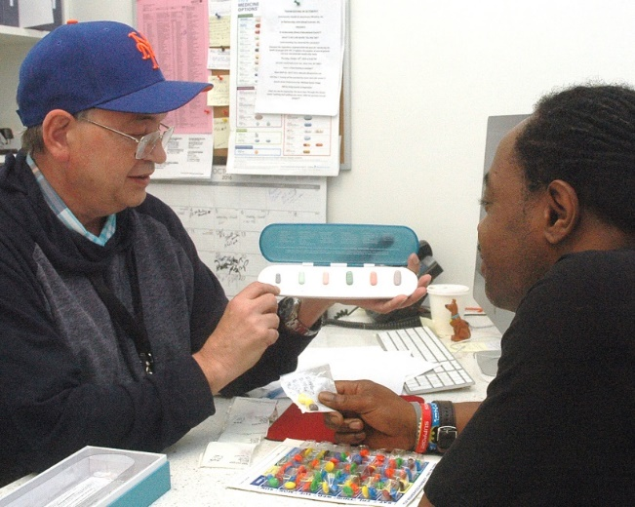
Impacts
Alliance Health Home Care Management teams (care manager & peer navigator) result in increased linkage to care and treatment adherence:
91% HH care managed clients were consistently engaged in care
54% were virally suppressed at intake
80% were virally suppressed at 6 month follow-up
Photo: David Nager/Alliance

Slide 18
Impacts within medical clinics
HH Enrollment: 90% conversion from clinic patient outreach to HH enrollment
63% re-engagement of patients who had fallen out of care (no medical visits in > 6 months)
Clients in Care
90% decrease in missed appointment rate
Appointment reminders via texting app; peer accompaniment; transportation assistance and coordination
Photo: David Nager/Alliance

Slide 19
Impacts within medical clinics
Viral Suppression
85% improvement in medication adherence:
Enrollment in Alliance Undetectable and/or Pharmacy Access Center Program
92% of clients were undetectable after 6 months of program enrollment
95% of clients had sustained viral suppression for at least 12 months
78% of unsuppressed clients at intake became undetectable by 6 months
Photo: David Nager/Alliance

Slide 20
Thank You
www.alliance.nyc
Sharen Duke & Marcy Thompson
sharen@alliance.nyc | marcy@alliance.nyc
212.645.0875

