Slide 1
Oversight of a Patient-Centered Infrastructure To Continuously Improve Patient Retention and Viral Load Suppression Rates
Moderator: Mindy Golatt, RN, MPH, Project Officer Presenters: Paul Cassidy, M.S.W., Program Director
Greater New Bedford CHC, MA
Sonji Miller, M.S., Manager of HIV and Substance Abuse Lawndale Christian Health Center, Chicago Ron Chacko, M.D., HIV Service Line Leader
Lawndale Christian Health Center, Chicago
Facilitator: Nanette Brey Magnani, Ed.D, QM Consultant
NQC/HIVQUAL

Slide 2
Session Outcomes
By the end of the workshop, participants will be able to:
Identify key elements of patient-centered infrastructures and supportive processes for continuous quality improvement
Share and discuss decision support tools that, when used, enhance a multidisciplinary team’s ability to design and implement interventions specific to sub-populations
Reflect on their own program infrastructures to identify ways to make them more patient-centered.

Slide 3
Agenda Thursday, November 29, 2012 – 8:00am – 9:30am
8:00 Welcome. Review Outcomes and Agenda.
Overview
Purpose
Why Continuous Quality Improvement?
8:20 Grantee Examples: Presentation
Greater New Bedford CHC
Lawndale Christian HC
8:50 Small Group Discussion: What do you do? What can you do?
9:10 Large Group Exchange.
9:30 Adjourn.

Slide 4
Overview
“Barbara, We have to continue to work until the good gets better, the better gets best. Never let it rest!”
Dr. Barbara Allen, CDC Country Director, Guyana, sharing a quote from a colleague working in the Santa Rita jail to improve care there.

Slide 5
Purpose
Our Purpose
Ryan White Programs are better, how can we improve better to be the best?

Slide 6
Fundamental Concept of Improvement
“Every system is perfectly designed to achieve exactly the results it achieves.”
6
Notes:
Was this the slide you were looking for? Couldn’t find any graphics on Rassoud presentation that were related to systems?
HCI FY08 Self-Evaluation Oral
6

Slide 7
Massachusetts RW Programs Participating in In+Care Retention and VL Suppression Results

Slide 8
Can RW Programs with “Better” Rates Improve Even More?
Are they better? Are they the best?
How do we define best?
How much can they improve?
What do you think is involved?

Slide 9
4 Guiding Principles of Improvement
Understanding work in terms of processes and systems
Developing solutions by teams of providers and patients
Focusing on patient needs
Testing and measuring effects of changes

Slide 10
Early QM Efforts
Designed to build RW grantees’ capacity to
Create and develop a QM/QI infrastructure
Create measurement systems
Performance measures – 7 to >20
Data collection and reporting – chart to EHRs and CAREWare
Develop staff
Improve patient care
Consumer Involvement

Slide 11
Current Quality Management System Components
QM infrastructure provides the foundation to support overall QM Program and QI Processes
Organizational Quality Management Committee
HIV QM Committee and QM Plan
Performance Measurement System
QI Project Teams
Consumer Advisory Groups

Slide 12
With this system who are we are missing?
Large Group Brainstorm

Slide 13
How Can We Serve These Patients? Can “Better Become Best?”
Greater New Bedford CHC
Patient Centered Process
Targeted care planning
Lawndale Christian Health Center
Patient Centered Process
Specific example of improved care for patients with behavioral health concerns related to adherence to appointments and medications

Slide 14
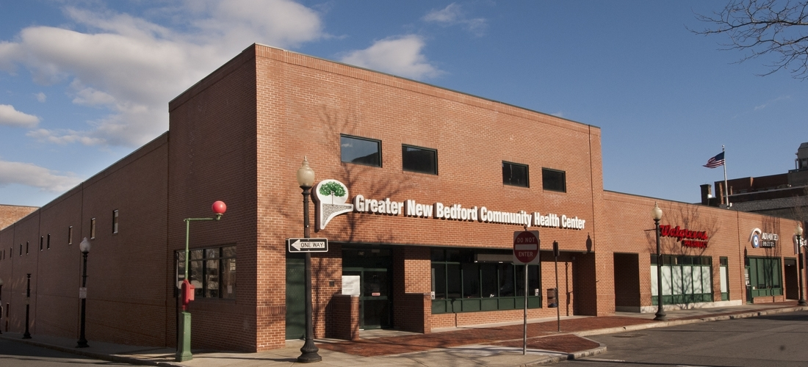
Greater New Bedford Community Health Center, MA

Slide 15
Retention and VL Suppression Results and Improvement Goal
Retention: 96% (top 10%)
VL Suppression: 73% (below top 25% and MA average)
Improvement Goal: To increase patients’ VL suppression rate from 73% to 85% in six months.

Slide 16
Baseline Data
Number of Patients = 320
Suppressed (Blue)= 236
Not Suppressed (Red)=84
Suppression Rate=73%

Slide 17
Phase 1: Plan/Do
Beginning May 9, 2012 Multidisciplinary team will meet 3 times per month to review needs/barriers for patients with viral load >200 copies.
Care plans will include recommended interventions tailored to each patient’s needs and specific staff will be assigned to individual patients based on staff relationships and nature of the intervention.
Care plans are developed and implemented by:
Social Workers
Peers
RNs
PDSA: Infrastructure Change

Slide 18
GNBCHC WEEKLY MULTI DISCIPLINARY MTGS.
Prepare updated data reports for meeting:
Monitoring performance measurement data; effectiveness of interventions; updated list of patients not meeting measure
RE- START WEEKLY MTGS-3/MONTH
REVIEW PATIENTS
TAKE NOTES
DEVELOP CARE PLAN TEMPLATE
DEVELOP PATIENT SPECIFIC CARE PLANS
TEAM MAKES RECOMMENDATIONS
ASSIGNED STAFF PRESENT PLAN TO PATIENT FOR PATIENT INPUT
FOLLOW –UP ON RECCOMENDATIONS
INTERVENTION IS INDIVIDUALIZED
Adherence RN INTERVENTION
DEVELOP AND IMPLEMENT CARE PLAN
Expand 15-30 min sessions
SOCIAL WORK INTERVENTION
FOLLOW-UP ON PLAN
PEER NAVIGATOR
INTERVENTION
FOLLOW –UP ON PLAN
***
BARRIERS TO VIRAL LOAD SUPRESSION
SUBSTANCE ABUSE
HOMELESSNESS
NOT ATTENDING APPOINTMENTS
MENTAL HEALTH ISSUES
REFUSE MEDICATIONS
SCHEDULED TEAM MEETINGS-REVIEW RESULTS OF INTERVENTIONS
# OF PATIENTS WITH VL >200 REVIEWED
# WITH TARGETED CARE PLANS
PATIENT RESPONSE TO INTERVENTION
DATA
ENTRY

Slide 19
Measurement of Interventions: Results
Individualized care plans implemented by:
Adherence Nurse
Social Worker
Peer Navigator

Slide 20
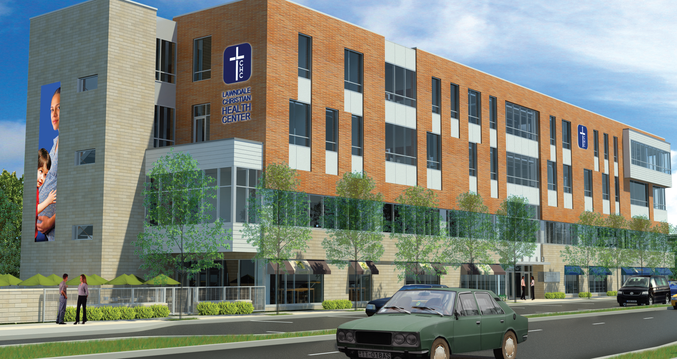
To show and share the love of Jesus.
Lawndale Christian Health Center, Chicago

Slide 21
LCHC Patient Demographics
Total Patients =165

Slide 22
Viral Load Suppression Baseline Data (In+ Care Campaign Measure -January 1, 2012-September 30, 2012 – Patients who receive Primary Care and Case Management Services)

Slide 23
LCHC John Ryan’s Multidisciplinary Clinic Integrated Clinical & Non-Clinical Patient-Centered Care
Rationale
Weekly Case Conferences – started July, 2008
Review patients with appointments during the week.
Care Plan developed with notes to assist Provider
Monthly Clinical Case Conferences – started 2010
Discuss medical treatment progress for patients seen
Discuss barriers to medical treatment adherence
Follow-up on select cases from previous weeks

Slide 24
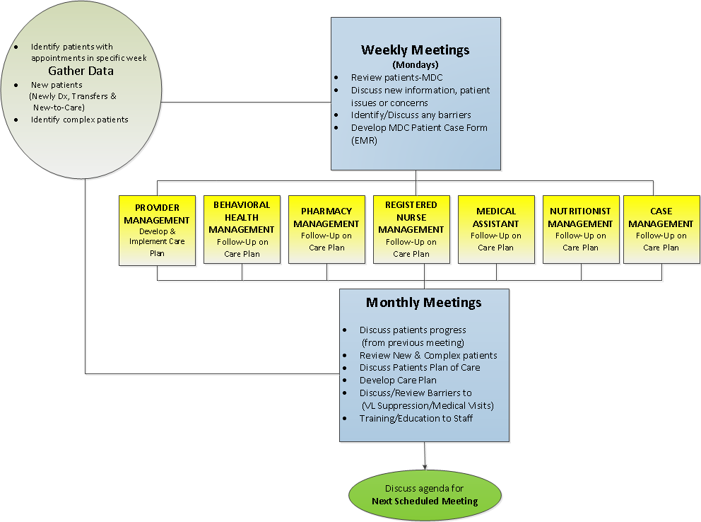
LCHC John Ryan’s Multidisciplinary Clinic Meetings

Slide 25
JR Multidisciplinary Clinic: Behavioral Health Model with Sub-Population
Rationale:
Medical treatment adherence (ART and medical visits) is commonly impeded by:
(a) current/past psychiatric disorders: substance-related disorders; personality disorders and neurocognitive deficits
(b) stressors related to daily living (e.g. housing, benefits)
2. Current Behavioral Health Model consultations and interventions during patient’s medical visits do not address specific persistent adherence barriers that requires more intensive interventions.

Slide 26
PDSA: Behavioral Health Pilot Intervention
Phase 1: Short-term joint psychotherapy and supportive case management to patients
with mood disorders and poor adherence
to medical appointments and/or ART.

Slide 27
Process Outcome: Behavioral Health Pilot Intervention
Phase 1: (Completed)
Between April 2012 to September 2012, 11 patients were referred for the Behavioral Health Pilot Intervention.
64% were in active treatment
(defined by 2 or more sessions completed w/Psychologist)
Phase 2: (Future)
% of missed medical visits
% of adherence to ART
% of completed assessments
-Psychiatric symptom checklist: Client Diagnostic Questionnaire(CDQ)
-HIV treatment adherence measure: Chesney-scale
-Health related quality of life: MOS-scale
-Daily stress index scale

Slide 28
Key Elements of Patient-Centered and CQI Processes
As a large group, identify key elements that need to be in place in order to manage continuous improvement for sub populations:
1.
2.
3.
….

Slide 29
Small Group Discussion
Instructions: In your small groups, share experiences with your own Quality Management Programs and identify what changes need to occur in order to improve care for sub populations and individual patients not retained and not suppressed.
Then, report out to the larger group.

Slide 30
Testing the “Best”….Stay Tune!
We propose….the “Best” is an improvement process that:
more frequently reports data to monitor retention and VL suppression for sub populations
“drills down” the data to identify patients falling out of
care, their reasons, and VL data
engages multidisciplinary team members in meaningful dialogue about individual patient approaches
that are incorporated into care plans
closes the loop by reporting on the effectiveness of
interventions back to the team for further discussion and
follow up.

Slide 31
In closing,
Keep in touch with your ideas.
Thank you.

Slide 32
Contact Information
Paul Cassidy, M.S.W., Program Director
Greater New Bedford Community Health Center
New Bedford, MA
pcassidy@gnbchc.org
Ron Chacko, M.D., HIV Service Line Leader
Lawndale Christian Center, Chicago, IL
ronchacko@lawndale.org
Sonji Miller, M.S., Manager of HIV and Substance Abuse
Lawndale Christian Health Center, Chicago, IL
sonjimiller@lawndale.org

Slide 33
Contact Information
Mindy Golatt, RN, MPH, Public Health Analyst, HRSA/HAB, Project Officer/Chicago, mgolatt@hrsa.gov
Nanette Brey Magnani, EdD, Quality Management Consultant, NQC/HIVQUAL, breymagnan@aol.com
Flowcharts
Notes:
Let’s take a look at the steps to create a flowchart:
Agree at the beginning what the flowchart should accomplish and the level of detail you will need to accomplish that goal.
Then, identify the first and last step of the process. This sounds easier than it is. It can be hard to clarify exactly where the process begins and ends, but it is critical that you set these boundaries at the beginning.
Then begin filling in the steps, from first to last. If you come to a decision point, a diamond, choose the most-often occurring path and continue it all the way to the end; then go back and complete the second branch. You’ll get terribly confused if you don’t.
When you’re done, review the chart: read it out loud to the group for accuracy and make sure everyone understands it.
If you uncover parts of the process that aren’t clear, don’t guess. Assign someone on the team to find out “what really happens,” gather additional input and report back.

Slide 34
Addendum

Slide 35
GNBCHC Workflow Process for Established Patients – RN Adherence Intervention
PATIENT REGISTERS
MA TAKES
VITALS
Determine next steps with patient
**
Provider
Reviews Med’n Regimen
PHYSICIAN EXAMINES
PATIENT, REVIEWS
RESULTS AND REGIMEN
>200
<200
RN – 15 min to 30 min Review barriers to adherence, customize approach - pre-pack meds, deliver to house, review meds and fill pill box
Multi-Disciplinary Team Review
Give lab orders, patient to Lab
Order Blood work for next three month review
Lab Blood Draw
Schedule next visit
Lab Results sent to Physician
Lab Results Sent to RN
Concern with Results
Lab Results Sent to Data Entry. Blood work electronically entered into EHR
Call patient and make earlier visit than previously scheduled
N
Y
No further
Follow-up

Slide 36
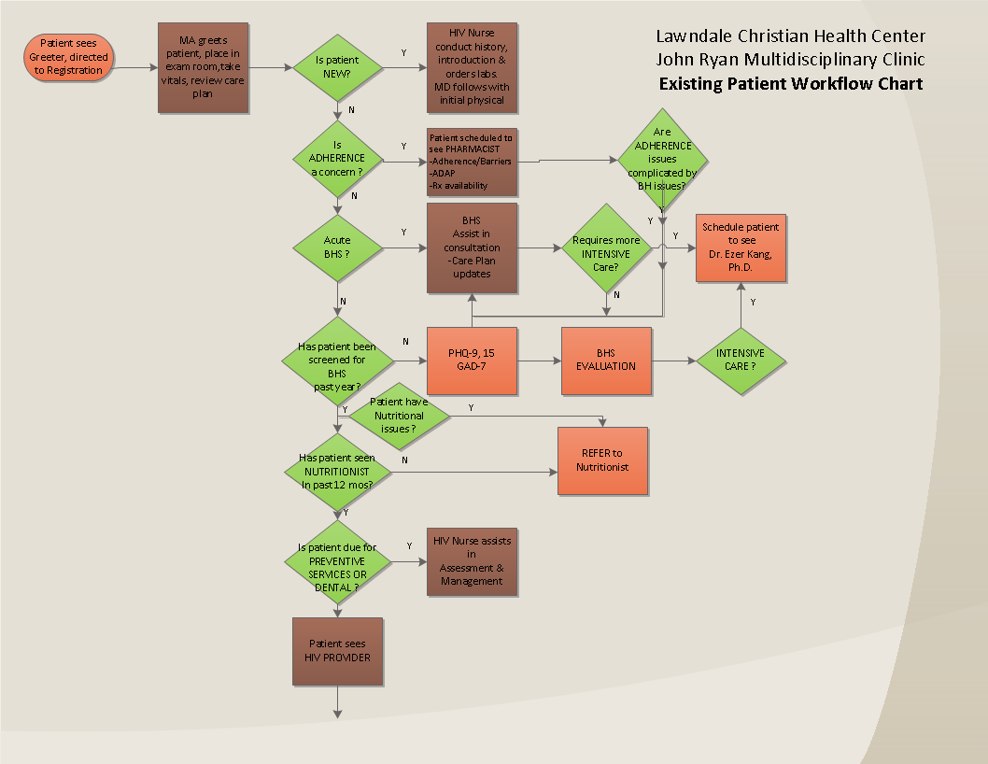

Slide 37
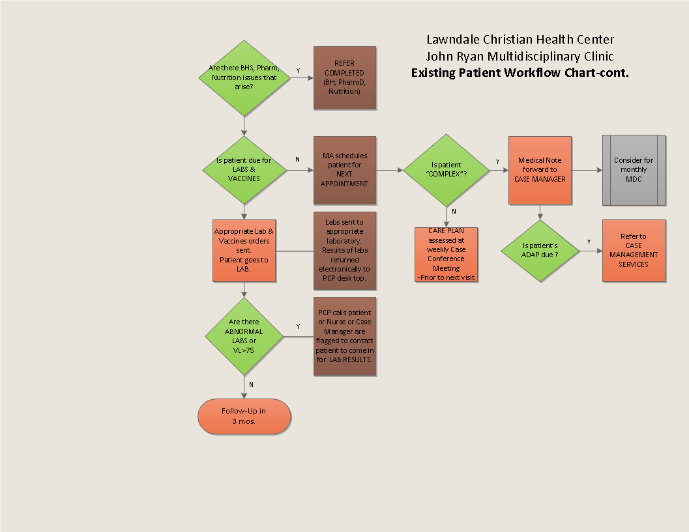
LCHC John Ryan’s Clinic Integrated Clinical & Non-Clinical Patient-Centered Care Workflow Process -CONTINUED

