Slide 1
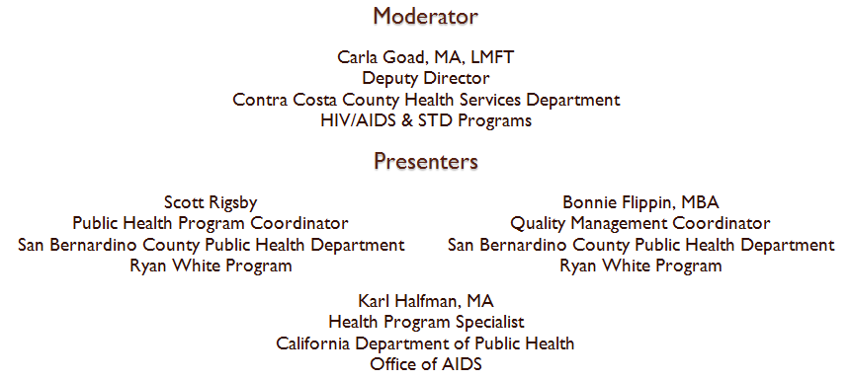
Making Data Count:
California's Experience Implementing a
Data Improvement Plan

Slide 2
Making Data Count:
California's Experience Implementing a Data Improvement Plan
Presented by Karl Halfman, Health Program Specialist  California Department of Public Health, Office of AIDS

Slide 3
ARIES Overview
AIDS Regional Information and Evaluation System is a web-based, centralized HIV/AIDS client management system that allows for coordination of client services among medical and supportive service providers and provides comprehensive data for program reporting and monitoring.
Providers can use ARIES to meet their federal reporting requirements for Ryan White, as well as the Housing Opportunities for Persons with AIDS (HOPWA) Program. ARIES participated in the beta testing of the client level data reporting and is a Ryan White Services Report (RSR)-Ready system.
ARIES is a collaborative project between the California Department of Public Health, the Texas Department of State Health Services, the San Bernardino County Public Health Department, and the San Diego County Health and Human Services Agency. ARIES is now used in California, Texas, Nevada, and Colorado.

Slide 4
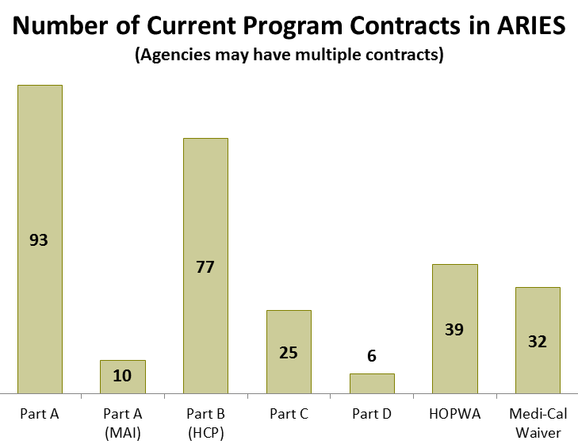
ARIES in California
231 agencies currently use ARIES. These include health departments, community clinics, hospitals, housing authorities, AIDS service organizations, and food banks throughout California.
Most ARIES agencies are funded by Part A and Part B.
1,545 users logged into ARIES during federal fiscal year (FFY) 2012.
32,036 clients were served by ARIES agencies during FFY 2012.

Slide 5
“The DIP”
After rolling out ARIES in California, the State Office of AIDS turned our attention to data quality.
In early 2010, a team consisting of three researchers, the ARIES Help Desk manager, an office technician, and a health program specialist began meeting to discuss how to monitor and improve the quality of ARIES data.
We developed and wrote the ARIES Data Improvement Plan – DIP for short – which has three levels of interventions.

Slide 6
“The DIP”
Since we did not have any additional resources to implement and maintain the DIP, we designed the plan to spread the work among existing staff. This makes efficient use of limited resources and helps keep the team engaged without burning out.
Our team meets for 60 to 90 minutes at the beginning of each month. We use this time to manage the workflow, review provider performance, identify trends or problems, and evaluate our efforts. We rarely cancel these meetings.

Slide 7
Overview of Interventions
Review that Month’s Report
Identify Providers
Contact Providers
Monitor Improvement

Slide 8
Intervention: Process Check
Process Checks ask: Are users entering data into ARIES?
A different topic is handled each month such as:
    Are services being entered?
    Are data being entered in a timely fashion?
    Are providers informing their clients about the ability to “share” their ARIES data with their other providers?
Occurs 11 to 12 times per year

Slide 9
Intervention: Focused Technical Assistance
Focused Technical Assistance (FTA) asks: What is the quality of the data being entered into ARIES?
Unlike typical user trainings, this intervention is narrowly focused on improving selected providers’ ability to collect and enter key data elements
Use webinars to focus on improving data elements such as CDC Disease Stage, Insurance, and CD4 Tests
Occurs 7 to 8 times per year

Slide 10
Intervention: ARIES User Group
The ARIES User Group asks: How are the ARIES data being used? and How can we better utilize the data?
Webinar conference call with formal presentations by providers and ARIES staff on innovative uses of the system, demonstrations of new features, etc.
Held 2 or 3 times per year.
All ARIES agencies in California are invited to attend.

Slide 11
Process Check
Review that Month’s Report
Identify Providers
Contact Providers
Monitor Improvement

Slide 12
Process Check
Here is an example of the steps we take for the Process Check on Timeliness of Service Data Entry.
The optimum goal for entering data into ARIES is in real-time. Some agencies may not be able to meet this goal due to staffing levels, lack of computers, or other business practices. State-funded providers who are unable to enter data in real-time have up to two weeks from the service date to enter the data.
We review the Timeliness of Service Data Entry by Agency Report in ARIES.
Review that Month’s Report
Identify Providers
Contact Providers
Monitor Improvement

Slide 13
Process Check
The Timeliness of Services Data Entry by Agency Report displays the average number of days (i.e., “lag days”) between when a service was provided and when it was entered into ARIES.
We identify those providers with 30 or more lag days. These are the providers we will contact for the Process Check.
Review that Month’s Report
Identify Providers
Contact Providers
Monitor Improvement

Slide 14
Process Check
We e-mail those providers with lag days over 30 with a note that:
  Reminds them about the expectation,
  Explains how to identify and remedy exceptions, and
  Asks whether they need technical assistance in order to meet said expectations.
  Most providers indicate that they have simply fallen behind. Some providers may identify problems – such as their access to ARIES has expired or the new data entry clerk needs training. In these cases, we link the provider to the appropriate resource to resolve the problem.
Review that Month’s Report
Identify Providers
Contact Providers
Monitor Improvement

Slide 15
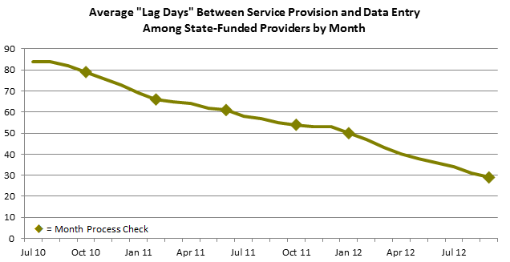
Process Check
We monitor agencies for improvement after the process check.
Since implementing the DIP, the average number of “lag days” has fallen steadily from 84 in July 2010 to 29 in September 2012.
Review that Month’s Report
Identify Providers
Contact Providers
Monitor Improvement

Slide 16
Process Check
Process Checks help us stay on top of problems. They also remind providers about keeping up-to-date with data entry so that they aren’t overwhelmed with data entry backlogs during RSR season.
Process Checks are repeated on a cyclical basis. When we first conducted the Timeliness of Service Data Entry in October 2010, we contacted 21 providers with more than 30 lag days. In February 2011, we reviewed provider performance and repeated the check. That month, we contacted 23 providers – 15 of whom had been contacted in October and were still working on improving their timeliness.
Review that Month’s Report
Repeat Process
Identify Providers
Contact Providers
Monitor Improvement

Slide 17
Process Check
Tips
  Slow and steady – We don’t operate in crisis. For example, some might think that 84 lag days needs to be corrected immediately. However, our view is that change takes time. We are confident that our interventions will improve data quality over the long haul.
  Honey, not vinegar – We view Process Checks as friendly-reminders. Process Checks also provide an opportunity to clarify expectations, problem-solve, and build relationships with end users. This approach yields better results than simply threatening sanctions for being out of compliance.

Slide 18
Focused Technical Assistance
Define Data Checks
Select Providers
Present Webinar
Run Fix-It Reports

Slide 19
Selecting Key Data Elements
In order to implement the Focused Technical Assistance, we needed to decide which data elements to target. We used a three step process to prioritize our workload.
Each team member identified the top 25 most important data elements out of the 1,922 data elements in ARIES. We asked ourselves questions like:
  Are providers required to collect this data element?
  Is this data element used by program and providers for planning or evaluation?
  Is this data element included on state or federal reports?
The individual lists were compiled into one list with 62 data elements – most of which were RSR data elements.
Is it important?
Is it “improvable”?

Slide 20
Selecting Key Data Elements
We then analyzed the frequency distributions of these 62 data elements to identify where providers were struggling. Data elements with high missing rates, high percentages of unknowns, or other data entry errors remained on our list.
Is it important?
Is it problematic?
Is it improvable?

Slide 21
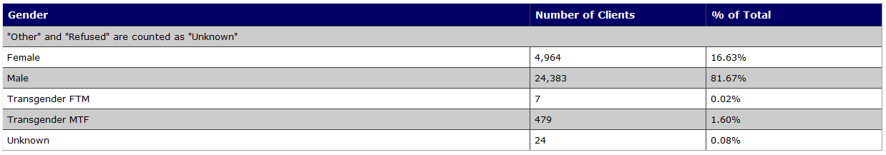
Selecting Key Data Elements
We did not focus on data elements that providers were having success with. For example, Gender is important. However, since Gender is a required field in ARIES, it has a 100% completion rate. The number of unknowns were almost nil. Focusing our energy on Gender meant ignoring some other data element that providers were struggling with.
Is it important?
Is it problematic?
Is it improvable?

Slide 22
Selecting Key Data Elements
Lastly, we identified data elements that we could actually affect. There were some data elements that were both important and problematic for which were we unable to operationalize data checks. These fell off our list.
For example, Current Living Situation is an RSR-required data element and has become increasingly important since the release of the National HIV/AIDS Strategy. At the time, 36% of ARIES clients had an unknown or missing living situation. When we began working on this Focused Technical Assistance, we discovered that ARIES does not currently allow us to create the reports needed to identify problems with Current Living Situation. This data element is on our laundry list until this capability can be added to ARIES.
Is it important?
Is it problematic?
Is it improvable?

Slide 23
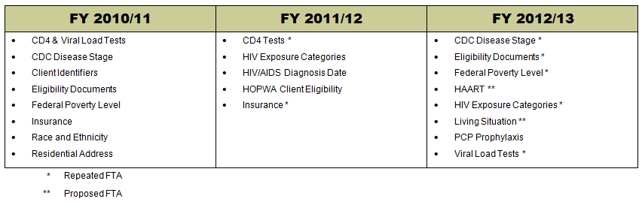
Focused Technical Assistance
We have adopted 15 key data elements so far.
Over the years, we have repeated some FTAs and adopted new ones.

Slide 24
Focused Technical Assistance
To prepare for an FTA, we first decide how to operationalize the data check. This process is heavily influenced by the RSR and HAB HIV Performance Measures. Each FTA consists of multiple data checks.
Once we had identified the criteria for each data check, we develop the FTA Monitoring Report which allows us to monitor and evaluate each agency’s performance. The report generates separate scores for each data check and one overall score. For example, we developed three data checks for the Insurance FTA to check for missing records, missing Start Dates, and unknown Insurance Sources.
Define Data Checks

Slide 25
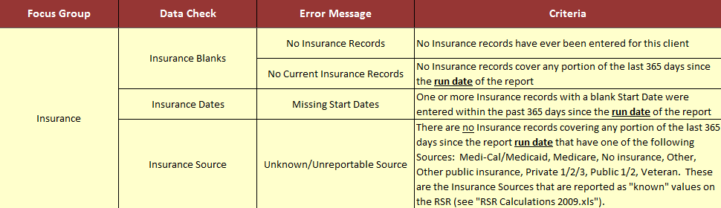
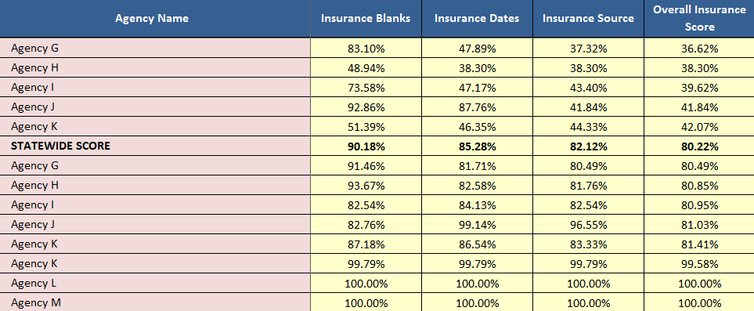
FTA Monitoring Report

Slide 26
Focused Technical Assistance
We review the FTA Monitoring Report to see how agencies are performing. Depending on the FTA topic, we may look at the performance of providers for a specific program (such as Part B or HOPWA), all state‐funded providers, or all ARIES agencies regardless of funding.
We decide which agencies to invite based on how they perform compared to the overall statewide score or program benchmarks.
We invite the selected agencies to a webinar to learn more about the particular data element. The audience can vary from 20 to 60 agencies depending on the topic and provider performance.
Define Data Checks
Select Providers

Slide 27
Focused Technical Assistance
We hold the webinar on that month’s topic. The webinars typically run between 30 and 60 minutes long. The presentations follow a basic format:
    Tell them why it is important to collect and enter data accurately and correctly.
    Demonstrate how to correctly enter the data.
    Show them how to identify and remedy data entry problems using the Fix-It Reports.
    Answer questions. Remind them where to go for more help.
  We take roll so we can follow up with providers who don’t attend. The presentations are posted on www.projectaries.org so that other grantees and providers can use them.
Define Data Checks
Select Providers
Present Webinar

Slide 28
Focused Technical Assistance
One principle of the FTA is that it is not enough to tell providers there’s a problem with their data, we have to give them tools to identify and resolve the problem.
Using the same criteria we defined for the FTA Monitoring Report, the ARIES Help Desk Manager designed Fix-It Reports in ARIES.
The Fix-It Reports display all the client records for the reporting period. Those records with problems appear at the top of the report with descriptions of the problems.
After the webinar, providers run the Fix-It Report to easily identify problem records that that need attention.
Define Data Checks
Select Providers
Present Webinar
Run Fix-It Reports

Slide 29
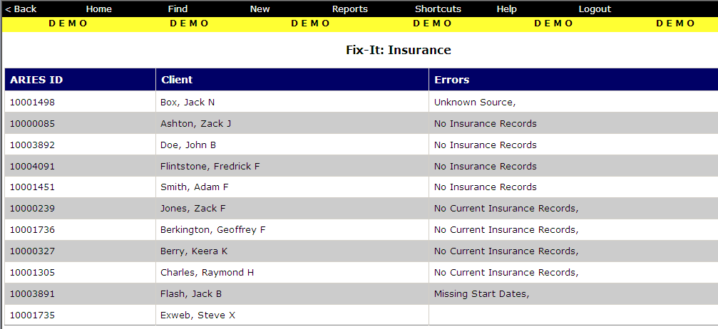
Fix-It Report
Client Data are fictitious

Slide 30
Focused Technical Assistance
We review subsequent FTA Monitoring Reports to see if the selected providers have improved or whether additional follow-up is needed.
To view the global impact of our efforts, we also track the overall statewide scores. Insurance is one of the data elements monitored through the DIP. Compliance among all ARIES agencies has steadily improved from 67.6% in February 2011 to 80.2% in September 2012. Because of the importance of this data element, we repeated this FTA.
Define Data Checks
Monitor Change
Select Providers
Present Webinar
Run Fix-It Reports

Slide 31
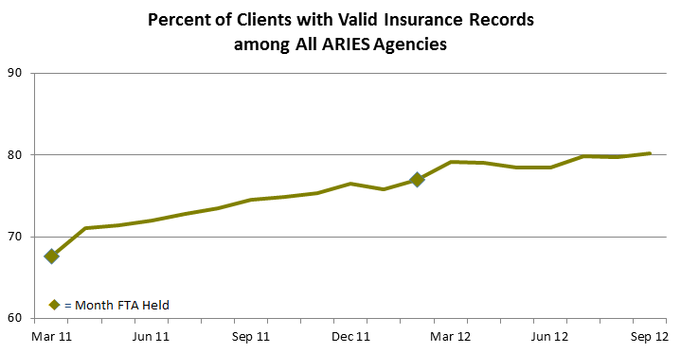
Focused Technical Assistance

Slide 32
Focus Technical Assistance
Tips
  Can’t Solve Every Problem – Resist the desire to fix everything. Given limited time and resources, we focused only on the most critical data elements.
  Framing the Situation – FTAs are really about making data count! Data collection is more than just a bureaucratic chore. We tell our data collectors why a particular data element is important and how it is used by providers, grantees, researchers, and others. We think staff are more committed to data quality when they know how their efforts fit into the larger picture.
  Lessons Learned – We are constantly learning from the DIP. We make adjustments to our plan throughout the year. We share ideas for system enhancements that arise from FTAs. We annually evaluate our work and make changes for the following year.

Slide 33
ARIES User Group
Define Data Checks
Select Providers
Present Webinar
Run Fix-It Reports

Slide 34
ARIES User Group
This is a forum for all participants to share and learn from each other.
Held 2 or 3 times per year.
All ARIES agencies in California are invited to participate.
Presenters discuss their work, share report templates with other users, demonstrate new features, reinforce policies, and glean feedback for potential or pending enhancements.

Slide 35
ARIES User Group
Providers have presented on innovative ways to utilize ARIES for (a) finding clients who have fallen out of care, (b) minimizing the impact of budget cuts on client care, (c) monitoring for duplicative services, and (d) identifying clients who should be on HAART.
ARIES Staff have demonstrated new features such as (a) using the Substance Abuse and Mental Illness Symptoms Screener (SAMISS), (b) running the HAB Quality Management Indicators and Client Follow-Up Reports, and (c) documenting Low Income Health Program (i.e., California’s Bridge to Health Care Reform) Enrollment.
There have also been presentations that reinforce policies and procedures like (a) safeguarding data security and client confidentiality and (b) preventing and resolving duplicate ARIES clients.

Slide 36
Benefits of the DIP
Define Data Checks
Select Providers
Present Webinar
Run Fix-It Reports

Slide 37
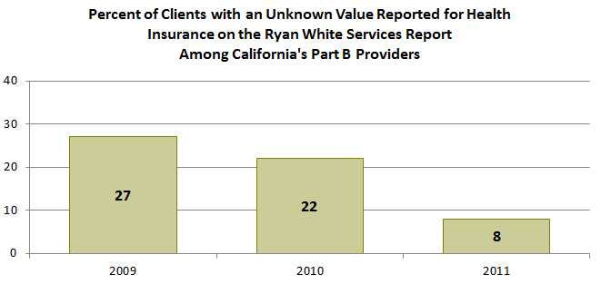
Benefits of the DIP
The DIP is closely aligned with the RSR and HAB’s efforts at improving data completeness.
When providers run the Fix-It Reports, there is a decrease in missing and unknown values related to that particular data element.
When we plan next year’s topics, we will use the RSR Completeness Reports to help prioritize which data elements to focus on.

Slide 38
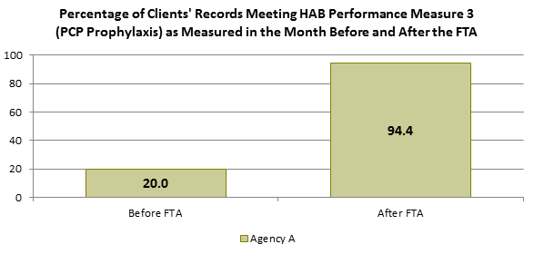
Benefits of the DIP
The FTAs also help ensure that the data used to calculate HAB Performance Measures are complete and accuracy.
For example, Agency A attended the PCP Prophylaxis FTA and then ran the Fix-It Report. Theoretically, their clients were meeting the measure at least 94.4% of the time all along. It just took awhile, following the FTA, for the data to catch up and accurately reflect the care that was being delivered.

Slide 39
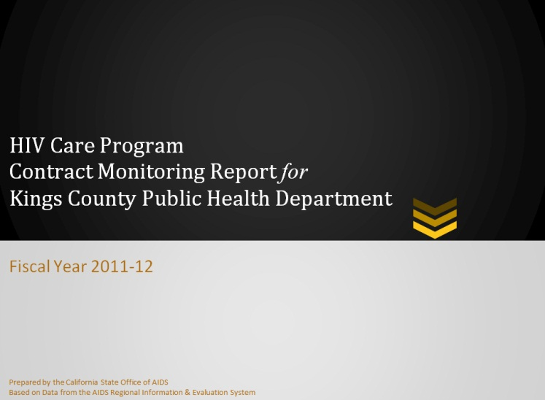
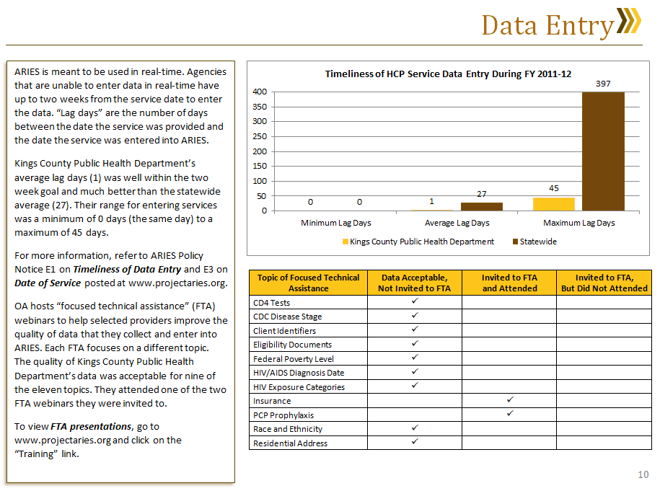
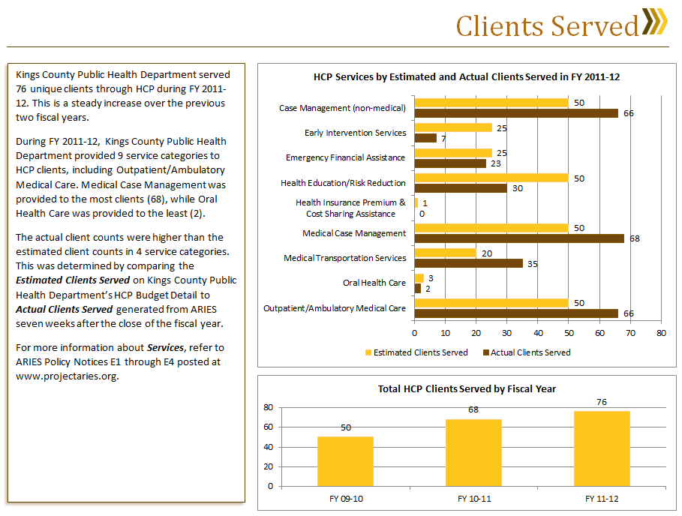
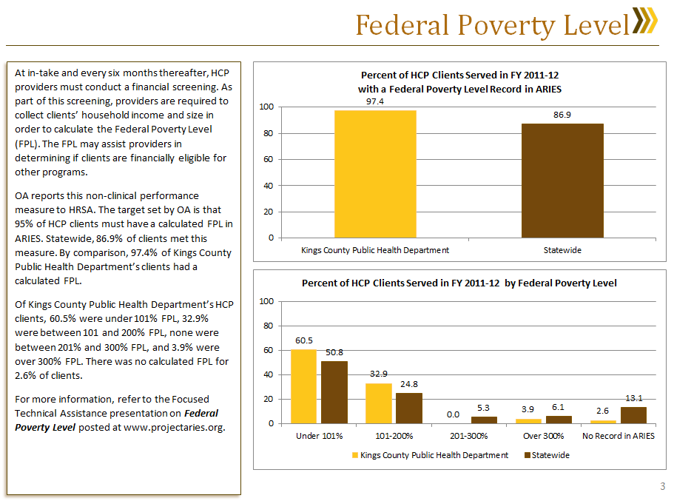
Benefits of the DIP
We have integrated data into the annual contract monitoring process by generating an HIV Care Program Contract Monitoring Report for each provider. Contract Monitors review these reports during their site visit to identify where the providers are doing well and where they could improve. Among other things, the reports demonstrate the value of quality data and reinforce the expectations for data collection.

Slide 40
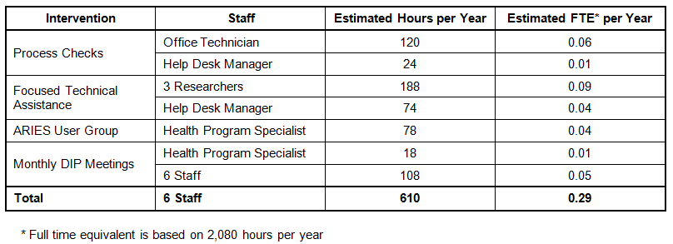
Benefits of the DIP
These and other benefits have been achieved by using existing staff resources more efficiently. The entire DIP takes six staff members about 610 hours – or almost one-third of an FTE – per year to manage and implement.

Slide 41
For More Information
Grantees outside of California who would like to learn more about adopting ARIES, please contact:
  Jenny Martin, ARIES Project Manager
  The Queenstone Group
  jmartin@queenstonegroup.com
  415-624-7950

Slide 42
For More Information
Grantees and providers who would like to learn the ARIES Data Improvement Plan, please contact:
  Karl Halfman, Health Program Specialist I
  California Department of Public Health, Office of AIDS
  karl.halfman@cdph.ca.gov
  916-449-5966
  Or visit www.projectaries.org and click on “Training” to access DIP materials.

Slide 43



County of San Bernardino
Department of Public Health
Ryan White Program
Making Data Count:
California’s Experience Implementing a Date Improvement Plan
TGA Perspective
Scott Rigsby
Public Health Program Coordinator
srigsby@dph.sbcounty.gov
Bonnie Flippin, MBA
Quality Management Coordinator
bflippin@dph.sbcounty.gov

Slide 44

Riverside/San Bernardino, CA TGA
Part A and MAI
Inland Empire HIV Planning Council and Clients
County of San Bernardino
County of Riverside
Administrative Agent
Intergovernmental Agreement

Slide 45
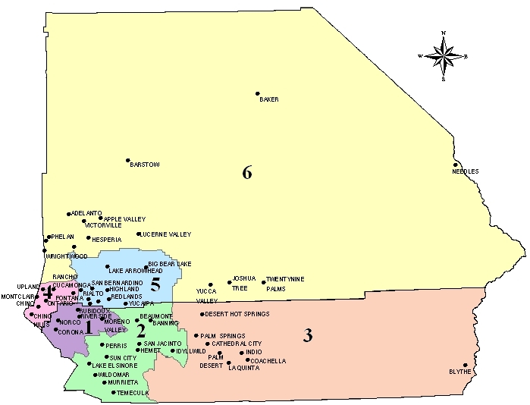
Riverside/San Bernardino, CA TGA
Population
4.2 Million
8,000+ PLWHA
4,000+
Clients

Slide 46
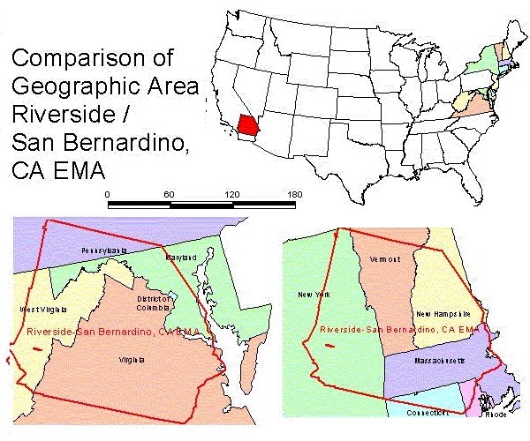
We’re Huge!
Largest RW Jurisdiction
27,407 sq. mi

Slide 47

Unique Barriers
Unique Region
Distance
West Coast / East Coast
Notes:
Describe “east coast epidemic”…….”west coast epidemic”…
San B = “East Coast”
RivCo = “West Coast”

Slide 48
Riverside/San Bernardino, CA TGA
Award = $7.9M
6 Providers
12 Service Locations
13 Funded Services
    Medical Care, Medical Case Management, Pharmacy, Mental Health, Substance Abuse, EIS, Dental, Home and Community- Based Services, Food, Transportation, Case Management, Housing, and Psychosocial Services.
Notes:
6 of us make up 97% of the program:
Coordinator
Two SAII (reporting, QM, compliance) → The admin work we are describing in this presentation
One Fiscal Specialist (Invoicing, Expenditure Tracking)
Two clerical

Slide 49

Local Data Improvement
Data Improvement Activities
Completeness Progress 2010 – 2011
Challenges/Successes

Slide 50

Data Improvement Activities
Contracts / Policies
Technical Leads
Fix-it Reports
Missing RSR Data Report
CA’s Focused TA Webinars
ARIES Data Reviews
Annual On-site Verification

Slide 51
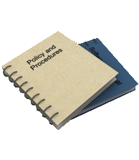
#1: Contracts / Policies
Contracts
  Required to utilize ARIES
  Required to input data within 20 days
  Required to comply with Policy Letters
Policies
  Required to input service data within 20 days
  Required to designate a Technical Lead
  Required to maintain minimum data requirements

Slide 52
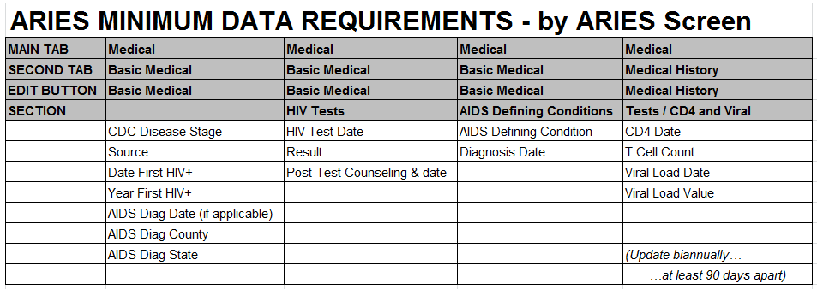
#1: Contracts / Policies
Policy: Minimum Data Requirements
  List Format – By ARIES Screen (Example)

Slide 53
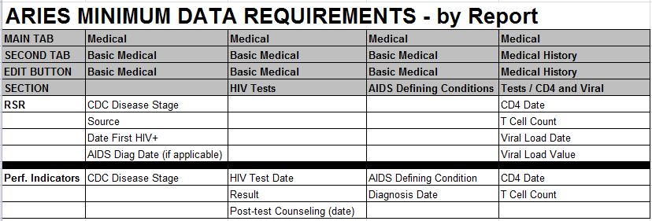
#1: Contracts / Policies
Policy: Minimum Data Requirements
  List Format – By Report (Example)

Slide 54
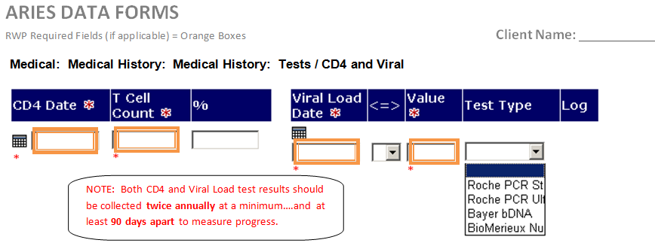
#1: Contracts / Policies
Policy: Minimum Data Requirements
  Screen Shot Format (Example)

Slide 55

#2: Technical Leads
Contractually required to write TL policy
Contractually required to designate a TL
Technical Lead Responsibilities:
  Obtaining RWP approval for new ARIES users
  Troubleshooting IT issues and contacting ARIES Help Desk
  Communicating ARIES requirements to agency staff
  Mentoring / Training agency staff
  Participating on monthly Technical Lead teleconferences
Notes:
Routinized Communication:
Sharing with agencies expectation…..changes….news from ARIES developers
Getting feedback from agencies……adjust procedures…..send up to ARIES developers
Agencies can share effective strategies…..tackle common issues together

Slide 56


#3: Fix-it Reports
State-Developed ARIES QA Reports (July 2010)
Assess data completeness at client-level
Current Fix-it Reports:
Client Identifiers
CDC Disease Stage (HIV Status)
Residential Address
Insurance
Poverty Level
Race & Ethnicity
HIV/AIDS Diagnosis Date
HIV Exposure Categories (Risk)
CD4 Count
Viral Load
PCP Prophylaxis

Slide 57
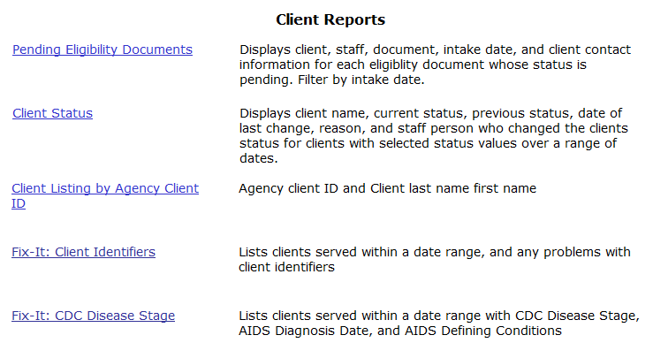
#3: Fix-it Reports
EXAMPLE: Choose report in list:

Slide 58
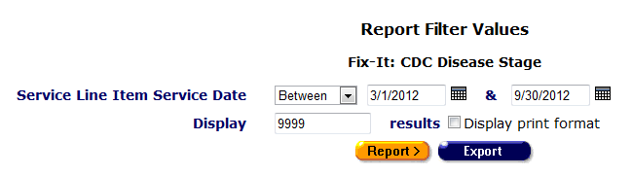
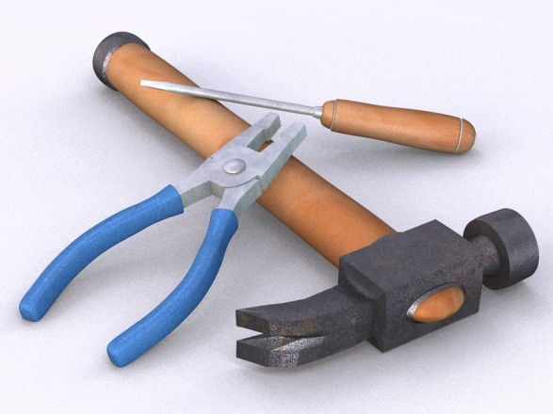
#3: Fix-it Reports
EXAMPLE: Enter parameters

Slide 59
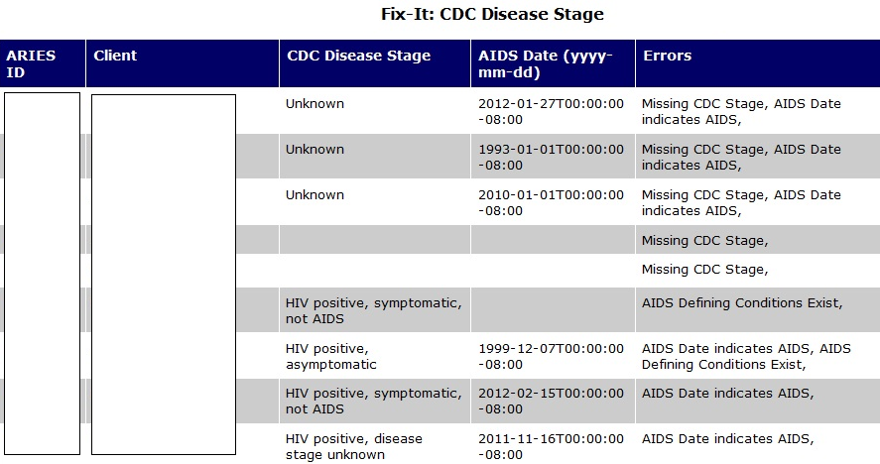
#3: Fix-it Reports

Slide 60
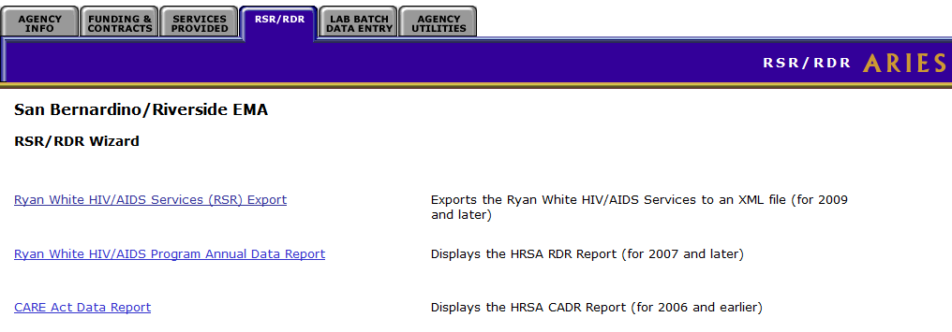
#4: Missing RSR Data Report
Assess data completeness at client-level – RSR Elements
Example: Select Report

Slide 61
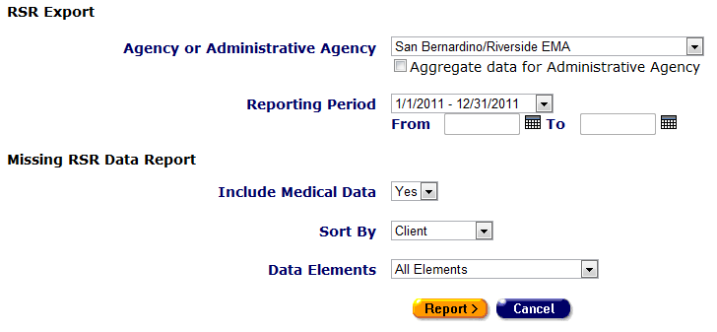
#4: Missing RSR Data Report
Example: Enter Parameters

Slide 62
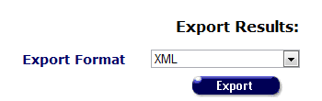
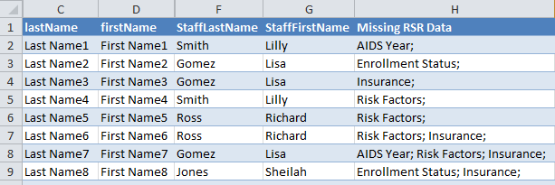
#4: Missing RSR Data Report
Example: Report Output – XML File

Slide 63

#5: Focused TA Webinars
Local providers and RWP staff have participated in several State FTA webinars
Information directly from the State
Opportunity for providers to share end-user experiences, challenges, ideas

Slide 64

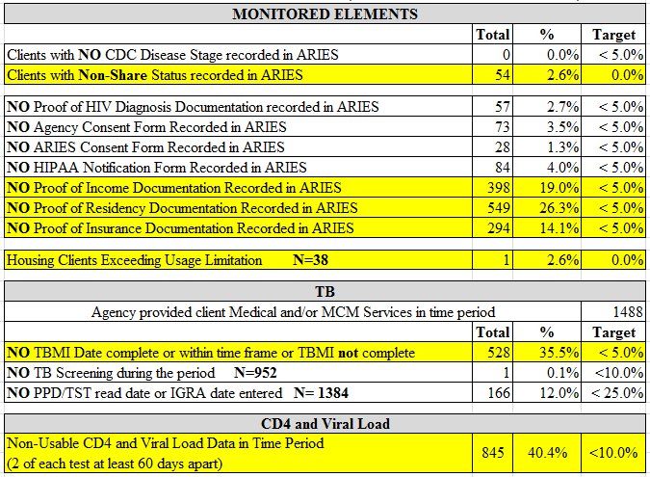
#6: ARIES Data Reviews
Biannual comprehensive review of data completeness

Slide 65

#7: On-site Verification
Annual on-site monitoring visits
Verification of ARIES Data
  Select 5 records with complete data in ARIES
  Review charts for backup documentation
  If one element cannot be verified, select 5 more charts
  Again, if one of those cannot be verified, select 5 more charts
Require written corrective action plans for any deficiencies
Follow-up visits for serious deficiencies

Slide 66

Progress 2010 to 2011
Example: No Values

Slide 67
Progress 2010 to 2011
Example: Unknown Values

Slide 68

Challenges / Successes
Challenges
Managing multiple requirements, overload
Helping to keep ARIES current
Maintaining communication
Staff reductions (at all levels)
Successes
Data focus
Close relationship with ARIES partners, state, agencies
Agency buy-in
Improved data collection

Slide 69

Questions?
QUESTIONS?

