Slide 1

Introduction to Quality
Session 101
Quality Improvement 101 and Ryan White Legislative Requirements for Quality Management: I Am New to Quality Improvement – Where Do I Start?
Tracy Matthews, RN, MHA
Barbara M. Rosa, RN, MS
Wednesday, Nov 28; 10:00–11:30 AM
Virginia C
RWA-0223

Slide 2
Learning Objectives
Recognize the important role quality plays in the delivery of health care as well as its basic definition and principles
Understand the quality expectations and requirements for Ryan White Programs
Learn the key characteristics of a Ryan White-funded quality management program
Learn concrete action steps which will allow you to initiate an effective quality management plan and quality management activities within your program

Slide 3
Agenda
HAB Expectations for Quality in RW programs - Tracy Matthews (15 min)
Pecha-Kacha (chit chat) about QI Principles - Barbara Rosa (10 min)
Where to start - Voices from peers (35 min)
Case Study (15 min)
Report out & Q&A (15 min)

Slide 4
Quality Management in the Context of the Ryan White Program

Slide 5
HAB’s Working Definition of Quality
“Quality of care is the degree to which health services for individuals and populations increase the likelihood of desired health outcomes and are consistent with current professional knowledge.”
Institute of Medicine. Medicare: A Strategy for Quality Assurance. Vol. 1. (1990)

Slide 6
Ryan White Treatment Extension Act of 2009
“The chief elected official/ grantee… shall provide for the establishment of a clinical quality management program to assess the extent to which HIV health services provided to patients under the grant are consistent with the most recent Department of Health and Human Services (HHS) guidelines for the treatment of HIV disease and related opportunistic infection, and as applicable, to develop strategies for ensuring that such services are consistent with the guidelines for improvement in the access to and quality of HIV health services”

Slide 7
Ryan White Program Quality Requirements
“RW grantees are directed to establish clinical quality management programs..” which include:
  Development of a comprehensive clinical quality management infrastructure, including routine QM meetings with cross-functional representation
  Description of QM program in a written quality management plan, with a clear indication of responsibilities and responsible parties
  Inclusion and involvement of key stakeholders in your quality management program
  Designated leaders for quality improvement and accountability

Slide 8
Ryan White Program Quality Requirements
“Assess the extent to which HIV health services are consistent with the most recent HHS guidelines…” which includes:
  Development and/or adaptation of quality indicators for key clinical and service categories
  Routine performance measurement of key care aspects
  Sharing of performance data with program staff
  Use of data to improve the organization’s performance on key services

Slide 9
Ryan White Program Quality Requirements
“Develop strategies for ensuring that such services are consistent with the guidelines for improvement in access to and quality of HIV service…” that include:
  Linking performance data results to quality improvement activities
  Establishment of quality improvement teams with cross-functional representation
  Integration of changes into routine program activities

Slide 10
Key Characteristics of a Quality
Management Program
Patient-centeredness is a fundamental focus of quality care and undergirds the 5 characteristics that follow.
1. A systematic process with identified leadership, accountability, and dedicated resources available to the program
2. Use data and measurable outcomes to determine progress toward relevant, evidenced-based benchmarks
3. Focus on linkages, efficiencies and provider, and client expectation in addressing outcome improvement

Slide 11
Key Characteristics of a Quality Management Program (cont.)
4. A continuous process that is adaptive to change and that fits within the framework of other programmatic quality assurance and quality improvement activities
5. Ensure that data collected are fed back into the quality improvement process to assure that goals are accomplished and that they are concurrent with improved outcomes

Slide 12
Quality Continuum

Slide 13
Overall Goal
The best care we know how to give,
for every patient,
at every site,
every day.

Slide 14
QI Principles

Slide 15
QI Principles

Slide 16
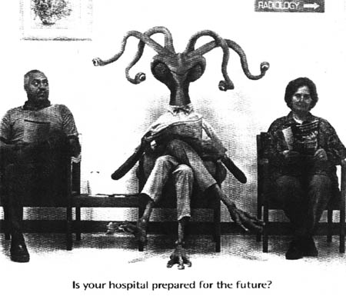
Success Is Achieved Through Meeting the Needs of Those We Serve.

Slide 17

Most Problems Are Found in Processes,
Not in People.

Slide 18

Do Not Reinvent the Wheel – Learn From Best Practices.

Slide 19

Learn Through Small, Incremental Changes to Achieve Continual Improvements.

Slide 20

Actions Are Based Upon Accurate and Measured Data.

Slide 21
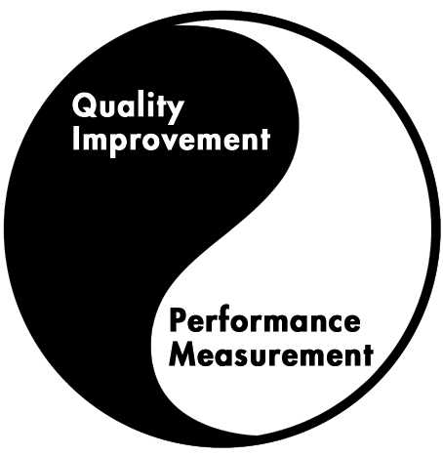
Infrastructure Enhances Systematic Implementation of Improvement Activities.
Quality Management
Program

Slide 22

Set Priorities and Communicate Clearly.

Slide 23
1) What does CQI stand for?
Community Quality Initiative
Case Management Quality Ideas
Continuous Quality Improvement
Circular Quantum Invention

Slide 24
2) What is the main difference between quality assurance and quality improvement?
Quality assurance uses mainly a team approach
Quality improvement focuses on statistical outliers for improvements
Quality assurance and quality improvement are practically the same
None of the above

Slide 25
3) What is the most important principle for quality improvement? Quality improvement focuses on…
Individual performers
Routine measurement of performance
Training of providers
Systems issues

Slide 26
4) Which of the following is NOT a statement by HAB about Quality Programs?
QM programs need to look beyond clinical services to consider both supportive services and outcomes
QM programs assess the extent to which HIV health services are consistent with the most recent HHS guidelines
The primary focus of the QM program is on performance measurement to assess clinical and non-clinical services
Quality is the degree to which a health or social support service meets or exceeds established professional standards and user expectations

Slide 27
5) The following performance data report is presented: PPD 95%, GYN 85%, and PCP Prophylaxis 55%. You advise the program to continue to measure…
Only PCP Prophylaxis
GYN and PCP Prophylaxis
All three indicators

Slide 28
6) The results of an adherence QI project are presented after 10 months of work, improving the rate to 98% and it was kept between 95%-100% for the last 4 months. You advise the program to…
Discontinue routine measurements
Switch to quarterly measurements
Keep monthly measurements

Slide 29
‘QI is not QA’
 | Quality Assurance | Quality Improvement
Motivation | Measuring compliance with standards | Continuously improving processes to meet standards
Means | Inspection | Prevention
Focus | Individuals, “bad apples” | Processes and Systems
Responsibility | Few | All

Slide 30
Quality Improvement Model: HIVQUAL
Quality
Management Program

Slide 31
Moving from Data to Improvement

Slide 32
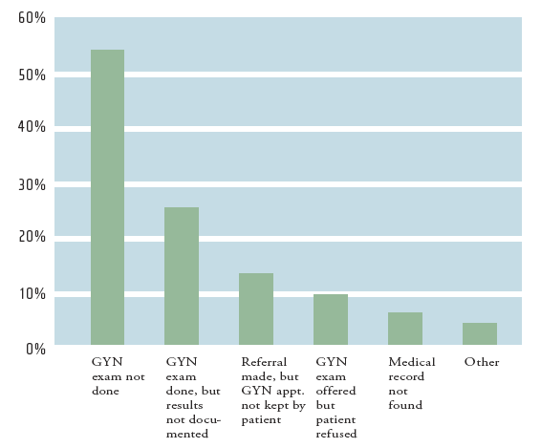

Key Question
What action steps should you take once the data are collected?
?
Notes:
The key question for this Tutorial is: What action steps should you take once data are collected?
We are assuming that you have collected valid and useful data, but what are you doing with the results? How are you analyzing the data? With whom are you sharing the data? What actions do you take in response to the presented data?

Slide 33
Data are a Guide, Not a Grade….
They tell us what questions to ask.
At the level of a network, we can NEVER say that data represent performance, we can only say that the data are spurring us to ask questions:
  “Why is this number so low?
  “Is it a data entry problem, a documentation problem, or a
  problem providing the care (or a mix)?”
  “Why are the numbers so different from this area to that area?”
  “What are these data telling us about our system?"
Only the providers can ANSWER those questions, but we can't even know what to ask if we aren't looking at the whole network’s data together.

Slide 34
Where Should I Start?
Find your quality plan and read it
Consider doing an Organizational Assessment of the quality management program
Take one Quality Academy Tutorial
Download one quality improvement publication at NationalQualityCenter.org
Sign up for NQC’s TOT or TQL Program

Slide 35
Individual/Group Exercise
Review the Quality Expectations Case Study handout
Individually, rate the components described for compliance with the required elements
Be ready to discuss your ratings with your table group
We will have an anonymous large group report out also…

Slide 36
Why Quality Improvement in HIV Care?
Magnitude of epidemic
Approximately 1.1 million people in the United States are living with HIV/AIDS
Over 550,000 people in the United States who had AIDS have died
39.5 million people around the world are living with HIV/AIDS
15.2 million children have been orphaned as a result of HIV/AIDS worldwide so far

Slide 37
Why Quality Improvement in HIV Care?
Effectiveness of medical care
As of 2005, the age-adjusted HIV death rate had fallen by 70% since its peak in 1994-1995
Increasingly effective HIV therapy had contributed to saving 3 million years of life
Within the last 15 years, vertical transmissions rates have been reduced from around 25% to under 4%
Notes:
RP Walensky et al. The survival benefits of AIDS treatment in the United States. The Journal of Infectious Diseases. Published online June 1, 2006.
Abstract: Mortality and Morbidity in the HAART Era: Changing Causes of Death and Disease in the HIV Outpatient Study (Poster 872)
Authored by: F. J. Palella Jr., R. Baker, A. C. Moorman, J. Chmiel, K. Wood, S. D. Holmberg, The HOPS Investigators
Affiliations: Northwestern Univ., Chicago, IL; Cerner Corp., Herndon, VA; CDC, Atlanta, GA

Slide 38
Why Quality Improvement in HIV Care?
Urgent need to address socioeconomic and racial disparities in prevalence and outcomes
32% of white Americans and 59% of black Americans living with HIV/AIDS rely on Medicaid for their health care
Racial and ethnic minorities account for 71% of new AIDS cases, and 64% of people living with AIDS
While African American teens account for only 15% of all American teenagers, they accounted for 65% of new AIDS cases reported in 2002

Slide 39
Why Quality Improvement in HIV Care?
Changing nature of the patient population
Women accounted for 8% of new AIDS diagnoses in 1985 and 27% in 2005
Heterosexual transmission currently accounts for approximately 1 in 3 newly diagnosed AIDS cases; in 1985 it accounted for only 3%
Between 2001 and 2005, AIDS cases increased most rapidly in the Midwest (38%) and the South (19%)
People living with HIV and taking ARV are more likely to die of an age-related illness than an AIDS-related illness
Notes:
Abstract: Mortality and Morbidity in the HAART Era: Changing Causes of Death and Disease in the HIV Outpatient Study (Poster 872)
Authored by: F. J. Palella Jr., R. Baker, A. C. Moorman, J. Chmiel, K. Wood, S. D. Holmberg, The HOPS Investigators
Affiliations: Northwestern Univ., Chicago, IL; Cerner Corp., Herndon, VA; CDC, Atlanta, GA

Slide 40
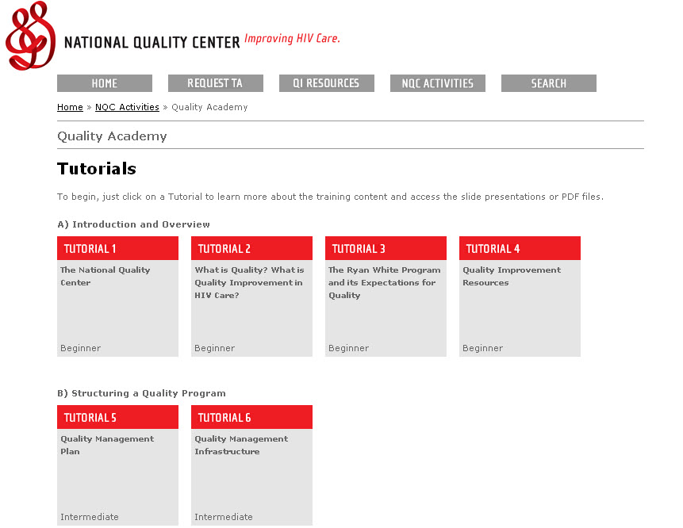
Resources
http://nationalqualitycenter.org/index.cfm/17263

Slide 41
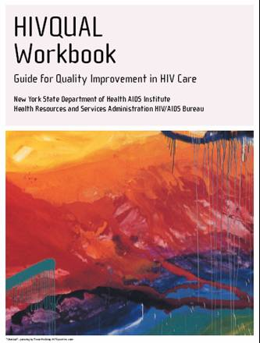
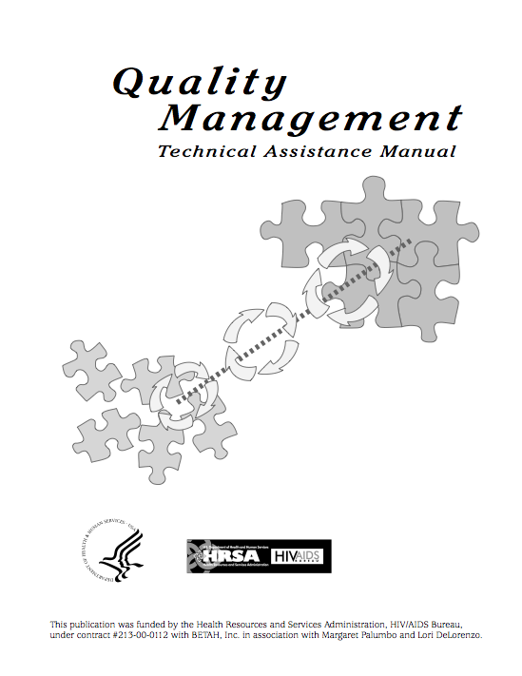
Quality Improvement Resources

Slide 42
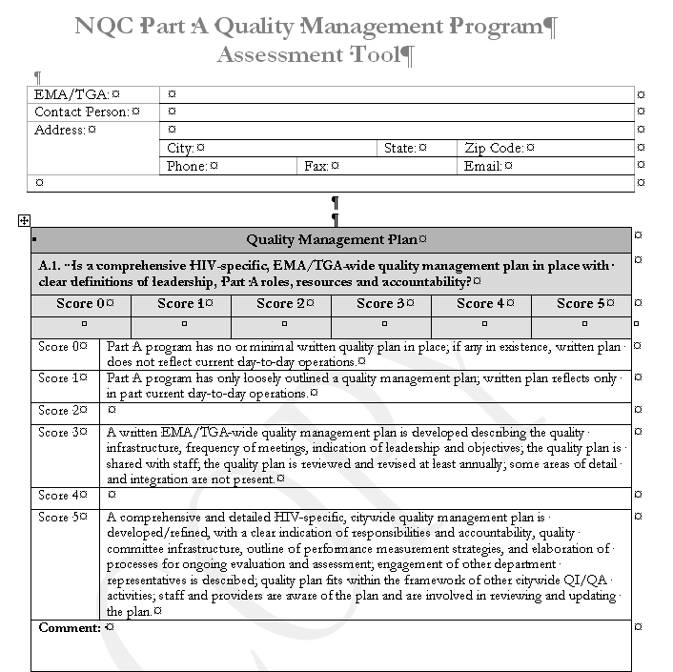
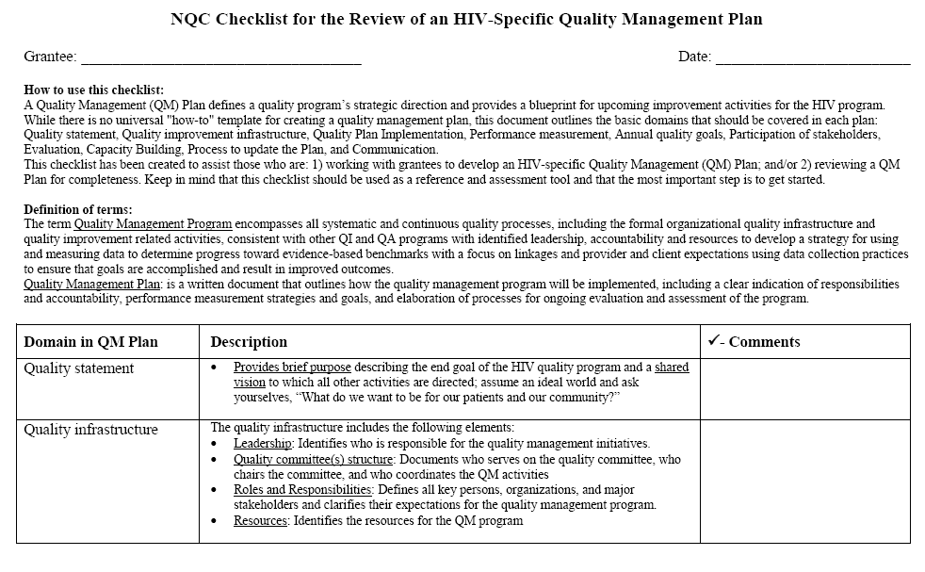
Quality Improvement Resources

Slide 43


Quality Improvement Resources

Slide 44
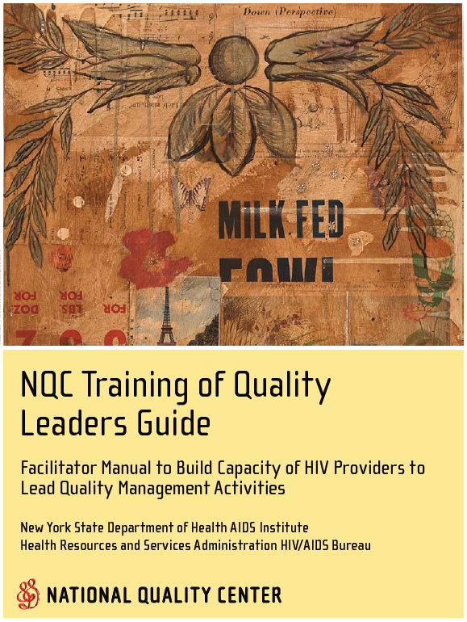
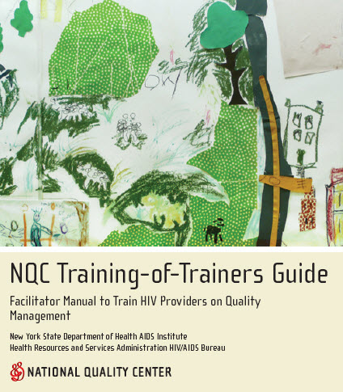
Quality Improvement Resources

Slide 45
Aha Moment and Action Planning
What have you learned from this workshop?
What will you do differently in response to this workshop?
Complete the Action Planning Form on your chair

Slide 46
Tracy Matthews, RN, MHA
HRSA/HIV/AIDS Bureau
301-443-7804
tmatthews@hrsa.gov
Barbara M Rosa, RN, MS
NQC Coach
National Quality Center
212-417-4730
NationalQualityCenter.org
Info@NationalQualityCenter.org

