Slide 1
Expanding Access to HIV Oral Health Care: Service Utilization and Costs for Program Replication
David Reznik
Helene Bednarsh
Carol Tobias

Slide 2
Financing of Oral Health Care for PLWHA Medicaid Adult Benefits
Medicaid is a major source of health-care coverage, including oral health care, for PLWHA.
Comprehensive adult dental coverage under Medicaid is only available in approximately 20% of states.
More than half of the states offer emergency or highly restricted dental services only.
Medicaid programs that offer some oral health benefits may not provide adequate coverage to eliminate oral disease.

Slide 3
Financing of Oral Health Care for PLWHA Medicaid Adult Benefits
Medicaid coverage for adult dental services has often been the victim of budgetary cuts during periods of fiscal retrenchment.
A fiscal year 2010 survey of Medicaid programs reported a reduction in Medicaid adult dental benefits in 20 states, more than in any year in the past decade; 14 states planned to reduce benefits in FY 2012.

Slide 4
Financing of Oral Health Care for PLWHA Medicaid Adult Benefits
Medicaid coverage for adult dental services has often been the victim of budgetary cuts during periods of fiscal retrenchment.
A fiscal year 2010 survey of Medicaid programs reported a reduction in Medicaid adult dental benefits in 20 states, more than in any year in the past decade; 14 states planned to reduce benefits in FY 2012.

Slide 5
State budget crises translate into cuts to oral health care
The cuts have left many poor people with few options to pay for services such as teeth cleanings, fillings and dentures.
“States that have recently slashed funding for adult dental coverage include Pennsylvania, Massachusetts, Illinois, California and Washington.

Slide 6
Washington State
“In 2007, Washington state was spending more than $30 million annually on its adult dental Medicaid program. In recent years, however, the state has cut those benefits, and in 2011 it axed non-emergency dental care for all Medicaid-eligible adults except those with developmental disabilities, long-term care patients, and pregnant women.
Of the 488,000 Medicaid-eligible adults in the state, only 38,000 are still eligible for non-emergency care, according to data compiled by the Washington State Dental Association.”
Daniel Lippman, Huffington Post Oct 2, 2012

Slide 7
Illinois
In Illinois Gov. Pat Quinn decided to cut $1.6 billion out of his state’s $15 billion Medicaid budget, reducing adult coverage to adult tooth extractions. Also eliminated from the state’s plan were vision chiropractic and podiatry coverage.
Daniel Lippman, Huffington Post Oct 2, 2012

Slide 8
Limits of Dental Coverage for PLWHA – Adult Medicaid Benefits
Most people with HIV who qualify for Medicaid do so by meeting the program’s income and disability standards. However, many PLWHA may not gain Medicaid coverage until their illness progresses to the point that they are determined to be eligible as a result of disability.
Presently, 68% of PLWHA have incomes below 100% of the federal poverty level, yet only 34% qualify for Medicaid.
Implementation of the Medicaid expansion contained in the Patient Protection and Affordable Care Act (ACA) would cover adults within 133% of the Federal Poverty Limit and would greatly benefit PLWHA.
However, the Obama administration has signaled that states can offer their existing Medicaid package as a benchmark for newly covered adults and states do have the option to include adult dental care in their Medicaid benchmark benefits under the ACA.

Slide 9
Ryan White HIV/AIDS Programs
75% of funding in Parts A, B and C must be spent on Core Services:
Primary Care
Medications
Oral Health Care
Mental Health Care
Substance Abuse Services
Medical case management/treatment adherence counseling
Other services such as food, transportation, peer counseling, translation, etc. are considered support services

Slide 10
Sustaining Oral Health Care for PLWHA
Sustainability depends on several factors:
Medicaid dental coverage in the state
Leveraging multiple Ryan White Program funding sources to finance the delivery of care.
Applying for foundation grants and other sources of funding outside of the Ryan White Program.
Leadership
AIDS Service organizations
Dental providers, accredited dental education programs
Consumers of care
Community Health Centers

Slide 11
Examples of Successful/Sustainable SPNS Oral Health Programs
HIV Alliance in Oregon
The SPNS Oral Health Initiative helped the program establish a dental clinic and hire a project coordinator.
The Ryan White Dental Reimbursement Program (Part F) created an ongoing source of revenue for oral health services.
Part B funding will fund the dental case manager, cover denture costs, and pay for transportation.
Foundation grants to cover additional costs.

Slide 12
Examples of Successful/Sustainable SPNS Oral Health Programs
Tenderloin Health Care
The SPNS Oral Health Initiative was instrumental in establishing dental operatories in the same facility where clients received their HIV care.
The Dental Director of the San Francisco Department of Health, Dr. Avi Nath, successfully applied for Part A funds to sustain the program once SPNS funding ended.
Working with the University of California at San Francisco (UCSF) Dental School’s General Practice Residency Program (to manage some surgeries, endodontics and dentures) allowed UCSF the ability to apply for Part F Dental Reimbursement funds to help defray the costs.

Slide 13
Ryan White Reauthorization
The Ryan White Programs are scheduled to be reauthorized by September 30, 2013.
Significant portions of the Patient Protection and Affordable Care Act, including Medicaid expansion, are scheduled to be fully implemented.
States can opt-out of the Medicaid expansion
Adult oral health care is not included in the Medicaid expansion.
Ryan White reauthorization is critical to maintain the existing oral health infrastructure for PLWHA

Slide 14
The SPNS Oral Health Initiative (2006-2011)
15 programs funded to expand access to HIV oral health care
8 rural programs, 7 urban programs
Service models
4 mobile vans
7 co-located medical and dental services
1 program in a dental hygiene school
3 Satellite clinics

Slide 15
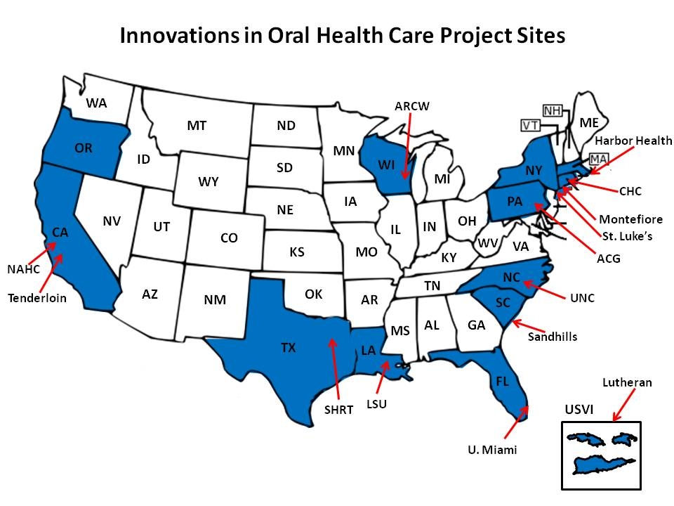
SPNS Sites
Notes:
Funded by HRSA in 2006 to increase access to oral health care for PLWHA
15 sites across the US.
2 in NYC, 2 in CA and one in USVI. The remainder are scattered.
BU was funded as the evaluation and technical assistance center

Slide 16
Eligibility Criteria
At least 18 years of age
HIV positive
Out of oral health care for prior 12 months, except for emergency care to relieve pain or infection

Slide 17
The overarching clinical goal of the SPNS Project was
to improve access to quality HIV oral health care.

Slide 18
A key study question for the multi-site evaluation addressed the clinical component of the SPNS project:
Do the demonstration programs increase access to oral health care for underserved populations?

Slide 19
Utilization data can tell us….
If people are receiving quality dental care
If people’s oral health needs are met
How many people complete their treatment plans and go on recall
And, most importantly, if access to oral health care has been increased!

Slide 20
Service Utilization: n=2178, 14 sites
Over the course of the study:
Patients made over 15,000 clinic visits
They received over 37,000 services
917 (42%) completed a Phase 1 treatment plan
Services provided in first 12 months of care
 | # provided | Patients who received any service n %
Clinic Visits | 11,315 | 2178 | 100%
Phase 1 Treatment Plans Completed* | 717 | 717 | 33%
Comprehensive Exams | 2077 | 1944 | 89%
*Phase 1 Treatment Plan = Prevent and treat active disease
Notes:
Carol

Slide 21
The ones that got away…
375 (17%) patients had only one visit

Slide 22
Category | Types of Dental Services Explanation | % Receiving Service
Diagnostic care | Exams, x-rays, etc. | 98%
Preventive care | Cleanings, fluoride, patient ed. | 63%
Restorative care | Restorations, fillings | 50%
Periodontal care | Non-surgical and surgical care | 42%
Oral surgery | Extractions, simple and surgical | 29%
Removable Prosthodontics | Partial and complete dentures, repairs | 21%
Endodontic services | Root canals, pulpal procedures | 11%
Fixed Prosthodontics | Bridges | 3%

Slide 23
Percent of patients receiving specific services

Slide 24
Service variation across sites

Slide 25
# of Procedures/Person

Slide 26
Limitations
The 14 sites had their own unique models of care and some models could not provide a comprehensive scope of care
The availability of specialists may limit the scope of care
The cost of fixed and/or removable prosthodontics may have limited the number provided.
Patient acceptance of a treatment plan could also have affected the delivery and scope of care provided
Edentulous patients would not necessarily have completed Phase 1 treatment as some of these services would not have been necessary.

Slide 27
What does it cost…..
To provide dental care to a PLWHA?
To provide dental care to PLWHA who receive Ryan White services in an EMA or state?
To open up a clinic that provides dental care to PLWHA?
It depends…….

Slide 28
It depends on….
The services covered
The price paid for a service, or the cost
If the patient is new to dental care or already enrolled in care
What other resources are available – Medicaid, private insurance, foundation funds

Slide 29
Pricing Methods
Used data from the SPNS initiative n=2178
Grouped sites according to services provided
Used 3 different fee schedules
Applied fee schedules to services provided during the first 12 months of care, at different levels of coverage
Did the same for the second 12 months of care

Slide 30
Definitions
Level of Care | # of sites | Covered Services
Basic Care | 14 | Diagnostic services, preventive services, restorations excluding crowns, periodontal care excluding surgery, adjunctive services
Intermediate Care | 12 | Basic care PLUS periodontal surgery, oral surgery, removable prosthodontics
Comprehen-sive care | 8 | Intermediate care PLUS crowns, endodontics, and fixed prosthodontics.

Slide 31
Average Cost/Person in First 12 months of Treatment
Low cost = Miami/Dade County fee schedule; Medium cost = Delta Dental; High cost = ADA usual & customary
Notes:
Carol
Here’s a summary of what is provided in the charts. This graph shows the cost of providing care for the first 12 months of treatment for people newly entering dental care, but not necessarily newly diagnosed with HIV.
Explain Low, Medium and High
Comprehensive care provided by 8 sites.
Intermediate care provided by 12 sites – did not include bridges, crowns or root canals
Basic care provided by all sites – did not include bridges, crowns, root canals, dentures, partials, oral surgery or surgical periodontic care. In other words, diagnostic, preventive, restorative with no crowns, perio with no surgery and adjunctive care.

Slide 32
Average Cost/Person for First 12 Months of Treatment
Service | % of Pts receiving service | Annual cost (medium)
Diagnostic Care | 98% | $153
Preventive Care | 63% | $60
Restorative Care (exc. crowns) | 59% | $205
Crowns | 6% | $112
Periodontal Care | 42% | $106
Endodontic Care | 11% | $107
Oral Surgery | 29% | $134
Removable Prosthetics | 21% | $291
Fixed Prosthetics | 21% | $88
Adjunctive | NA | $18
TOTAL |  | $1271
Notes:
Carol
This table is a little easier to read – it shows the average cost per person for comprehensive care in their first year of treatment, using the medium fee schedule.
Out of the $1271 that it would cost, on average, nearly ¼ would go for removable prosthetics – partials, dentures and their repair and maintenance. Another ¼ would go for restorative care, 16% for fillings and 9% for crowns.
Diagnostics are only 12% of the costs and preventive care – cleanings and fluoride – are just 5% of the costs of care.

Slide 33
Change in Costs – Year 2*
*Using the medium cost schedule
Notes:
Carol
After the first year of care, most people move into maintenance mode if they are not there already.
As a result, the cost of care is cut by over 2/3 for all levels of care, and the difference in costs for different levels of care is much smaller. Presumably, many of the more expensive, specialty services have been provided in Year 1.

Slide 34
Difference in cost – Years 1 and 2*
* Using intermediate level of care and medium cost schedule
Notes:
Carol
This shows the change in costs by service category – so you can see the 3 areas where costs changed the least are in preventive care, perio care and adjunctive (these are mostly consults), in other words, maintenance and prevention remained fairly constant. The change in restorative care is fairly dramatic, going from over $200/person to $50/person in year 2.
Removable prosthetics still remain the highest cost category – indicating that the people who needed this level of care didn’t get everything completed in their first year, or that they continued to have high repair or maintenance costs.

Slide 35
Things to think about
Who are your dental providers – CHCs, university clinics, private practices, HIV clinics?
What will they accept for payment rates?
What is the trade off between depth of coverage and numbers served?
How can you encourage retention and prevention?

Slide 36
Limitations
Funding available (Public and Private)
Services covered by RW (decision of EMA or State)
Other Parts of RW funding oral health
Geographic
Burden of care

Slide 37
Contact Information
David Reznik
dreznik@mindspring.com
Helene Bednarsh
helene_bednarsh@bphc.org
Carol Tobias tcarol@bu.edu
http://echo.hdwg.org

