Slide 1



The Missing Link in Test-and-Treat identifying and improving gaps in care
test
treat
Sophy Wong, MD
Medical Director, East Bay AETC
Medical Director, HIV ACCESS
Internist and HIV specialist, Asian Health Services
Assistant Clinical Professor of Medicine, UCSF

Slide 2
disclosures
None!
I have no financial arrangements or affiliations with commercial interests.
Commercial support was not received for this activity.
I will not discuss off-label uses of drugs or products in my presentation.

Slide 3
objectives
Describe the impact of using clinical data, especially linkage rates, retention rates and viral loads on test-and-treat outcomes.
Identify and analyze gaps in linkage to and retention in care.
Propose a work plan to implement at least one strategy for identifying and/or improving linkage and retention rates.

Slide 4
workshop format
Gardner & CDC test-link-treat cascades
Case
Definitions of linkage, retention, and viral load suppression
The Alameda County experience
How to use this data to improve care
Your experience and way forward!

Slide 5
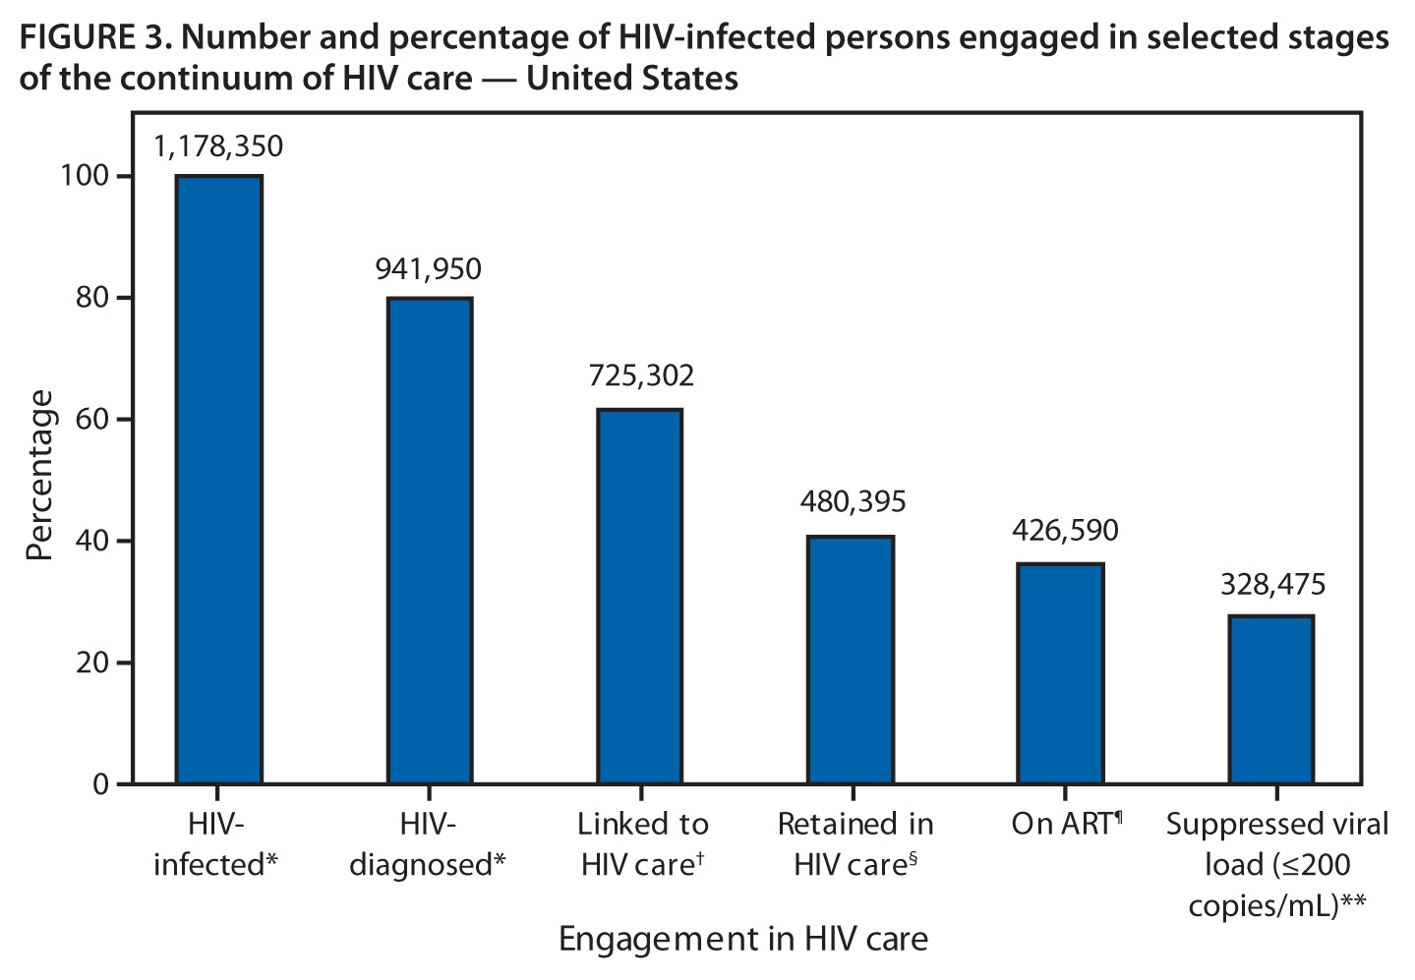
80%
62%
41%
36%
28%
2011-11-29 MMWR 60
Notes:
* HIV-infected, N = 1,178,350; HIV-diagnosed, n=941,950. Source: CDC. HIV surveillance—United States, 1981–2008. MMWR 2011;60:689–93.
† Calculated as estimated number diagnosed (941,950) × estimated percentage linked to care (77%); n = 725,302. Sources: Marks G, Gardner LI, Craw J, Crepaz N. Entry and retention in medical care among HIV-diagnosed persons: a meta-analysis. AIDS 2010;24:2665–78; Torian LV, Wiewel EW. Continuity of HIV-related medical care, New York City, 2005–2009: do patients who initiate care stay in care? AIDS Patient Care STDS 2011;25:79–88.
§ Calculated as estimated number diagnosed (941,950) × estimated percentage retained in care (51%); n = 480,395. Sources: Marks G, Gardner LI, Craw J, Crepaz N. Entry and retention in medical care among HIV-diagnosed persons: a meta-analysis. AIDS 2010;24:2665–78; Torian LV, Wiewel EW. Continuity of HIV-related medical care, New York City, 2005–2009: do patients who initiate care stay in care? AIDS Patient Care STDS 2011;25:79–88; Hall IH, Mahle KC, Tang T, Li J, Johnson AS, Shouse L. Retention in care of HIV-infected adults and adolescents in 13 U.S. areas. Presented at the National HIV Prevention Conference, Atlanta, GA, August 14–17, 2011; Tripathi A, Youmans E, Gibson JJ, Duffus WA. The impact of retention in early HIV medical care on viro-immunological parameters and survival: a statewide study. AIDS Res Hum Retroviruses 2011;27:751–8.
¶ Calculated as estimated number retained in HIV care (480,395) × percentage prescribed ART in MMP (88.8%); n = 426,590. Source: Data from the Medical Monitoring Project.
** Calculated as estimated number on ART (426,590) × percentage with suppressed viral load in MMP (77.0%); n = 328,475 (28% of the estimated 1,178,350 persons in the United States who are infected with HIV). Source: Data from the Medical Monitoring Project.

Slide 6

New HIV infections
Access to care: test & treat!
⬇ HIV health disparities

Slide 7
treatment reduces transmission by
96%
Notes:
HIV Treatment Is Prevention: The Results of HPTN 052
Among HIV-serodiscordant couples, treatment of the infected partner
decreased the risk for transmission to the uninfected partner by 96%.
Combination antiretroviral therapy (ART) has long been known to drive viral
replication to levels below the limit of detection, leading to significant
improvements in patients' health. Given that ART also decreases the amount
of HIV present in genital secretions, experts have speculated that it
should also reduce sexual transmission of HIV. Several observational
studies -- most recently, the Partners in Prevention HSV/HIV Transmission
Study (JW AIDS Clin Care Jun 7 2010) -- have supported this hypothesis, but
only a randomized, controlled trial could provide definitive proof. Enter
the HPTN 052 study.
The results of this trial were released in May 2011, after the data and
safety monitoring board (DSMB) concluded that the study had demonstrated
its goal (JW AIDS Clin Care May 16 2011). Now, they are being published in
the New England Journal of Medicine and simultaneously presented at this
year's International AIDS Society meeting in Rome.
The HPTN 052 study involved 1763 HIV-serodiscordant couples in nine
countries (5 in Africa, 2 in Asia, and 2 in the Americas). Per inclusion
criteria, all the HIV-infected partners had baseline CD4 counts between 350
and 550 cells/mm{super 3}, and all were treatment naive (except for
possible ART to prevent perinatal transmission). They were randomized 1:1
to receive early ART at enrollment or to delay therapy until their CD4
counts were <=250 cells/mm{super 3} on two consecutive measurements or they
developed an AIDS-related illness. Nearly all the couples were heterosexual
(97%), and half the HIV-infected participants were men. The median baseline
CD4 count was 442 cells/mm{super 3} in the early-therapy group and 428
cells/mm{super 3} in the delayed-therapy group. AZT/3TC/efavirenz was the
most commonly used antiretroviral regimen in the study.
At the time of the DSMB review, 90% of couples remained in the study, with
a median follow-up of 1.7 years; 89% of participants in the early-therapy
group had viral loads below 400 copies/mL. A total of 39 HIV transmission
events occurred during follow-up: 4 in the early-therapy group and 35 in
the delayed-therapy group. In 28 of these cases, genetic testing confirmed
that the HIV-infected partner in the study was the source of infection:
Only 1 of these cases was in the early-therapy group versus 27 in the
delayed-therapy group, which translated to a 96% risk reduction with early
ART.
Of interest, 17 of the 28 linked infections occurred when the infected
partner had a CD4 count >350 cells/mm{super 3}, and 23 were among African
couples. A high plasma viral load at baseline increased the likelihood of
transmission, whereas consistent condom use decreased the likelihood.
The clinical benefits of early ART were also evident, with the
delayed-therapy group experiencing significantly more clinical events
(primarily, extrapulmonary tuberculosis).
Comment: This study conclusively demonstrates that treatment of HIV
infection decreases the risk for sexual transmission and improves the lives
of those infected, regardless of CD4-cell count. Clearly, the study has
important policy implications. Is it time to recommend treatment for
HIV-infected individuals in stable serodiscordant couples in order to
prevent infection of their partners? I think the evidence is now quite
strong (AI evidence) and we should therefore move in that direction. I also
think it is probably time to stop guiding ART by CD4-cell count and just
treat anyone who is willing to be treated -- not only for their own health
but also for the larger public health benefit.
-- Carlos del Rio, MD
Published in Journal Watch HIV/AIDS Clinical Care July 19, 2011
Citation(s):
Cohen MS et al. Prevention of HIV-1 infection with early antiretroviral
therapy. New Engl J Med 2011 Jul 18; [e-pub ahead of print].
(http://dx.doi.org/10.1056/NEJMoa1105243)
Hammer SM. Antiretroviral treatment as prevention. New Engl J Med 2011 Jul
18; [e-pub ahead of print]. (http://dx.doi.org/10.1056/NEJMe1107487)

Slide 8
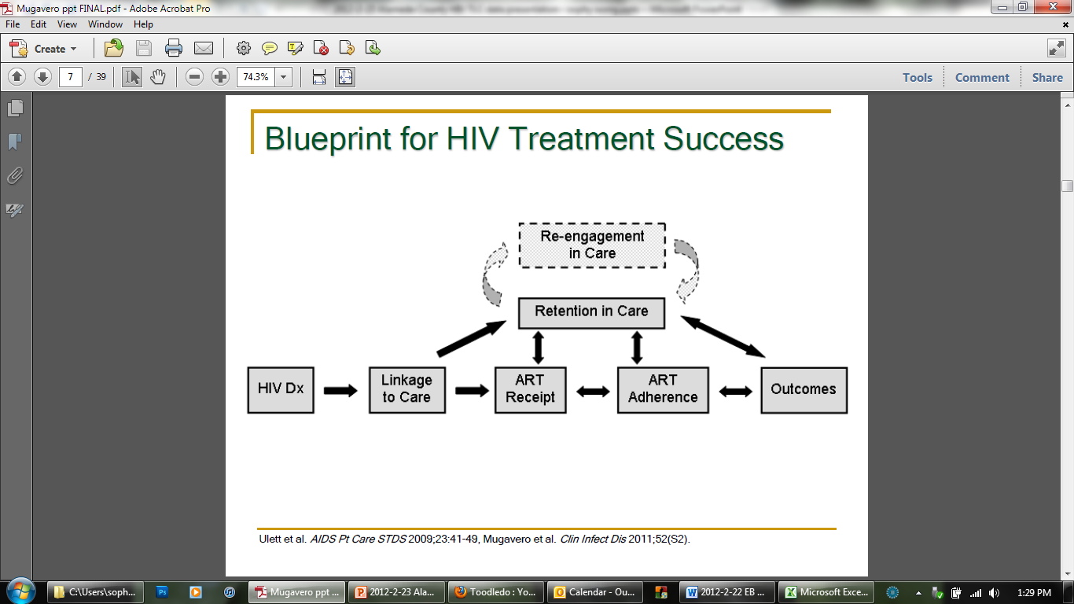
NHAS Goals
79% → 90%
65% → 85%
73% → 80%
28% → 48%

Slide 9
case
A 28 year old African American bisexual man tests positive at a community-based rapid testing project…

Slide 10
2011-11-29 MMWR 60
Notes:
* HIV-infected, N = 1,178,350; HIV-diagnosed, n=941,950. Source: CDC. HIV surveillance—United States, 1981–2008. MMWR 2011;60:689–93.
† Calculated as estimated number diagnosed (941,950) × estimated percentage linked to care (77%); n = 725,302. Sources: Marks G, Gardner LI, Craw J, Crepaz N. Entry and retention in medical care among HIV-diagnosed persons: a meta-analysis. AIDS 2010;24:2665–78; Torian LV, Wiewel EW. Continuity of HIV-related medical care, New York City, 2005–2009: do patients who initiate care stay in care? AIDS Patient Care STDS 2011;25:79–88.
§ Calculated as estimated number diagnosed (941,950) × estimated percentage retained in care (51%); n = 480,395. Sources: Marks G, Gardner LI, Craw J, Crepaz N. Entry and retention in medical care among HIV-diagnosed persons: a meta-analysis. AIDS 2010;24:2665–78; Torian LV, Wiewel EW. Continuity of HIV-related medical care, New York City, 2005–2009: do patients who initiate care stay in care? AIDS Patient Care STDS 2011;25:79–88; Hall IH, Mahle KC, Tang T, Li J, Johnson AS, Shouse L. Retention in care of HIV-infected adults and adolescents in 13 U.S. areas. Presented at the National HIV Prevention Conference, Atlanta, GA, August 14–17, 2011; Tripathi A, Youmans E, Gibson JJ, Duffus WA. The impact of retention in early HIV medical care on viro-immunological parameters and survival: a statewide study. AIDS Res Hum Retroviruses 2011;27:751–8.
¶ Calculated as estimated number retained in HIV care (480,395) × percentage prescribed ART in MMP (88.8%); n = 426,590. Source: Data from the Medical Monitoring Project.
** Calculated as estimated number on ART (426,590) × percentage with suppressed viral load in MMP (77.0%); n = 328,475 (28% of the estimated 1,178,350 persons in the United States who are infected with HIV). Source: Data from the Medical Monitoring Project.

Slide 12
Definitions
Linkage: how does the CDC define linkage to care?
Retention: how does HRSA define retention in care?

Slide 15
Definitions
Viral load suppression: how does the CDC define viral load suppression?

Slide 17
The Missing Link in Test-and-Treat
test
treat
link

Slide 18
The Missing Link:
Linkage & retention is our weakest point.

Slide 19

So what?

Slide 20
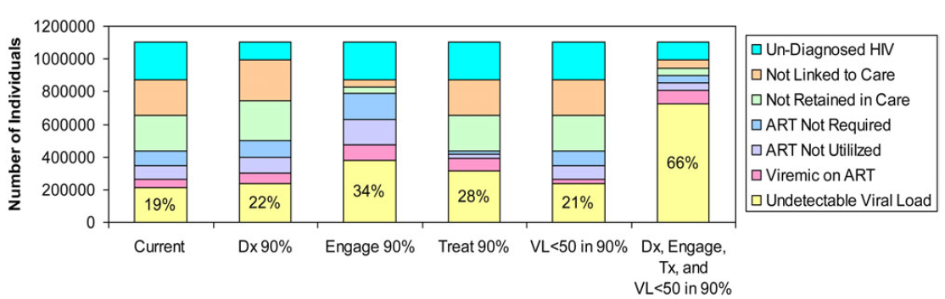
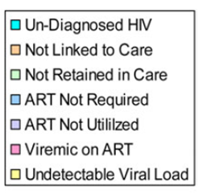
What will it take to substantially reduce HIV transmission in an entire population?
Answer: Treatment AND Prevention
Gardner, CID 2011

Slide 21


Slide 22
Questions?

Slide 23
CME / CE credits
If you would like to receive continuing education credit for this activity, visit:
http://www.pesgce.com/RyanWhite2012

Slide 24

thanks!
AETC:
Kathleen Clanon
East Bay AETC team
OAA/DPH HIV data team:
Lorenzo Hinojosa
Neena Murgai
Kate Buchacz
Elaine Bautista
Alex Marr
Kaiser: Leo Hurley
Highland: Doug White
AHS: Koji Sakakibara
EBAC Downtown Youth Clinic
HIV ACCESS:
Lois Lindsey
Dan Clanon
Jose Reyes
Brianna Rogan
Alameda County DPH:
Damon Francis
Office of AIDS:
Kabir Hypolite
CA State:
Mark Damesyn
Matt Facer

