Slide 1
Meet the CHAC
CDC/HRSA Advisory Committee on HIV, Viral Hepatitis and STD Prevention and Treatment

Slide 2

Antigone Dempsey, MEd
HIV and Sexual Health Lead
Altarum Institute
antigone.dempsey@altarum.org
Twitter: @antigonedempsey
Kathleen A. Clanon MD
Director, Division of HIV Services
Alameda County Medical Center
kclanon@jba-cht.com
Ernest Hopkins
Director of Federal Affairs
San Francisco AIDS Foundation
ehopkins@sfaf.org
Steven Johnson, MD
Professor of Medicine
Division of Infectious Diseases
University of Colorado School of Medicine
Steven.Johnson@ucdenver.edu
Kali Lindsey
Director, Government Affairs & Communications
National Minority AIDS Council
klindsey@NMAC.org

Slide 3
Role of the CHAC
The CDC/HRSA Advisory on HIV, Viral Hepatitis and STD Prevention and Treatment advises the HHS Secretary, CDC Director, and the HRSA Administrator on:
  Objectives, strategies, policies and priorities for HIV, Viral Hepatitis and STD prevention and treatment efforts
  Policy issues related to professional education, patient healthcare delivery, prevention services, research, training and strategic issues influencing the ability of CDC and HRSA to full fill their missions addressing HIV, Viral Hepatitis and STD prevention and care
  Support the agencies in their development of responses to emerging health needs related to HIV, Viral Hepatitis and STDs

Slide 4
Objectives and Scope of CHAC
CHAC will advise CDC and HRSA on activities related to:
Prevention and control of HIV/AIDS, Viral Hepatitis and other STDs
Support of healthcare services to persons living with HIV/AIDS
Education of health professionals and the public about HIV/AIDS, viral hepatitis and other STDs

Slide 5
Objectives and Scope of CHAC (2)
The CHAC also supports the agencies’ response to prevention and health service delivery needs of affected communities, and the needs of individuals living with or at risk for HIV, viral hepatitis and other STDs

Slide 6
CHAC Membership
Jeanne Marrazzo, MD, MPH, co-chair
Antigone Dempsey, MEd, co-chair
Kathleen Clanon, MD
William Cunningham, MD, MPH
Carlos del Rio, MD
Perry N. Halkitis, PHD, MS
Marjorie J. Hill, PHD
Regan Hofmann
Ernest C. Hopkins
Steven C. Johnson, MD
Maria Lago, MSW
Kali D. Lindsey
Kenneth H. Mayer, MD
Andre W. Rawls, JD, PHD
Britt Rios-Ellis, PHD

Slide 7
Diverse Membership
People living with HIV/AIDS
African Americans
Latino/a’s
Asian, Pacific Islanders
Gay and Lesbian

Slide 8
Backgrounds Represented
Community-based Organizations
Community Health Centers
National Organizations
Healthcare Providers
Public Health
(state, local and federal)
Migrant Health
Pharmaceutical Industry

Slide 9
Recent Issue/Topic Areas
Enhancing Hepatitis Prevention Treatment and Care in the United States
Integrating HIV Prevention and Care Data Systems
External Peer Review of CDC Youth HIV/STI Prevention and Sexual Health Activities
Preparing for the Ryan White Reauthorization
HIV Prevention Trials Network (HPTN Study 052)
Update on ACA Implementation: HRSA Perspectives
Update on Hepatitis C
Responding to the urgent threat of Gonorrhea Antimicrobial Resistance

Slide 10
CHAC’s Areas of Focus 2011-2012
Sexual Health Approach
HIV Disclosure and Liaison with the Presidential Advisory Council on HIV/AIDS
Viral Hepatitis
Ryan White Reauthorization

Slide 11
CHAC Activities on Sexual Health

Slide 12
2012: Sexual Health: Why Now?
High population burden of STDs, HIV and other sexual health problems
  19 million STI each year—almost half among persons 15-24
  25% adolescent F infected with at least one STD
  Estimated 1.1 million Americans living with HIV, approximately 50,000 new infections/year
  Nearly 50% of all pregnancies in the U.S. are unintended
  11% of women and 2% of men aged 18-44 years reported experiencing forced sex at some time in their lives
  20%-25% of women in college reported experiencing an attempted or completed rape in college
Cost of STDs, including HIV, estimated at $15.9 billion per year

Slide 13
The National Shift
In the last two years, important policy documents have emphasized the importance of sexual health in improving the health of the country.
  The National HIV/AIDS Strategy: “opportunity for working together to advance a public health approach to sexual health that includes HIV prevention as one component”.
  The Affordable Care Act aims to expand the use of evidence-based prevention services, including those related to sexual health.
  Healthy People 2020 included “Reproductive and Sexual Health” as one of 12 high-priority health topics.
  The National Prevention Strategy—with a vision to move “the nation from a focus on sickness and disease to one based on prevention and wellness”—also designated “Reproductive and Sexual Health” as one of its top seven targeted priorities.

Slide 14
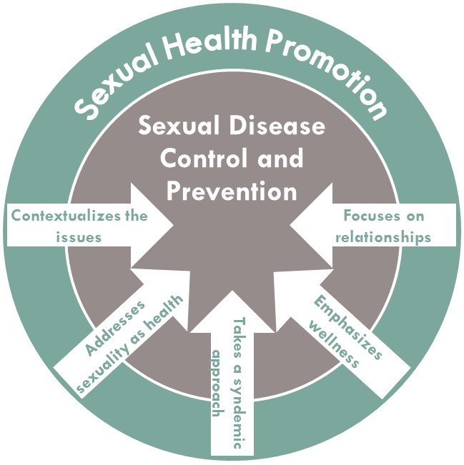
A Sexual Health Framework:

Slide 15
Sexual Health Activities
Active workgroup that meets regularly
Drafted and passed a resolution endorsing a definition for sexual health
Drafted and submitted 2 letters to the Secretary on sexual health

Slide 16
Sexual Health Definition
Sexual health is a state of wellbeing in relation to sexuality across the lifespan that involves physical, emotional, mental, social, and spiritual dimensions.
Sexual health is an inextricable element of human health and is based on a positive, equitable, and respectful approach to sexuality, relationships, and reproduction, that is free of coercion, fear, discrimination, stigma, same, and violence.
It includes: the ability to understand the benefits, risks, and responsibilities of sexual behavior; the prevention of disease and other adverse outcomes; and the possibility of fulfilling sexual relationships.
Sexual health is impacted by socioeconomic and cultural contexts-including policies, practices, and services-that support healthy outcomes for individuals, families, and their communities

Slide 17
CHAC Activities on HIV Disclosure

Slide 18
Disclosure Activities
Established liaisons between the CHAC and PACHA
Created a cross workgroup on HIV disclosure
Held and Disclosure Summit in June 2012

Slide 19
National HIV/AIDS Strategy
The Federal Implementation Plan put forth the following directives for PACHA and CDC/HRSA Advisory Committee on HIV, Viral Hepatitis and STD Prevention and Care:
  PACHA will be tasked with developing recommendations for ways to promote and normalize safe and voluntary disclosure of HIV status in various contexts and circumstances.
  CHAC will solicit public input and make recommendations for normalizing and promoting individuals’ safe, voluntary disclosure of their HIV status. HRSA will publish the recommendations.

Slide 20
No Simple Answers
For addressing how to normalize and promote individuals’ safe and voluntary disclosure of their HIV status.
  HIV criminalization laws, stigma, discrimination, and denial cause significant barriers for people and create unsafe environments for disclosure.
  Safe and voluntary disclosure is impacted and influenced by individuals past experiences with disclosing, stigma and discrimination; and one’s family norms, race and ethnicity, socioeconomic/education status, gender, sexual orientation, gender identify and the intersection of syndemics such as substance abuse, violence, etc.

Slide 21


Disclosure Impacts Many Different Social Networks

Slide 22
Family Networks
Aunts/ Uncles
Grandpar-ents
YOU
Spouse/ Partner
Children
Parents
In-Laws
Nieces and Nephews
Siblings
Cousins

Slide 23



Slide 24
Social Networks
Room-mates
Friends
YOU
Class-mates
Parish-ioners
Minister
Team-mates
PLWHAs
Sexual Partners
Neighbors
Teachers
Online friends
Cast Members
Choir Members
Club Members
AA/NA Fellowship

Slide 25
Professional Networks
Boss
Co-Workers
YOU
Employees
Housekeeping/ Janitors
Professional Colleagues
Clients
Funders
Board or Committee Members
Your Next Employer
LinkedIn
Professional Clubs

Slide 26
Service Networks
Barbers/ Hairdresser
Personal Trainer
YOU
Nail Salon
Dentist
Yoga Instructor
Bartender/ Waitress
Doctor
Optometrist
Tanning/ Massage Specialist

Slide 27
Sexual Networks
Spouse
Ex-Spouse
YOU
Boyfriend/ Girlfriend
Booty Call
Ex-boyfriend/ girlfriend
Trick
Online hook-up
Your Next Date
Crush

Slide 28




Your Life…

Slide 29
Disclosure is not a single, discrete event, but rather an ongoing, voluntary process that spans a lifetime.

Slide 30
Disclosure Summit
Co-chaired by Douglas Brooks (PACHA) and Antigone Dempsey (CHAC)
Convened a two-day summit with thought leaders from cross-cutting and diverse public and private partners such as:
  people living with HIV/AIDS and community advocates
  social scientists
  medical ethicists
  researchers
  business representatives
  health providers
  education leaders
  lawyers
  policy makers and others

Slide 31
Disclosure Summit - Concept
Ground in theory, expertise and experience
Attendees will gather input from experts and researchers working on HIV disclosure, stigma and discrimination through presentations. A panel of PLWHAs will also be convened
Create principles and policy recommendations
Attendees will participate in facilitated and thoughtful discussions on the following: 1) set of principles for safe and voluntary disclosure, and 2) short and long-term policy recommendations for promoting safe and voluntary disclosure
Synthesize and build consensus
Attendees will agree on a set of principles for safe and voluntary disclosure of HIV status and create 5 policy recommendations (2 short term and 3 long term). Proposed ways to disseminate and educate the public will also be discussed

Slide 32
Outcomes
A set of principles for safe and voluntary disclosure of HIV status in the US.
A set of short-term and long-term policy recommendations for promoting safe and voluntary disclosure of HIV status in the US.

Slide 33
Viral Hepatitis

Slide 34
Viral Hepatitis Activities
Resolution to change the charter and name of CHAC to include viral hepatitis
Established a workgroup on viral hepatitis
Resolutions supporting new HCV testing guidelines and expansion of viral hepatitis activities

Slide 35
Resolutions on Viral Hepatitis
On November 16, 2011, unanimously approved the motion that Bureau of Primary Health Care (BPHC) should collaborate with HIV/AIDS Bureau (HAB), CDC, Centers for Medicare and Medicaid Services (CMS) and other federal partners to ensure CDC’s HIV, Hepatitis B Virus (HBV) and Hepatitis C Virus (HCV) screening recommendations are used to create relevant performance measures for use in FQHCs, federally-funded sites and programs, and CBOs that also provide HIV, HBV and HCV testing.
On May 9, 2012, CHACHSPT unanimously approved the motion that CHACHSPT endorses CDC’s pending draft HCV routine screening recommendations for the 1945-1965 birth cohort as an important supplement to the ongoing HCV risk-based screening recommendations.

Slide 36
Viral Hepatitis Workgroup Charge
Identify opportunities within CDC/HRSA to improve and coordinate prevention, screening, linkage to care and treatment for individuals with chronic HBV and chronic HCV;
Assess the current state and adequacy of surveillance measures for both acute and chronic hepatitis, core indicators and quality measures to (1) determine whether existing measures are adequate to evaluate gaps, barriers and progress in implementing CDC’s pending draft HCV screening recommendations for the 1945-1965 birth cohort and other elements of Viral Hepatitis Action Plan (VHAP) and (2) assess missed opportunities for earlier diagnosis to prevent morbidity and mortality; and
Evaluate the implications of ACA on VHAP.

Slide 37
Ryan White Reauthorization

Slide 38
Ryan White Reauthorization Workgroup Charge
On May 9, 2012, CHAC unanimously approved the motion to establishment of a new workgroup to develop a series of recommendations for CHAC’s deliberation and potential adoption regarding the reauthorization of the Ryan White Program that reflects the evolving needs in the context of ACA implementation.
The new Ryan White Reauthorization Workgroup agreed to discuss concerns regarding the retention of quality of care in HIV care settings in light of ACA implementation in 2014. The workgroup will propose health metrics and quality of care indicators (e.g., biomedical outcomes and extragenital STD screening) that CHAC should recommend to HRSA. The workgroup will begin addressing these issues during its first teleconference in June 2012.

Slide 39
Next CHAC Meeting
December 11-12, 2012
Rockville, MD

Slide 40
Questions and Comments
Questions?
What are the current issues and concerns that you are facing in your community that you think CHAC should be aware of and discussing?

