Slide 1
Bone Health in the HIV Infected-Are We Missing Opportunities to Intervene?
Jennifer Janelle, MD
Carmen D. Zorrilla, MD
Jeffrey Beal, MD
Robert Lawrence, MD
Laura Armas-Kolostroubis, MD

Slide 2
Workshop Format
00-05 min Introduction and Review of Objectives and Workshop Format
05-35 min Bone Disease in HIV Infection Didactic
35-65 min Facilitated break-out groups for case-
based discussion
65-90 min Discussion, presentation from work
groups, formulation of strategies for
integration of bone health screening
and treatment into prevention and care
services

Slide 3
Workshop Facilitators
Jennifer Janelle, MD
Clinical Asst Professor Pediatric Infectious Diseases, UF Gainesville
Carmen D. Zorrilla, MD
Professor of Obstetrics and Gynecology, University of Puerto Rico
Jeffrey Beal, MD
PI and Clinical Director for Florida/Caribbean AETC, USF
Medical Director Bureau of HIV/AIDS Florida DOH
Robert Lawrence, MD
Clinical Professor of Pediatric Infectious Diseases, UF Gainesville
Laura Armas-Kolostroubis
Associate Professor of Pediatric Infectious Diseases, UF JAX

Slide 4
What is currently accepted about bone disease

Slide 5
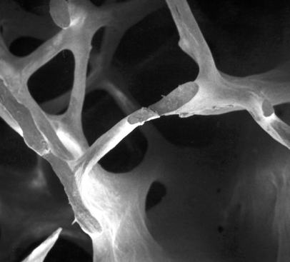
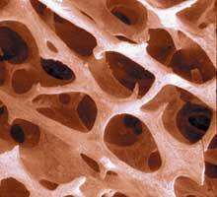
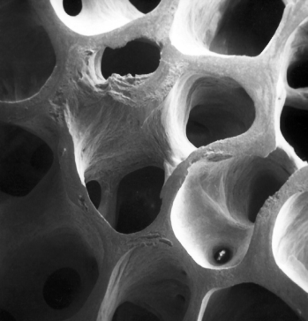
Progression of Bone Disease
Normal
Osteopenia
Osteoporosis
Notes:
What is bone Disease? A systemic skeletal disease characterized by microarchitectural deterioration of bone tissue with a resultant increase in fragility
The picture on the left is a cross-sectional view of a normal bone. It looks like a honeycomb. Bone loss starts to occurs when there is a disruption in the balance of activity between bone formation and bone resorption (osteoblast and osteoclast activity) and the rate of bone resorption exceeds formation. What you get is bone thinning or osteopenia. As the disease progresses to osteoporosis you are not only left with decreased bone mass, but also deterioration of bone tissue and disruption of bone architecture. Osteoporosis is a risk factor for fracture just like HTN is for stroke. .. And just like HTN, osteoporosis is silent and often goes unnoticed until an acute event occurs, which in the case of bone disease is a fracture.

Slide 6
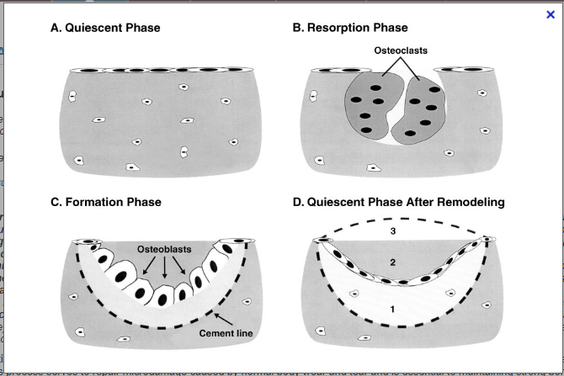
Bone-Remodeling Unit
http://pubs.niaaa.nih.gov/publications/arh25-4/276-281.htm
Notes:
The bone remodeling cycle: Breaking down and rebuilding. Bone is constantly being remodeled by two kinds of cells. Osteoblasts form new bone, while osteoclasts promote resorption, the process by which small packets of bone are broken down and assimilated. These processes permit bone to restructure itself in response to stress and help to maintain strong bones.
A. Quiescent phase. Bone surface is inactive. Neither bone resorption nor bone formation is occurring on this region of bone surface.
B. Resorption phase. Osteoclasts (i.e., bone-resorbing cells) remove a discrete packet of bone, creating a cavity, a temporary weak spot or link.
C. Formation phase. Osteoblasts form a bone matrix, which fills in the cavity. The cement line defines the boundary between the newly formed bone and the surface excavated by osteoclasts at the end of the resorption phase (B).
D. Quiescent phase. Inactive bone surface after a completed remodeling cycle. The new surface may be underfilled (1), exactly filled (2), or overfilled (3), reflecting a local decrease, no change, or increase in bone mass, respectively. The most likely mechanism for alcohol-induced bone loss in adults is underfilling of the resorption cavity during bone remodeling.

Slide 7
Lifestyle Factors Contributing to Bone Disease
Smoking
Low calcium intake
Alcohol use
Vitamin D deficiency
Inadequate physical activity
Aluminum (antacids)
Immobilization
Low body weight
Adapted from National Osteoporosis Foundation. Clinicians Guide To Prevention and Treatment of Osteoporosis. Washington, DC: National Osteoporosis Foundation;2010.
Notes:
Alcohol – 3 or more drinks/day

Slide 8
Medical Conditions Contributing to Bone Disease
Adrenal insufficiency
Diabetes mellitus
Hyperparathyroidism
Hyperprolactinemia
Premature ovarian failure
Multiple myeloma
Chronic metabolic acidosis
Congestive heart failure
End stage renal disease
Thalassemia
Sickle cell disease
Adapted from National Osteoporosis Foundation. Clinicians Guide To Prevention and Treatment of Osteoporosis. Washington, DC: National Osteoporosis Foundation;2010.

Slide 9
Medications Contributing to Bone Disease
Anticoagulants (heparin)
Anticonvulsants
Depo-medroxyprogesterone
Lithium
Glucocorticoids
Cancer chemotherapeutic drugs
Barbiturates
Adapted from National Osteoporosis Foundation. Clinicians Guide To Prevention and Treatment of Osteoporosis. Washington, DC: National Osteoporosis Foundation;2010.
Notes:
Glucocorticoids (≥ 5 mg/day prednisone or equivalent for ≥ 3 months)

Slide 10
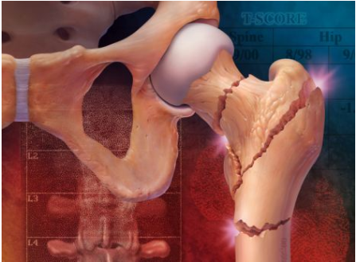
Fragility Fractures
Fractures that occur in the absence of significant trauma
Bone mineral density is a strong predictor of fracture risk
http://www.thehealthage.com/site/wp-content/uploads/2012/02/fragility-fractures.jpg accessed 10/17/2012.

Slide 11
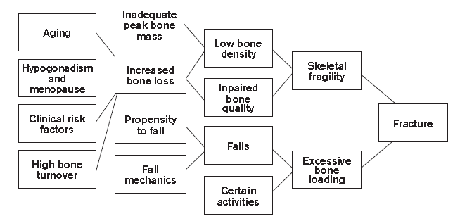
Pathogenesis of Osteoporosis-Related Fractures
National Osteoporosis Foundation. Clinicians Guide To Prevention and Treatment of Osteoporosis. Washington, DC: National Osteoporosis Foundation;2010.

Slide 12
Measuring Bone Density
Dual-Energy X-Ray Absorptiometry
(DEXA Scan )
Normal BMD > - 1.0
2.49
Osteopenia -1 to – 2.9
T-Scores
0
-1.0
-2.5
Osteoporosis ≤ - 2.5
Notes:
Quantitative computerized tomography (QCT) measures volumetric bone density of the spine and hip and can analyze cortical and trabecular bone separately. It is not recommended for screening because the use of T-scores to predict the risk of fracture has not been validated with QCT.
Quantitative ultrasonography of the calcaneus is another technique that can predict fractures in men and women. It is less expensive and more portable than DXA and does not expose patients to ionizing radiation. It is as effective as DXA in predicting fractures of the femoral neck, hip and spine, however, current diagnosis and treatment for osteoporosis relies on DXA alone and measurements obtained from quantitative ultrasonography are not interchangeable with those from DXA.³

Slide 13
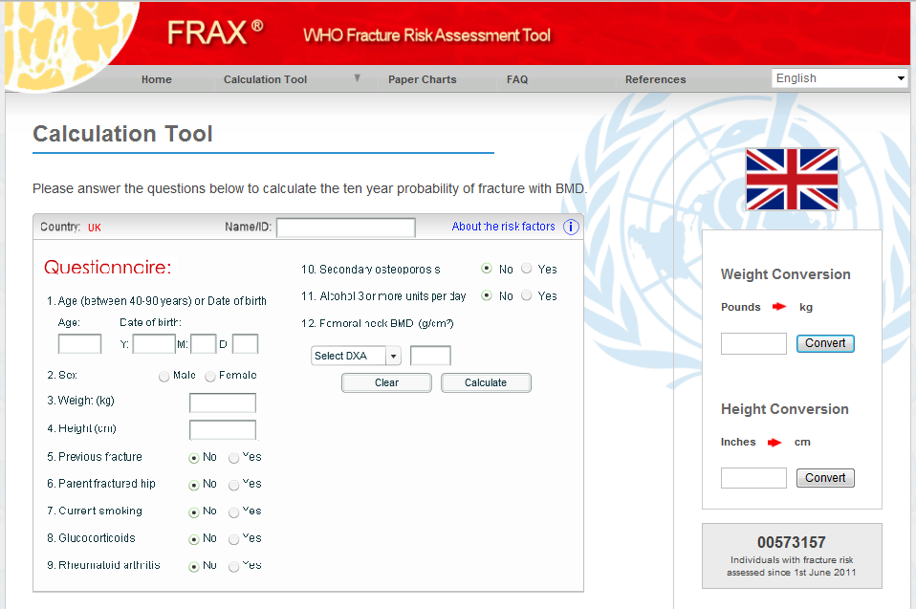
Notes:
FRAX calculates the 10-year probability of a major osteoporotic fracture (hip, clinical spine, humerus or wrist fracture) and the 10-year probability of hip fracture. Treatment should be considered in those with a FRAX result showing a 10 year probability of hip fracture ≥ 3% or a 10 year probability of a major osteoporosis-related fracture ≥ 20%.

Slide 14
osteoporosis in women

Slide 15
American College of Gynecology (ACOG) Recommended Screening
All postmenopausal women with fractures to confirm diagnosis of osteoporosis and determine disease severity (B)
Recommended BMD screening frequency
No more frequently than every 2 years, in the absence of new risk factors (B)
ACOG Practice Bulletin Number 50, January 2004

Slide 16
ACOG Recommended Screening
All postmenopausal women age ≥ 65 yrs (B)
Postmenopausal women younger than 65 yrs with 1 or more risk factors for osteoporosis (B)
ACOG Practice Bulletin Number 50, January 2004

Slide 17
Risk Factors for Osteoporotic Fractures in Women
h/o prior fracture
+ family history
Caucasian race
Dementia
Poor nutrition
Smoking
Low weight and body mass index (BMI)
Estrogen deficiency
Long-term low calcium intake
Alcoholism
Impaired eyesight despite adequate correction
h/o falls
Inadequate physical activity
Long term steroid use
ACOG Practice Bulletin Number 50, January 2004
Notes:
Estrogen deficiency – early menopause (age younger than 45) or bilateral oophorectomy
Prolonged premenopausal amenorrhea (>1 year)

Slide 18
Issues that are less clear

Slide 19
What About Men?
U.S. Preventive Services Task Force (USPSTF) concluded
“…for men, evidence of the benefits of screening for osteoporosis is lacking and the balance of benefits and harms cannot be determined.”
Ann Intern Med. 2011;154:356-364.

Slide 20
Bone Disease in HIV: Another Kind of AIDS Crisis?
Notes:
The pictures in this slide are typical 50 year old HIV patients that we would see at the infectious disease clinic across the street. The pictures are taken from a 2009 article in New York Magazine called, “Another Kind of AIDS Crisis.” The article describes the challenges that practitioners faced during the forefront of the disease back in the 1980s and relates them to today’s challenges of managing the chronic disease. The “crisis” that we are seeing today is that HIV patients are getting older faster. They are experiencing age-related morbidities at a much earlier age than the general population. This includes cardiovascular disease, cancers, dementia, and bone disease, which I am going to talk about today.

Slide 21
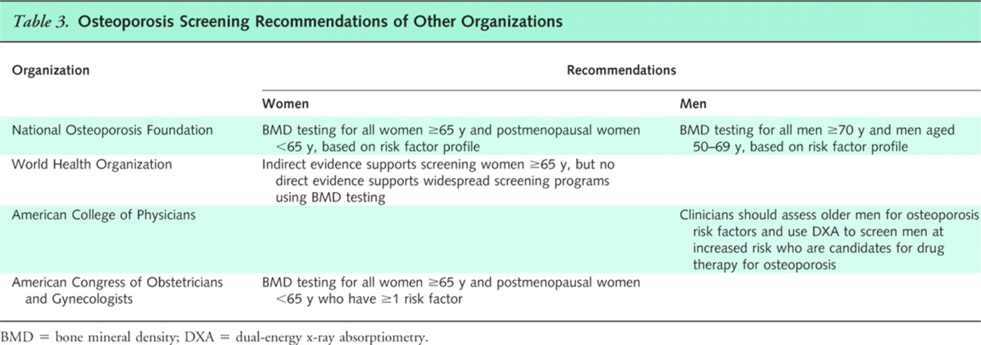
From: Screening for Osteoporosis: U.S. Preventive Services Task Force Recommendation Statement
Ann Intern Med. 2011;154(5):356-364. doi:10.1059/0003-4819-154-5-201103010-00307
Figure Legend:
Osteoporosis Screening Recommendations of Other Organizations
Date of download:
10/16/2012
Copyright © The American College of Physicians.
All rights reserved.

Slide 22
Low BMD Common In HIV (+) Patients
Publication | Number of Pts |  | % ↓ BMD |  | Age
 | HIV+ | HIV– | HIV+ | HIV–
Amiel et al 2004 | 148 | 81 | 82.5 | 35.8 | 40
Brown et al 2004 | 51 | 22 | 63 | 32 | 40
Bruera et al 2003 | 111 | 31 | 64.8 | 13 | 33
Dolan et al 2004 | 84 | 63 | 63 | 35 | 41
Huang et al 2002 | 15 | 9 | 66.6 | 11 | 39
Knobel et al 2001 | 80 | 100 | 87.5 | 30 | 40
Loiseau-Peres et al 2002 | 47 | 47 | 68 | 34 | 42
Madeddu et al 2004 | 172 | 64 | 59.3 | 7.8 | 39
Tebas et al 2000 | 95 | 17 | 40 | 29 | 36
Teichman et al 2003 | 50 | 50 | 76 | 4 | 36
Yin et al 2005 | 31 | 186 | 77.4 | 56 | 27
Brown TT & Qaqish RB. AIDS 2006; 20:2165-2174
Notes:
Bone mineral density is the most common measure of bone disease studied. This is a table of studies included in a meta-analysis by Todd Brown and colleges that looked at the prevalence of low bone mineral density in HIV-infected patients compared to the general public. The column on the left shows the lead author in each study and the date the study was published. The middle columns show the sample size of HIV+ and HIV- patients in each study and the last two columns on the right show the percent decrease in BMD in each study sample. What they found is that low BMD is more common in HIV patients than their matched uninfected controls. You can see that in the HIV+ column the prevalence various from roughly 40-80%. What’s interesting is that with the exception of one study, the prevalence of low BMD occurred in over 50% of all HIV+ study patients. The consistency is surprising in that the studies occurred in different countries across the world with various demographics.

Slide 23
Fracture Rates
8,525 HIV+ patients
2,208,792 HIV- patients
Notes:
We haven’t seen as much data published on fracture rates as we have on bone mineral density. Triant and colleges looked at the rate of fractures in HIV+ vs HIV- patients at a Boston hospital system reported as ICD-9 codes. The X-axis on the graph is the age range of patients in the study and the Y-axis is the fracture prevalence per 100 persons. You can see the HIV+ females in the _______ columns and the HIV- females in the _______ columns. You can see that among the women the was a greater prevalence of fractures with HIV+ women in all age ranges. Lets take a look at the males. The HIV+ males are the ______ columns in the graph and the HIV- males are the _____ columns. You can see that HIV+ males had more fractures than the HIV- males in all age ranges.

Slide 24
Risk Factors for Osteoporosis in the HIV Infected
Low calcium intake
Vitamin D deficiency
Alcohol use
Smoking
Inadequate physical activity
Low body weight
Adrenal insufficiency
Diabetes
?low CD4 count*
Chronic metabolic acidosis
Depression
Hypogonadism
Medications
Antiretrovirals?
Antipsychotics
Anticonvulsants
HIV viremia?
Lipoatrophy?
Adapted from CID 2010:51(8):937-946 and NOF Clinicians Guide to Prevention and Treatment of Osteoporosis, 2010.
*J Acquir Immune Defic Syndr 2011;57:205-210
Notes:
Lipoatrophy may mediate bone loss through relationships between central signaling of adipocyte hormones, ?central fat accumulation assoc with lower BMD
Low CD4 Count is Associated with an increased risk of fragility fracture in HIV-infected patients (yong et al. J acquir Immune Defic Syndr 57:3:205

Slide 25
Role of HIV Infection?
Direct effects of HIV:
Increases osteoblast apoptosis
Shift stem cell differentiation to adipocyte (not osteoblast)
Notes:
What we do know about HIV and bone disease comes from in in vitro studies. In vitro studies have shown that the HIV protein gp120 has a direct effect on bone metabolism. If you recall, the Gp120 protein is the HIV protein responsible for binding to the CD4 receptor on T cells. Studies have shown that the protein causes apoptosis of osteoblasts through an increase in TNF-alpha. The gp120 protein also decreases osteoblast differentiation from stem cells and instead shifts the differentiation of osteoblasts into adipocytes (or fat cells) through an increase in the signaling molecule PPAR-gamma. The HIV protein has also been found to increase osteoclast activity, which in vivo would cause an increase in bone resorption (or breakdown).

Slide 26
Role of HIV Infection?
Direct effects of HIV:
Increases osteoclast activity through an increase in RANKL and M-CSF.
Dolan SE, et al. AIDS 2004; 18: 475-83.
Borderi M, et al. AIDS 2009, 23: 1297-1310

Slide 27
Role of Antiretrovirals: ASSERT Study
Stratified by GFR, race, and BMI
Wk 48
Primary endpoint
Abacavir – Lamivudine 600/300 mg daily
+
Efavirenz 600 mg daily
Tx- naïve patients
N = 385
96 wk
Tenofovir – Emtricitabine 300/200 mg daily
+
Efavirenz 600 mg daily
96 wk
Secondary endpoint: changes in hip and lumbar BMD
Glucocorticoids, calcium and vitamin D supplements prohibited
DEXA scans at baseline, week 24, and week 48
Notes:
Objective: To compare changes in BMD and bone turnover b/t two Nucleoside Reverse Transcriptase Inhibitors (NRTI) regimens with same NNRTI
Design: Randomized, open-label study
Setting: 76 centers in Europe
Patients: HIV (+) tx-naïve patients

Slide 28
Baseline Characteristics
Stellbrink HJ, et al. CID 2010; 51(8):973-5

Slide 29
HAART Initiation and Bone Turnover
100
97%
92%
80%
81%
80
72%
75%
60
Unadjusted % change from baseline
ABC/3TC
44%
44%
TDF/FTC
40
20
0
P1NP
Osteocalcin
BSAP
CTX
N = 114 134 112 130 114 134 113 134
ABC / 3TC – abacavir / lamivudine
TDF / FTC – tenofovir / emtricitabine
Notes:
There is some bone resorption/bone loss with ARV initiation regardless of the chosen regimen. From the graph you can see that there was a greater increase in all of the markers in the tenofovir group. You next question may be, “Well how clinically significant is this? Should we be worried about prescribing tenofovir?”

Slide 30
ASSERT Study: % Change in BMD of Spine
HAART Initiation
Rebound
P-value = 0.036
ABC / 3TC – abacavir / lamivudine
TDF / FTC – tenofovir / emtricitabine
Notes:
In both groups the steepest decrease in BMD occurred in the first 24 weeks of treatment with some recovery after the 24 week mark. The tenofovir group in blue had a greater percent change in BMD of the spine compared to the abacavir group.

Slide 31
ASSERT Study: % Change in BMD of Hip
HAART
Initiation
No Rebound
P-value < 0.001
ABC / 3TC – abacavir / lamivudine
TDF / FTC – tenofovir / emtricitabine
Stellbrink HJ, et al. CID 2010;51(8) 973-5
Notes:
At present we dont have correlations with the "clinical" impact of these temporary decreases in BMD or their risk of fractures. This is why we need to study and follow patients

Slide 32
Why are HIV patients at risk for bone disease?
HIV
HOST
HAART
Notes:
So why are HIV patients at risk for bone disease? The answer to this question appears to involve a clinical triad of factors which includes: the HIV infection itself, the effect of HAART therapy on bone metabolism, and host risk factors. This leads us to the first component of the triad…HIV
Does HIV Infection cause bone disease??

Slide 33
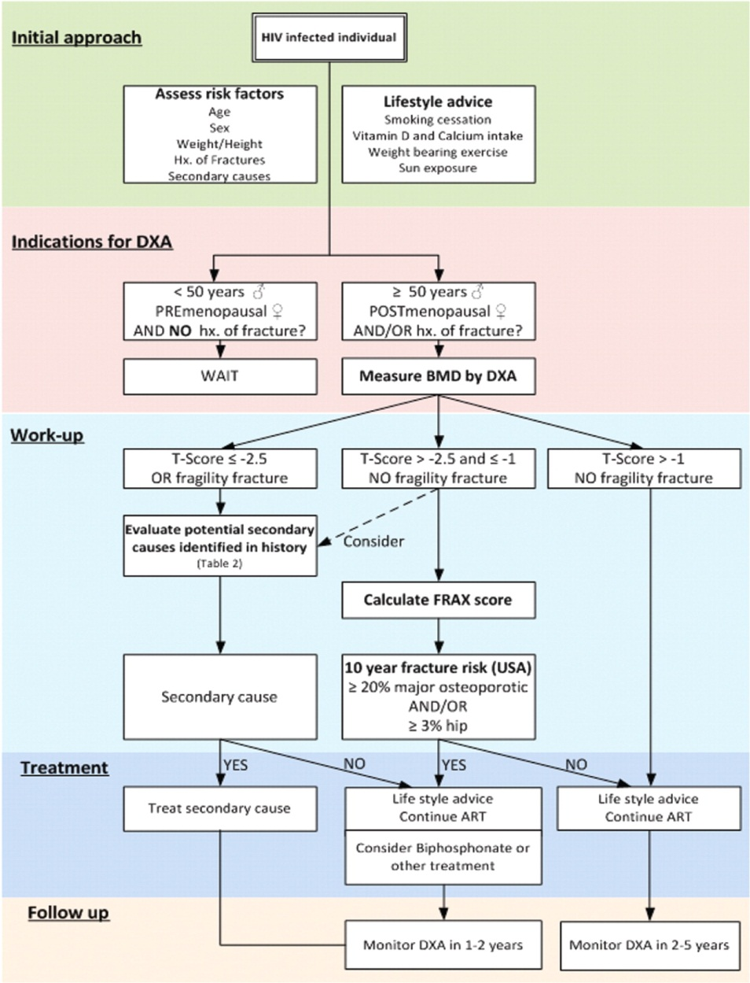
Approach to bone problems in patients with human immunodeficiency virus (HIV) infection (adapated from Dolin et al [126]).
McComsey G A et al. Clin Infect Dis. 2010;51:937-946
© 2010 by the Infectious Diseases Society of America
Notes:
Approach to bone problems in patients with human immunodeficiency virus (HIV) infection (adapted from Dolin et al [126]). ART, antiretroviral therapy; BMD, bone mineral density; DXA, dual-energy x-ray absorptiometry; FRAX, Fracture Risk Assessment Tool; Hx, history.

Slide 34
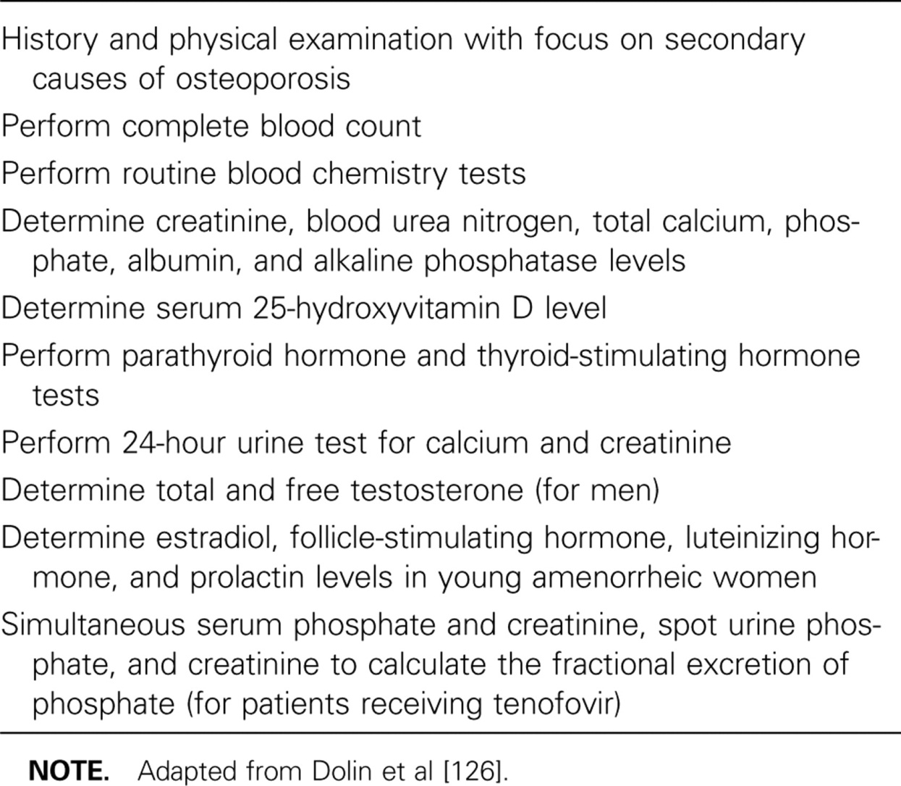
Work-Up for Secondary Causes of Osteopenia and/or Osteoporosis.
McComsey G A et al. Clin Infect Dis. 2010;51:937-946
© 2010 by the Infectious Diseases Society of America
Notes:
Work-Up for Secondary Causes of Osteopenia and/or Osteoporosis

Slide 35
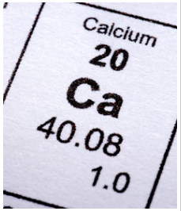
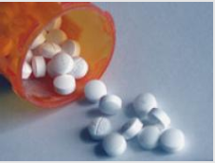
interventions
http://www.webmd.com/food-recipes/ss/slideshow-vitamin-d-overview
http://impowerage.com/fitness/exercise/6-ways-exercise-helps-people-with-osteoporosis

Slide 36
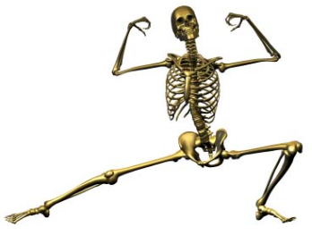
Lifestyle
Smoking and alcohol cessation
Weight bearing exercise
Increase dietary intake/supplementation of calcium and vitamin D
Fall prevention
http://www.boneporosis.com/exercises.html

Slide 37
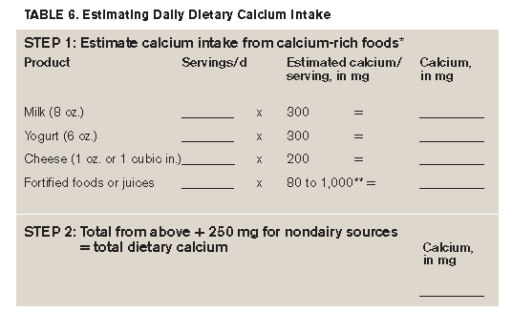
Adequate Calcium Intake
All individuals – at least 1,200 mg/day
Combined diet and supplements
Clinicians Guide To Prevention and Treatment of Osteoporosis. Washington, DC: National Osteoporosis Foundation;2010.
Notes:
99% of the body’s calcium stores is in bones. When exogenous supply is inadequate, bone tissue is resorbed from the skeleton to maintain serum calcium at a constant level
Men and women age 50 and older typically consume only 600-700 mg per day calcium in their diets
* About 75 to 80 percent of the calcium consumed in American diets is from dairy products.
** Calcium content of fortified foods varies.

Slide 38
Vitamin D
Major role in calcium absorption, bone health, muscle performance and risk of falling
Debate about optimal vitamin D level
25(OH)D level below 10 ng/mL
Rickets and osteomalacia*
≤ 30 ng/ml currently the favored level to suggest deficiency**
*N Engl J Med 2007;357:266-281.
** J Clin Endocrinol Metab 2010;95:471-478.
Notes:
¹⁸ This is based on several findings. First, 25(OH)D levels are inversely associated with parathyroid (PTH) hormone levels until vitamin D levels reach 30 to 40 ng/ml at which point PTH begins to level off. Secondly, intestinal calcium transport increased by 45-6% in women with 25(OH)D levels were increased from an average of 20 to 32 ng/ml.¹⁷ This has led to a general consensus that levels of 25(OH)D less than 30 ng/ml represent deficiency. Levels of 25(OH)D greater than 150 ng/ml are associated with vitamin D intoxication.

Slide 39
Dietary Sources of Vitamin D
Source | Vitamin D Content
Fresh wild-caught salmon (3.5 oz) | 600-1000 IU vit D3
Farm raised salmon (3.5 oz) | 100-250 IU vit D3
Canned salmon (3.5 oz) | 300-600 IU vit D3
Sardines, canned (3.5 oz) | 300 IU vit D3
Tuna, canned (3.6 oz) | 230 IU vit D3
Cod liver oil (1tsp) | 400-1,000 IU vit D3
Egg yolk | 20 IU vit D2 or D3
Fortified milk | 100 IU vit D3/8oz
Fortified orange juice | 100 IU vit D3/8oz
Fortified yogurt | 100 IU vit D3/8 oz
Fortified cheeses | 100 IU vit D3/3 oz
Fortified breakfast cereal | 100 IU vit D3/serving

Slide 40
Vitamin D Replacement Options in the Setting of Deficiency
50,000 IU vitamin D weekly for 8 weeks, then 50,000 IU vitamin D every 2-4 weeks, or
1000 IU vitamin D3 daily, or
3000 IU vitamin D2 daily, or
100,000 IU vitamin D3 every 3 months

Slide 41
Pharmacologic Therapy National Osteoporosis Foundation
Consider in perimenopausal women and men ≥ 50 yrs if
Hip or vertebral fracture
T-score ≤ -2.5 at femoral neck or spine after exclude secondary causes
Low bone mass (T score -1.0 to -2.5 at femoral neck or spine) + 10 year prob of hip fracture ≥ 3 % or 10 yr prob of major osteoporosis related fracture ≥ 20%
Patient preference
Adapted from National Osteoporosis Foundation. Clinicians Guide To Prevention and Treatment of Osteoporosis. Washington, DC: National Osteoporosis Foundation;2010.

Slide 42
ACOG: Who to Treat
Women with history of fragility or low-impact fracture (A)
Postmenopausal women with BMD T score < -2 by central DXA in absence of risk factors (RF) or <-1.5 with 1 or more RF (A)
ACOG Practice Bulletin Number 50, January 2004

Slide 43
Bisphosphonates
 | Dose | Postmenopausal Osteoporosis |  |  | Osteoporosis in Men | Major SEs
 |  | Prevention |  | Treatment |  | Class: atypical femur fx Musculoskeletal pain Osteonecrosis of jaw, ?A fib
Alendronate | Oral daily or weekly dosing | Yes |  | Yes | Yes | GI – esophagitis, ulcers
Risedronate | Oral daily, weekly or monthly dosing | Drug |  | Yes | Yes | GI - esophagitis, ulcers
Ibandronate | Oral daily or monthly dosing; intravenous dosing every 3 months | Yes |  | Yes | No | GI – esophagitis, ulcers
Zoledronate (Reclast) | Single Intravenous dose annually | Yes | Yes |  | Yes | Renal toxicity Hypersensitivity reactions Uveitis, episcleritis
Notes:
First line therapy for osteoporosis, inhibit osteoclast-mediated bone resorption
Continuous administration is needed to maintain osteoclast suppression on newly formed resorption surfaces
Reclast is contraindicated in patients with creatinine clearance less than 35 mL/min or in patients with evidence of acute renal impairment.

Slide 44
Non-Bisphosphonates
Drug Class | Drug Name | Administration | Postmenopausal Osteoporosis |  | Osteoporosis in Men | Major Side Effects
 |  |  | Prevention | Treatment
Parathyroid Hormone | Teriparatide | Daily subcutaneous dosing | No | Yes | Yes | Leg cramps, dizziness, potential increased risk of cancer, AVOID in those with increased risk of osteosarcoma, prior XRT, bone metastases, hypercalcemia or skeletal malignancy. Max length of treatment 2 years
Estrogens | Estrogens |  | Yes | No | No
Calcitonin | Calcitonin | Daily intranasal spray; SC injection | No | Yes | No | Not for first line therapy; rhinitis, epistaxis
Raloxifene |  | Oral daily dosing | Yes | Yes | No

Slide 45
Questions/discussion

