Slide 1
Supporting National HIV/AIDS Strategies:
the domestic experience and the AETCs
Ryan White All Grantees Meeting
Washington, DC
November, 2012

Slide 2
AETC network
Established in 1987
Purpose: Build US HIV clinical workforce
Offer: education and training for the entire healthcare team
Based on: local needs assessments

Slide 3
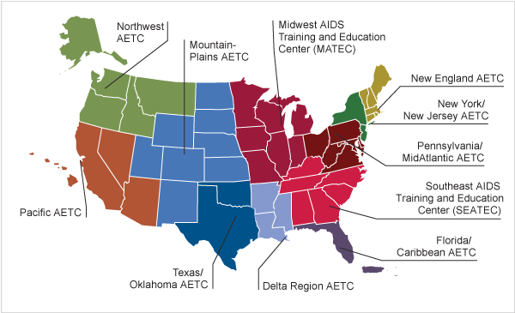
National & International Centers
AETC National Resource Center
AETC National Center for HIV Care in Minority Communities
National HIV/AIDS Clinicians' Consultation Center
AETC National Evaluation Center
AETC National Multicultural Center
International Training and Education Center on HIV (I-TECH)

Slide 4
AETCs
a group of expert clinicians and educators, devoted principally to the care of HIV patients
affiliated in their mission to provide the latest in clinical science, practice guidelines and systems integration to community-based practitioners
to improve access to and the quality of HIV care
commitment to network activities
organizational structure that transcends individual training events
Adapted from PBRN definition, AHRQ, USDHHS

Slide 5
Who we are as AETCs
The Nation’s experts in HIV clinical care and capacity building
Supported by the infrastructures of leading academic medical centers and clinical institutions across the cross country

Slide 6
  Uniquely positioned to translate knowledge
Our trainers are leaders in the HIV field
  NIH clinical trials
  NIMH Behavioral Interventions
  Policy Interventionists
  Educators
Members of the HIV Care team
Linking institutions and populations that rarely interact on the same level

Slide 7
How?
Use evidence based models
Leverage resources
Collaboration
  across departments within federal government
  across different levels of government
  academia and community
  across disciplines
Cost effective

Slide 8
What we do
Engage clinical sites
Build clinical capacity
Translate science to practice
---by appreciating the context of practice
We build the HIV workforce for today and …..the future

Slide 9
Methods
On site or Off
Telehealth and web based programs
Didactic sessions
Skill building
Preceptorships
Clinical guidance
Technical assistance

Slide 10
Key to NHAS implementation
  Without a well informed, accessible, clinical workforce the National HIV AIDS Strategy cannot be implemented
  AETCs build capacity to both test and treat
  Educate and train to
    reduce incidence
    Increase access
    reduce morbidity and mortality
    thereby reduce health disparities

Slide 11
Reducing New Infections
In one year, AETCs conducted 642 trainings for 22,669 healthcare providers on implementing HIV testing recommendations
Target primary care providers to incorporate HIV prevention into clinical encounters
Integrate prevention messages into HIV clinical encounters

Slide 12
Increasing Access, Improving Outcomes
AETCs have reached more than 148,000 healthcare providers through 19,300 training programs.
Increase clinician HIV knowledge and clinical skills addressing quality indicators
Link community-based providers with experts at academic medical centers
Continuous clinical guidance through consultation and mentoring
Free, prompt, state-of-the art phone, telehealth and web-based consultation

Slide 13
Reducing Disparities
Support healthcare providers who provide services to communities of color, women, gay/lesbian/bisexual/transgender people
Engage and empower clinicians of color through mentoring and clinical training
Help providers develop methods to decrease stigma and discrimination
44% of all AETC trainees are racial/ethnic minorities; 73% are women.

Slide 14
NHAS Into action
Engaging with your regional AETC
  aids-ed.org
    Individual Clinicians
    Clinical Sites
    Health Departments
    Professional organizations
    Primary care associations
  National Clinical Consultation Center
      www.nccc.ucsf.edu
      Warmline 800-933-3413 (M-F, 5am-5pm PST, plus voice mail)
      PEPline 888-448-4911
      Perinatal HIV Hotline 888-448-8765 (24 hr)

