Slide 1
Identifying and Incorporating into Practice Screening Tools for People with HIV who are
Aging in the Ryan White HIV/AIDS Program
July 20, 2021
HIV/AIDS Bureau (HAB)
Health Resources and Services Administration

Slide 2
Identifying and Incorporating Screening Tools into Practice for Older Adults with HIV in the Ryan White HIV/AIDS Program
Adelero Adebajo, MD, MPH, AAHIVS, FACP
Eau Claire Cooperative Health Care Center, Columbia, SC

Slide 3
Learning Objectives
To be able to recognize the need for functionality screening
To be able to identify the possible challenges associated with some functionality screening tools
To be able to chose functionality screening tools suitable for a health center and client

Slide 4
Operational Model of Care
Cooperative Health is a Federally Qualified Community Health Center (FQHC) located in the four county midlands region of South Carolina.
Currently awarded the Ryan White Part C and D HIV grant to provide and coordinate services to the state of South Carolina.
Services include Adult & Family Medicine, Pediatrics, Ob-Gyn, Podiatry, Behavioral Medicine, Dental, Orthopedics, Radiology, and Pharmacy.
Practice out of 30 locations.
Notes:
The Cooperative Health is a Federally Qualified Community Health Center (FQHC) located in the four county midlands region of South Carolina.
Services include: Adult & Family Medicine, Pediatrics, Ob-Gyn, Podiatry, Behavioral Medicine, Dental, Orthopedics, Radiology, and Pharmacy.
Cooperative Health is currently awarded the Ryan White Part C and D HIV grant to provide and coordinate services to the state of South Carolina.
We practice out of 30 locations.

Slide 5
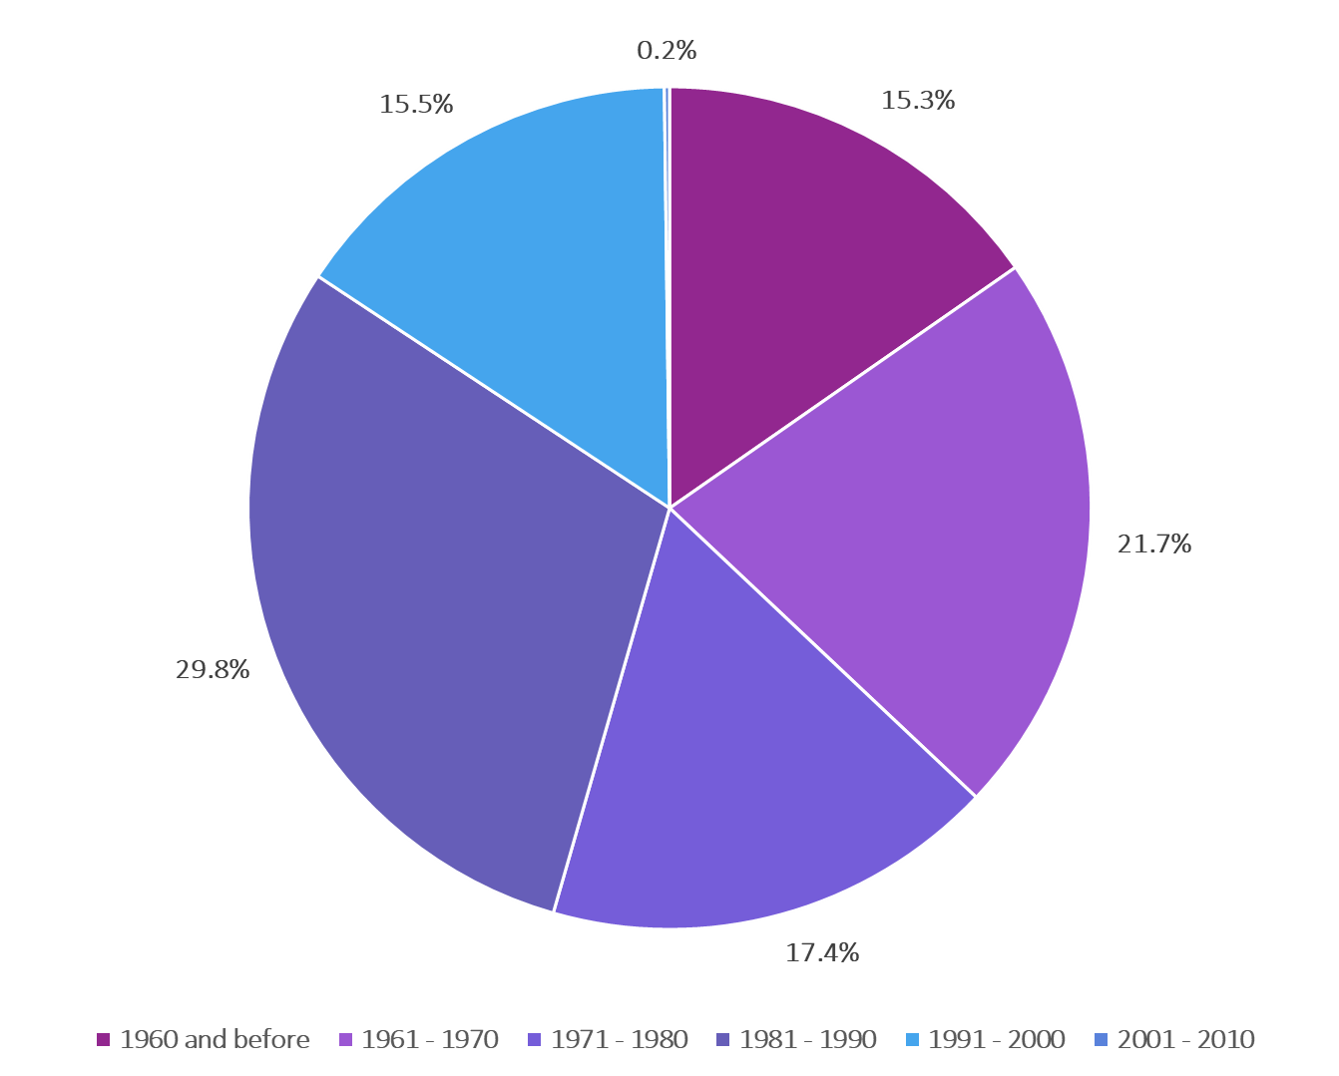
Practice Demographics by Birth Years
Notes:
1960 and before: 15.3 percent
1961-1970: 21.7 percent
1971-1980 17.4 percent
1981-1990: 29.8 percent
1991-2000: 15.5 percent
2001-2010: 0.2 percent

Slide 6
Practice Demographics by Race
Notes:
American Indian/Alaska Native: 0.2%
Black: 87.2%
White: 9.9%
Asian: 0.2%
Native Hawaiian/Pacific Islander: 0.4%
Unknown: 2.5%

Slide 7
Operational Model of Care
Cont.
  Hybrid HIV Care Model
        Each physician has an assigned Patient Service Representative (PSR) and Medical Assistant (MA) but share one Ryan White Registered Nurse (RN).
        Other support staff include Referral Coordinator, Medical Case Manager (MCM), Housing Coordinator, ACA Coordinator, Peer Counselor, Behavioral Health Counselor, Psychiatrist, Pharmacist, Patient Care Coordinator, Dentist, & Orthopedic.
        Other resources including wellness centers, rehab facilities, and adult day care services available.
Notes:
We have a hybrid HIV care model, majority, over 90 percent receive both HIV and Primary Care. Others receive Primary care only or HIV care only. Care provided by three Physicians.
Most patients are seen out of one site.
Each Physician has an assigned PSR, MA, but share one Ryan White registered nurse (RN).
Our other support staff include: Referral Coordinator, Medical Case Management, Housing Coordinator, ACA Coordinator, Peer Counselor, Behavioral Health Counselor, Psychiatrist, Pharmacist, Patient Care Coordinator, Dentist, & Orthopedic.
There are also outside resources like wellness centers, rehab facilities, adult day care services available.

Slide 8
The Work Flow
Patient is checked in by PSR.
Patient is worked up by the MA.
Patient is seen by the MCM.
Frailty/functional screening done by Ryan White RN.
Patient is evaluated by the physician.
Necessary referrals are made.
₁
₂
₃
₄
₅
₆
Notes:
Patient is checked in by Patient Service Representative (PSR)
Patient is worked up by the Medical Assistant (MA).
Patient is seen by the Medical Case Manager (MCM)
Frailty/functional screening done by Ryan White RN
Patient is evaluated by the physician
Necessary referrals are made

Slide 9
Types of Screening Tools

Slide 10
Types of Frailty and Functional Assessment Tools Used at Cooperative Health
FRAIL Scale
Timed Up and Go Test (TUG)
STEADI Fall Risk
Mini Mental State Exam (MMSE)
Patient Health Questionnaire (PHQ) 2/9
Notes:
Below are the screening tests we have administered. We realized that not all tools apply to all patients. Our goal is to find a suitable tool for a patient that we can maintain.
FRAIL scale,
PHQ 2/9,
Mini Mental State Exam (MMSE)
STEADI Fall Risk
Get up and Go

Slide 11
FRAILITY
To assess this, we use the FRAIL scale
The FRAIL scale has been demonstrated as a tool that can effectively identify frailty
Easy to administer in office setting, 5 questions tool
The tests are administered by Nurses while waiting in exam rooms
₆
Notes:
Clinically recognizable state of increased vulnerability resulting from an aging-associated decline in reserve and function across multiple physiologic systems.(4,5)
To assess this we use the FRAIL scale
The FRAIL scale has been demonstrated as a tool that can effectively identify frailty.(6)
Easy to administer in office setting, 5 questions tool
The tests are administered by Nurses while waiting in exam rooms

Slide 12
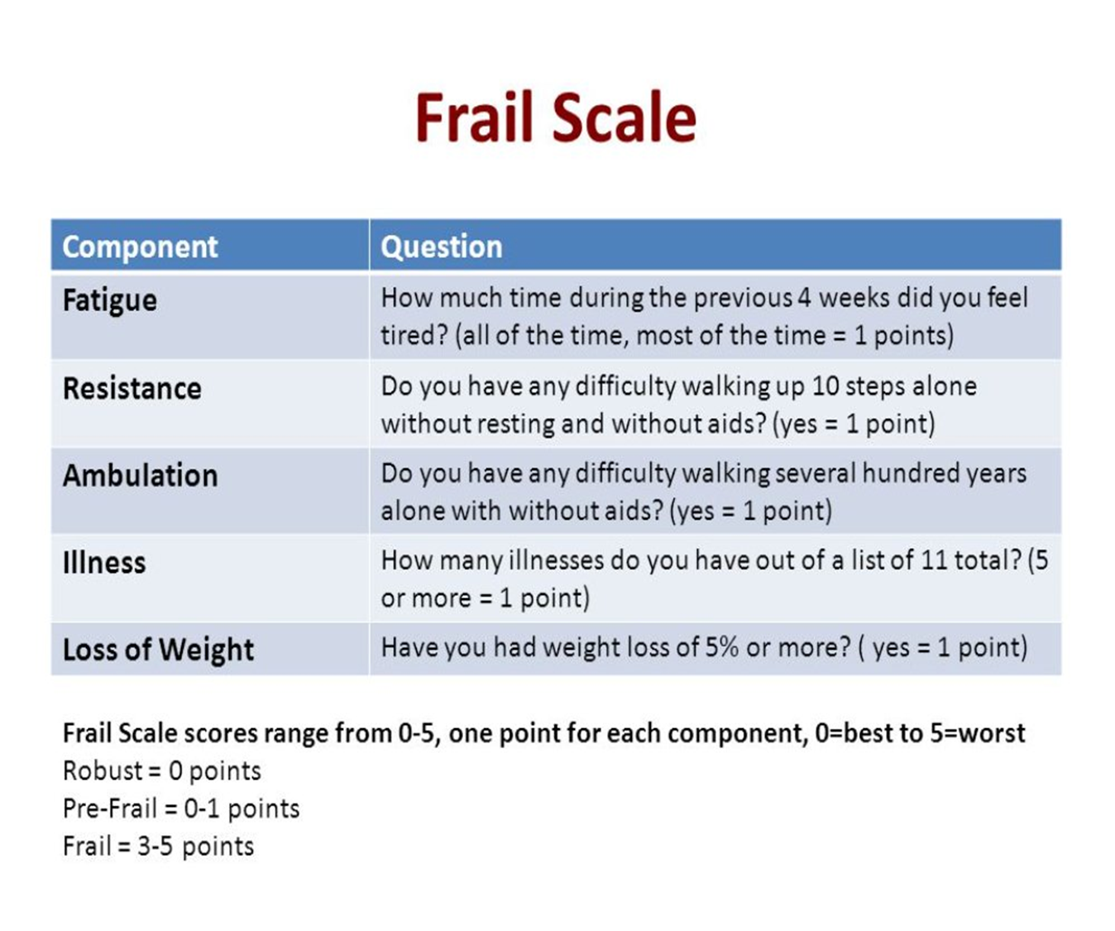
The Frail Scale

Slide 13
FRAIL Scale Challenges
Pros:
Easy to administer
Does not require equipment for administration, based mainly on patient’s response
Takes short time to administer
Can be administered by any clinical staff
Fits well into clinic workflow
Cons:
Not part of our EMR
Sheet has to be scanned into chart
Consumes time to pull previous result and trend during visit
Notes:
Pros:
Easy to administer
Does not require equipment for administration, based mainly on patient’s response
Takes short time to administer
Can be administered by any clinical staff
They fit well into clinic workflow
Cons:
Not part of our EMR
Sheet has to be scanned into chart
Consumes time to pull previous result and trend during visit

Slide 14
STEADI Fall Risk Assessment
  More than 25% of people 65 and older fall each year, and over 3 million are treated in emergency departments annually for fall injuries (CDC).
  Incorporates screening patients for fall risk, assessing modifiable risk factors, and intervening to reduce risk of falling by using effective clinical and community strategies.
  Some of our interventions include requesting mobility assistance devices, home health referrals, physical therapy referrals, and medication review.
Notes:
More than 25% of people 65 and older fall each year, and over 3 million are treated in emergency departments annually for fall injuries (CDC).
Incorporates screening patients for fall risk, assessing modifiable risk factors, and intervening to reduce risk of falling by using effective clinical and community strategies.
Some of our interventions include requesting mobility assistance devices, Home Health referrals, physical therapy referrals and medication review.

Slide 15
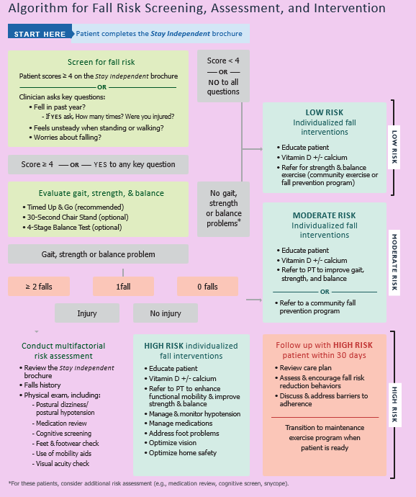
Algorithm for Fall Risk screening, Assessment, and Intervention
https://www.cdc.gov/steadi/pdf/STEADI-Algorithm-508.pdf

Slide 16
STEADI Fall Risk Challenges
Pros:
First stage incorporated electronically
Takes few minutes to administer
Does not require special skill to administer
Cons:
If score is high further testing is required which will be time consuming
Subsequent tests not yet incorporated into EMR
Notes:
Pros:
First stage incorporated electronically
Takes few minutes to administer
Does not require special skill to administer
Cons:
If score is high further testing is required which will be time consuming
Subsequent tests not yet incorporated into EMR

Slide 17
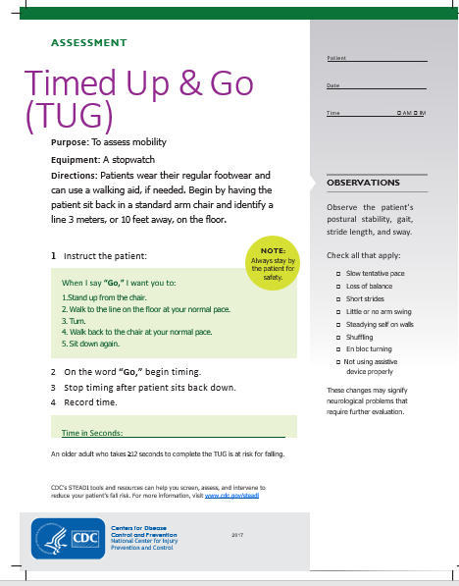
Timed Up and Go Test (TUG)
https://www.cdc.gov/steadi/pdf/TUG_test-print.pdf

Slide 18
Timed Get Up and Go Test
Challenges
Pros:
Takes relatively few minutes to administer
Easy to administer
Test is more objective; not based on subjective responses
Cons:
Requires more time and space to administer
Requires chairs with arm rests for some clients
Not suitable for all (e.g. visually impaired)
Not incorporated into our EMR yet
Trending previous result will take time
Requires some level of skills from the administrator
Notes:
Get up and Go Test
Pros:
Takes relatively few minutes to administer
Easy to administer
Test is more objective not bases on subjective responses
Cons:
Requires more time and space to administer.
Requires chairs with arm rests for some clients.
Not suitable for all e.g. the visually impaired, underlying comorbidities
Not incorporated into our EMR yet
Trending previous result will take time
Requires some level of skills from the administrator

Slide 19
Mini Mental State Exam (MMSE)
Widely used test of cognitive function among the elderly; includes tests of orientation, attention, memory, language and visual-spatial skills (NIH.gov)
Currently administered to aging patients 70 years and over with hope of trending changes, not so much as a one-time screening tool
Notes:
Widely used test of cognitive function among the elderly; it includes tests of orientation, attention, memory, language and visual-spatial skills (NIH.gov).
The United States Preventive Services Task Force concludes that the evidence is lacking, and the balance of benefits and harms of screening for cognitive impairment cannot be determined.
Currently administered to aging patients 70 years and over with hope of trending changes, not so much as a one time diagnostic tool.

Slide 20
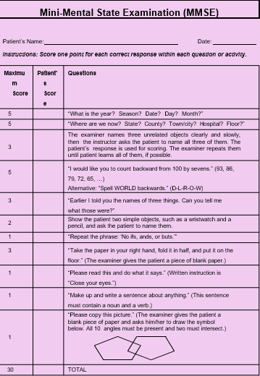
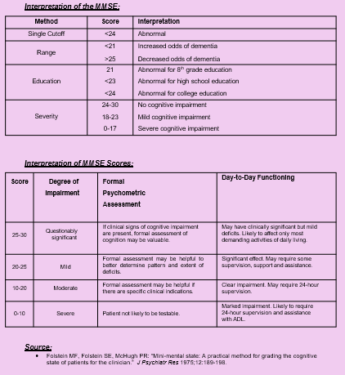
Mini Mental State Exam (2)

Slide 21
Mini Mental State Exam
Challenges
Pros:
Useful in monitoring changes in cognitive function
Cons:
Could be impaired by patient’s level of education
Time consuming
Requires some level of skills to administer
Notes:
MMSE
Pros:
Useful in monitoring changes in cognitive function
Cons:
Could be impaired by patient’s level of education
Time consuming
Requires some level of skills to administer

Slide 22
Patient Health Questionnaire (PHQ) 2/9
  Self administered screening tool that can be completed during patient intake.
  Useful in screening for depression and is also a reliable and valid measure of depression severity.
  Brief depression screening tool that is also useful in detecting depression and its severity as well as useful for monitoring.
₇
₈
Notes:
Self administered screening tool that can be completed while during patient intake.
Useful in screening for depression and it is also a reliable and valid measure of depression severity. (7).
Brief depression screening tool that is also useful in detecting depression and its severity as well as useful for monitoring.(8)

Slide 23
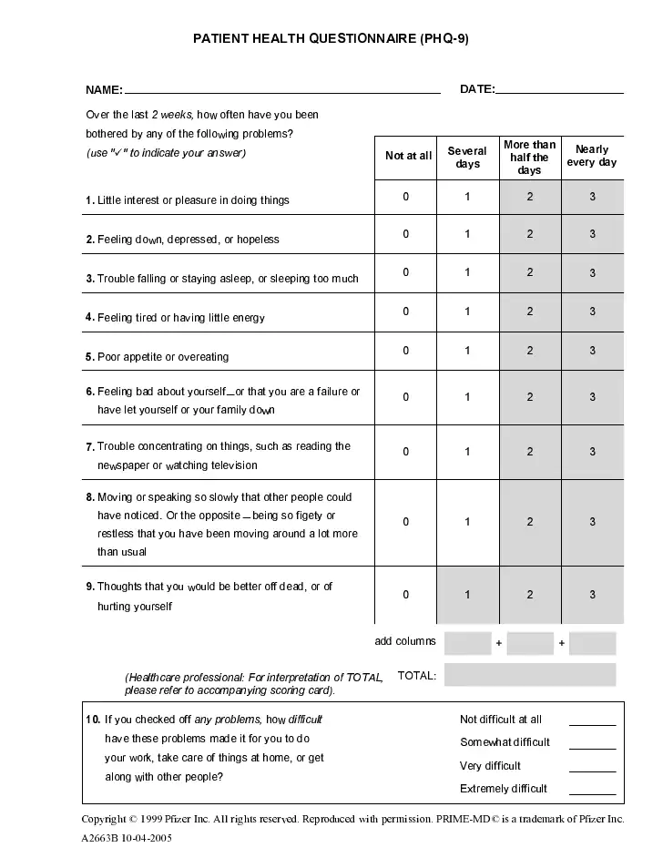
PHQ-9 Questionnaire

Slide 24
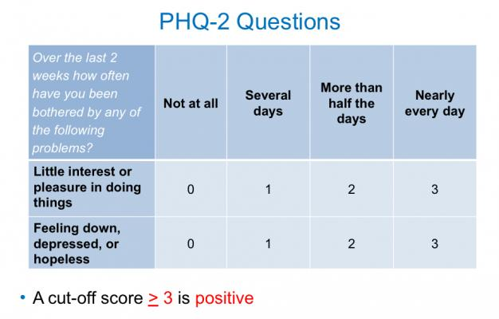
PHQ-2 Questionnaire
https://www.itnonline.com/content/two-item-questionnaire-aids-depression-screening-radiation-therapy-patients

Slide 25
PHQ 2/9 Challenges
Pros:
Can be self administered during check prior to visit or at the visit
Incorporated into EMR and can be easily trended
Cons:
Requires some level of education if self administered
Staff may have to administer if patient doesn’t understand
Time consuming if administered by staff
Notes:
Pros:
Can be self administered during check prior to visit or at the visit
Incorporated into EMR and can be easily trended
Cons:
Requires some level of education if self administered
Staff may have to administer if patient doesn’t understand
Time consuming if administered by staff

Slide 26
Key Points Considered in Selecting and Implementing Tools
  We chose tools that are validated to assess functionality.
  We decided on tools that are relatively easier to apply and that are user friendly to save on time.
  We considered the volume of other measures like UDS, internal QI projects, that we are expected to report at each visit before choosing which functionality tools to use.
  We chose tools that will prevent extensive length of stay at the office for the patient.
  Majority of our screening tool could be incorporated into our EMR making it easier to track.
Notes:
We chose tools that are validated to assess functionality.
We decided on tools that are relatively easier to apply and that are user friendly to save on time
We considered the volume of other measures like UDS, internal QI projects, that we are expected to report at each visit before choosing which functionality tools to use
We chose tools that will prevent extensive length of stay at the office for the patient
Majority of our screening tool could be incorporated into our EMR making it easier to track.

Slide 27
How We Integrated Screening into Practice
The need to screen was shared with support staff to increase buy in.
To reduce the burden on the support staff, we started functional assessments from age 65 years to allow staff to become comfortable administering the screenings.
Notes:
The need to screen was shared with support staff to increase buy in.
To reduce the burden on the support staff, we started functional assessment from age 65 years to allow staff to become comfortably administering the screenings accurately and in a timely manner.
Nursing staff found it easier to administer those that can be filled into the EMR.
Sharing outcome of screening with the support staff helps boost participation.
MCMs can identify barriers facing each individual and assist in linking them to outside resources.

Slide 28
Outcome of Integrating Screening Tools
  Nursing staff found it easier to administer those that can be filled into the EMR.
  Sharing outcome of screening with the support staff helps boost participation.
  MCMs can identify barriers facing each individual and assist in linking them to outside resources.
  More patients were identified who will benefit from more resources.
  Our support staff are appreciating and paying closer attention to patients' quality of life
Notes:
Nursing staff found it easier to administer those that can be filled into the EMR.
Sharing outcome of screening with the support staff helps boost participation.
MCMs can identify barriers facing each individual and assist in linking them to outside resources.
More patients were identified who will benefit from more resources.
Our support staff are appreciating and paying closer attention to patients' quality of life

Slide 29
Modifications
We avoid administering the functional test when clients are in acute pain to allow to better assess their baseline.
We have to manually scan results of screening that are not on EMR.
We implemented frailty screening older clients, those above 65 years first.
We are currently limited to less time-consuming tools.
We currently administer most tools annually except PHQ 2/9.
Notes:
We avoid administering the functional test when clients are in acute pain to allow to better assess their baseline.
WE have to manually scan results of screening that are not on EMR.
We implemented frailty screening older clients, those above 65 years first.
We are currently limited to less Tim- consuming tools.
We currently administer most tools annually except PHQ 2/9.

Slide 30
References
HRSA/RWHAP
Blaylock, J. M., G. W. Wortmann. 2015. “Care of the Aging HIV Patient.” Cleve Clin J Med 82 (7): 445–55
Wing, E. J. 2016. “HIV and Aging.” Int J Infect Dis 53: 61–8.
Fried, L. P., C. M. Tangen, J. Walston, et al. 2001. “Frailty in Older Adults: Evidence for a Phenotype.” J Gerontol A Biol Sci Med Sci 56 (3): M146–56.
Xue, Q. L. “The Frailty Syndrome: Definition and Natural History.” 2011. Clin Geriatr Med 27 (1): 1–15.
Kojima G. Frailty Defined by FRAIL Scale as a Predictor of Mortality: A Systematic Review and Meta-analysis. J Am Med Dir Assoc. 2018 Jun;19(6):480-483. doi: 10.1016/j.jamda.2018.04.006. PMID: 29793675
Kurt Kroenke MD, Robert L. Spitzer MD, Janet B. W. Williams DSW; https://doi.org/10.1046/j.1525-1497.2001.016009606.x
BerndLöwe, Kurt Kroenke, Kerstin Gräfe; https://doi.org/10.1016/j.jpsychores.2004.09.006
Center for Disease Control (CDC)

Slide 31
Thank You
Thank You

Slide 32

Contact Us
Adelero Adebajo MD, MPH, AAHIVS, FACP
Ryan White Program
1228 Harden Street, 2nd Floor, Columbia, SC 29204
Phone: (803) 705-3168
Fax: (803) 753 6497
Email: ryanwhiteandpreventionteam@ecchc.org

Slide 33

Cognitive screening for hiv+ older adults
Ward Carpenter, MD
Co-Director of Health Services
Los Angeles LGBT Center

Slide 34
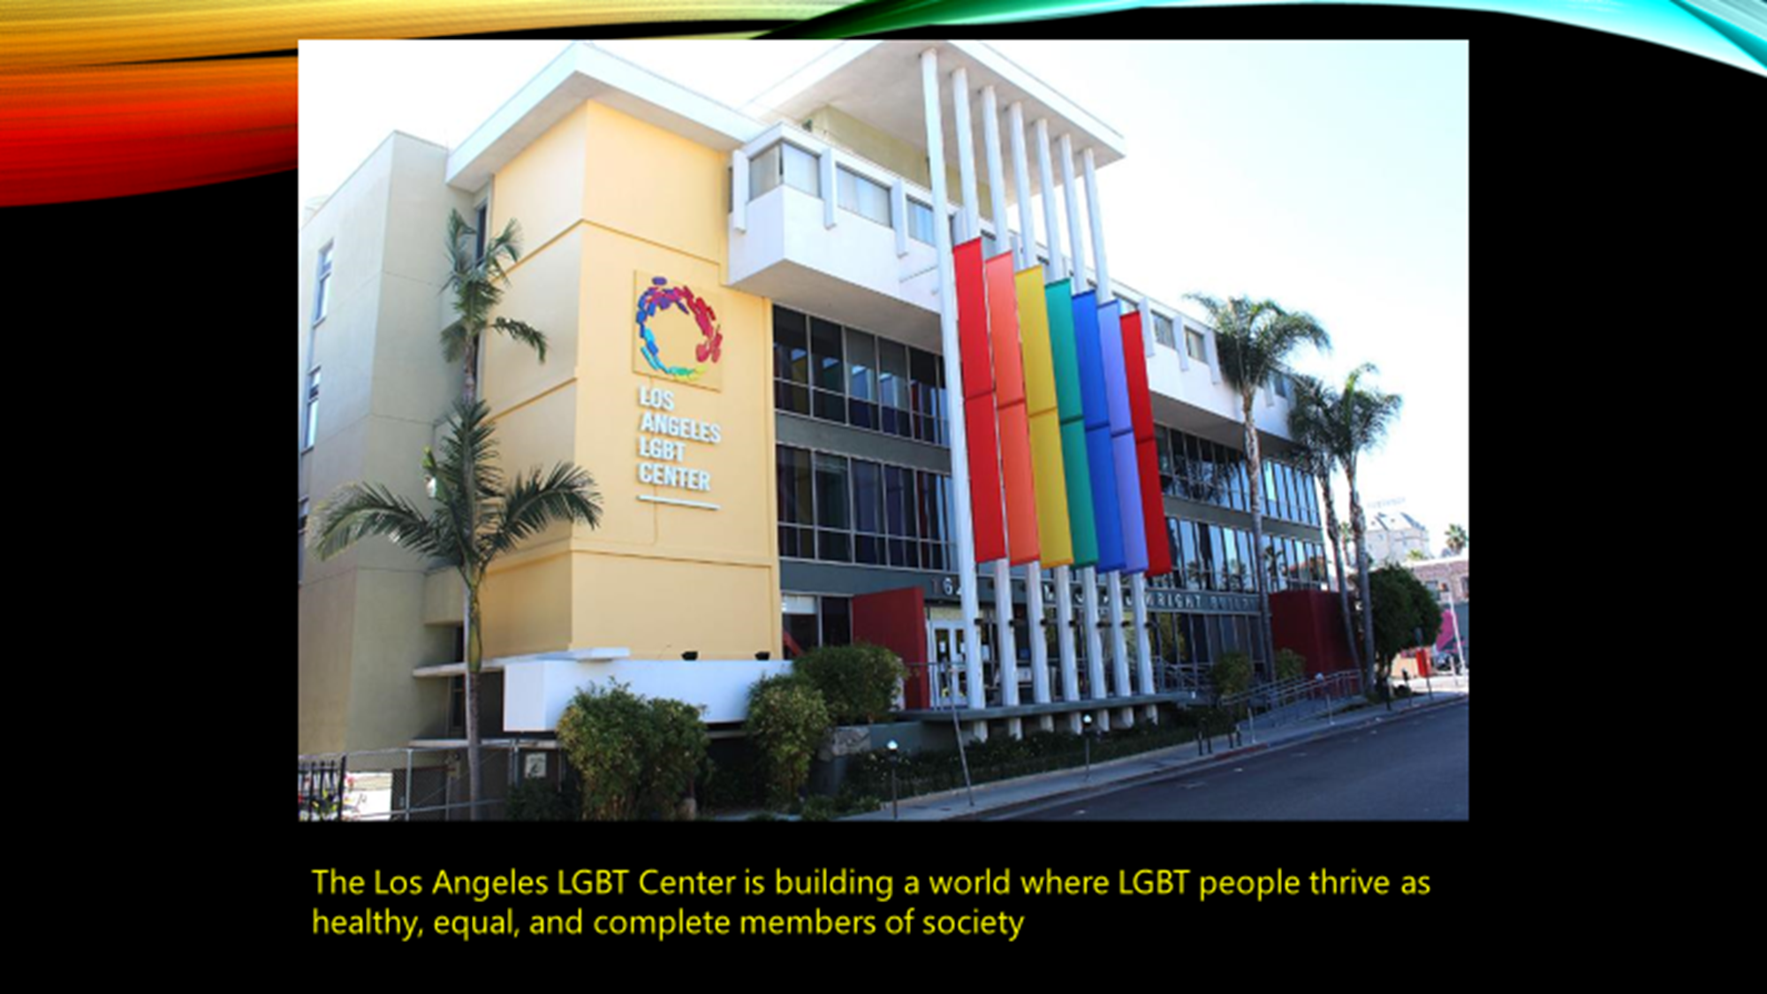

Los Angeles LGBT Center
Ryan white program
Primary care
Mental health
  Individual therapy
  Group therapy
  Addiction recovery services
  Intimate partner violence
  Psychiatry
Sexual health
Case management
Pharmacy
Research
RWSP since 1991
FQHC since 2013
20,000 health center clients
163,000 visits per year
6 clinical sites
3800 HIV+ patients
1000 HIV+ clients over 55

Slide 35
Presentation 2
Learning objectives
Describe the development and implementation of a cognitive screening program for HIV+ older adults within a primary care clinic
Discuss some of the real-life challenges inherent in creating a cognitive screening program
Receive practical advice for starting a similar program at your center

Slide 36
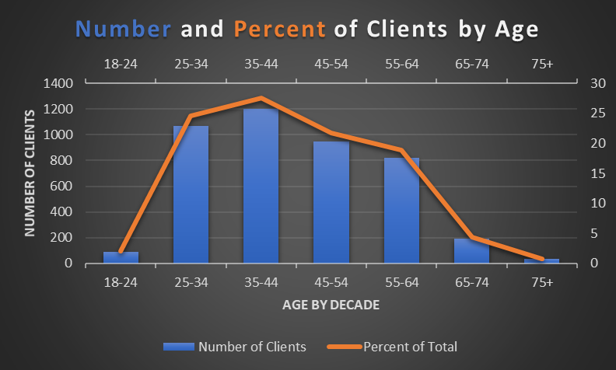
center HIV+ client demographics

Slide 37

Overall Goals of HIV and aging program
To prepare the Center for the coming shift in client needs
To better support a group of people with high medical and mental health needs and often very limited social supports
To detect challenges associated with aging in HIV+ adults >50 at a time when intervention is still helpful
Notes:
To detect challenges associated with aging in a HIV+ adults >50
To better support a group of people with high medical, mental and social needs, beginning at younger ages, with often very limited social supports

Slide 38
Cognitive screening program
Hypotheses:
  We will find undetected mild cognitive impairment (MCI) among HIV+ people who are still functioning well and living independently
  We will find undetected moderate cognitive decline and early dementia among HIV+ people who are struggling to live independently
Project: implement cognitive screening program in primary care clinic
Interventions:
  Address treatable causes (e.g. medication side effects, substance use, depression)
  Use available treatments (e.g. donepezil)
  Multidisciplinary care team support
  Social support
  Wellness promotion

Slide 39
Anticipated challenges
Perceived lack of expertise
Perceived lack of tools to offer
Staff burnout/morale/buy-in
Patient screening fatigue
IT and Data Collection

Slide 40
strategies for Implementing cognitive screening program
Education: Staff training to increase awareness, buy-in and comfort level
Low burden:
  Easy to administer
  Integrated within EMR
  In-person or via telehealth
  Using available staff and resources
Start small
Data: Create data mapping and monitoring from start

Slide 41
Elements of cognitive screening program
All HIV+ patients 50+ receive Mini-Cog screener yearly
Screening added on during existing annual assessment by RN Case Managers
Screeners built directly into EMR:
  self-scoring
  self-charting
  linked to reporting software
Follow up protocols and standing orders written for any positive screeners

Slide 42
Workflow for positive screens
Positive Mini-Cog
SLUMS
Clinical Pharmacist
Labs
PCP
Medication
Imaging
Multi-Disciplinary Care Plan
Support Services

Slide 43

Choice of tools
Mini-Cog©
  Simple and quick to administer
  Two components: 3-item recall test + clock drawing test
  http://mini-cog.com/wp-content/uploads/2015/12/Universal-Mini-Cog-Form-011916.pdf
St. Louis University Mental Status Exam (SLUMS)
  Assessment tool for Mild Cognitive Impairment and Dementia
  11 questions over 8 cognitive domains
  Able to be used in people of varying educational achievement
  https://health.mo.gov/seniors/hcbs/hcbsmanual/pdf/4.00appendix8slumsform.pdf

Slide 44
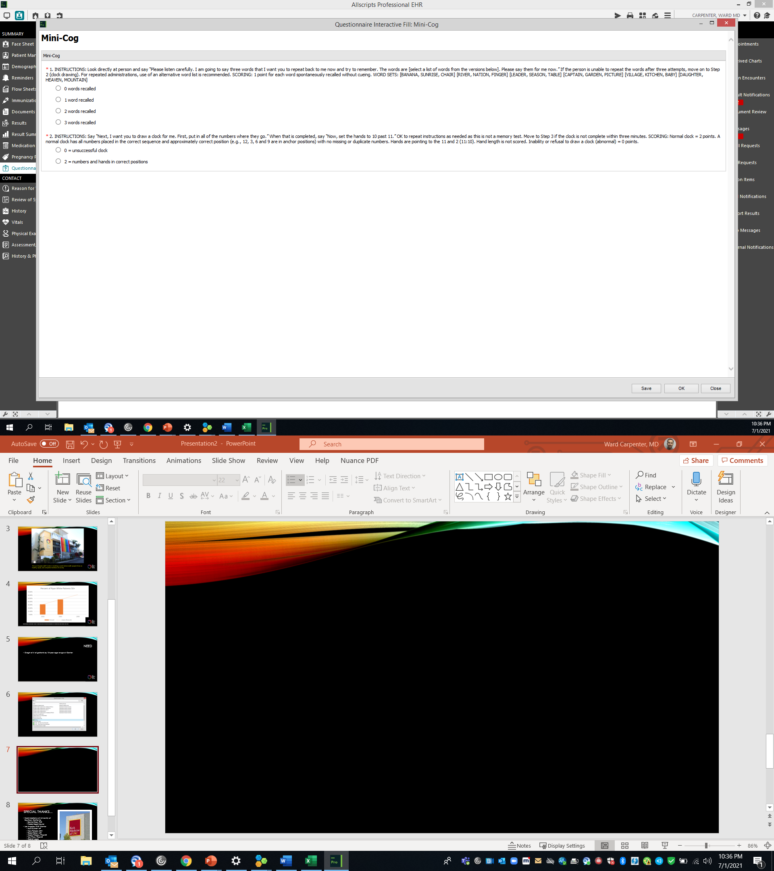
Mini-Cog built into emr

Slide 45
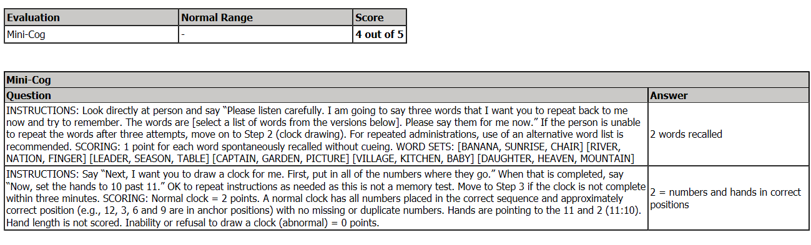
Mini-Cog automatic scoring

Slide 46
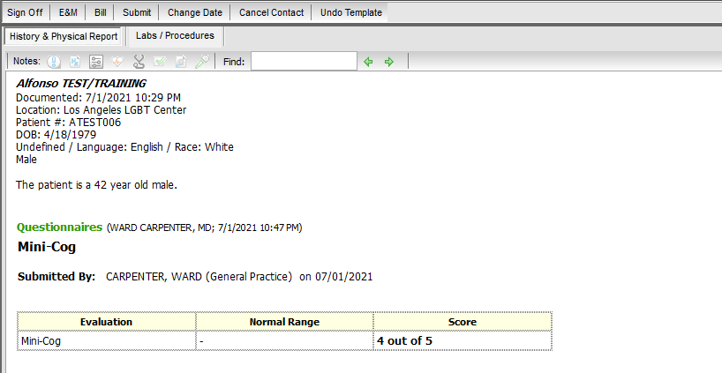
Mini-Cog summary in visit note

Slide 47
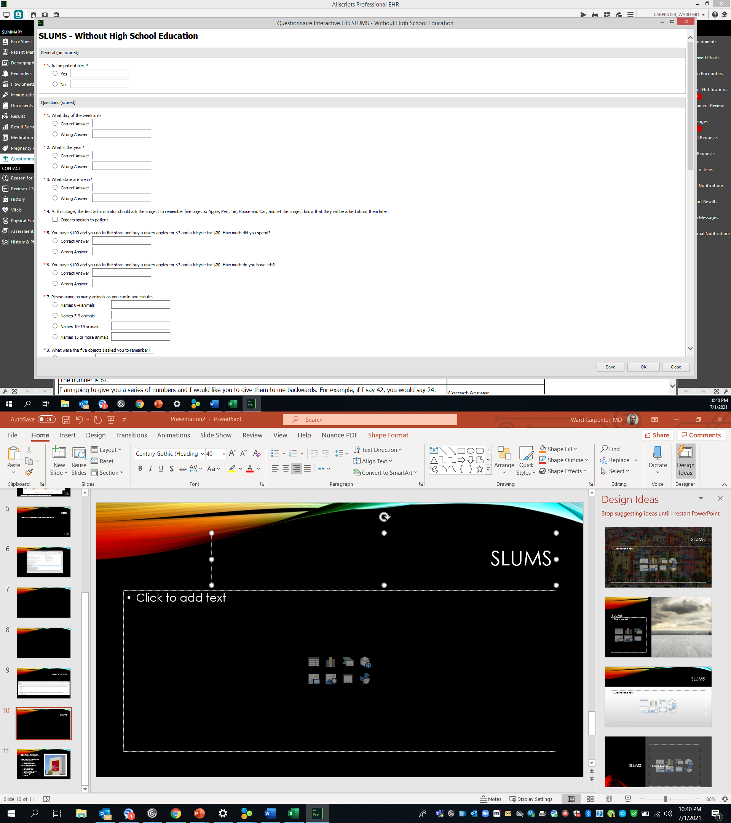
SLUMS built into emr

Slide 48
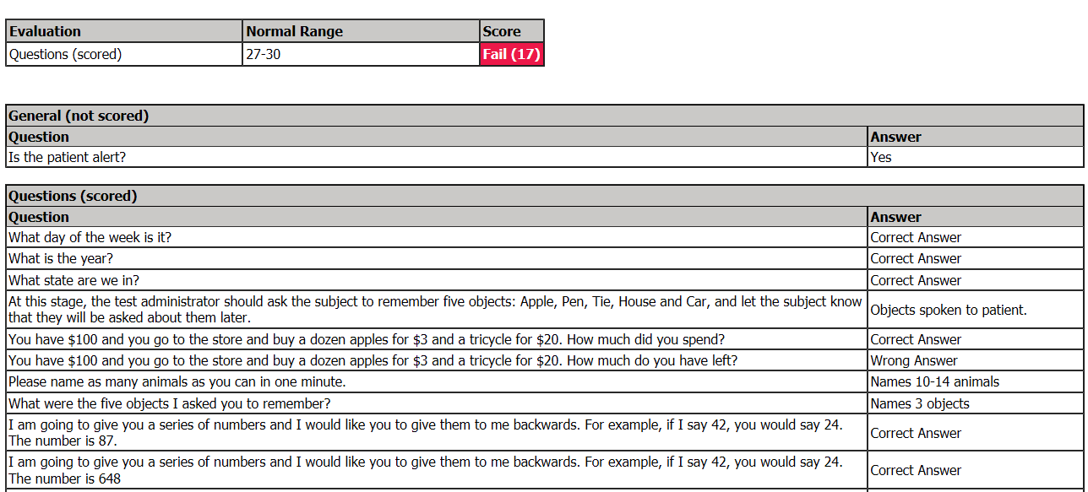
Slums automatic scoring

Slide 49
Anticipated & Observed challenges
Anticipated:
Perceived lack of expertise →
Perceived lack of tools to offer →
Staff burnout/morale/buy-in →
Patient screening fatigue →
IT and Data Collection →
Observed:
Education improved confidence
Education improved comfort
Education achieved buy-in
Not seen so far
Effective structure for QA/QI
COVID/telehealth
Staff turnover

Slide 50
Lessons learned
Recruit a small, multidisciplinary group of champions
Build the system/protocols/infrastructure first if possible
Do proceed even if you don’t have system/protocols/infrastructure in place
Start screenings immediately after trainings
Start teaching rounds soon after starting screenings
Use technology to your advantage
When you hit a barrier, pivot and keep going

Slide 51
The future…
Add further screenings (frailty, abuse/neglect)
Monthly case conference
Move screening to medical assistants
Roll out to all clinic patients 65+
PACE Program??

Slide 52
Presentation Learning objectives
Describe the development and implementation of a cognitive screening program for HIV+ older adults within a primary care clinic
Discuss some of the real-life challenges inherent in creating a cognitive screening program
Receive practical advice for starting a similar program at your center

Slide 53


Special thanks…
Keck Medicine of University of Southern California
  Bonnie Olsen, PhD
  Theresa Sivers-Teixeira, PA-C
  Freddi Segal-Gidan, PA, PhD
  Christina Penate, MFT
  Erin Thayer, MPH
Los Angeles LGBT Center
  Louis Guitron, NP
  Kiera Pollock, MSW
  Robert Bolan, MD
  Nicole Thibeau, PharmD
  Tam Phan, PharmD
  Gabriel Lopez
  Khoa Bui

Slide 54
Contact Information
Ward Carpenter, MD
Co-Director of Health Services
Los Angeles LGBT Center
wcarpenter@lalgbtcenter.org

Slide 55

Any Questions?

Slide 56
Contact Information: HRSA HAB
Susan Robilotto, D.O.
Senior Sponsor, Aging and HIV Workgroup
Director, Division of State HIV/AIDS Programs
HIV/AIDS Bureau
Health Resources and Services Administration
Email: srobilotto@hrsa.gov
Phone: 301-443-6554
Web: hab.hrsa.gov
Kelli Abbott, MSW
Project Manager, Aging and HIV Workgroup
Public Health Analyst, Division of State HIV/AIDS Programs
HIV/AIDS Bureau
Health Resources and Services Administration
Email: kabbott@hrsa.gov
Phone: 301-443-1993
Web: hab.hrsa.gov
R. Chris Redwood, MBA/HCM, RN
Co- chair, Aging and HIV Workgroup
Nurse Consultant, Clinical and Quality Branch
Division of Policy and Data
HIV/AIDS Bureau
Health Resources and Services Administration
Email: rredwood@hrsa.gov
Phone: 301-443-2118
Web: hab.hrsa.gov

Slide 57






Connect with HRSA
Learn more about our agency at:
www.HRSA.gov
Sign up for the HRSA eNews
FOLLOW US:

