Slide 1
PWH Involvement in Case Conferencing
Adam Thompson, CQII Coach
Kimberly McCargo, BSN, MPH – Director of Population Health, CompleteCare Health Network
Terri Fox, MSW – Grants Manager, Jefferson Health New Jersey Infectious Diseases EIP Program

Slide 2
Objectives
Review Not-In-Numerator Reporting (Drilling Down the Data) and Case Conferencing Processes
Highlight two QI projects which leveraged PWH involvement in Case Conferencing to improve outcomes
Discuss lessons learned from the QI project and PWH involvement

Slide 3
Drilling Down the Data
Revealing Opportunities

Slide 4
Tools for Drilling Down the Data
Not-in-Numerator Reporting
Case Conferencing
Integration of PWH Expertise and Experience

Slide 5
Drilling Down the Data
Drilling Down the Data is a process used to help identify potential factors leading to a health outcome at the individual patient level
The process leverages Not-in-Numerator Reporting to generate a list of patients and then uses Case Conferencing to facilitate the discovery and intervention selection process
Drilling Down the Data is one way to systematically address individual patient barriers to care to improve health outcomes
The process is particularly helpful when examining disparities and addressing complex co-occurring conditions and/or social determinants of health barriers

Slide 6
Not-in-Numerator Reporting
Not-in-Numerator Reporting is a tool used in “drilling down the data” and is utilized to identify the specific patients not experiencing an expected health outcome, such as viral load suppression.
The process uses routinely reported RWHAP data to identify those patients not in the numerator or those patients who are not getting the expected outcome
For example, using the Viral Load Suppression measure to identify those patients who are not virally suppressed
Once the patients are identified, the agency has a list of only those patients not experiencing the outcome
This helps the agency focus more clearly on the issues facing these patients without the “noise” of the rest of the agency overshadowing

Slide 7
Case Conferencing
Case Conferencing differs from routine coordination.
Case conferencing is a more formal, planned, and structured event separate from regular contacts.
The goal of case conferencing is to provide holistic, coordinated, and integrated services across providers, and to reduce duplication.
Case conferences are usually interdisciplinary and include one or multiple internal and external providers and, if possible and appropriate, the client and family members/close supports.

Slide 8
Patient-Centered Care
In patient-centered care, an individual’s specific health needs and desired health outcomes are the driving force behind all health care decisions and quality measurements.
Patients are partners with their health care providers, and providers treat patients not only from a clinical perspective, but also from an emotional, mental, spiritual, social, and financial perspective.

Slide 9
Integration of PWH
Persons with HIV bring lived experience which can be translated into actionable recommendations for interventions and improvements
Involvement of PWH is required as part of the Ryan White Legislation because of the important partnership required to achieve public health goals such as ending the HIV epidemic
PWH can help ensure that care remains patient-centered by bringing the values, preferences, and experiences of the community to the case conferencing process
PWH should be viewed and valued as any other external consultant brought in to support improved care practices

Slide 10
PWH Integration in Case Conferencing Drill Down Sessions
A completed process …

Slide 11
Jefferson Health New Jersey EIP Program
HIV Primary Care Program co-located with an Infectious Diseases Practice in a large health system
Program undergoing transformation practices throughout the clinic and health system
Added Care Coordination, Clinical Outreach Services, Team-based Care Model
Adapted from the Los Angeles County Medical Care Coordination Model
Program funded through Ryan White Part A, New Jersey Department of Health, and Billing
Practice has provided care continuously for over 30 years

Slide 12
Multidisciplinary Care Team
Clinical Teamlet
Infectious Disease Specialist
Certified Medical Assistant
Behavioral Health Teamlet
Licensed Clinical Social Worker
Psychiatrist
Physician Assistant
Supportive Teamlet
Medical Care Coordinators (Registered Nurse)
Medical Case Manager
Non-Medical Case Manager
Community Health Worker

Slide 13
Building on a Process
“Drilling Down the Data” Tool from The AIDS Institute
Implemented specifically to address non-suppression in a population of PWH

Slide 14
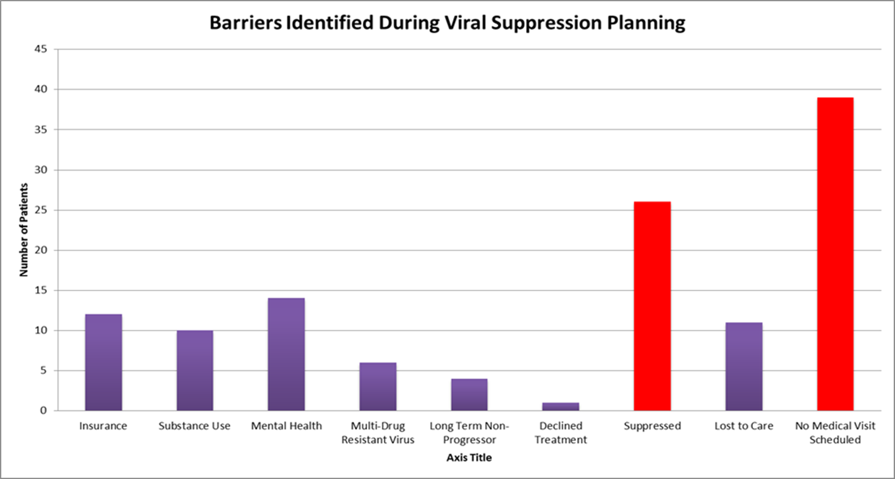
Team-Based Care and Disparity Analysis

Slide 16
Why continue to drill down the data?
Need for Health Systems to manage a population
Desire to provide personalized care in the era of standardization and metrics
Leverage Agency experience in Not-In-Numerator Reporting as a Quality Tool
Manage differential experiences leading to special cause variations
Align and reinforce treatment message across the team
Expand the pool of interventions
Overall clinic viral load suppression rate was high (88%) but staff wanted to do more

Slide 17
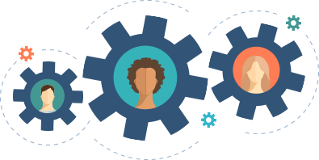
Drilling Down Part Deux
Identify Area of Interest
Determine Data Needed for Case Review
Convene Multi-disciplinary Team
Hypothesize about Key Drivers of Outcome
Create a List of Potential Interventions
Prioritize and Select Intervention
Implement Intervention
Evaluate Outcome
Additional or Different Strategies

Slide 18
Case Conferencing Team
Facilitation Team
Intervention Panel Team
Infectious Disease Specialist
Doctor of Pharmacy
Person with HIV
Medical Student
HIV Primary Care Provider
Community Health Worker
Nurse Care Manager
Medical Case Manager
Nonmedical Case Manager
Medical Assistant
Clinical Director

Slide 19
Change in Viral Load Suppression Rates
July 2019
Data Drill Down Meetings Begin
October 2019
Data Drill Down Meetings End

Slide 20
Change in Viral Load Suppression for Intervention Panel

Slide 21
Honoring Autonomy
Patient Challenge
New Approach
Older African-American Woman with intermittent adherence that was affecting her CD4 count
The patent had received multiple adherence interventions and “talks” with the care team
The team had resolved that she was set in her ways and when she got sick then she might change
The clinic has historical knowledge of the types of care needed for people who choose not to take medication – hospice and end of life
Offering a patient all the options that respected her autonomy might yield a different outcome

Slide 22
PWH Integration in Case Conferencing Drill Down Sessions
In the beginning …

Slide 23
CompleteCare Health Network
HOLD FOR CCHN Overview from Kim

Slide 24
Practice Transformation
CCHN is part of the AIDS Education and Training Centers Practice Transformation Project and adopted formalized case conferencing
The CCHN team received training in motivational interviewing and power and privilege dynamics in medicine
The CCHN team identified patients who were not virally suppressed for case review
The AETC provided a facilitation team comprising an expert in the application of motivational interviewing and a PWH with lived and professional experience receiving and delivering services in a RWHAP

Slide 25
CCHN Case Conferencing Team
Facilitation Team
Intervention Team
Expert in Motivational Interviewing and Power and Oppression dynamics
Person with HIV
HOLD FOR KIM’s TEAM DESCRIPTION
Nurse Medical Case Manager
Linkage to Care Coordinator
Community Health Worker
Non-Medical Case Manager (?)
Nurse Care Coordinator

Slide 26
Case Study 2 – Seeing Through Behavior
Patient Challenge
New Approach
A homeless woman with a history of addiction and poor social support was unable to manage large amounts of information before disruptively leaving the clinic
She would routinely and brutally insult staff on her way out the door
Leadership was concerned with the behavior and recommended discharge from the practice
The clinic disagreed arguing that she had shown signs of improving engagement despite this behavior
An active drug-user might be going into withdrawal thereby increasing her agitation and desire to leave
Her response to staff might be driven by the effects of withdrawal
Awareness that the patient might leave the clinic, get high, and associate the symptoms of withdrawal with the clinic – distrust, judgement, anxiety
Until she is no longer using the drug, the team will need to change or manage the interactions differently

Slide 27
Lessons Learned

Slide 28
Critical Elements
Clinical Champion to Convene and Coordinate
Integration of PWH with Lived Experience
Multidisciplinary and Culturally Representative Staff
Dedication and Commitment to the Process
Preparation for the Drill Down Sessions
External Facilitation by Peer Experts

Slide 29
Lessons Learned
The integration of Persons with HIV allowed the team to navigate “risky” conversations and generate “out-of-the-box” ideas
Coordination of staff was relatively easy with the support of clinical leadership
Trust had to be built for the process to work between the Facilitation Team and the Intervention Teams
A good abstraction tool can save your team a lot of time by being prepared with the right data at the right time
The lens of clinical pharmacy allowed for deeper discussions about how medications and regimens may be affecting outcomes

Slide 30
Questions

