Slide 1
Using Data for Decision Making: Part 2
May 30, 2019
2:00 PM - 3:30 PM ET
Molly Tasso (Planning CHATT)
Ann Dills (Texas Department of State Health Services, HIV/STD Program)
Allen Murray (Co-chair, Operations Committee, Houston Area Ryan White HIV Health Services Planning Council)
Notes:
Molly
Hello everyone, and welcome to today’s webinar, part two of the Using Data for Decision Making webinar series. My name is Molly Tasso and I am a Technical Assistance Coordinator for the Planning CHATT project.

Slide 2
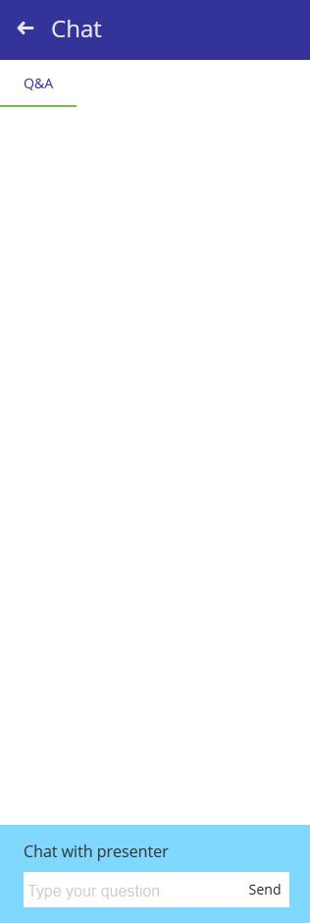
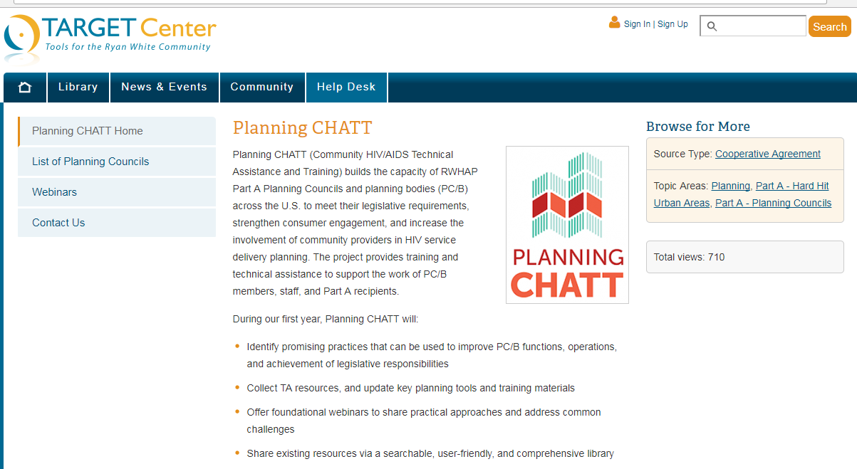
How to Ask a Question
Attendees are in listen-only mode.
If you have a question, use the chat box at the lower-left of your screen to chat with the presenter.
You may also email questions to planningCHATT@jsi.com after the webinar.
Notes:
Molly
Before we get started, here are some technical details. First, attendees are in listen-only mode but we encourage you to communicate with each other and ask lots of questions using the chat box! You can submit your questions at any time during the call, or during the question period at the end. Our presenters, along with Planning CHATT staff, will take as many of your questions as we can at the end of today’s session. And if you think of a question after the webinar that’s fine too – you can always email questions to us at planningCHATT@jsi.com.

Slide 3



Can You Hear Us?
The audio is being shared via your computer speakers/headset.
If you can’t hear the audio, make sure your computer audio is turned on.
If you’re still having problems, please chat the host.
Call-in number: 800-581-5838
Passcode: 567706
Notes:
[Molly]
The easiest way to listen to our webinar is through your computer. If you can’t hear very well, check to make sure your computer audio is turned on. If you still can’t hear us, or if you experience a sound delay at any point, try refreshing your screen.
And finally – if needed - you can mute your computer audio and call in using your telephone at the number you see on your screen. You’ll need to use a passcode, which is also listed on the screen. We have also put this information in the chat box.

Slide 4
Agenda
How to prepare and present data for use by PC/PB
Using data to carry out legislative responsibilities
Using data to identify and address specific needs in setting priorities
Role of PC/PB members as planners and advocates
Resources
Questions and answers
Notes:
Today, we’ll begin the presentation with an overview of best practices for preparing and presenting data for use by PC/PB, then move into a discussion about how to use data to carry out legislative responsibilities and identify and address specific needs in setting priorities. Our presentation will then end with a conversation about the role of PC members as both planners and advocates and a Q&A session.

Slide 5
Objectives
By the end of the webinar, you will be able to:
Describe how PC/PBs use data to carry out legislative responsibilities, including updating its Integrated HIV Care and Prevention Plan.
Identify ways to make data presentations understandable for PC/PB members and useful for HIV planning purposes.
Differentiate between member roles of ‘advocate’ and ‘planner’ and understand how PC/PB members can operate in each of these roles.
Notes:
As you can see here, by the end of the webinar, our objective is that you are:
Able to describe how PC/PBs use data to carry out legislative responsibilities, including updating its Integrated HIV Care and Prevention Plan.
Identify ways to make data presentations understandable for PC/PB members and useful for HIV planning purposes.
And Differentiate between member roles of ‘advocate’ and ‘planner’ and understand how PC/PB members can operate in each of these roles.

Slide 6

Planning CHATT
Notes:
As I stated earlier, these webinars are put on by the Planning CHATT project

Slide 7
Community HIV/AIDS Technical Assistance and Training (Planning CHATT) Project
Planning CHATT builds the capacity of Ryan White HIV/AIDS Program (RWHAP) Part A planning councils/planning bodies and planning bodies (PC/PB) across the U.S.
Our goal is to help PC/PB to meet legislative requirements, strengthen consumer engagement, and increase the involvement of community providers in HIV service delivery planning.
Notes:
Planning CHATT builds the capacity of Ryan White HIV/AIDS Program (RWHAP) Part A planning councils/planning bodies and planning bodies (PC/PB) across the U.S.
Our goal is to help PC/PB to meet legislative requirements, strengthen consumer engagement, and increase the involvement of community providers in HIV service delivery planning.

Slide 8
Webinar Presenters
Molly Tasso
  TA Coordinator
  Planning CHATT
Ann Dills
  HIV Systems Consultant
  Texas Department of State Health Services Mobile
Allen Murray
  Co-chair, Operations Committee
  Houston Area Ryan White HIV Health Services Planning Council
Notes:
Today, I’m excited to have with me two great presenters who will guide us through today’s presentation.
First, we have Ann Dills from the Texas Department of State Health Services HIV/STD Program. Ann has been working in HIV/AIDS since 2000 and prior to moving to Texas, she worked as a Medical Case Manager in an infectious disease clinic. She started at Department of State Health Services with the HIV/STD Program in 2007 as an HIV Case Management Training Specialist, and developed the Texas HIV Case Management training program. Currently, she works as a Systems Consultant with the HIV/STD Program, with a focus on working with communities to create pathways from diagnosis to care, with a focus on health disparities.
We also have with us Allen Murray, who serves as the Co-chair of the Operations Committee of the Houston Area Ryan White HIV Health Services Planning Council, where he also sits on the Priority & Allocations and Steering Committees, and made significant contributions to the development the Texas 2017-2021 (Integrated) Plan. He is also highly involved in local and state advocacy efforts and Houston’s plan to end the HIV epidemic.

Slide 9
How to Prepare and Present Data for Use by PC/PB
Notes:
Introduce Ann D.
Talking point suggestion for this and Part I: remind participants that many of the slides are derived from Module 10 which they can use for training their own PC/PB.

Slide 10
Importance of How Data are Presented
Written reports, oral presentation, and charts have influence on understanding and use of data
PC/PBs can become strong users of data through:
  Use of well designed, clear reports and presentations
  Sound basic training on data sources and uses
  Mini-trainings provided along with presentations
  Allocation of the time necessary to discuss and clarify data
  PC/PB & recipient commitment to ensuring that all members feel comfortable asking questions and know they will receive thoughtful, useful answers

Slide 11
Written Data Reports Prepared for the PC/PB should…
Include narrative, tables, and charts
Provide information on data sources, sample size and methods, and limitations
Use plain language – designed for your audience
  A plain language document looks good, is organized logically, and is understandable the first time you read it
Use technical terms only when necessary and always be defined and explained
Include an Executive Summary
Be reviewed in draft form by the responsible committee
Notes:
Talking point suggestion: this is something PC/PB can ask anyone who will be preparing data for them to consider in advance.

Slide 12
Oral Data Presentations to the PC/PB should…
Use plain language
Define new or unfamiliar terms
Maximize use of charts with brief text to explain them
Avoid data overload
Include a structured “mini-training” to maximize understanding of data presented
Be previewed by the responsible committee and Executive Committee and revised as needed
Be available electronically before the meeting, and copied and distributed at the meeting
Notes:
Talking point suggestion: this is something PC/PB can ask anyone who will be preparing data for them to consider in advance.

Slide 13
Data Charts in Reports/Presentations should…
Be clear and easy to read using color contrast, data labels, and numbers large enough to read
Include brief text to highlight and explain content
Use graphics to highlight key data
Use consistent formats
  Same type of chart used for same type of data throughout presentation and across presentations
  Same colors used for a population or other variable
Specify total number and percent of responses/clients

Slide 14
Discussing the Data: The Presenter or Leader Should…
Allocate ample time for discussion anytime data are presented
Encourage questions about data source and quality
Identify and highlight findings that would benefit from diverse input and interpretation
Be sure major points of discussion are summarized and included in minutes
Document and follow up on data questions and provide answers

Slide 15
Making Data User-friendly in Practice
Chart Comparison

Slide 16
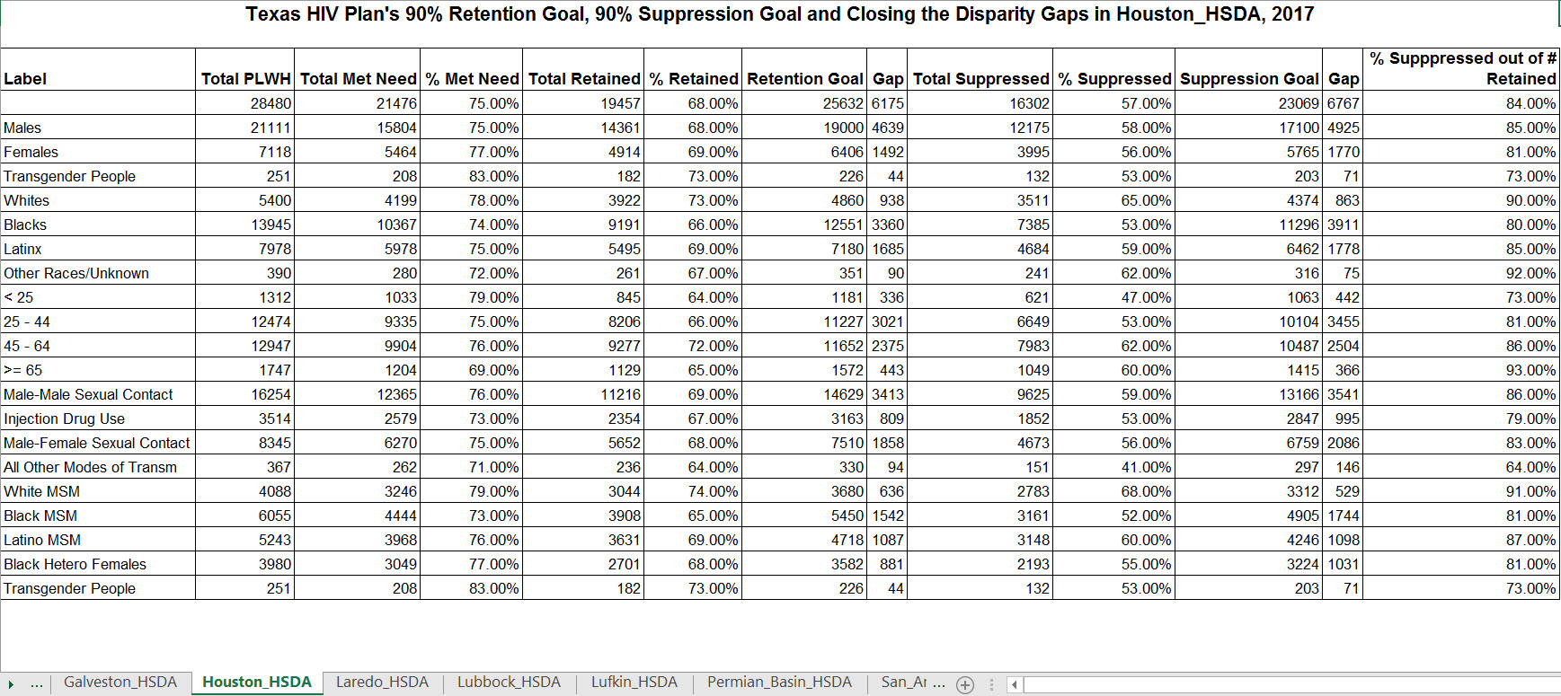
Notes:
Typical chart. Focused on an epi audience. Too much information without breaking info up. Hard to focus on what’s important. No context

Slide 17
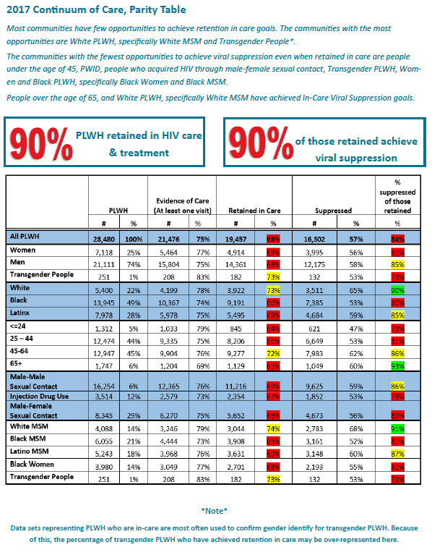
Notes:
Info in an easier to read/read at a glance format. Next two slides break up sections for focus

Slide 18
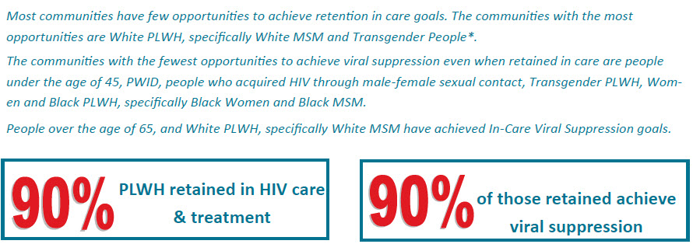
Notes:
Tell ppl yr goals, provide highlights, info to focus on

Slide 19
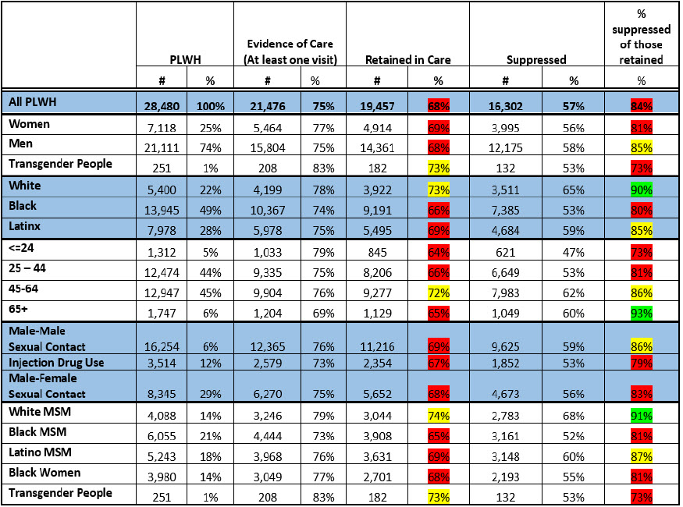
Notes:
Table is easier to read, categories are separated in a way that’s visually easier to read. Stoplight color coding let’s ppl see priorities at a glance.

Slide 20
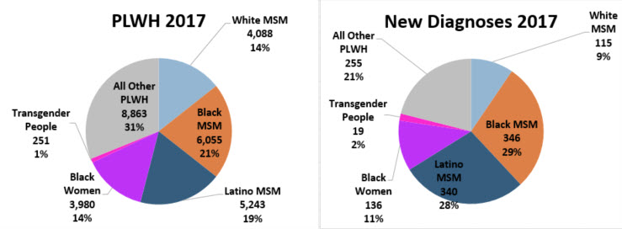
Notes:
Typical pie chart. Pie charts are harder to compare change/difference. Harder to make sense of it.

Slide 21
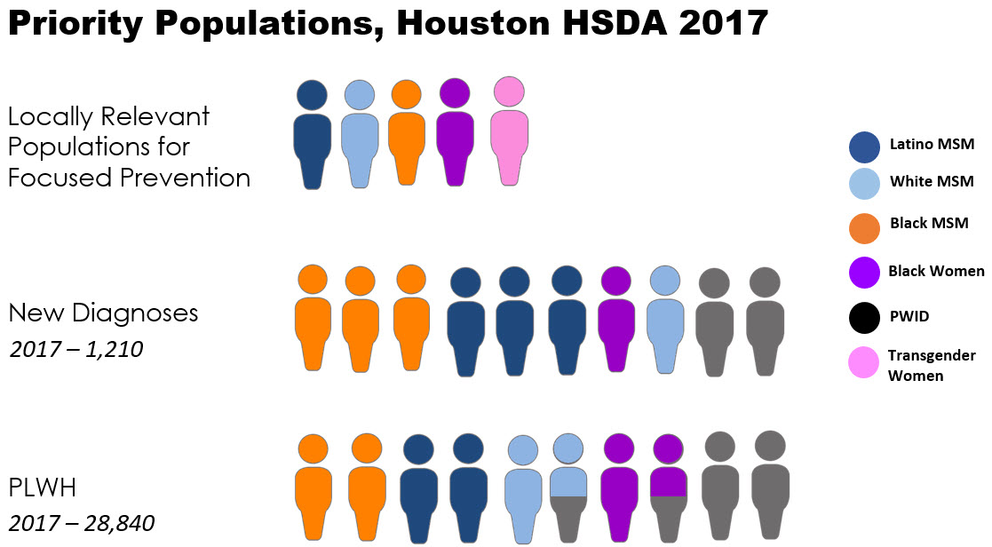
Notes:
Easier to see at a glance the difference between PLWH and new dx. Allows info to see populations in diff parts of system. Focus conversation on each part

Slide 22
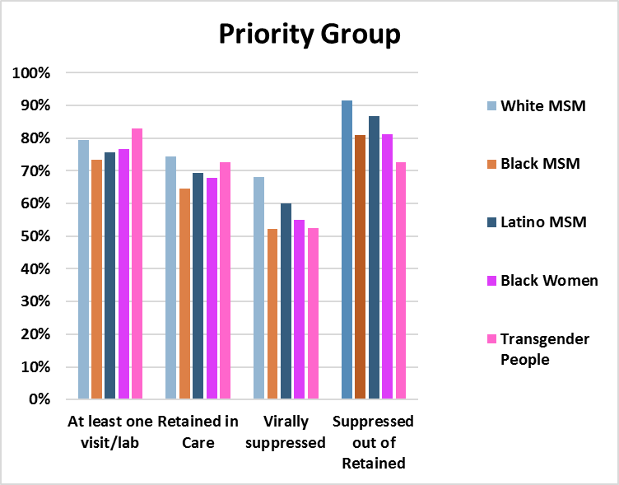
Notes:
Typical bar chart showing health outcome differences among different ppl. Too much information/not enough focus. Doesn’t highlight disparities in a meaningful way

Slide 23
In-Care Viral Suppression, Priority Populations,2017
100%
95%
90%
85%
80%
75%
70%
65%
60%
55%
Latino MSM
White MSM
Target
Black MSM
Black Women
Latinx Transgender People
Black Transgender People
Houston
Dallas
San Antonio
Austin
Ft. Worth
Notes:
Focus in on the parts of yr system you want ppl to influence (retention, ICVS) This display highlights disparities between populations, stoplight allows at a glance prioritization. Walking thru each community allows opportunity for dialogue

Slide 24
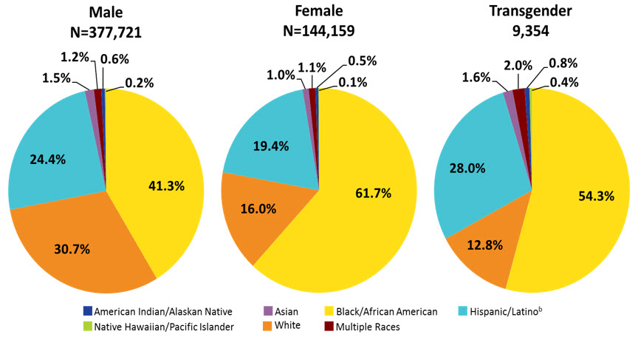
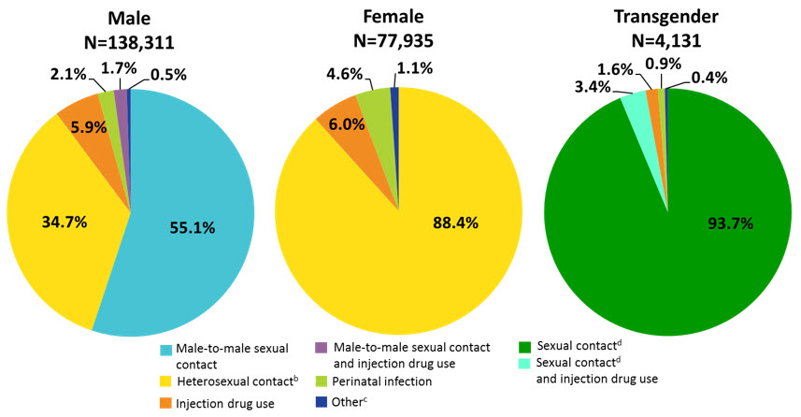
Notes:
Using the same color scheme for two different categories on consecutive slides – confusing, makes it harder to orient to what each slide is telling you. Hard to keep consistency in color across presentation when talking about these different categories.

Slide 25
Sound Data-use Practices for PC/PBs

Slide 26
Sound Practices to Facilitate Decision-Making
In decision making:
Develop and consistently follow a process to weigh, summarize, compare, and use data to reach decisions
Give organized opportunities for individual and research-based data to be presented before decision making
Have a policy and process to manage conflict of interest
Empower all members to use data and help uphold a commitment to data-based decision making

Slide 27
Sound Data-Use Practices for PC/PB Members and Committee Members
Become familiar with all the data types and sources
Look for appropriate and timely data to answer specific questions
Always look at subpopulations
Identify data gaps
Review multiple data sources (triangulation) and give most weight to the “best” data
Notes:
Talking point:
Remind audience that they can figure out what the ‘best data’ is through assessing data quality, as described in webinar 1.
For example:
Review data from multiple sources
Ask questions about how data were gathered, tabulated, and analyzed
Compare and weigh data from different sources and studies
Encourage them to go back and review those slides for a refresher.

Slide 28
Use Quantitative and Qualitative Data
Example:
Client utilization and characteristics data show that Latinas were much less likely to use mental health services last year than in prior years
A Latina focus group indicates that two bilingual clinical social workers left their jobs about a year ago and were replaced by staff who do not speak Spanish – and sometimes no interpreter is available
Notes:
Talking points:
Use quantitative data to identify issues & use qualitative information to understand them better

Slide 29
Using Data to Carry out Legislative Responsibilities

Slide 30
Using Data in Priority Setting & Resource Allocation (PSRA)
Begin the PSRA process with a data presentation summarizing data from various sources (including needs assessment, epidemiology report, service utilization and client characteristics data)
Use a structured process to allow individuals and organizations, both members and non-members, to speak about their concerns and needs
Notes:
Talking points:
Begin by defining what PSRA is…

Slide 31
Using Data in PSRA, cont.
Solicit and answer any data-related questions either before or during the meeting(s) where priorities and/or allocations are set
Review data on other funding streams
Have readily available:
  Previous year’s service priorities
  Previous year’s allocations and expenditures by service category – including over- and under-expenditures
  Unit and per client costs by service category

Slide 32
Using Data in PSRA, cont.
Prepare and discuss data by service category that summarizes:
  Service needs and gaps, as identified through service category-based findings from needs assessment, service utilization and client characteristics data from the RSR
  Overall service quality, as identified through HIV care continuum data for all RWHAP clients, CQM and other performance data, client feedback through CQM and needs assessment, the unmet need estimate, and summary monitoring data
  Disparities in care, based on subpopulation-based analyses of service utilization, needs assessment data on service needs and gaps, and performance along the RWHAP HIV care continuum

Slide 33
Using Data for Developing Directives
Develop directives prior to PSRA for inclusion in allocation decisions
Review and triangulate data describing service gaps, barriers, or disparities in care that need special recipient attention
Carefully consider in-depth information from focus groups, key informant interviews and group sessions with providers and other stakeholders
Be sure to consider:
  Geographic areas – central city, suburbs, outlying counties
  Service models – new/refined approaches
  PLWH subpopulations – especially where disparities exist

Slide 34
Using Data for Developing Directives, cont.
Develop directives to address needs revealed by data, for example:
  Populations: Develop directives to require services appropriate for specific PLWH groups based on service utilization, client characteristics, and HIV care continuum data showing populations that are underserved or have low retention in care or viral suppression
  Service model: Use CQM data showing good results for a new service model to direct expanded use of that model
  Geographic area: Use utilization, focus group, and PLWH survey data on disparities in access to care to develop a directive requiring services to be offered in a specific area

Slide 35
Using Data in HRSA/CDC Integrated HIV Prevention and Care Planning
Use all available types of data to set challenging but reasonable goals and objectives for your Plan
Use HIV care continuum and other performance measures and outcomes data to assess progress
Update your plan with new epidemiology data
Refine annual work plans based on new needs assessment, service utilization and client characteristics data

Slide 36
Using Recent Data to Answer Questions About the Current System of Care
Needs assessment findings on client needs and service participation, gaps, and barriers (from surveys, focus groups, or special studies)
Needs assessment data on services--from the provider inventory and profile of capacity/capability
RSR client characteristics and service utilization data
Recipient data on service expenditures including percent of funds expended by service category
Data on linkage, retention, and viral suppression from the HIV care continuum for RWHAP clients and subpopulations
CQM and other data on performance measures and outcomes
Data on other funding streams

Slide 37
Understanding the Current System of Care, cont.
Make data review a workplan task for the committee responsible for care strategy/system of care
Discuss the data to identify changes needed in:
  Service priorities
  Allocation of funds
  Directives
  Standards of care
Work with the recipient on new or revised service models that address identified limitations
To assess improvements in the system of care review data annually to identify changes in service utilization, disparities, performance and clinical measures

Slide 38
Using Data to Identify and Address Health Disparities

Slide 39
Using Data to Identify and Address Health Disparities
Identifying and addressing HIV-related health disparities should be an integral part of all planning done by the PC/PB:
Consider population-specific needs in setting priorities
  Example: PLWH who are parents of young children may be a small percent of clients, but a special study or focus group shows that they require child care to keep appointments – this service category needs high enough priority to ensure funding if other funding streams are not available

Slide 40
Using Data to Identify and Address Health Disparities, cont.
Address disparities through allocations
  Example: Providers report they are serving immigrants who speak less-frequently needed languages – funds need to be allocated for interpretation and translation in the absence of bilingual staff
  Example: CQM data indicate that male immigrants are missing appointments at a growing rate. These groups have a high rate of employment, and case managers point to the recent elimination of evening and weekend hours at several clinics due to funding cuts – allocations need to be adjusted to provide evening/weekend access

Slide 41
Using Data to Identify and Address Health Disparities, cont.
Develop directives to address disparities
  Example: Focus group and CQM data indicate that young MSM of color need case managers with special training and skills – a directive can require that subrecipients hire such staff
  Example: CQM data and results of a recent pilot project indicate that young MSM of color that receive peer navigator services keep appointments, adhere to medications, and have higher rates of viral suppression compared to other MSM of color – a directive (and allocations) can call for expansion of this model

Slide 42
Using Data to Identify and Address Health Disparities, cont.
Develop or refine services to increase access to and retention in care
  Example: Needs assessment data show that transgender PLWH face special barriers to care including stigma and negative responses from some service providers. The PC/PB may work with the recipient on development of a transgender-appropriate service model and/or training for all subrecipients on serving this population, using allocations and directives to get these improvements implemented

Slide 43
Role of PC/PB Members as Planners and Advocates
Allen Murray
Houston Area Ryan White HIV
Health Services Planning Council
Notes:
Members can be both advocates who represent their constituent subpopulation, agency or organization and not solely their individual needs or concerns – and planners on behalf of all PLWH in the jurisdiction

Slide 44
Members often come to the PC/PB as advocates
Bring passion
Provide a voice for their own communities or for populations their organization serves
Also learn to advocate on behalf of other subpopulations that may not be represented in PC/PB deliberations

Slide 45
Members learn when and how to be planners:
Consider the entire community
Seek Win-Win versus Win-Lose
Listen to others
Come prepared – review data and reports; ask questions
Use data to make decisions – not “impassioned pleas”
Understand boundaries
Remain passionate and committed!

Slide 46
Acting as an Advocate
In discussing service needs: call attention to the needs of a specific HIV group or subpopulation – their own community or another group that is not represented
During needs assessment: ensure that the needs of this group are studied and documented
During PSRA: support targeting of services to this group
During integrated/comprehensive planning:
  Question assumptions
  Help ensure that important factors are considered
  Ask how plan addresses service access/quality for this group
During evaluation: provide the perspective of a consumer from this group

Slide 47
Acting as a Planner
In needs assessment and integrated/comprehensive planning: ensure that the needs of diverse PLWH communities are studied and documented
In decision making:
  Consider the needs of all communities and PLWH populations in the service area
  Prioritize needs and allocates resources to services based on needs assessment data and objective criteria, not personal experiences
  Help prevent and manage conflict of interest – including their own and that of other members
  Take responsibility for helping to ensure an equitable and data informed decision-making process

Slide 48
Resources
Notes:
OK – so I see that you have been chatting in questions as we’ve been going through this. We’ll get to them in a moment, but I do want to direct you to some resources that you can access after this webinar. While I’m talking about the resources, think about any questions that you have and chat them in.

Slide 49

Compendium of Materials for Planning Support Staff
www.targetHIV.org/planning-chatt/pcs-compendium
Quick Definitions and Descriptions for Data-related Terms and Concepts Used by RWHAP Planning Bodies
Understanding and Using Data: Model Planning Council Training Session
Notes:
Molly
As many of you hopefully know, the Compendium of Materials for Planning Council Support staff is available on the Planning CHATT website and contains some great resources. Specifically, the Quick Definitions and Descriptions for Data-related Terms and Concepts Used by RWHAP Planning Bodies and the Model Planning Council Training Session on Understanding and Using Data are two great resources both related to what we’ve talked about today, and I would encourage you to check them out.

Slide 50

Training Guide for RWHAP Part A Planning Councils /Planning Bodies
www.targetHIV.org/planning-chatt/training-guide
Notes:
Molly
Lastly, the Training Guide is designed to help planning councils/planning bodies (PC/PB) conduct orientation and ongoing training to prepare members to participate fully in RWHAP Part A planning and decision making.
The Training Guide is composed of ten modules and includes things like trainer notes, presentation slides, experiential activities and quick reference handouts. It’s a really great resource to help onboard new PC/PB members – or can be a great refresher for those who have been around a while.

Slide 51
Data-specific Training Guide Modules
Module 4: Needs Assessment
Module 5: PSRA
Module 7: Maintaining and Improving a System of Care
Coming soon!
Module 10: Data-based Decision Making: Understanding, Assessing, and Using Data
Notes:
There are a number of modules which delve into PC/PB activities that involve the collection, assessment, understanding and use of data (about PLWH needs, service availability, service utilization and service quality).
I’m excited to announce that Module 10 - Data-based Decision Making: Understanding, Assessing, and Using Data – will be released very soon and includes, but also goes above and beyond the content covered today. We will be sending an email to our CHATT listserve once the module is posted online so make sure you’re signed up to receive this alert.

Slide 52
Questions & Answers
Notes:
OK – so now we’ll move into our Q&A portion. We’ll try to get to all of your questions, but if we can’t, we’ll answer them in a Q&A document that will be posted to the Planning CHATT website.

Slide 53
Thank You
Please complete the evaluation!
www.targetHIV.org/planning-CHATT
Sign up for our mailing list, download tools and resources, view archived webinars and more…
Contact Planning CHATT: planningCHATT@jsi.com
Notes:
Thank you all again!
Visit our website to sign up for our mailing list, download tools and resources, view archived webinars and more!
Chat evaluation link

