Slide 1
Let’s Work: Developing Work Plans for Part A Planning Councils/Planning Bodies
Victoria “Tori” Williams (Houston EMA)
Elizabeth Rios (Boston EMA)
Jamal Refuge (Planning CHATT)
Wednesday, January 27th, 2021, 3PM-4:30PM ET

Slide 2
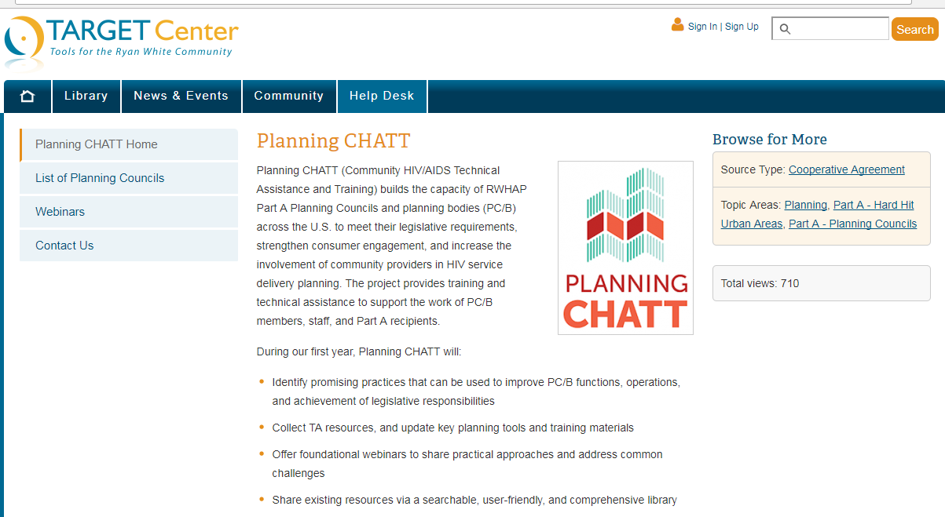
How to Ask a Question
Attendees are in listen-only mode.
If you have a question, use the chat box at the lower-left of your screen to chat with the presenter.
You may also email questions to planningCHATT@jsi.com after the webinar.

Slide 3
Can You Hear Us?
The audio is being shared via your computer speakers/headset.
If you can’t hear the audio, make sure your computer audio is turned on.
If you’re still having problems, please chat the host.
Call-in number: 301-715-8592
Webinar ID: 945 5632 9155
Passcode: 247311

Slide 4
Agenda
Welcome and Introductions
Overview of Work Plans
Work Plan Development, Implementation, and Maintenance Strategies
Work Plan Examples and Resources
Questions and Answers

Slide 5
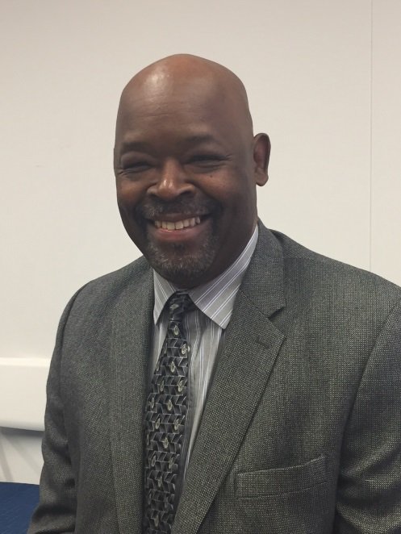
Planning CHATT: A HRSA-supported Cooperative Agreement (U69HA30795)
Lennwood Green Project Officer
Division of Metropolitan HIV/AIDS Programs
HIV/AIDS Bureau, HRSA

Slide 6
Webinar Presenters
Elizabeth Rios
Boston EMA
Victoria “Tori” Williams
Houston EMA
Jamal Refuge
Planning CHATT

Slide 7
Objectives
By the end of this webinar you will be able to:
Understand the importance of developing a work plan
Identify the five basic components of a work plan
Identify key roles and responsibilities to support work plan implementation
Understand how to align internal work plans with the annual RWHAP Part A planning cycle

Slide 8
Overview of Work Plans

Slide 9
Expectations for Work Plan Development for Part A PCs/PBs
Legislation requires preparation of integrated plans that set goals and objectives and guide the work of the program
Programs are expected to regularly review work plan progress and refine objectives and strategies as needed – your work plan should be a living document that guides the annual planning cycle

Slide 10
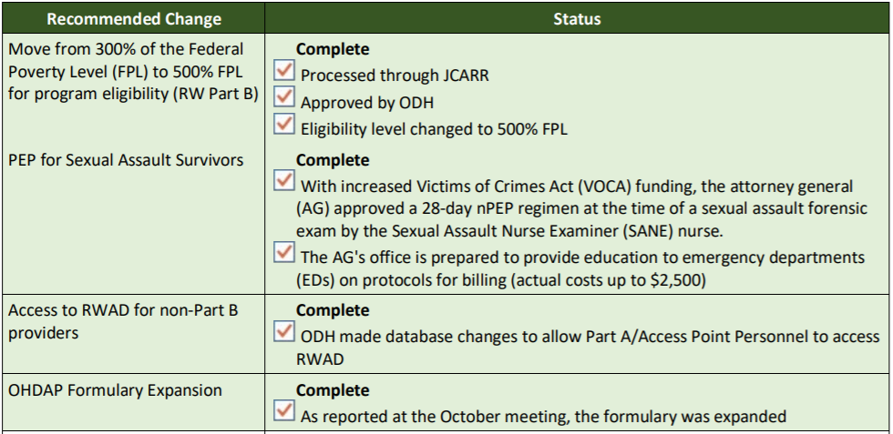
Typical Core Work Plan Components
Goals and SMART objectives
Activities/Action steps
Example: Ohio Quick Hits
Assigned roles/responsibilities
Evaluation method
Completion date
Source: Ohio Department of Health

Slide 11
Examples & Resources

Slide 12
Work Plan Example - Boston

Slide 13
Work Plan Example - Houston

Slide 14
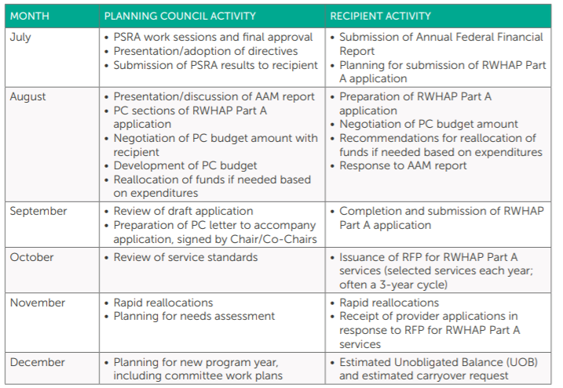
Example: Sample Planning Calendar
Ryan White HIV/AIDS Program (RWHAP) Part A Planning Council Primer

Slide 15
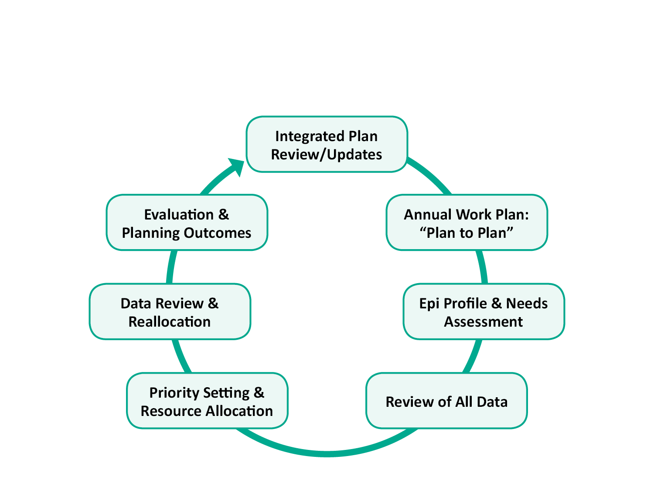
Resource: Annual Planning Cycle
Annual work plan for PC/PB (often in chart format) to guide the planning process, based on:
Current HRSA/CDC Integrated Prevention and Care Plan
Work plan in the annual application
Legislative and administrative requirements
Local structures and processes
Training Guide for RWHAP Part A Planning Councils/Planning Bodies: A Member’s First Planning Cycle, Module 3

Slide 16
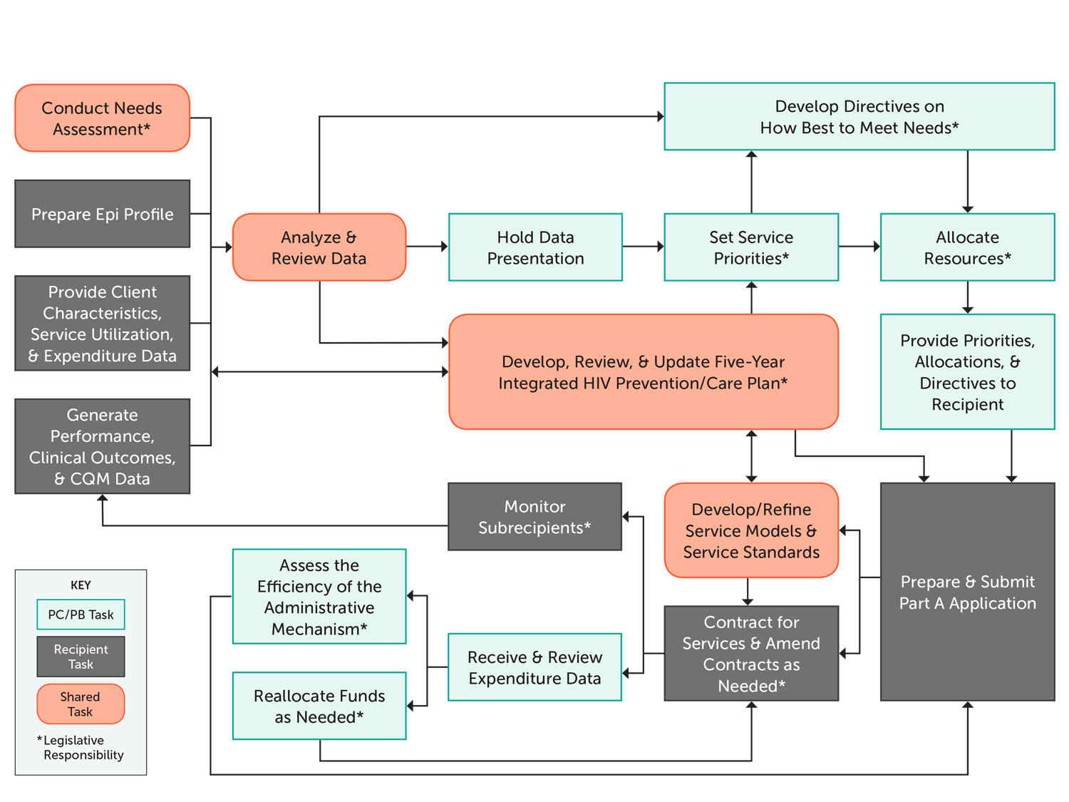
Resource: Annotated Flow Chart of Annual Planning Cycle
Training Guide for RWHAP Part A Planning Councils/Planning Bodies: A Member’s First Planning Cycle, Module 3

Slide 17
How has having a work plan benefited your PC/PB?

Slide 18
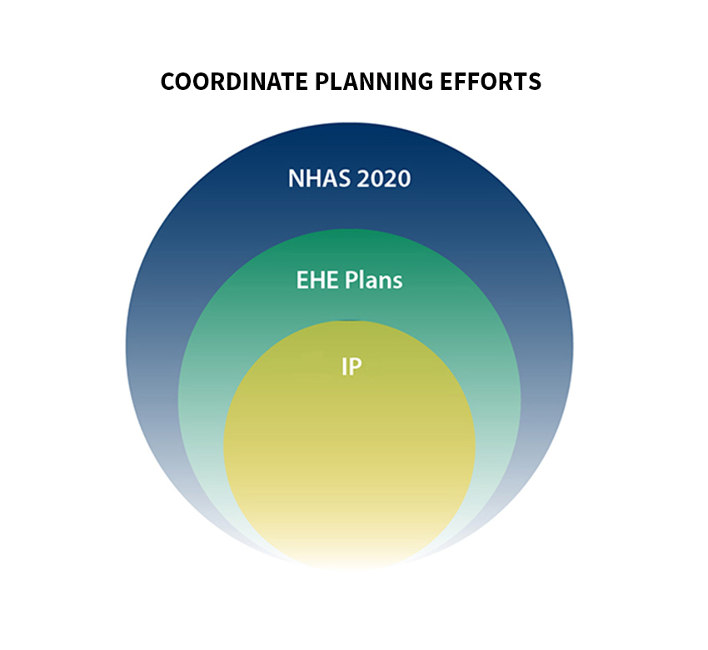
Work Plan Benefits for Part A PCs/PBs
Achieve concurrence with other committee/federal work plans:
Ending the HIV Epidemic: A Plan for America

Slide 19
Work Plan Benefits for Part A PCs/PBs cont’d
Serve as a teaching and organizing tool for PC/PB members
Leverage the skills of PC/PB members
Ensure quality deliverables and reporting
Provides guidelines for voting and decision making
Promotes teamwork
Identify resources and partnerships
Recipient
Organizations
Consumers

Slide 20
Briefly describe your overall process for developing your PC/PB work plan.

Slide 21
Boston
Planning cycle runs from September to June
Project Coordinators liaison with committees and PC/PB leadership; Program Manager oversees entire process
Key activities:
April - June:
Vote on PSRA, allocations for the next year (e.g. carryover funds), review needs assessment finding and AAM findings
August
Plan meetings for the year
Contact stakeholders for data and other information
Quarterly meetings with recipients

Slide 22
Houston
The development of an annual plan is written into PC policies
In December, staff draft the work plan for the coming year
PC provides input and approval in January
Use to orient all PC and committee members in February
Distribute highlights to the community at large in February
Manager oversees entire plan

Slide 23
Houston
Key activities:
April
Training (e.g. epidemiologic profile)
Walk through of the plan, including pertinent documents (e.g. timeline chart)
May
Designing and prioritizing services
June
Begin PSRA process

Slide 24
What tools do you use to develop your work plan?

Slide 25
Boston
Excel spreadsheet broken down by month
Basecamp to help manage work plan assignments
Project software tool that allows users to:
Send messages
Chat
Pings
Schedule meetings
Share meeting minutes
Use Canva to send work plan summaries and announcements as the development process is underway

Slide 26
Houston
Work plan is a Word document organized by committee and broken down over twelve months
Accompanied by a timeline chart
Lists most critical meetings and tasks for all committees
Timeline is distributed to the community to encourage their input and participation in the different processes
*where applicable

Slide 27
Share one challenge and one success with developing your work plan.

Slide 28
Boston: Challenges and Successes with Developing Work Plans
Challenge
Success
Urgent matters outside of work plan (e.g. COVID-19)
Solution: Schedule ad hoc meetings
Simplify needs assessment process for PC/PB members
Solution: Break down into 5 parts
Introduction to the Needs Assessment
Develop A Tool
Implementation of the Tool
Analyze Data
Report Findings

Slide 29
Houston: Challenges and Successes with Developing Work Plans
Challenge
Success
Mid-Year release of a new Initiative or Work Product
External crisis (e.g. hurricane, COVID-19)
Solution for both: Use the Ryan White Part A Work Plan as the foundation
Hurricane Harvey and COVID-19
Solutions:
Implement emergency policies
Locate all Council and committee members
Maintain the RW Part A work plan as much as possible
Send frequent reminders

Slide 30
Work Plan Implementation

Slide 31
How do you leverage the skills of PC/PB members, recipients, and other stakeholders to implement the work plan?

Slide 32
Leveraging PC/PB Members and Other Stakeholders’ Skills for Work Plan Implementation
Boston
Houston
Public speaking and facilitation skills
Delegate tasks among PC/PB members based on skill level
Mentorship
Utilize recipient resources (e.g. data sharing)
Provide education in facilitation and leadership skills
Practice these skills through committee and PC participation, mentorship and leadership
Assign members with particular skills to appropriate committees
Over time, move members to different committees

Slide 33
Work Plan Maintenance

Slide 34
Describe your process for maintaining your work plan.

Slide 35
Maintenance Strategies
Boston
Houston
Ongoing supervision meetings with PC leadership staff to discuss any changes needed to the work plan (e.g. guest presenter changes)
Ensure that work plan is detailed and realistic at the beginning of the year
Adjust the plan according to quarterly updates on the status of goals and activities, which are provided by Committee Co-Chairs

Slide 36
What adaptations have you made to your work plan in response to COVID-19?

Slide 37
Work Plan Adaptations
Boston
Houston
Modify method of collecting information from subcontractors
Provide only partial funding reports due to COVID-19
The Houston EMA was able to maintain the 2020 Work Plan because the PC:
Lowered quorum requirements
The Governor loosened requirements within the Open Meetings Act
Consumers taught staff to use Zoom
Made sure that all members had access to up to date IT equipment

Slide 38
Wrap-Up & Key Takeaways
Every PC/PB should have a work plan.
Work plans are unique; not everyone’s work plan will look the same.
Be sure that your work plan goals, objectives, and activities are as detailed as possible. Your work plan should delineate roles and responsibilities clearly.
A work plan is a living document; update your work plan regularly as you accomplish your goals.

Slide 39
Questions and Answers

Slide 40
www.targetHIV.org/planning-CHATT

Slide 41
Thank You
Please complete the evaluation!
TargetHIV.org/planning-CHATT
Sign up for our mailing list, download tools and resources, view archived webinars and more…
Contact Planning CHATT: planningCHATT@jsi.com

