Slide 1
Understanding the Legislation Authorizing the Ryan White HIV/AIDS Program (RWHAP)
Slides for Module 1

Slide 2
Understanding the Legislation
History and Evolution of the Ryan White HIV/AIDS Program (RWHAP) Legislation
Overview of RWHAP Parts
Understanding Part A

Slide 3
Training Objectives
Following the training, participants will be able to:
Describe how the RWHAP legislation evolved from 1990 to 2009 to reflect changes in the epidemic and advances in prevention and treatment
Identify the 3 largest sources of funding for HIV care and treatment in the U.S.
Identify and differentiate the 5 RWHAP Parts
Describe at least 3 important similarities between RWHAP Part A and Part B
Describe at least 4 key characteristics of RWHAP Part A

Slide 4
History and Evolution of RWHAP Legislation

Slide 5
RWHAP Legislation
Largest Federal government program specifically designed to provide services for people living with HIV (PLWH) – $2.32 billion in funding in FY 2017
Third largest Federal program serving PLWH – after Medicaid and Medicare
First enacted as the Ryan White Comprehensive AIDS Resources Emergency (CARE) Act in 1990
Current legislation is the Ryan White HIV/AIDS Treatment Extension Act of 2009 (Title XXVI of the Public Health Service Act)

Slide 6
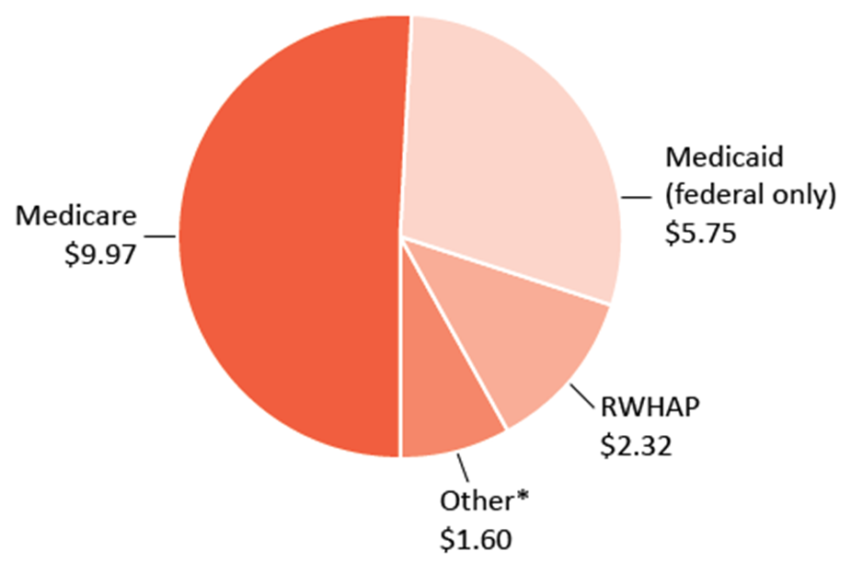
Federal Funding for HIV/AIDS Care in the U.S. by Program, FY 2017 [$ in Billions]
Total = $19.65 billion
*Other includes VA, SAMHSA, and FEHB (Federal Employees Health Benefits) Plan
Source: Kaiser Family Foundation Fact Sheet, “U.S. Federal Funding for HIV/AIDS: Trends Over Time”

Slide 7
RWHAP Appropriations, Total and by Part FY 2010 - FY 2017

Slide 8
Purpose of RWHAP Legislation
Began as “emergency relief” for overburdened healthcare systems at a time when effective medications were not available
Now:
“Revise and extend the program for providing life-saving care for those with HIV/AIDS”
“Address the unmet care and treatment needs of persons living with HIV/AIDS by funding primary health care and support services that enhance access to and retention in care”

Slide 9
RWHAP and the HIV Timeline: 1987-1996
1987: AZT becomes the first approved drug for HIV/AIDS treatment
1990: Ryan White Comprehensive AIDS Resources Emergency (CARE) Act becomes law
1994: Clinical trials demonstrate that AZT can substantially reduce perinatal transmission
1995: First highly active antiretroviral therapy (HAART) is approved
1996: RWHAP is reauthorized, with separate funding for the AIDS Drug Assistance Program (ADAP)

Slide 10
RWHAP and the HIV Timeline: 1997-2000
1997: HIV/AIDS Bureau (HAB) is established to bring all RWHAP programs into one agency within the Health Resources and Services Administration (HRSA)
1997-99: Congressional Black Caucus calls for action to address HIV-related health disparities, and the Minority AIDS Initiative (MAI) is launched
2000: RWHAP is reauthorized and refined to increase access to care for individuals who know their status but are not receiving HIV-related medical care and to target resources to areas with the greatest need

Slide 11
RWHAP and the HIV Timeline: 2006-2010
2006: RWHAP is reauthorized, with added focus on medical services, inclusion of MAI, and quality management, and Part A program eligibility redefined
2007: Five new Part A programs are funded
2009: RWHAP is reauthorized again, with added focus on finding individuals who do not know their status
2009: A record 82.9 million adults are tested for HIV
2010: National HIV/AIDS Strategy (NHAS) provides national goals to end the epidemic

Slide 12
RWHAP and the HIV Timeline: Recent
2011: Research demonstrates “treatment as prevention,” showing that viral suppression prevents HIV transmission
2013: HIV Care Continuum Initiative is launched to monitor and increase HIV testing, linkage to care, retention in care, and viral suppression
2013: HIV/AIDS Bureau establishes a revised portfolio of care and treatment performance measures
2015: HRSA reports on RWHAP client-level data, describing recipients, providers, clients, and services

Slide 13
Importance of RWHAP: Scope
More than 1.1 million people in the U.S. are living with HIV
About 1 in 7 do not know their status
About half of PLWH who know their status receive at least one medical, health, or related support service from a Ryan White HIV/AIDS Program provider – over 551,000 in 2016

Slide 14
Importance of RWHAP: Client Need
RWHAP serves PLWH who are low-income and do not have insurance that covers their HIV care and medications – over 60% have incomes below the federal poverty line
RWHAP is the payor of last resort – funds may not be used to pay for items or services that are eligible for coverage by other federal or state programs or private health insurance
RWHAP is not an “entitlement” program: it must operate using the funds appropriated annually by Congress and awarded to recipients

Slide 15
Importance of RWHAP: Outcomes
More than 80% of RWHAP clients in 2016 were retained in care – they had at least two outpatient ambulatory health services (OAHS) visits during the year, at least 90 days apart
About 85% of clients receiving outpatient OAHS through RWHAP achieved viral suppression in 2016
Up from 69.5% in 2010
Far above the 49% viral suppression rate of all PLWH in the U.S. in 2014

Slide 16
Factors Affecting HIV Services
The epidemic continues, especially among traditionally underserved and hard-to-reach populations – but new diagnoses have been declining since 2008
Because of effective therapies, PLWH can live nearly normal life spans if they begin treatment early and stay in care
Treatment is prevention – viral suppression prevents HIV transmission
Changes in the larger health care system and financing have affected how RWHAP funds are used at the state and local levels

Slide 17
Tools for Ending the Epidemic
Recent tools include:
National goals to end the epidemic, first developed through the National HIV/AIDS Strategy (NHAS)
The HIV care continuum, which helps track the estimated number of people living with HIV, percent diagnosed, and percent who are linked to care, retained in care, and achieve viral suppression
Performance measures developed by HRSA/HAB to assess quality of care and clinical outcomes of RWHAP-funded services

Slide 18
National Goals to End the Epidemic
2020 Goals:
Reduce new HIV infections
Increase access to care and improve health outcomes for people living with HIV
Reduce HIV-related disparities and health inequities
Achieve a more coordinated national response to the HIV epidemic

Slide 19
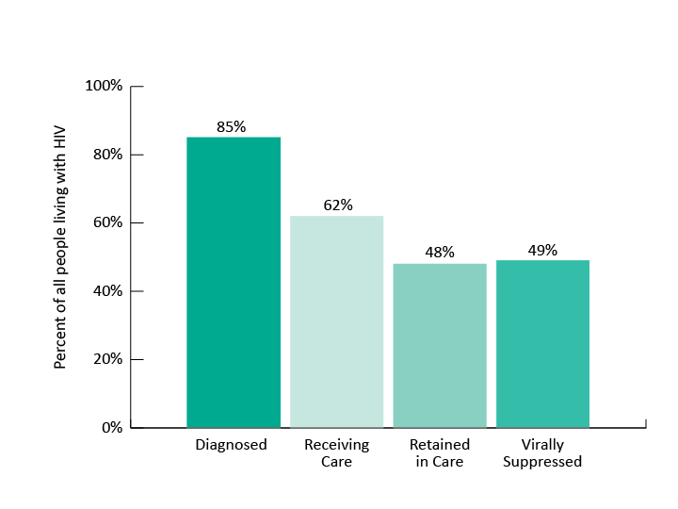
HIV Care Continuum, United States, 2014
An estimated 1.1 million people are living with HIV in the U.S.

Slide 20
Performance Measures Portfolio
Established in 2013
Focus on critical areas of HIV care and treatment, including processes (like development of treatment plans) and outcomes (like viral suppression rates)
Alignment with milestones along the HIV care continuum
Can be used by individual providers or at a system of care level – by all RWHAP-funded providers in a service area

Slide 21
Overview of RWHAP Parts

Slide 22
The Ryan White HIV/AIDS Program
Provides a comprehensive system of care for people living with HIV
Most funds support primary medical care and other medical-related and support services
Provides ongoing access to HIV medications
Small amount of funds used for technical assistance, clinical training, and development of innovative models of care

Slide 23
The Ryan White HIV/AIDS Program (cont.)
Includes 5 Parts: A, B, C, D, and F
Administered by the HIV/AIDS Bureau (HAB), within the Health Resources and Services Administration (HRSA)
RWHAP Parts designed to work together to ensure a comprehensive system of care in urban, suburban, and rural communities throughout the U.S.

Slide 24
RWHAP Part A
Funding for areas hardest hit by the HIV epidemic
Funding for two categories of metropolitan areas:
Eligible Metropolitan Areas (EMAs), with at least 2,000 new cases of AIDS reported in the past 5 years and at least 3,000 people living with HIV
Transitional Grant Areas (TGAs), with 1,000 – 1,999 new cases of AIDS reported in the past 5 years and at least 1,500 people living with HIV
Funds are used to develop or enhance access to a comprehensive system of high quality community-based care for low-income PLWH

Slide 25
RWHAP Part B
Funding to all 50 States, DC, Puerto Rico, U.S. territories and jurisdictions to improve the quality, availability, and organization of HIV health care and support services
Provides funds for medical and support services
Includes the AIDS Drug Assistance Program (ADAP), which provides access to HIV-related medications, through direct purchase and purchase of health insurance
Also provides funds to emerging communities with a growing epidemic, reporting 500-999 new cases in the past 5 years

Slide 26
RWHAP Part C
Funding to support “early intervention services”: comprehensive primary health care and support services for PLWH in an outpatient setting
Competitive grants to local community-based organizations, community health centers, health departments, and hospitals
Priority on services in rural areas and for traditionally underserved populations
Capacity development grants provided to help public and nonprofit entities deliver HIV services more effectively

Slide 27
RWHAP Part D
Funding to support family-centered HIV primary medical and support services for women, infants, children, and youth living with HIV
Competitive grants to local public and private health care entities, including hospitals, and public agencies
Includes services designed to engage youth with HIV and retain them in care
Recipients must coordinate with HIV education and prevention programs designed to reduce the risk of HIV infection among youth

Slide 28
RWHAP Part F: Dental Services
Two types of dental programs:
Dental Reimbursement Programs run by dental schools and other dental programs
Community Based Dental Partnership Program, to provide dental services for PLWH while providing education and clinical training for dental care providers

Slide 29
RWHAP Part F: Minority AIDS Initiative (MAI)
Funds used to improve access to HIV care and health outcomes for disproportionately affected racial and ethnic minorities
Part A programs apply for MAI funds as part of the annual application and receive funds on a formula basis
Formula is based on the number of racial and ethnic minority individuals with HIV/AIDS in the jurisdiction

Slide 30
RWHAP Part F: Special Project of National Significance (SPNS)
Supports the development of innovative models of care to better serve PLWH and address emerging client needs
Competitive funding
Projects include a strong evaluation component
Promising models are disseminated

Slide 31
RWHAP Part F: AIDS Education and Training Centers (AETCs)
Supports a network of 8 regional centers that provide targeted, multidisciplinary education and training programs for health care providers serving PLWH
Intended to increase the number of providers prepared and motivated to counsel, diagnose, treat, and medically manage PLWH
AETC’s National Clinician Consultation Center responds to questions from clinicians

Slide 32
Importance of Collaboration Across RWHAP Parts
Representatives of all RWHAP Parts as members of Part A planning councils/planning bodies (PC/PBs)
Coordination of needs assessment by all RWHAP Parts through the Statewide Coordinated Statement of Need (SCSN), led by Part B
Collaboration in development of the HRSA/CDC Integrated HIV Prevention and Care Plans, submitted by RWHAP Parts A & B
Coordination in targeting and use of resources

Slide 33
Coordination of Care Across Parts
A single RWHAP client living in an EMA or TGA might:
Receive medications through RWHAP Part B ADAP
Get oral health care from a RWHAP Part F-funded dental program
Obtain other services funded through RWHAP Part A, Part C, and/or Part D
Participate in a RWHAP Part F demonstration SPNS project

Slide 34
Understanding Part A

Slide 35
Ryan White HIV/AIDS Programs: Part A
Funding for Eligible Metropolitan Areas (EMAs) and Transitional Grant Areas (TGAs) that are severely & disproportionately affected by the HIV epidemic
In 2018, 24 EMAs and 28 TGAs
Service areas can include a single county or a multi-county area
11 programs have service areas that cross state boundaries

Slide 36
RWHAP Part A
Funds go to the Chief Elected Official (CEO) of “the city or urban county that administers the public health agency that provides outpatient and ambulatory services to the greatest number of individuals with AIDS” [§2602(a)(1)]
Recipient must establish an Intergovernmental Agreement (IGA) with any jurisdiction with at least 10% of the total number of reported cases of AIDS to establish a mechanism for allocating resources to address their service needs [§2602(a)(2)]

Slide 37
RWHAP Part A (cont. 1)
Legislative requirement for extensive community planning, including participation of consumers of RWHAP Part A services
EMAs required to have planning councils that decide how program funds will be used – they are not advisory
TGAs strongly encouraged by HRSA/HAB to maintain planning councils
TGAs that choose not to have planning councils encouraged to have planning bodies with roles, responsibilities and membership that are as much like planning councils as possible

Slide 38
RWHAP Part A (cont. 2)
RWHAP Part A programs receive both “formula” and “supplemental” funding:
Part A formula funding is based on the number of living case of HIV and AIDS in the EMA or TGA
Minority AIDS Initiative (MAI) formula funding is based on the number of minorities living with HIV and AIDS
Supplemental funding is competitive, based on demonstration of additional need in the annual application

Slide 39
Services Fundable under RWHAP Part A
Core medical services identified in the legislation For example: Outpatient Ambulatory Health Services, Oral Health, Medical Case Management, Mental Health
Support services needed so that PLWH can reach their medical outcomes For example: Medical Transportation, Emergency Financial Assistance, Food Bank/Home-Delivered Meals
HRSA/HAB provides service definitions and descriptions Refinements to service categories and definitions in 2016 and 2018 [Policy Clarification Notice (PCN) #16-02]

Slide 40
Collaboration between Recipient and Planning Council/Planning Body
Recipient receives and administers funds and is responsible for contracting with providers (subrecipients) who provide care and treatment
Planning council/planning body (PC/PB) decides how best to use available funds to help support a community-based system of care for PLWH
PC/PB and recipient work closely together, sharing responsibility for tasks like needs assessment and integrated/comprehensive planning

Slide 41
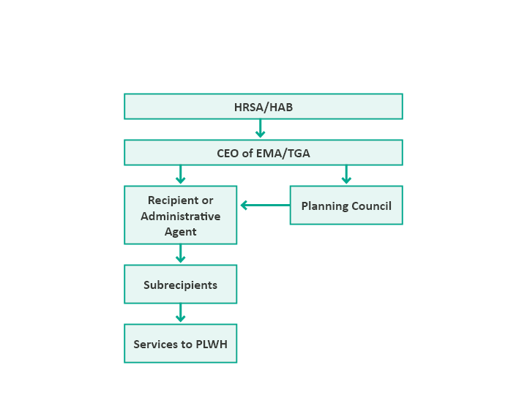
Flow of RWHAP Part A Decision Making & Funds
Planning council sets priorities, allocates resources, and gives directives to recipient on how best to meet these priorities

Slide 42
Similarities between RWHAP Part A and Part B
Grants go to the CEO of a governmental jurisdiction – states and territories for Part B, cities and counties for Part A
Funds may be used to support the same set of medical-related and support service categories
Expectation is support of comprehensive outpatient health and support services for PLWH
Structured community planning is required
Programs must submit and periodically update an integrated/comprehensive plan

Slide 43
Similarities between RWHAP Part A and Part B (cont.)
Majority of funds awarded under a formula based on the number of people living with HIV and AIDS in the service area
At least 75% of service funds must be used for medical care and other medical-related services (such as oral health and medical case management)
Up to 25% may be used for support services needed so clients can achieve positive medical outcomes
Waiver can be requested if other resources are available and less funding is needed for medical services

Slide 44
Sum Up
RWHAP plays a critical role in responding to the HIV epidemic
The legislation has evolved to reflect changes in the epidemic, advances in treatments, and a focus on reaching PLWH with the greatest need for services
Each RWHAP Part has a special role in overall HIV services – and all Parts need to collaborate to provide a seamless system of prevention and care
RWHAP Part A plays a special role in HIV planning and services in metropolitan areas with a high rate of HIV

Slide 45
Optional Slides for Activities

Slide 46
Quick Activities to Apply Knowledge
Following are 3 quick activities to increase interaction during your presentation/lecturette and help participants apply what they are learning to practical situations. Revise them if needed to fit your situation, and use them in small groups or pairs, or in the full group. Following is the title of each activity and where you may want to insert it:
Insert Quick Scenario A: Importance of Serving on a RWHAP Part A PC/PB after slide 16
Insert Quick Scenario B: Collaboration Across Parts after slide 33
Insert Quick Discussion C: The RWHAP and HIV Community Planning after slide 39

Slide 47
Quick Scenario A: Importance of Serving on a RWHAP Part A PC/PB
You joined the PC/PB about 9 months ago. You serve on the Membership Committee and are doing outreach to recruit new consumer members. At a meeting with several consumers, one of them says: “You just told us that members have to attend a 2-hour PC/PB meeting every month, plus a committee meeting, and read a lot of materials. That’s a big time commitment. What could I accomplish as a member that makes it worth the time?”
How do you respond?
Notes:
Sample

Slide 48
Quick Scenario B: Collaboration Across Parts
Your PC /PB’s care strategies/system of care committee is concerned about recent data showing low rates of retention, treatment adherence, and viral suppression among young African American and Latino men who have sex with men. You are planning a “roundtable” to learn more about the situation and what might be done to improve outcomes. Besides Part A subrecipients and consumers, you aren’t sure whom to invite. How could Part B, Part C, Part D, and Part F recipients or subrecipients contribute to this discussion – what might each of them bring?
Notes:
New – a quick scenario designed to help participants explore the benefits of collaborative in HIV planning

Slide 49
Quick Discussion C: The RWHAP and HIV Community Planning
It is May and your PC/PB has 2 new members. They just received a quick orientation from the PC Support Manager and the Chair. Neither has prior HIV community planning experience. As a veteran member, you have agreed to mentor them. Your annual Priority Setting and Resource Allocation (PSRA) process begins next week with the Data Presentation.
What 3-4 things do these new members most need to understand about the RWHAP and Part A in order to participate knowledgeably in the PSRA process?
How can you best help prepare them?
Notes:
Sample

Slide 50
Activity: Evolution of the RWHAP
Work in a small group
Choose a facilitator, recorder, and reporter
Consider the question assigned to you
Be prepared to share your work with the full group

Slide 51
Discussion Questions
Based on the discussion today and your own knowledge and experience:
What are some important ways in which the RWHAP legislation and program have evolved based on changes in the epidemic?
What are some important ways in which the RWHAP legislation and program have evolved based on changes in HIV prevention and treatment?

Slide 52
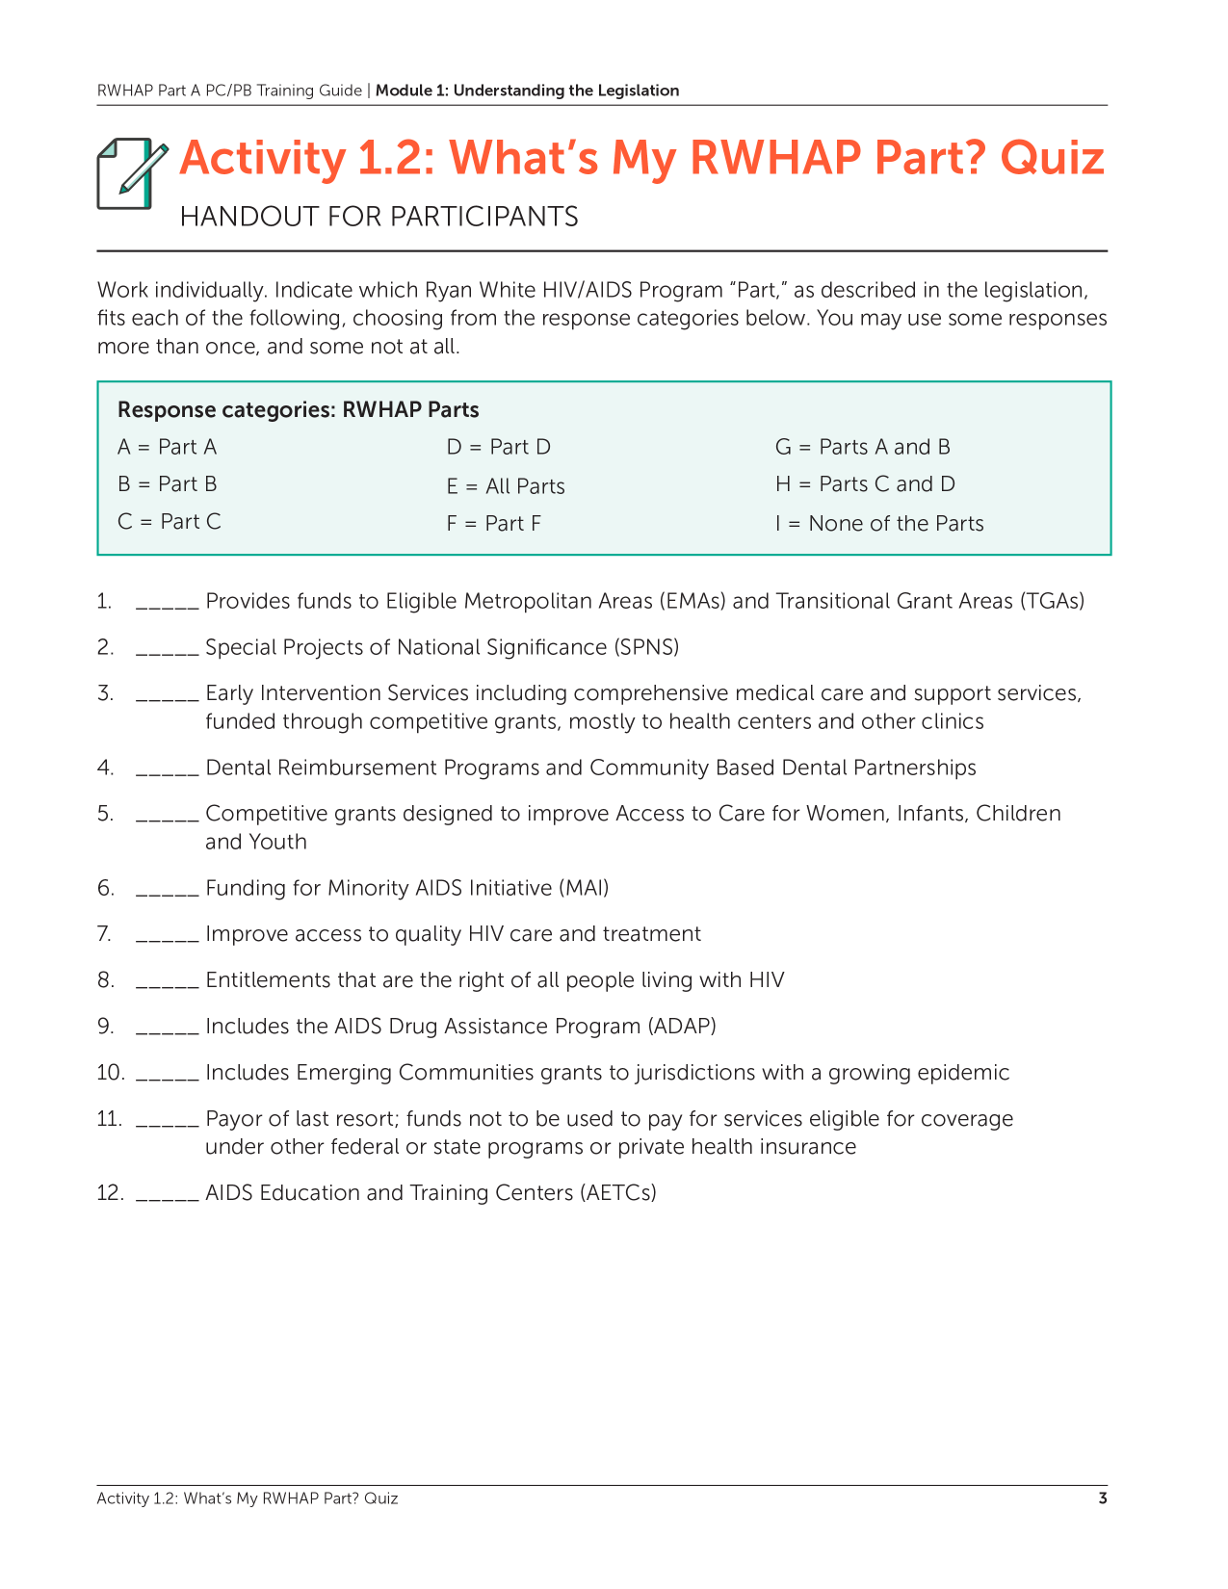
Activity: What’s my RWHAP Part?

Slide 53
Quiz Key
Individually answer the 12 questions, using the following lettered responses (some may be used more than once, some not at all). Then share at your table.
Part A
Part B
Part C
Part D
All Parts
Part F
Parts A and B
Parts C and D
None of the Parts

