Slide 1
Self-Care and Stress Management Techniques

Slide 2
Learning Objectives
At the end of the session participants will be able to:
Describe why self-care is critical to patient care and a part of practicing trauma-informed care
Explore six common types of self-care
Develop a self-care plan for home and work
Practice self-care
Notes:
Review the objectives.

Slide 3
Six Types of Self-Care
Physical
Emotional
Psychological
Spiritual
Personal and interpersonal
Professional
Notes:
Review the slide.

Slide 4
How Do You Practice Self-Care?
Video:
https://www.youtube.com/watch?v=VUKPrSMmbzc&t=6s
Notes:
Ask participants for a few ways they practice self care.
Watch the video: https://www.youtube.com/watch?v=VUKPrSMmbzc&t=6s

Slide 5
Physical Self-care
Eat
Move, dance
Sleep, take a nap
Check in with yourself – (e.g., mindfulness)
Notes:
Review the slide.

Slide 6
Emotional Self-care
Take compliments from others and give some to yourself everyday
Be selfish once a day
Aim to be device free for at least one waking hour every day
Practice acceptance and forgiveness
Relaxation techniques – listening to music, sewing
Notes:
Emotional self-care is identifying, accepting and expressing a range of feelings. By focusing on your mental/emotional self-care, you can build resilience, lessen stress and anxiety, and cultivate an overall feeling of being capable and successful.

Slide 7
Psychological Self-care
Take a couple of minutes each day to pay attention to your inner experience (thoughts, feelings, attitudes)
Engage your intelligence in other topics – music, art, language – not work related
Learn to ask and accept help
Clinical supervision
Notes:
Review the slide.

Slide 8
Spiritual Self-care
Understand your authentic self
Identify what’s important to you
Try meditation
Try yoga
Read
Notes:
There are many ways to define spirituality, as it means different things to different people. Spirituality focuses on cultivating a sense of peace, self-love and purpose, not only within yourself but within the earth and the universe that is all around you. Finding your own understanding and practice of spirituality can be of great benefit to your life, as it helps you gain perspective and comfort, enables you to focus on the bigger picture, understand more of the why, disconnect from the modern world, and detangle yourself from a love of material possessions. Whatever you do, make it meaningful to you.

Slide 9
Personal and Interpersonal (Social) Self-care
Make a plan
Learn something new
Cultivate your creative side
Nurture your social connections – family and friends
Notes:
Review the slide.

Slide 10
Professional Self-care
Set boundaries
Seek supportive supervision
Notes:
Read the slide.
Video - self care at work: https://www.youtube.com/watch?v=nJgXdiperVc

Slide 11
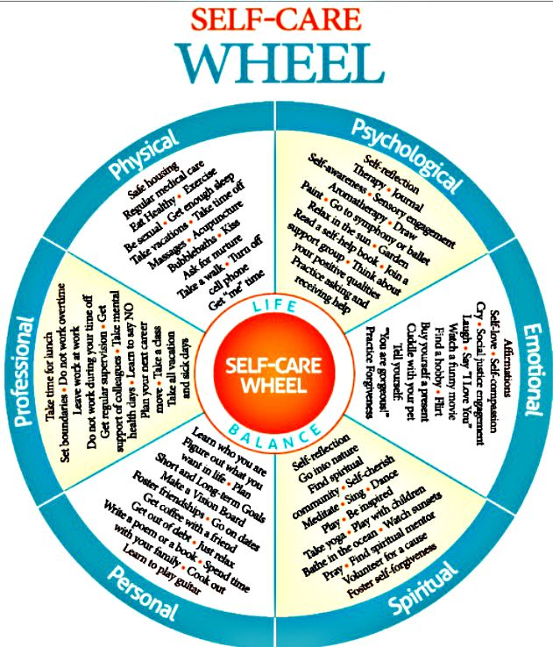
Activity: Make Your Own Self-Care Plan
https://www.su.ualberta.ca/media/uploads/857/Selfcare.pdf
Notes:
Distribute the handout, Self-care worksheet, and give participants a few minutes to complete it.

Slide 12
Self-care is personal.
Do what feels right to you.
Self-care can look different at different stages of your life.
Notes:
Ask for a volunteer to read each bullet on the slide, and share the web resource with participants.

