Slide 1
Habilidades de educación popular y facilitación

Slide 2
Objetivos
Al final de esta sesión, las participantes podrán hacer lo siguiente:
Explicar la diferencia entre la educación convencional y la educación popular.
Identificar y aplicar los principios y métodos de la educación popular.
Notes:
Read the slide.

Slide 3
La educación convencional frente a la educación popular
Educación convencional | Educación popular
La educación como la domesticación del grupo dominante. | Educación para la liberación y la transformación.
Se adapta a los alumnos a lo que el sistema quiere que sean. | El facilitador crea condiciones para el aprendizaje y el liderazgo compartido.
El docente es el “experto”. | Las participantes crean conocimiento juntas.
Se utiliza el liderazgo jerárquico para mantener el desequilibrio de poder. | Todas se examinan críticamente a sí mismas y al mundo que las rodea.
Notes:
Paolo Freire was a Brazilian educator who is known as one of the first people to write about popular education. He described conventional education as education for domestication by the dominant group. Another way to think of the purpose of conventional education is to fit the learners into what the system wants them to be. Conventional education centers the teacher as “expert” and uses hierarchical leadership to maintain a power imbalance.
By contrast, Freire distinguished popular education as education for liberation and transformation. Popular education uses a facilitator to create the conditions for shared learning and leadership. Participants create knowledge together and critically examine themselves and the world around them.

Slide 4
Teatro imagen
“El teatro imagen es un método aplicado dentro del Teatro del Oprimido, que utiliza el teatro como una herramienta para la transformación. Fue creado por el brasileño Augusto Boal, un colega de Paulo Freire. El teatro imagen usa los cuerpos de los participantes como ‘arcilla’ para ‘esculpir’ estatuas, imágenes fijas que representan sus experiencias, sentimientos, ideas, opresiones o sueños”.
– Marc Weinblatt, Mandala Center for Change, http://www.mandalaforchange.com/site/
Notes:
Explain that to help us reflect on these two styles, we will use a method called Image Theater.
Ask for a volunteer to read the slide.

Slide 5
Teatro imagen
¡Practiquemos!
Notes:
Divide participants into groups of five or six.
Give each group 10 minutes to create two images: one that represents conventional education and one that represents popular education.
Have each small group share their images with the larger group.

Slide 6
Teatro imagen
Reflexión sobre la actividad que compara la educación convencional y la educación popular
Notes:
Thank everyone for their participation.
Ask, “What did you notice about the images related to conventional education? Popular education? Which style do you think will work better with your clients and community members?”
Write reflections on flipchart.

Slide 7
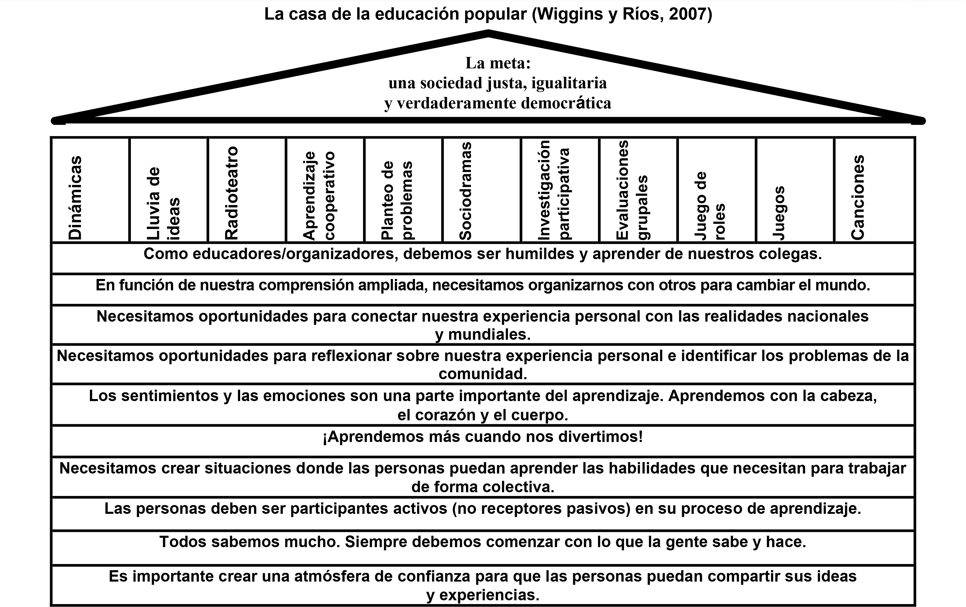
Notes:
Explain that we often use a house as a metaphor for popular education. To review some of the principles and methods of popular education, we will now build the house together.
Ask for volunteers to read the principles (foundation stones, written horizontally). Ask volunteers to read the methods and share examples of each.
Reference the Popular Education manual for descriptions of the methods and dinamicas, and the Popular Education fact sheet for more information about the principles.

